Slide 1

Sensors and readout
Sho Uemura, P-25

Slide 2
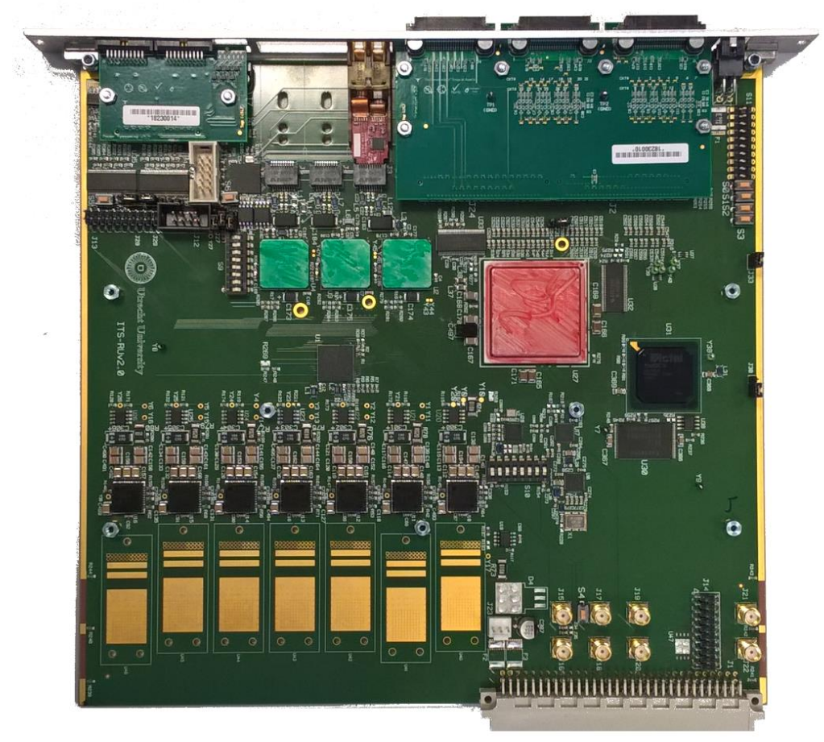
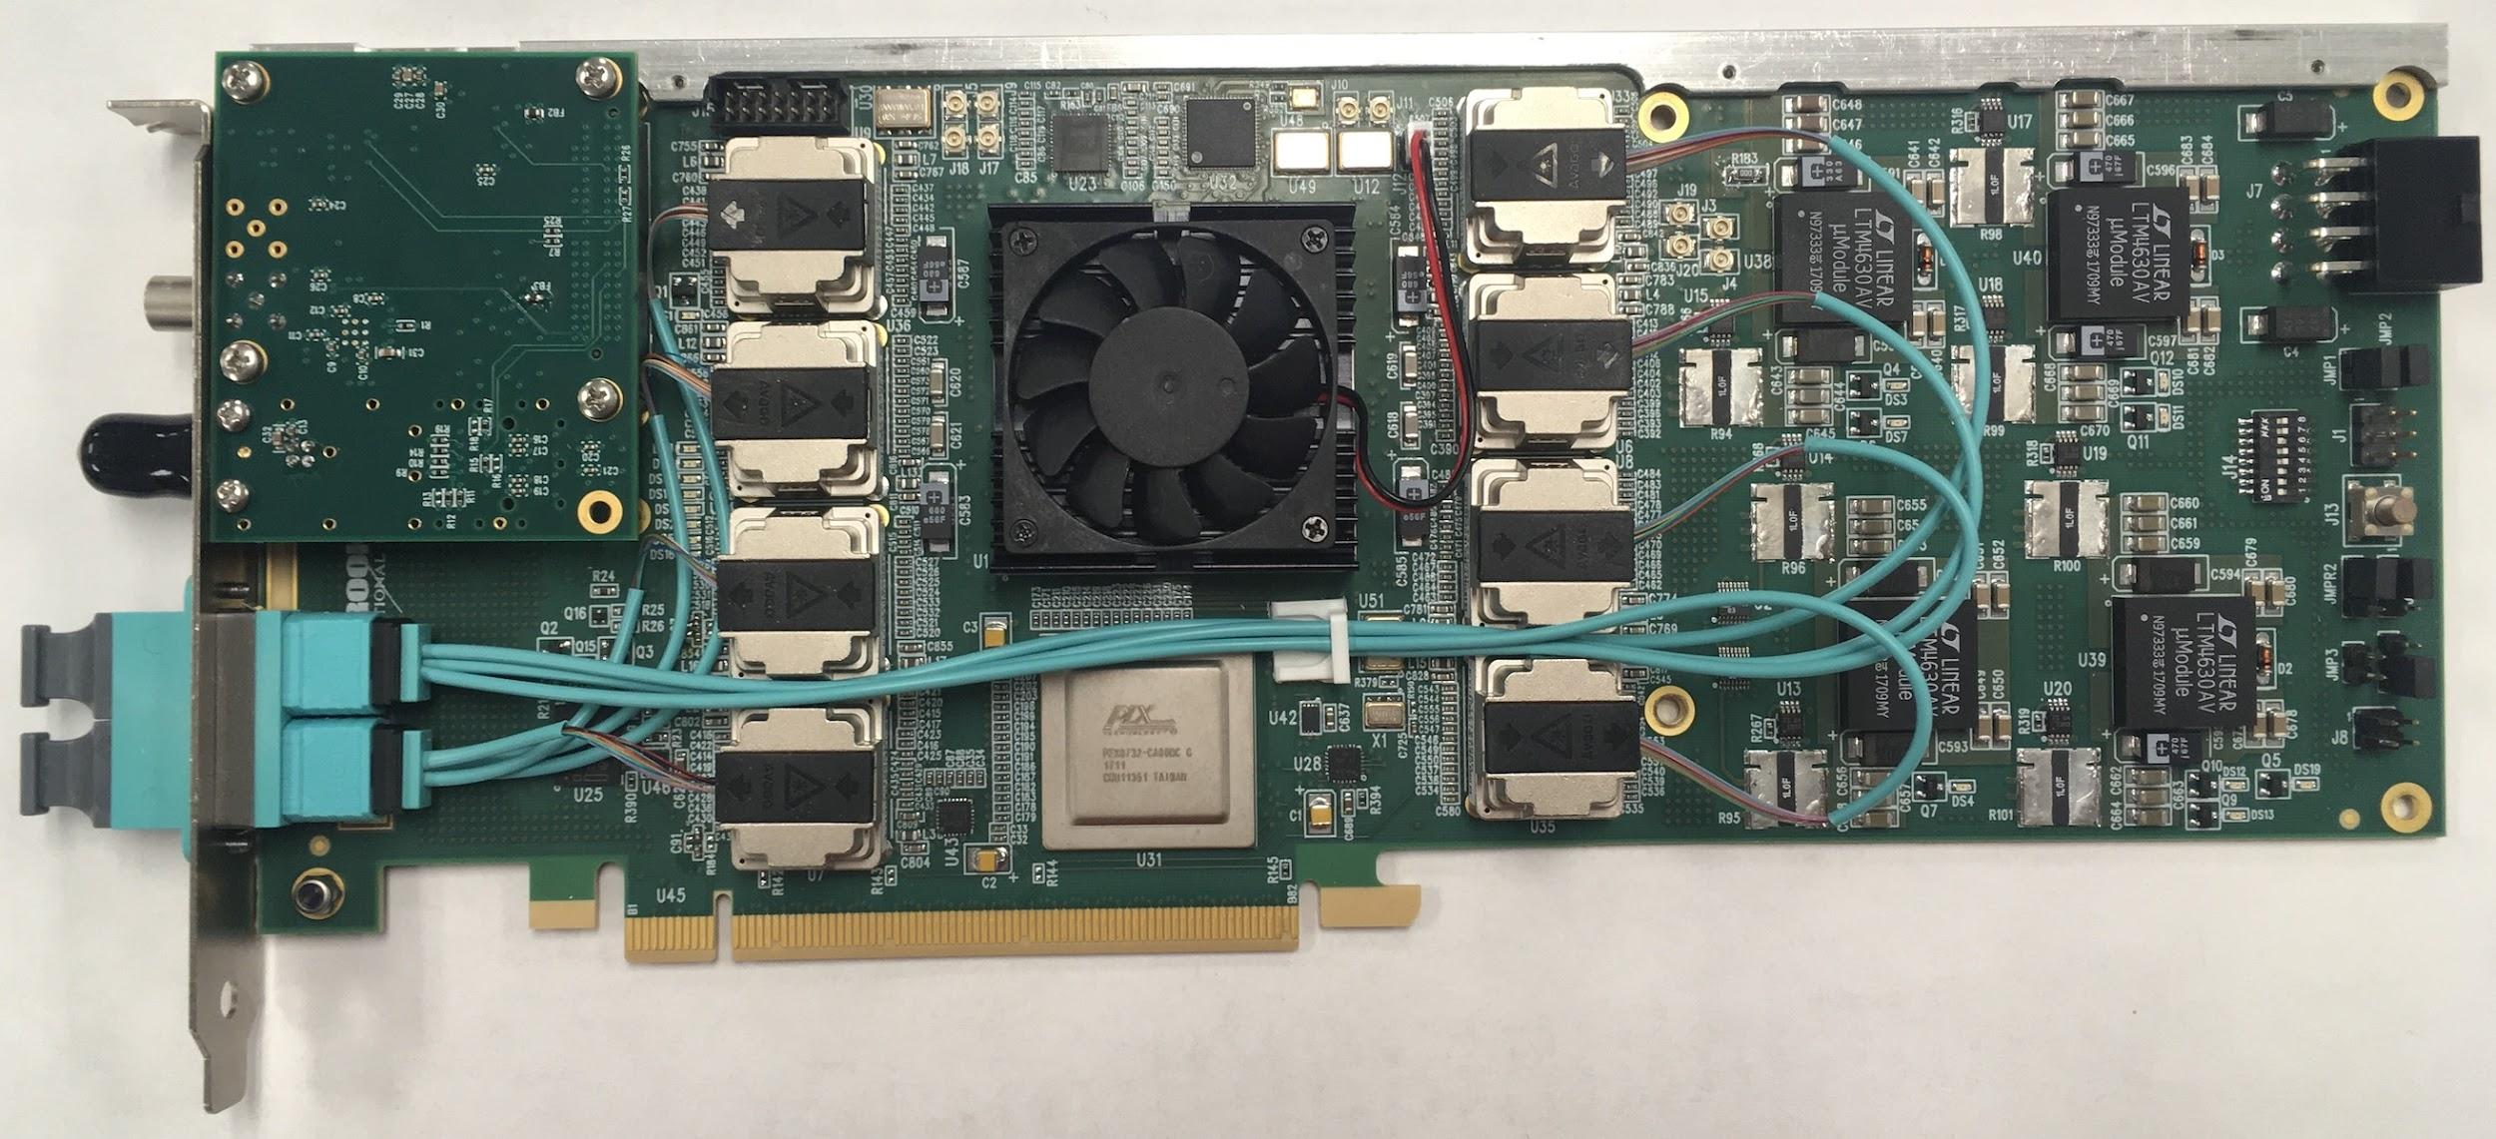
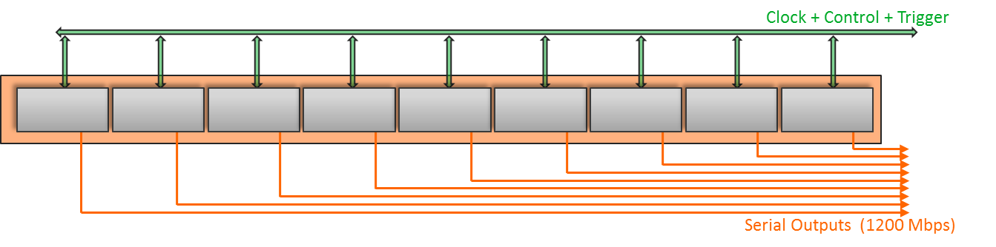
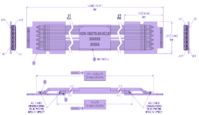
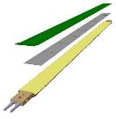
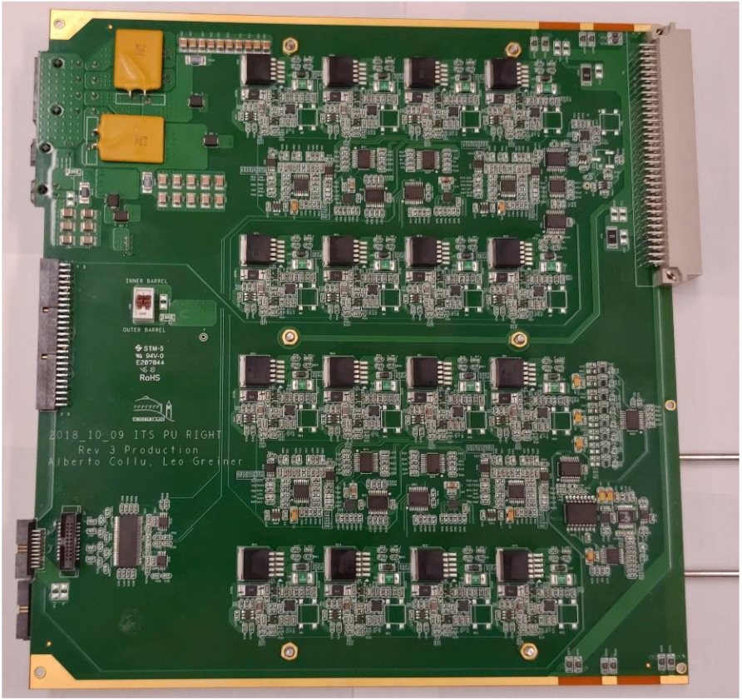
System overview
Readout Unit
Front End
FELIX
Back End
5-10 m twinax
GBT Optical Links
9-sensor stave
Control
Data (9x1.2Gbps), Clock, Control/Trigger
Data (3x3.2 Gbps)
Trigger
PCIe
FPC
Clock/Trigger
ALPIDE Sensors
Power supplies
Regulated power
Power
Cold Plate
DAQ and Slow Control
sPHENIX GTM
Power Board
Interaction Region
Experimental Hall
Counting House

Slide 3
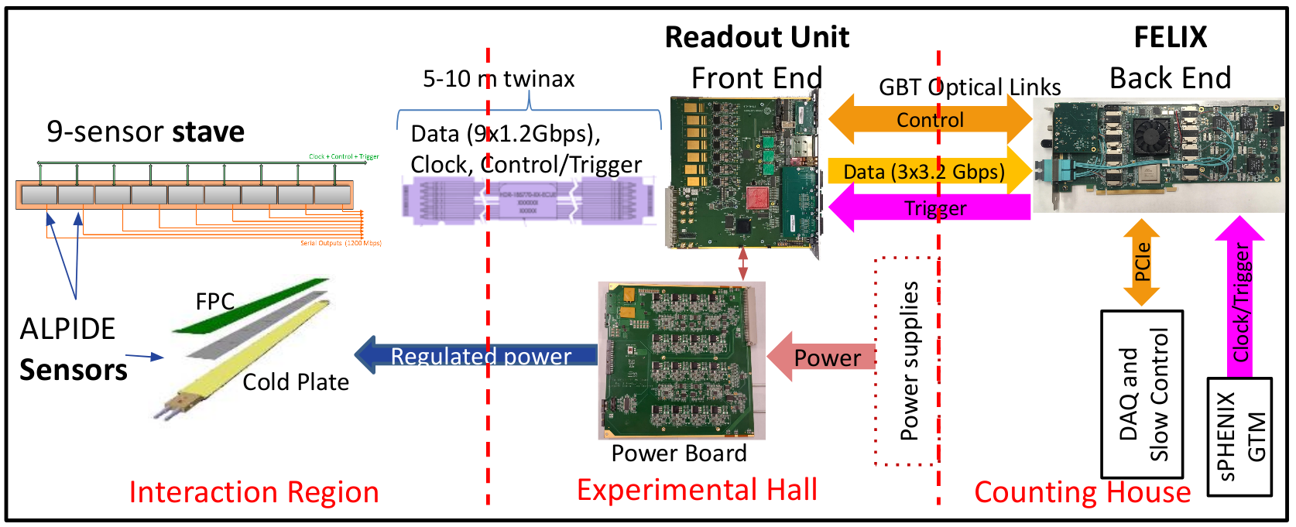
Outline
Staves
Signal cables
Readout electronics
sPHENIX DAQ integration
Test beams
System documentation

Slide 4
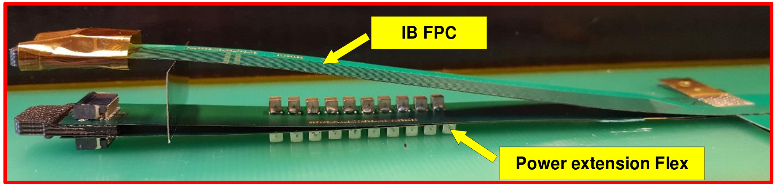
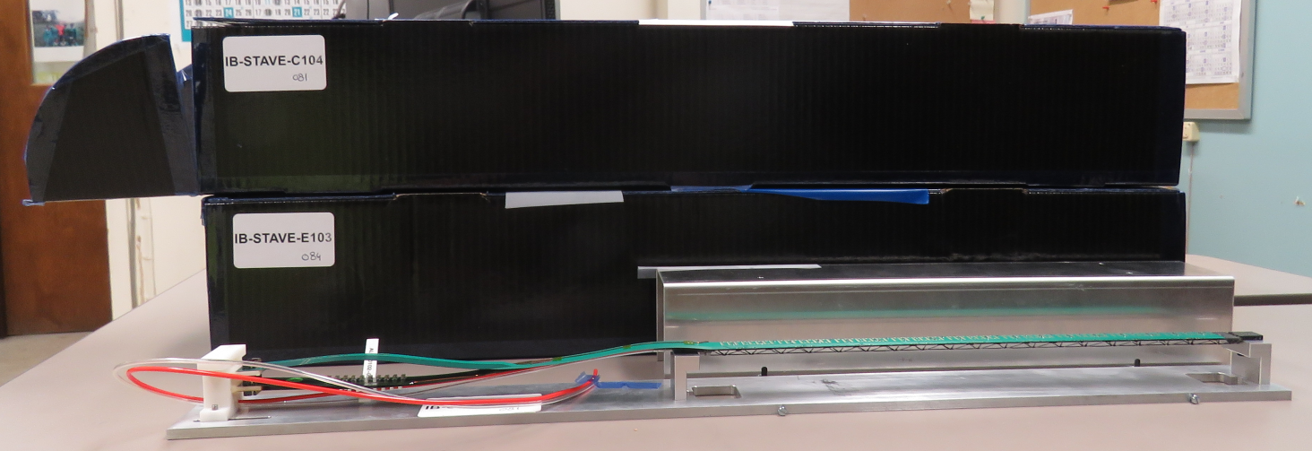
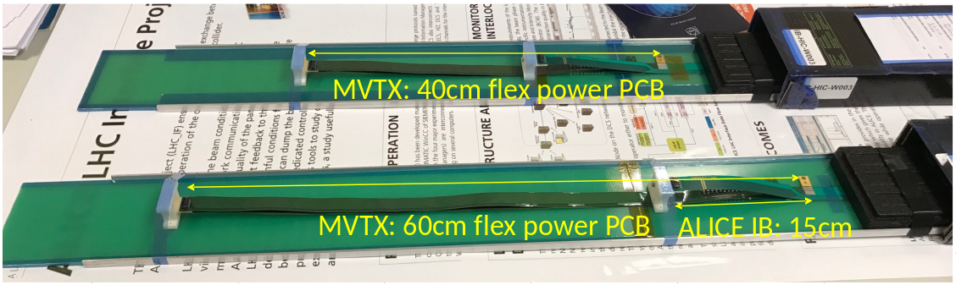
Stave
Stave consists of three flex circuits: one signal FPC that carries the ALPIDE sensors, two power FPCs that carry AVDD and DVDD
For MVTX mechanical integration (Walt’s talk), the power FPCs must be lengthened to 40 cm (from 15 cm)
  We qualified 40 and 60 cm FPCs at CERN: identical performance
4 staves at LANL
MVTX stave modifications have been qualified, and we have our first staves

Slide 5
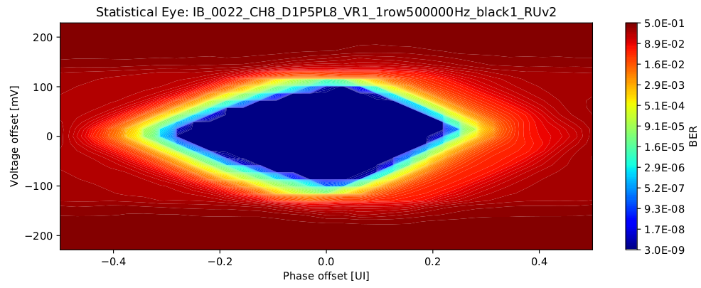
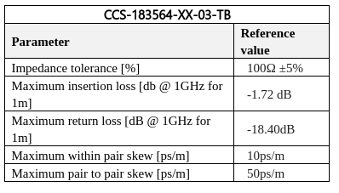
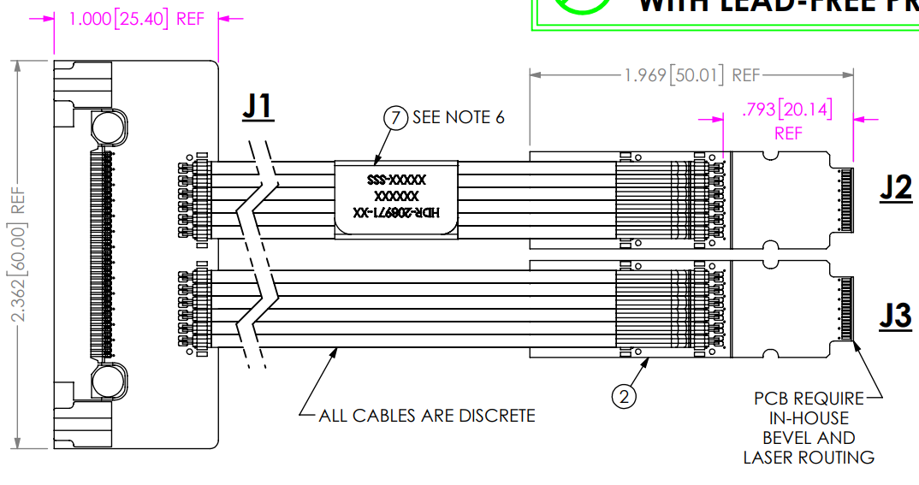
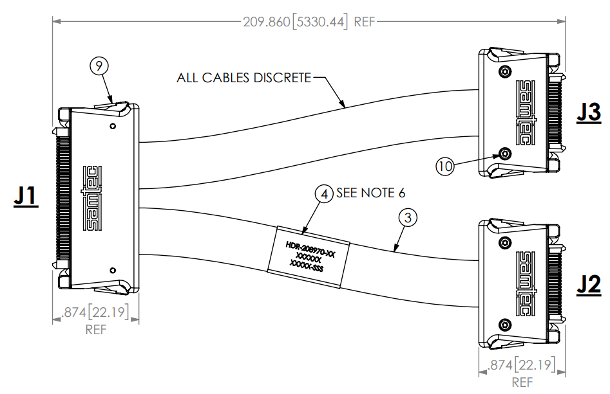
Signal cable design
The Samtec twinax cables carry clock (40 MHz), control (40 Mbps bidirectional), data (9x1.2 Gbps)
ALICE is using halogen-free cables (32 AWG, LDPE dielectric) due to CERN LSZH requirement; 2.65 + 5.3 m cables have been tested and are now in production
RU
RU
Stave
Stave

Slide 6
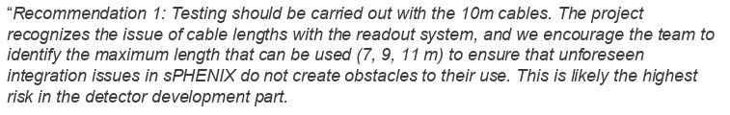
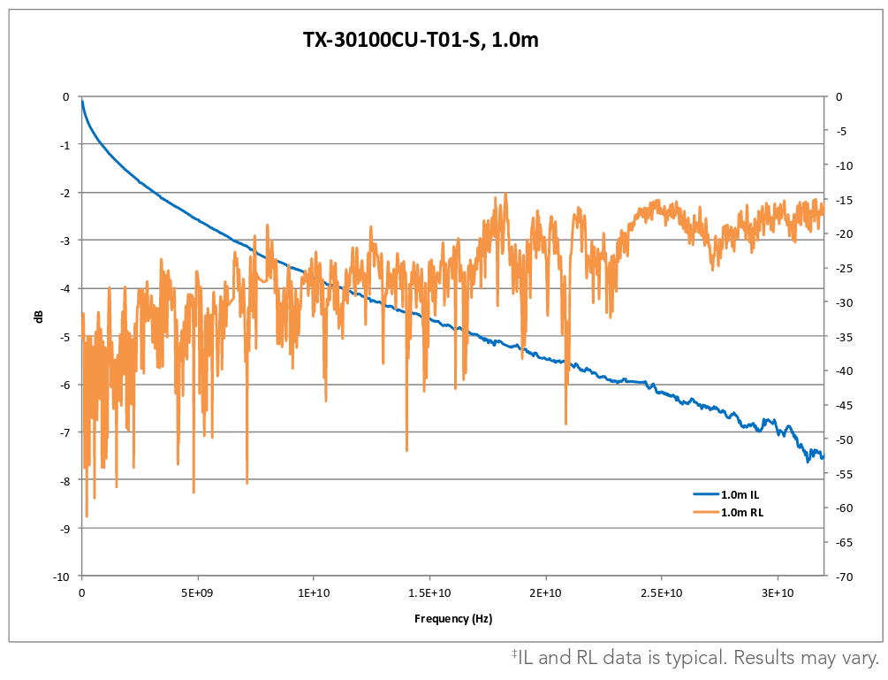
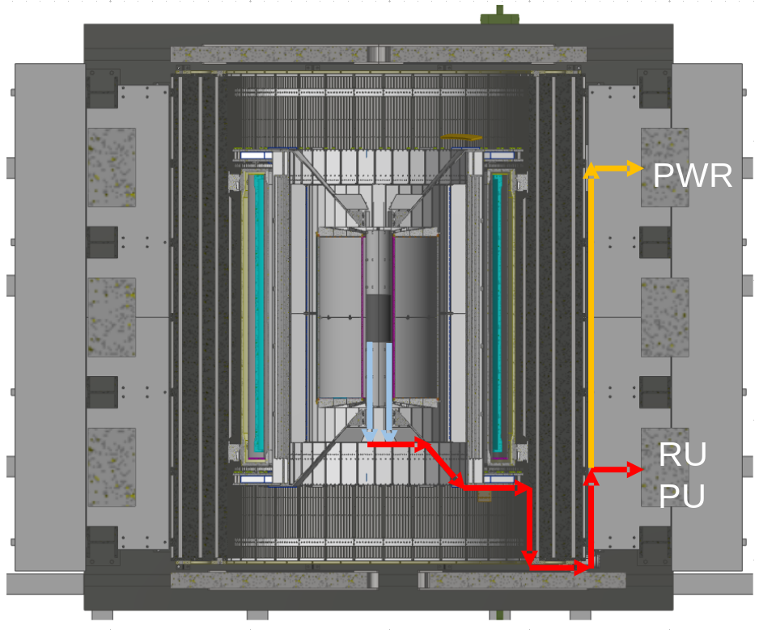
Cable testing
BNL has approved non-halogen-free cables (30 AWG, FEP dielectric); improved signal integrity
sPHENIX cable run estimates are converging: 1.4 + 6.5 m
We have Samtec quotes for 1.2/2.65 + 5.3/8.8 m (total length 6.5 - 11.45 m), will order soon
We will qualify these cables using stave and RU (bit error rates, statistical eye), and scope/network analyzer
We will test full-length MVTX cables in the next months

Slide 7
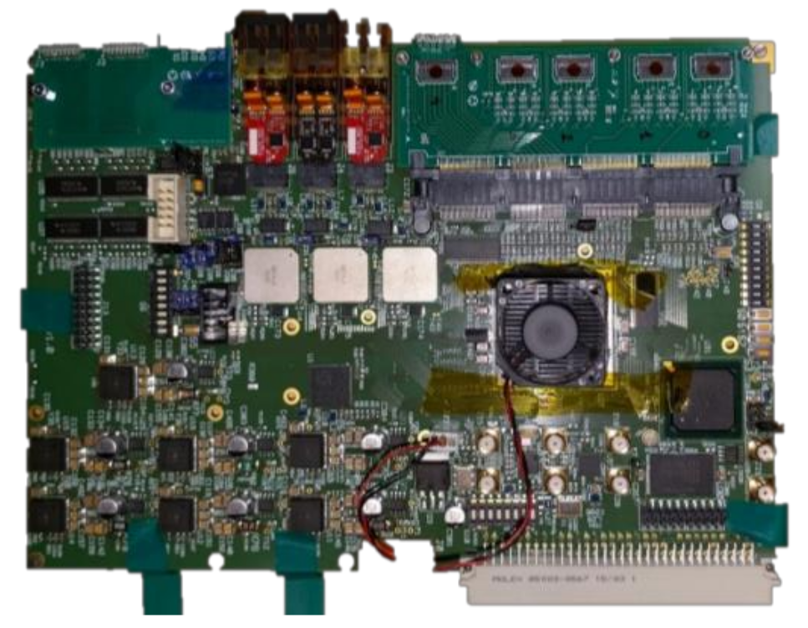
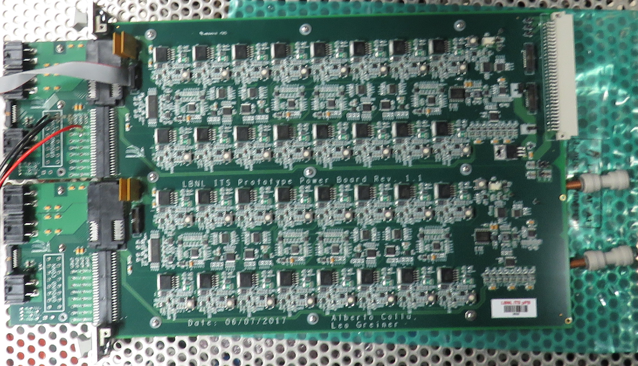
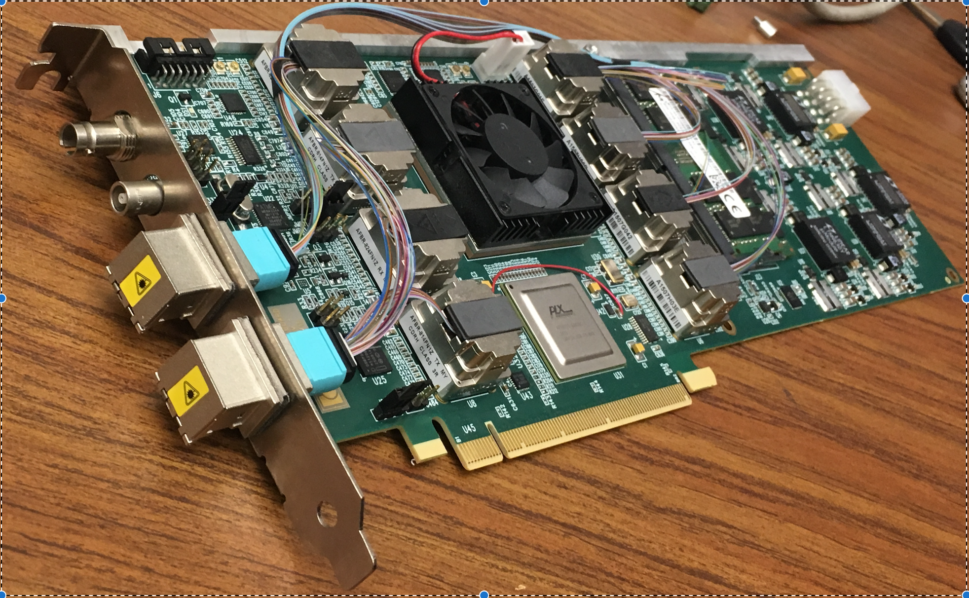
Readout electronics
RU v1.0
Prototype PB
FELIX v1.5
RU v2.1, Power Board in production by ALICE
FELIX v2.0 in production by ATLAS
MVTX firmware and software in sync with current ALICE and ATLAS work, with MVTX-specific logic developed under this LDRD
same functionality
production-qualified
RU v2.1
Production PB
FELIX v2.0
Key readout boards qualified and in production
@LANL May
in discussion with LBNL
in hand

Slide 8
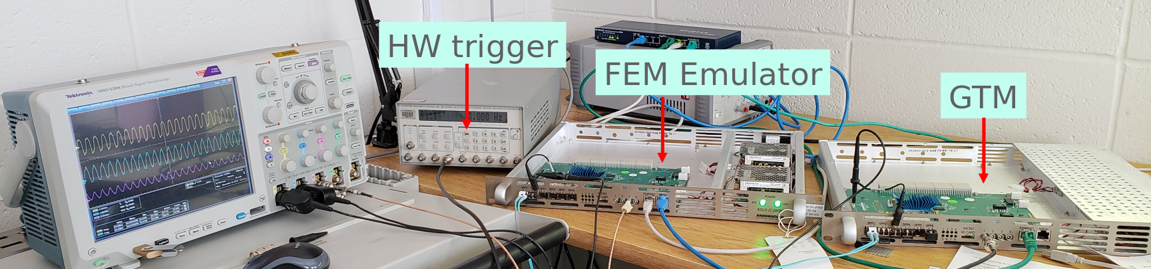
sPHENIX DAQ integration
sPHENIX detectors implement “plugins” to tie in to the central DAQ; the MVTX plugin was demonstrated at the 2018 test beam
sPHENIX clock and trigger is distributed by Granule Timing Module (GTM): BNL prototype ready for use
  We are implementing the “receiver” in FELIX that will allow MVTX to receive a trigger from sPHENIX
MVTX is participating in discussions for the sPHENIX DAQ design
MVTX is fully integrated with sPHENIX

Slide 9
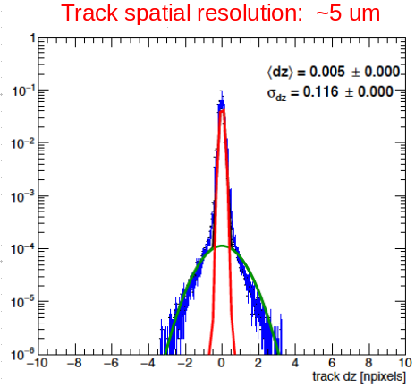
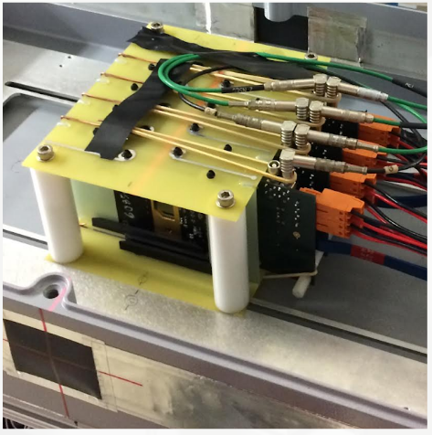
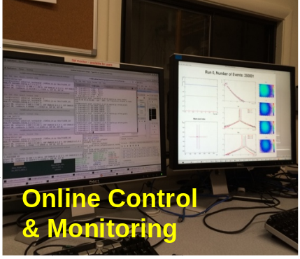
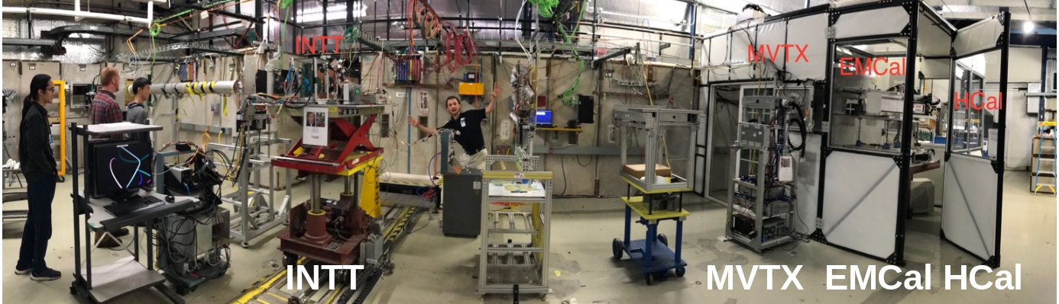
2018 test beam: 4-chip telescope
Joint test beam with sPHENIX silicon and calorimeters, Feb.-Mar. 2018 at Fermilab
Demonstration of tracking performance, and the full readout chain with sPHENIX DAQ and monitoring - ahead of schedule

Slide 10
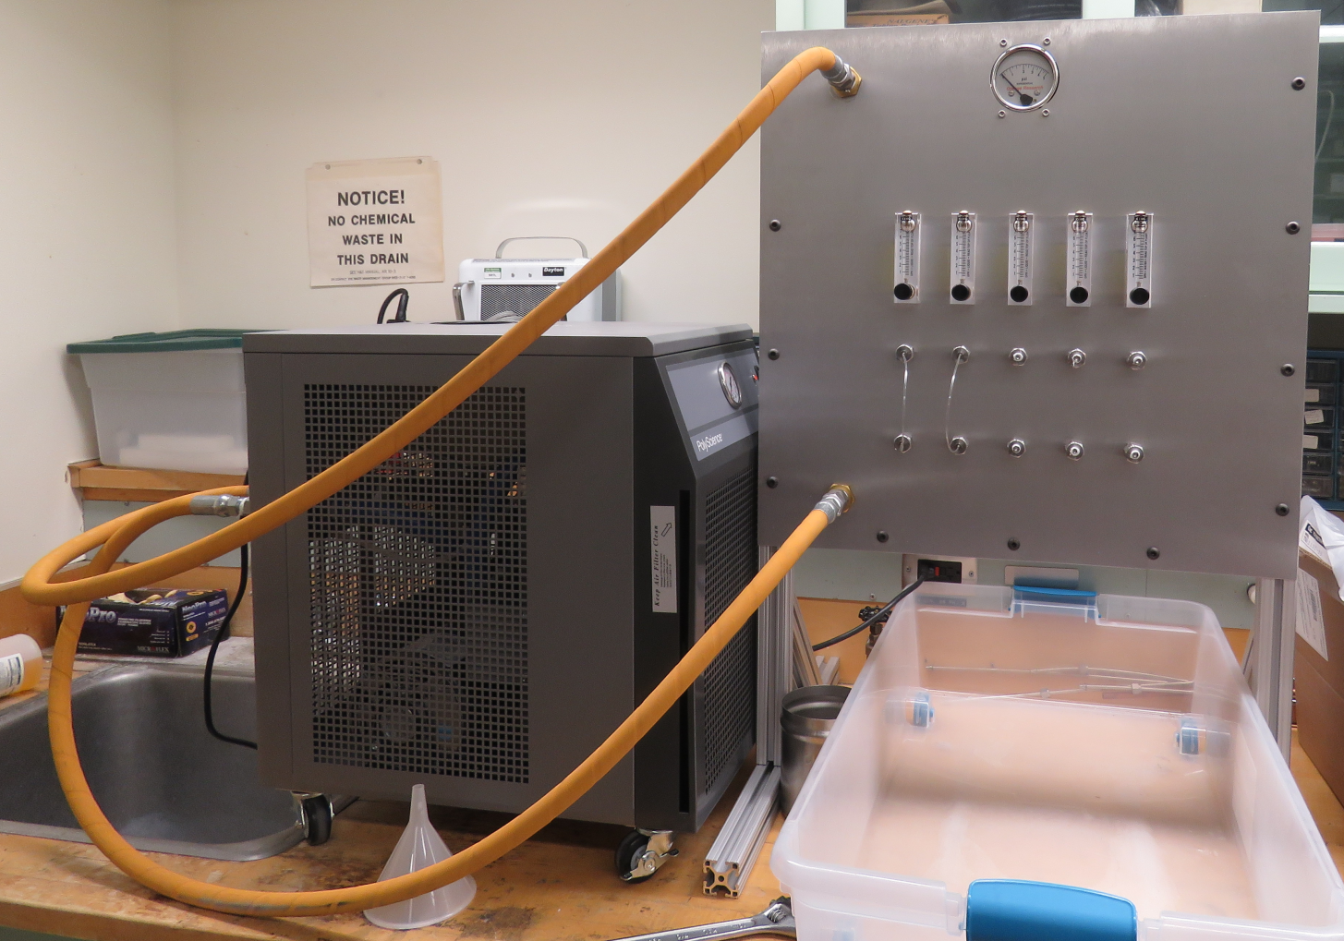
2019 test beam: 4-stave telescope
Scheduled for end of May, again at Fermilab
Additions compared to the 2018 test beam:
  Staves (from single chips)
  Full-length MVTX signal cables (from 5 m off-the-shelf cables)
  FELIX v2.0 (from v1.5)
  Cooling system
  Power board
  sPHENIX GTM
Full test of all components of the MVTX detector - LDRD “stretch goal”

Slide 11
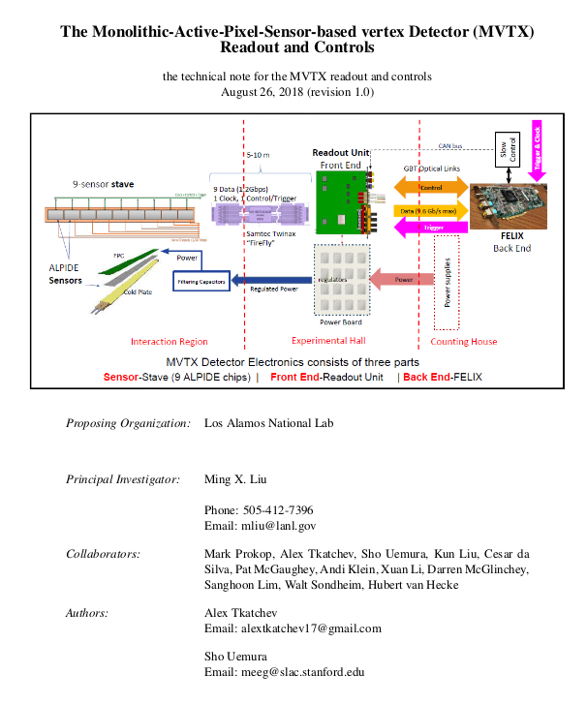
System documentation and simulation
Technical description of the full readout system (sensors, RU, FELIX, software)
Updated GEANT4 simulation of the MVTX with the current mechanical design
End-to-end description of the system developed under this LDRD
We will transition to the MVTX project with a fully qualified and documented system

