Slide 1

MVTX prototype and tracking tests
Sho Uemura
P-25
UNCLASSIFIED
Notes:
‹#›

Slide 2
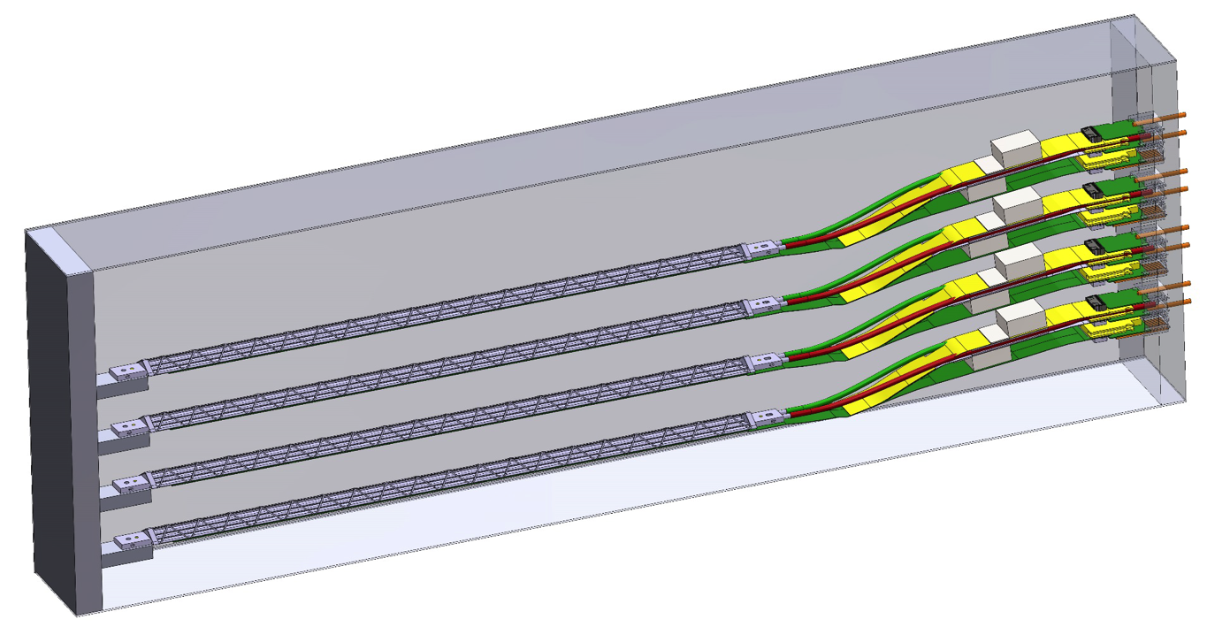
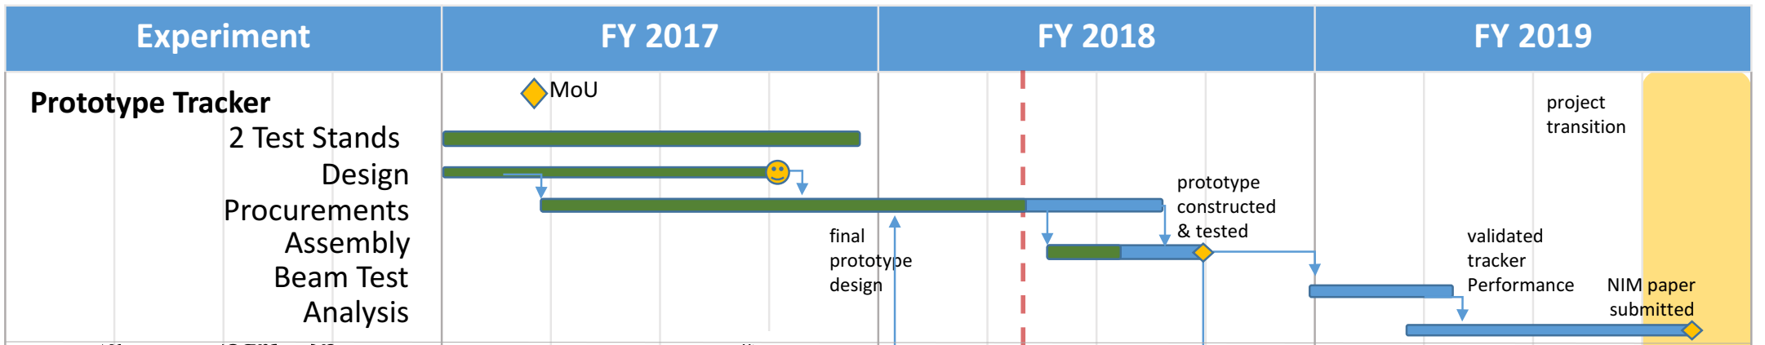
Goals for the MVTX prototype
Prove the MVTX design meets physics requirements:
Measure position resolution and hit efficiency
Validate simulations of multiple scattering and cluster size
Validate clustering, tracking, and alignment algorithms on real data
Verify the full MVTX readout chain
Deliverables:
MVTX prototype (the “telescope”) with single sensors or staves, and full readout chain
Beam test measurements validating the MVTX design
We have the hardware and readout: now we are ready to meet these goals in the next months
Notes:
‹#›

Slide 3
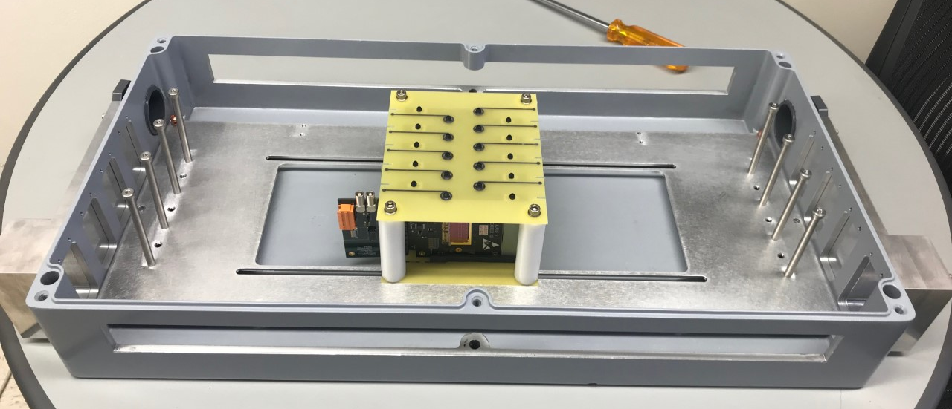
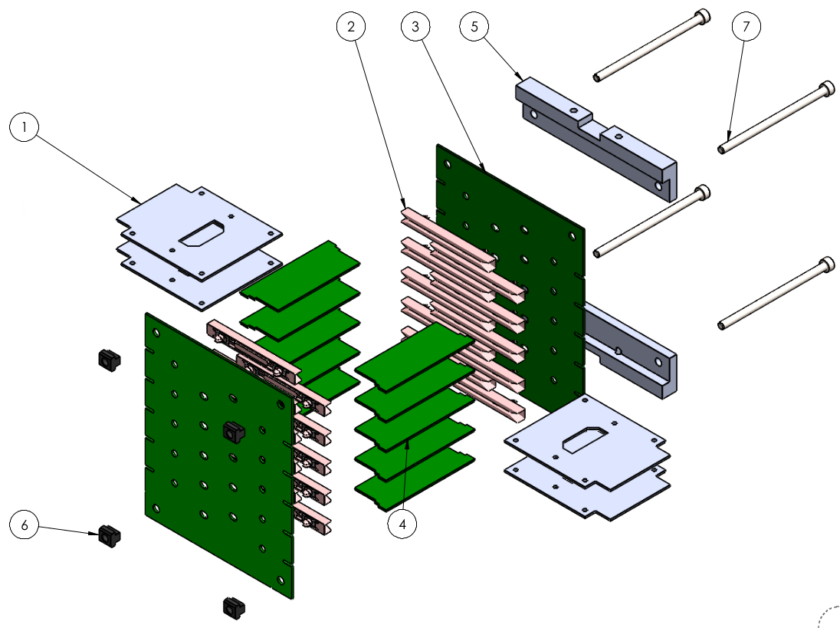
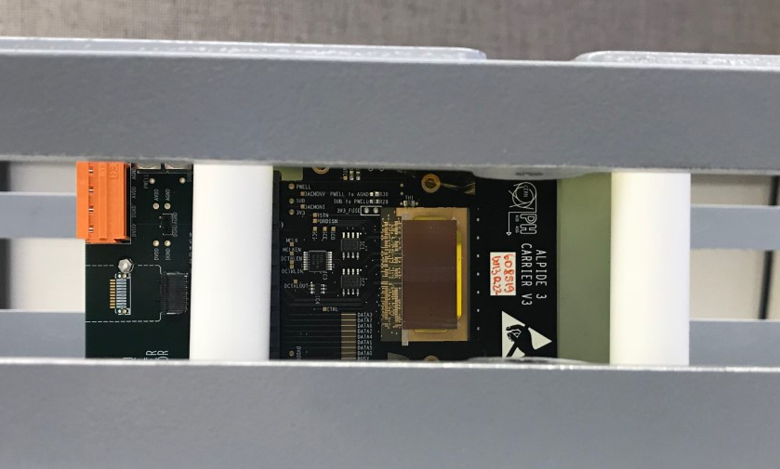
MVTX prototype box
beam
One versatile box for different configurations
Mounting hardware holds ALPIDE sensors or staves
  We will run with three ALPIDEs and one HIC (unmounted stave)
Windows for beam test, cable feedthroughs, air cooling vents
Adaptable for present and future needs
Notes:
‹#›

Slide 4
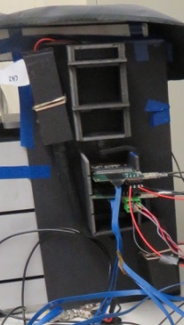
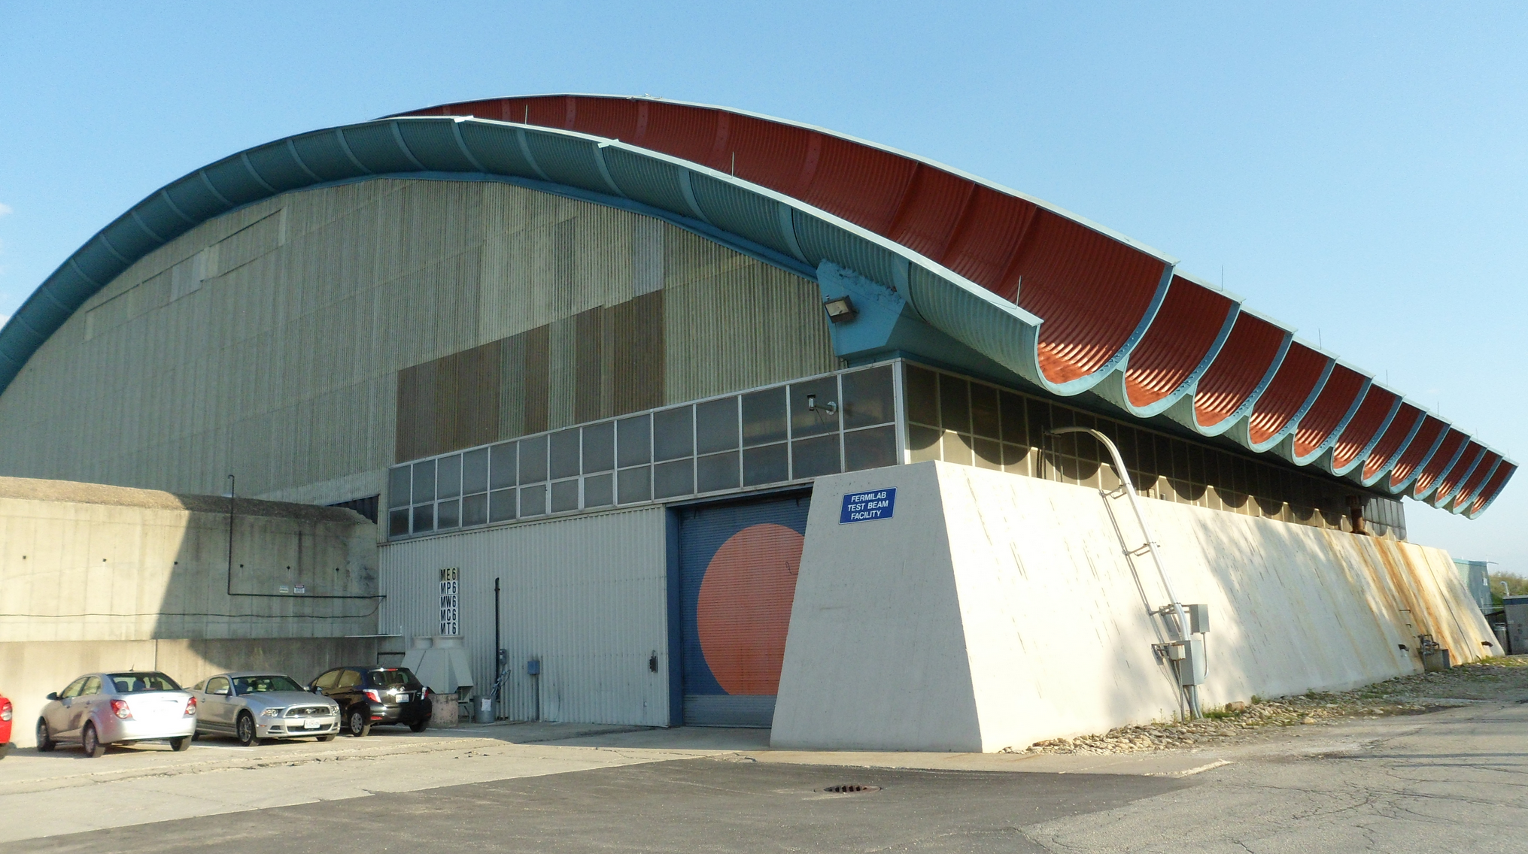
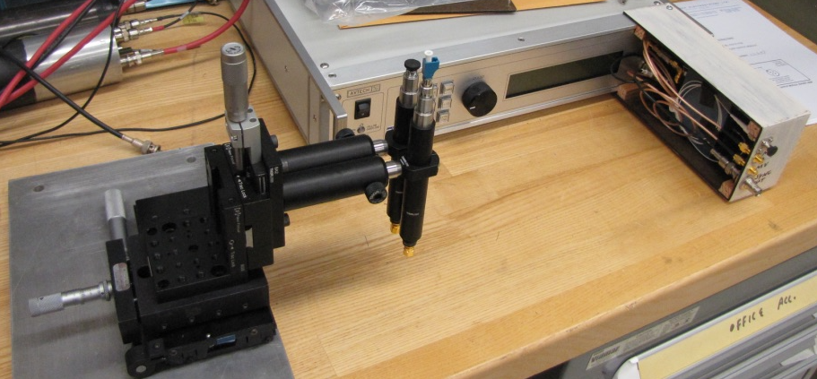
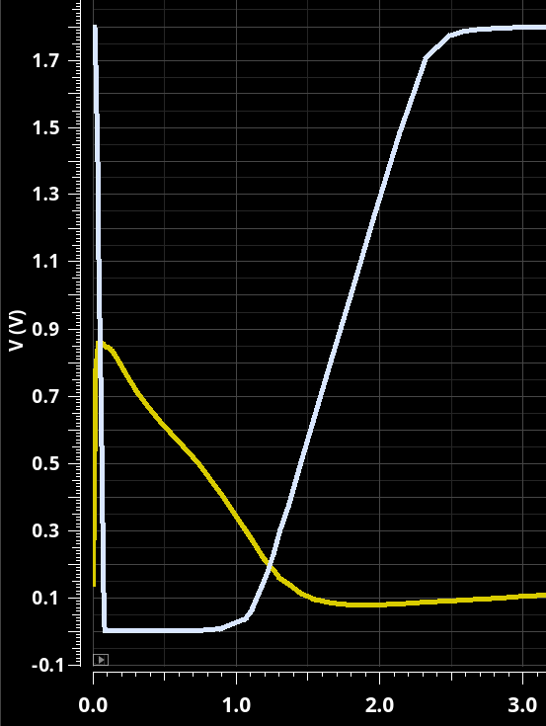
Testing program
Cosmic rays
Efficiency and resolution
Preliminary alignment
Laser pulser
Optimize ALPIDE parameters
Validate ALPIDE simulations
Beam tests
Large samples of clean tracks: precision alignment
Momentum dependence
High rate/high occupancy
Integration with other sPHENIX subsystems
Beam tests are not essential, but very useful
Notes:
‹#›

Slide 5
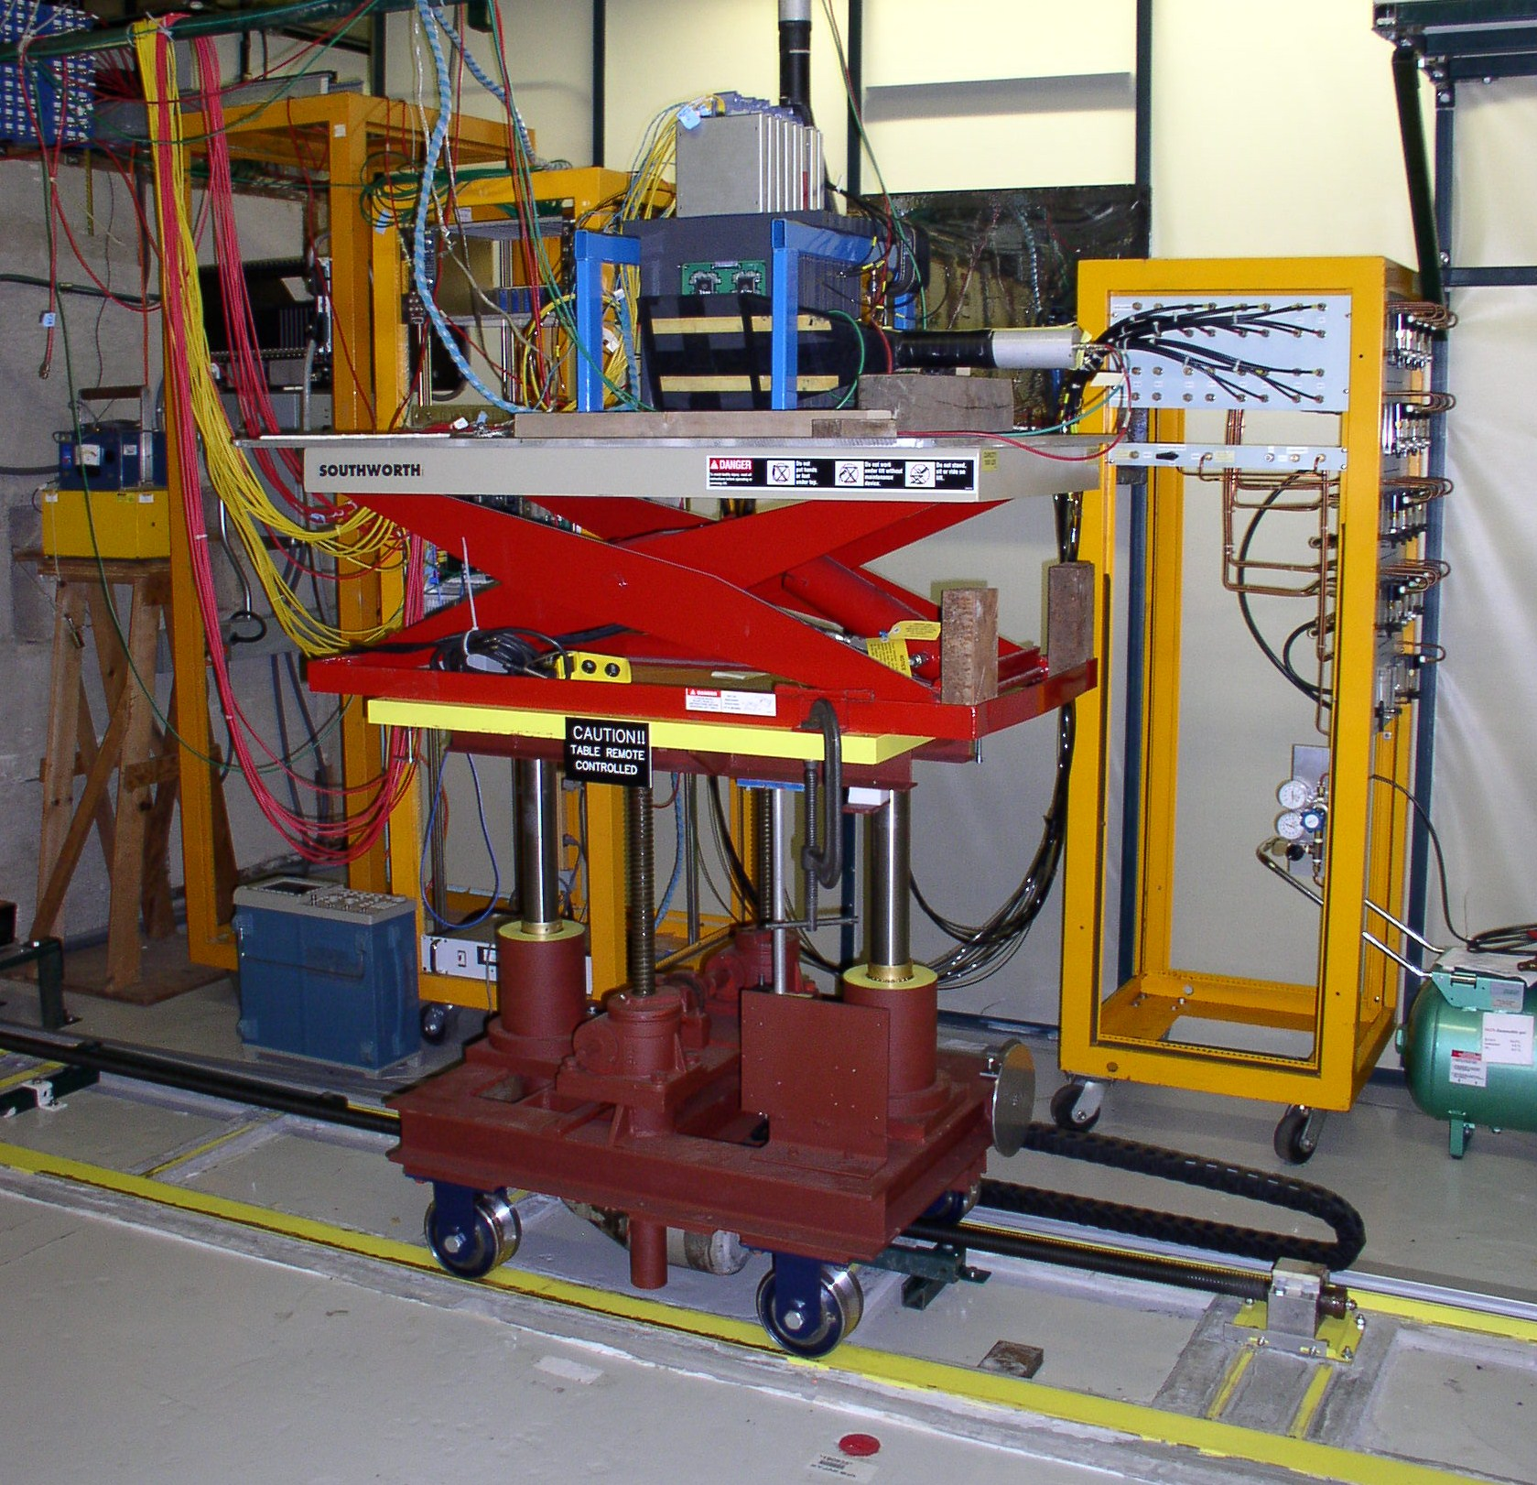
2018 beam test
Fermilab Test Beam Facility
120 GeV primary proton beam, 1-60 GeV secondary particles
Great infrastructure: motion tables, cabling, trigger detectors
sPHENIX beam test
Primary sPHENIX goal: test performance of the EMCal and HCal (month-long test program)
The sPHENIX silicon detectors (MVTX and INTT) are opportunistic users: calorimeters are off March 6-9, INTT and MVTX will get beam
MVTX here
beam
Ahead of schedule thanks to rapid progress on readout and prototype, and our good relations with sPHENIX
Notes:
‹#›

Slide 6
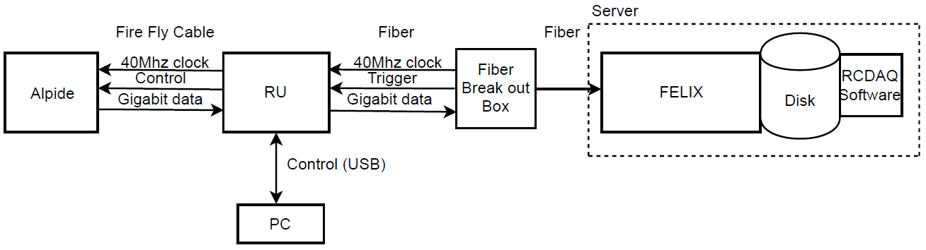
2018 beam test: preparations
Same proven readout chain
Single Readout Unit for whole MVTX prototype
Control PC in beam enclosure: control power supplies, program and control Readout Unit
DAQ server in control room: fiber link to the RU, network gateway to the outside
Bench test: run full readout chain using 53 MHz clock and scintillator trigger, exercise the monitoring – just like at Fermilab
We will arrive at Fermilab with a fully tested system
Notes:
‹#›

Slide 7
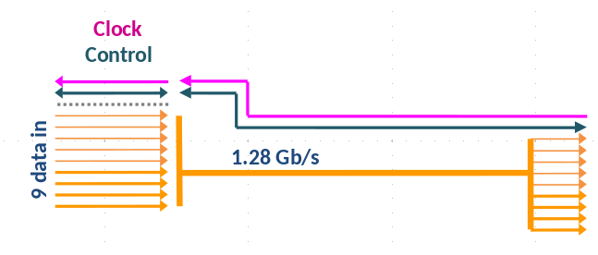
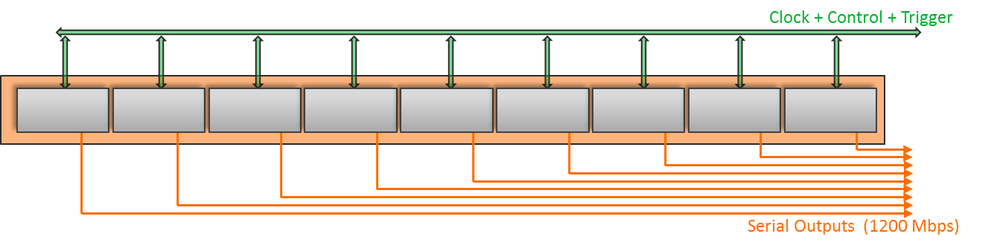
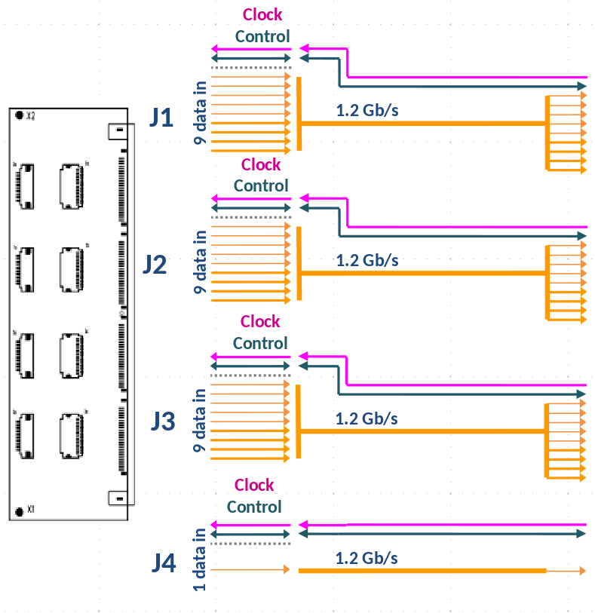
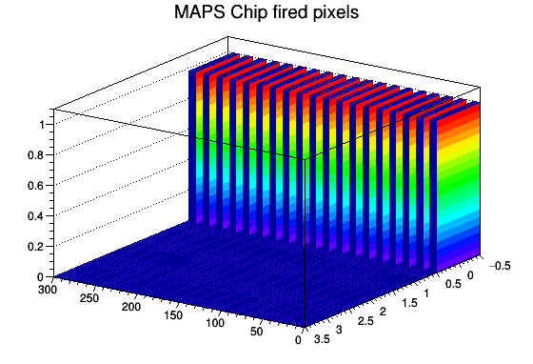
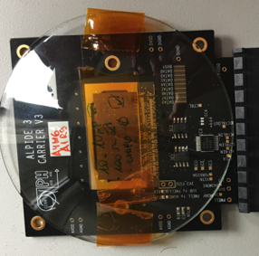
2018 beam test: preparations
Development for the beam test
New transition board supports four layers instead of one
Clock and trigger: ready for test with 53 MHz clock and scintillator trigger
Online decoding and monitoring using sPHENIX framework
default ALICE transition board
new LDRD transition board
Moving from development system to production
Notes:
‹#›

Slide 8
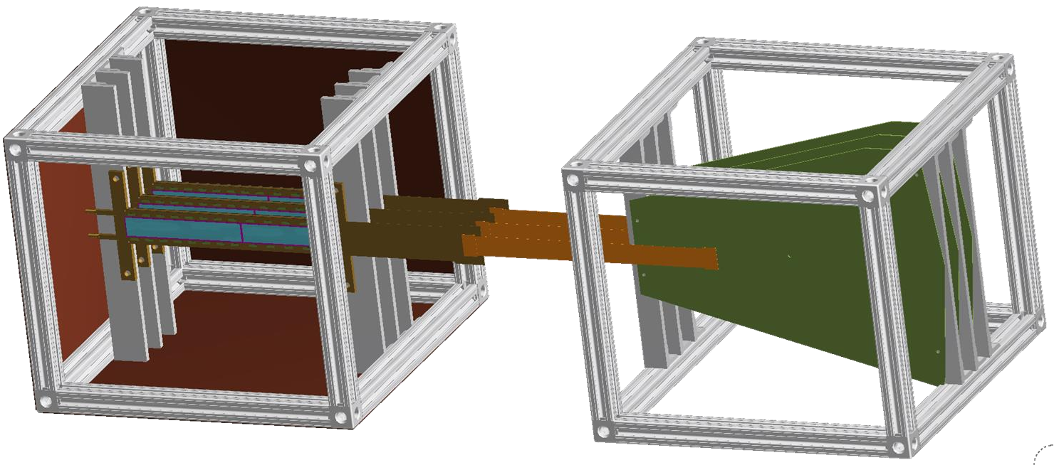
2018 beam test: schedule and run plan
Schedule
Pack and ship week of Feb. 12
Arrive Feb. 19, install Feb. 21, safety walkthrough Feb. 22
Return March 3, ready for beam
Expect INTT/MVTX joint beam time March 6-9 (nights)
Uninstall and ship, return March 13
Goals and stretch goals
INTT is the primary user during our beam time: they are upstream of us and they request the beam: secondaries at 2 and 8 GeV, protons at 120 GeV
Main goal: 1-hour runs for each beam type (100k-1M tracks)
If possible: high occupancy run, latency scan, off-normal incidence, different ALPIDE configurations
Flexible run plan: we can meet our goals in one night, but we will use all the beam time we get
INTT
Notes:
‹#›

Slide 9
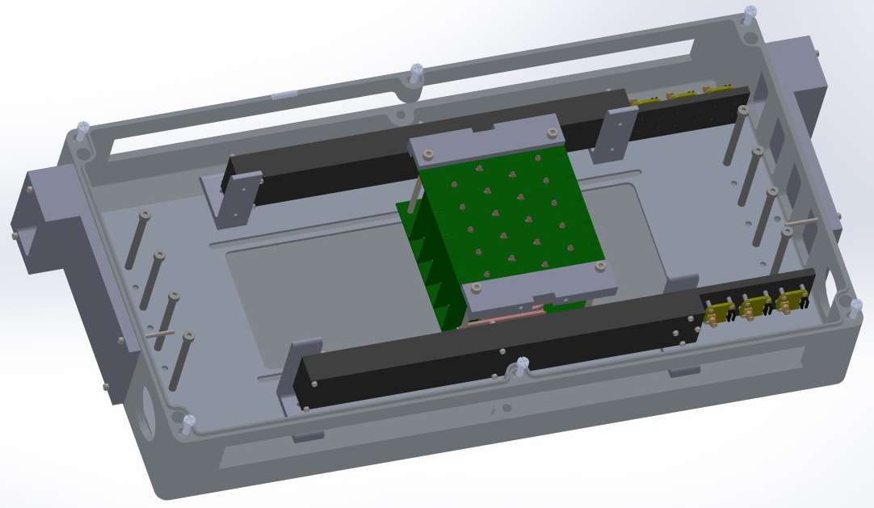
Future studies and beam tests
cosmic rays
Cosmic ray telescope
After the Fermilab beam test, use the prototype with cosmic ray muons and SiPM-based trigger boxes
Switch to staves when available, test cooling and power
  “Full goal” of a 1/10 slice of MVTX including support systems
Goals for a second beam test
We will join 2019 sPHENIX beam test, or schedule dedicated MVTX beam time
We will have staves, not single chips
sPHENIX trigger will be better defined, allowing DAQ integration between subsystems
MVTX readout will be feature-complete, ready for readout stress tests
Prove a full system with complete software, firmware, and hardware - ready for the transition to MVTX
Notes:
‹#›

