Slide 1
S3P Tutorials
CW23 - Stanford, March 27-31, 2023
Computational Electrodynamics Department
SLAC National Accelerator Laboratory

Slide 2
S3P Capability
Calculates scattering parameters of RF components
Typical applications
  Waveguide component matching
  RF load
  Traveling wave accelerator structure coupler design

Slide 3
S Parameter Solver
S-Parameter Equation
am,am+1…
bm,bm+1…
b1,b2…
an,an+1…
a1,a2…
bn,bn+1…
a: input wave
b: reflected wave
[b]=[S][a]
S: scattering matrix
Port: a reference point on a waveguide. Properties set to simulate infinite long waveguide

Slide 4


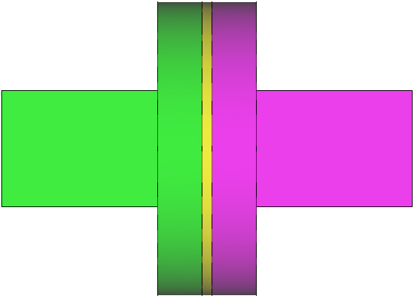
S3P Examples
90 degree bend
Waveguide load
Window

Slide 5
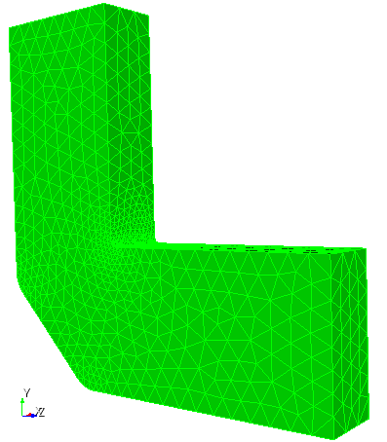
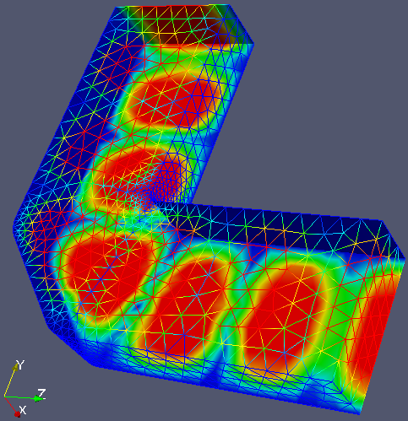

S3P Practice 1: XBand Mitered Bend
10.16
22.86
Dimensions
(WR90): 22.86X10.16
R5
R1
16
60
Run S3P
1) model 2) mesh
3) Solver 4) postprocess

Slide 6
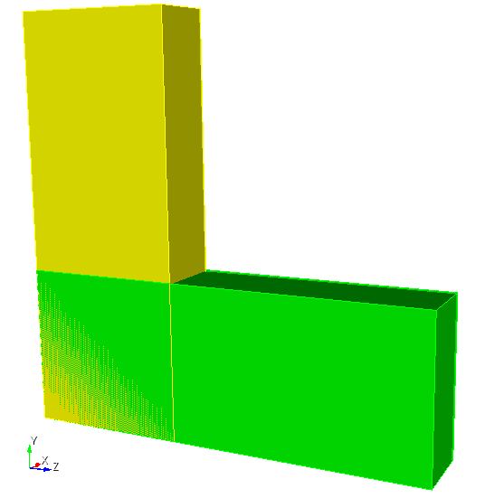
Steps to Create the Model
Create “brick”: 10.16 X 22.86 X 60
Move (dx,dy,dz): 0, 0, {0.5*60-0.5*22.86}
Create “brick”: 10.16 X 60 X 22.86
Move (dx,dy,dz): 0, {0.5*60-0.5*22.86},0

Slide 7
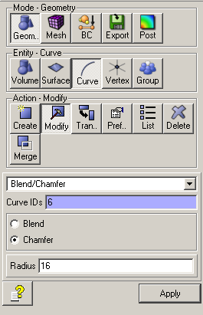
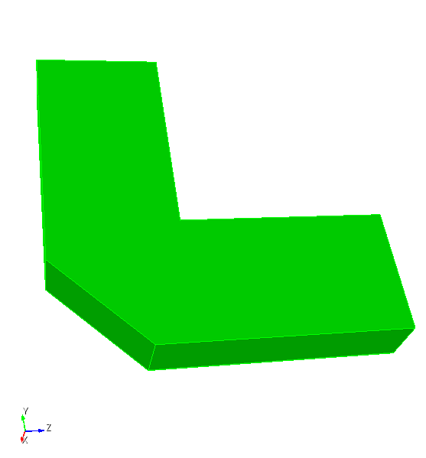
Now Add Chamfer and Rounding
Unite all (remember to “compress ids”
Cut corner (chamfer) with “radius” 16

Slide 8
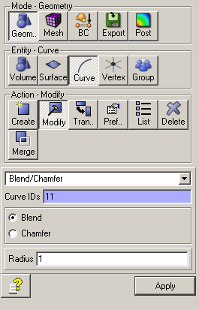
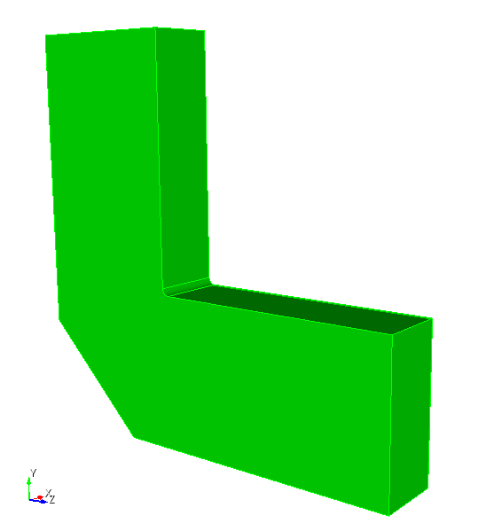
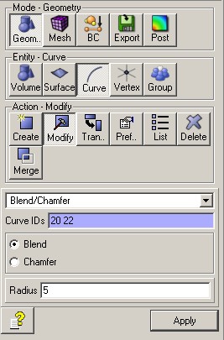
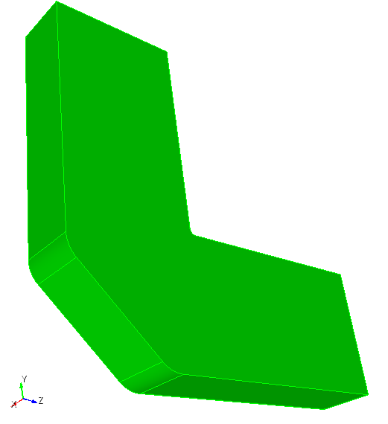
Add “Tool” Roundings
Blend “sharp corner” with radius 1
Blend “chamfered corners” with radius 5
Then “export” the model

Slide 9
JOU File to Create 90 Degree Bend
reset
brick x 10.16 y 22.86 z 60
move volume 1 location x 0 y 0 z {0.5*60-0.5*22.86}
brick x 10.16 y 60 z 22.86
move volume 2 location x 0 y {0.5*60-0.5*22.86} z 0
unite all
compress ids
modify curve 6 chamfer radius 16
modify curve 11 blend radius 1
modify curve 20 22 blend radius 5
export acis “90DegreeBend.sat" overwrite

Slide 10
Parameterized JOU File
reset
#{wgwidth = 22.86}
#{wghight = 10.16}
#{wglength = 60.0}
#{cornercut = 16}
#{rcorner1 = 1}
#{rcorner2 = 5}
brick x {wghight} y {wgwidth} z {wglength}
move volume 1 location 0 0 {0.5*wglength-0.5*wgwidth}
brick x {wghight} y {wglength} z {wgwidth}
move volume 2 location 0 {0.5*wglength-0.5*wgwidth} 0
unite all
compress ids
modify curve 6 chamfer radius {cornercut}
modify curve 11 blend radius {rcorner1}
modify curve 20 22 blend radius {rcorner2}
export acis “90DegreeBend.sat" overwrite

Slide 11
Modify “Mesh-pillbox.jou” to Mesh the Bend
reset
import acis "90DegreeBend.sat"
volume all scheme Tetmesh
volume all sizing function type skeleton scale 5 time_accuracy_level 2 min_size auto max_size 3 max_gradient 1.2
mesh volume all
Sideset 7 surface 10
Sideset 8 surface 12
Sideset 6 surface all except 10 12
block 1 volume all
block 1 element type tetra10
volume all scale 0.001
export Genesis "90DegreeBend.gen" block all overwrite
TIP: copy and modify an existing meshing journal file

Slide 12
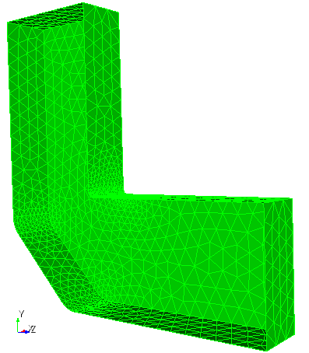
The Mesh
Front surface visibility off
(in CUBIT)
mesh adapted to curvature of surface

Slide 13
S3p input – 90DegreeBend.s3p
ModelInfo: {
File: ./90DegreeBend.ncdf
BoundaryCondition: {
Exterior: 6
Waveguide: 7, 8
}
}
FiniteElement: {
Order: 1
CurvedSurfaces: on
}
FrequencyScan: {
Start: 9.424e+9
End: 14.424e+9
Interval: 0.2e+9
}
PostProcess: {
Toggle: on
PortNumber: 7
//only save mode file for port with
//this reference number;
}
Port: {
ReferenceNumber: 7
NumberOfModes: 1
}
Port: {
ReferenceNumber: 8
NumberOfModes: 1
}

Slide 14
Input: ModelInfo
ModelInfo: {
File: ./bend.ncdf
BoundaryCondition: {
Exterior: 6
Waveguide: 7, 8
}
}
Two ports: reference 7 and 8

Slide 15
Input: FrequencyScan
FrequencyScan: { //enable frequency scan of S parameter
Start: 9.424e+9
End: 14.424e+9
Interval: 0.2e+9
}
// if “Start” = “End”: perform single frequency S parameter computation

Slide 16
Input: Port Information
Port: {
ReferenceNumber: 7
NumberOfModes: 1
}
// NumberOfModes : number of modes to load for this port
// Use the cutoff frequencies to estimate how many modes need to be loaded

Slide 17
Input: PostProcess
PostProcess: {
Toggle: on // on or off
PortNumber: 7 // save mode files for this port excitation
// ModeFile: rec // mode file name: rec.port#.modeN,
// modeN indicates Nth port mode;
// default mode file name: s3p.port#.modeN,
}
Specify the input port and compute the field distributions.
If specified: only save mode files for port excitation with the specified reference number
If not specified, save mode files for all the ports

Slide 18
Run s3p
Copy 90DegreeBend.ncdf to NERSC
Copy run-s3p.batch to NERSC
$ sbatch run-s3p.batch
s3p result is written into subdirectory: s3p_results
#!/bin/bash -l
#SBATCH -C cpu
#SBATCH -q debug
#SBATCH -A m349
#SBATCH -N 1
#SBATCH -t 00:10:00
#SBATCH -J s3p_run
#SBATCH -e myjob.%j.err
#SBATCH -o myjob.%j.out
#SBATCH --ntasks-per-node=4
export DIR=$PWD
cd $DIR
srun -n 4 -c 4 --cpu-bind=cores /global/cfs/cdirs/ace3p/perlmutter/CPU/s3p 90DegreeBend.s3p
run-s3p.batch

Slide 19
Files in s3p_results Directory
Filenames | Description
PortRef7.out PortRef8.out | Port mode, can be used to examine the waveguide modes
Reflection.out | S-parameter - amplitude
Sparameter.out | S-parameter - complex
port_7 port_8 | 2d port files
s3p.port7.mode0.f1.042400E+10.mod s3p.port7.mode0.f1.062400E+10.mod s3p.port7.mode0.f1.082400E+10.mod …. s3p.port7.mode1.f1.122400E+10.mod s3p.port7.mode1.f1.142400E+10.mod s3p.port7.mode1.f1.162400E+10.mod s3p.port7.mode1.f1.182400E+10.mod | Field files. “s3p” is the default prefix for the mod file, it will take the “ModeFile” as the prefix if specified in the input. “port7.mode#” is the port mode ID
s3p.output | Log file
VECTOR | Directory – DOF coefficient

Slide 20
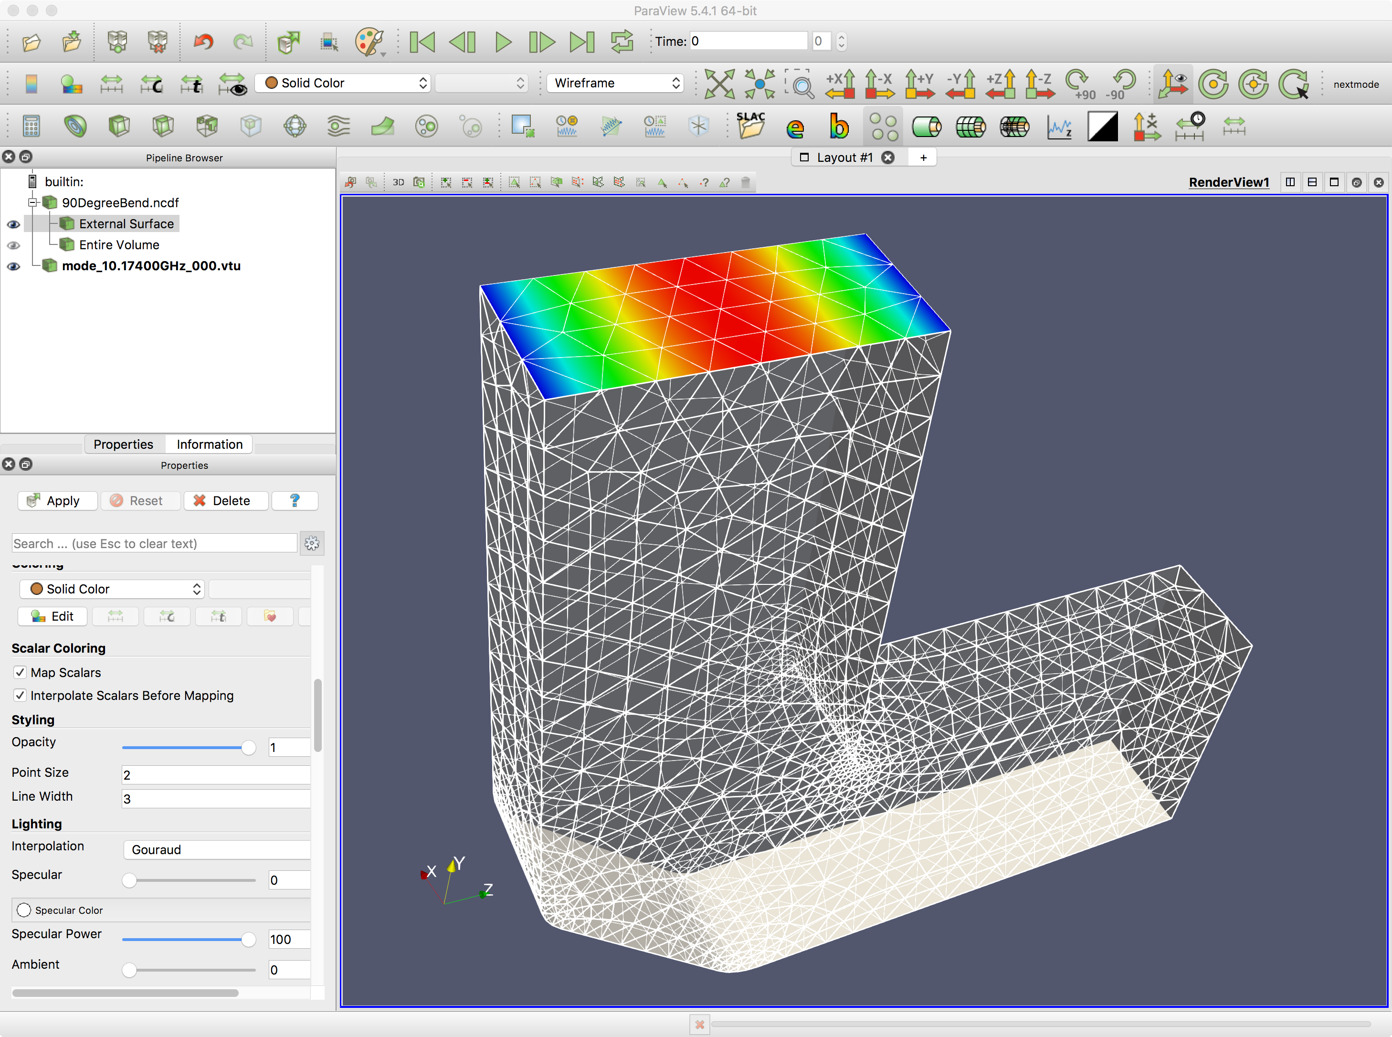
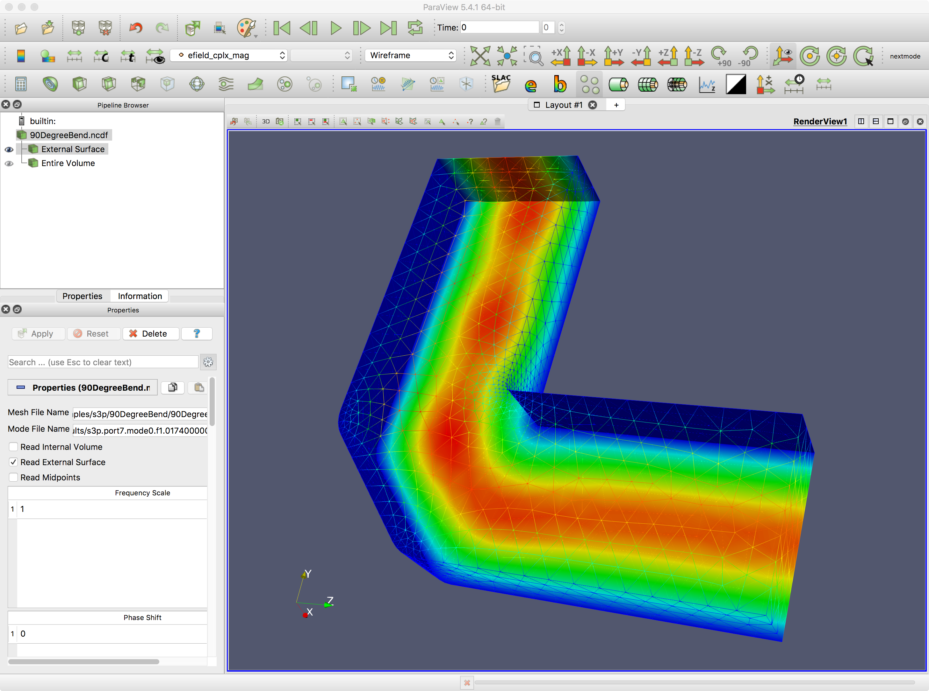
Mitered Bend Paraview Visualization
Copy whole directory back to laptop (Warning: Many (larger) files)
$scp –r <username>@perlmutter-p1.nersc.gov:tmp/s3p/90DegreeBend/s3p_results ./.
Port mode E field (11.3424GHz)

Slide 21
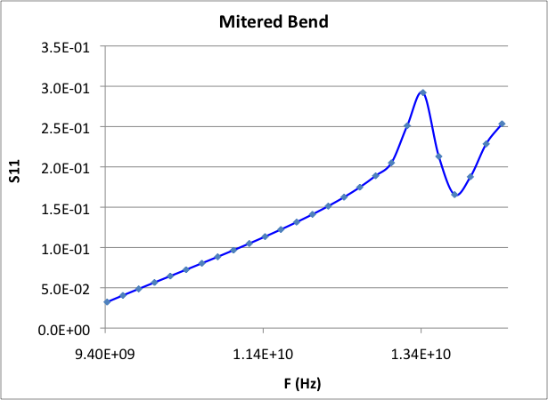
Mitered Bend TE10 S11
TE10 reflection

Slide 22
S3P Practice 2 – recWG-load1
Model and mesh multi-volume geometry
Lossy material specification

Slide 23
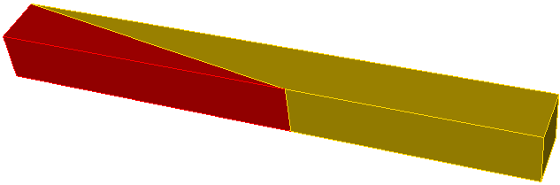
S3P Practice 2 – recWG-load1
Model a waveguide load with the following geometry
Calculate S11 from 2.456GHz to 3.056GHz
200 mm
WR284
72.136X34.036
Model only half the geometry
Magnetic Symmetry plane

Slide 24
Model: step1-Make-recWG-load1.jou
reset
##wr284
##wguide: 2.84*fsc0=72.136
##hguide: 1.34*fsc0=34.036
#{wwidth = 72.136}
#{wheight = 34.036}
#{loadl = 200.0 }
#{wlength = 150 }
##the port location is at 150
brick x {0.5*wwidth} y {wheight} z {loadl}
body 1 move {0.25*wwidth} 0 {-0.5*loadl}
webcut volume 1 with plane vertex 5 vertex 6 vertex 3
brick x {0.5*wwidth} y {wheight} z {wlength}
body 3 move {0.25*wwidth} 0 {0.5*wlength}
unite 2 3
compress ids
export acis "recWG-load1.sat" overwrite

Slide 25
Mesh: step2-Mesh-recWG-load1.jou
reset
import acis "recWG-load1.sat"
imprint body 1 2
merge body 1 2
volume all scheme tetmesh
surface all scheme triadvance
volume 1 size 8.0
volume 2 size 8.0
## interface surfaces
surface 1 size 8.0
surface 1 interval hard
mesh volume 1
mesh volume 2
smooth vol all
smooth surface all
sideset 1 surface 5 7
sideset 7 surface 6
sideset 6 surface all except 5 7 6 1
block 1 vol 2
block 2 vol 1
block all element type tetra10
transform mesh output scale 0.001
export genesis "recWG-load1.gen" overwrite

Slide 26
s3p input: recWG-load1.s3p
ModelInfo: {
File: ./recWG-load1.ncdf
BoundaryCondition: {
Magnetic: 1
Exterior: 6
Waveguide: 7
}
Material : {
Attribute: 1
Epsilon: 1.0
Mu: 1.0
}
Material : {
Attribute: 2
Epsilon: 10.0
Mu: 1.0
EpsilonImag: -1.52
}
SurfaceMaterial: {
ReferenceNumber: 6
Sigma: 5.8e7
}
}
FiniteElement: {
Order: 1
CurvedSurfaces: on
}
FrequencyScan: {
Start: 2.456e+9
End: 3.056e+9
Interval: 0.05e+9
}
PostProcess: {
Toggle: on
PortNumber: 7 // save mode files for this port
}
Port: {
ReferenceNumber: 7
NumberOfModes: 2
}

Slide 27
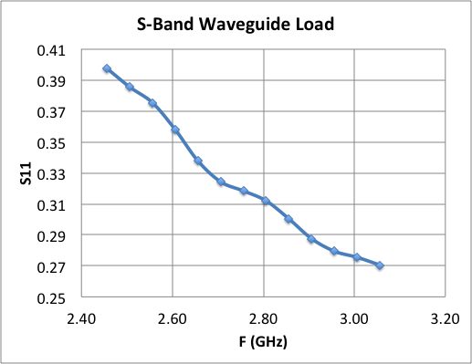
s3p result: Reflection.out

Slide 28
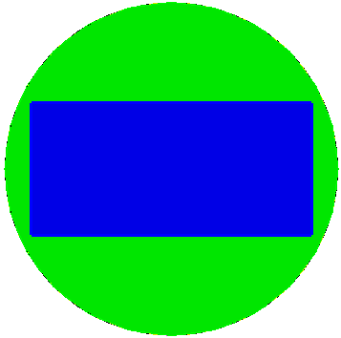

S3P Practice 5 - Window
33
120
72.136X34.163
3
μ_{r}=9.37
45
Material : {
Attribute: 1
Epsilon: 1.0
Mu: 1.0
}
Material : {
Attribute: 2
Epsilon: 9.37
Mu: 1.0
}
vacuum
block
window
block
Model ¼ geometry

Slide 29
S3P – Window: step1-Make-window.jou
reset
#{w284=72.136 }
#{h284=34.163 }
#{cradius = 45 }
#{wdwt = 3 }
#{cavl = 15 }
#{wlengthz = 60}
## ceramic window
brick x {w284} y {h284} z {2*wlengthz}
create cylinder height {2*cavl+wdwt} radius {cradius}
unite all
compress ids
webcut volume 1 with plane zplane offset {0.5*wdwt}
webcut volume 2 with plane zplane offset {-0.5*wdwt}
webcut volume all with plane xplane offset 0
delete volume 6 4 5
webcut volume all with plane yplane offset 0
delete volume 1 2 3
compress ids
export acis "window.sat" overwrite

Slide 30
S3P – Window: step2-Mesh-window.jou (1)
reset
import acis "window.sat”
volume all scheme tetmesh
merge tolerance 0.0001
imprint body all
merge body all
volume 1 3 sizing function type skeleton scale 5 time_accuracy_level 2 min_size auto max_size 6 max_gradient 1.2
volume 2 sizing function type skeleton scale 3 time_accuracy_level 2 min_size 1.5 max_size 3 max_gradient 1.2
group 'ms’ add surface Is_merged
ms expand size 2
ms expand interval hard

Slide 31
S3P – Window: step2-Mesh-window.jou (2)
mesh volume all
smooth vol all
smooth surface all
group "port7" add surface 16
group "port8" add surface 2
group "sym1" add surface 5 11 17
group "sym2" add surface 1 9 14
group "ss6" add surface all
ss6 subtract ms from ss6
ss6 subtract sym1 from ss6
ss6 subtract sym2 from ss6
ss6 subtract port7 from ss6
ss6 subtract port8 from ss6
sideset 1 surface in sym1
sideset 2 surface in sym2
sideset 7 surface in port7
sideset 8 surface in port8
sideset 6 surface in ss6
block 1 vol 1 3
block 2 vol 2
block all element type tetra10
transform mesh output scale 0.001
export genesis "window.gen" overwrite

Slide 32
S3P – Window: window.s3p
ModelInfo: {
File: ./window.ncdf
BoundaryCondition: {
Magnetic: 1
Electric: 2
Exterior: 6
Waveguide: 7, 8
}
Material : {
Attribute: 1
Epsilon: 1.0
Mu: 1.0
}
Material : {
Attribute: 2
Epsilon: 9.37
Mu: 1.0
}
SurfaceMaterial: {
ReferenceNumber: 6
Sigma: 5.8e7
}
}
FiniteElement: {
Order: 2
CurvedSurfaces: on
}
FrequencyScan: {
Start: 2.356e9
End: 3.856e9
Interval: 0.1e+9
}

Slide 33
S3P – Window: run & postprocess
Run s3p: input file “window.s3p”
Plot S11
Use “acdtool postprocess rf” to print out field along (x=0, y=0) and plot using other software, e.g. exel or gnuplot.
Visualize using Paraview
  Field contour plot
  Arrow plot
  Electric field along (x=0, y=0)

Slide 34
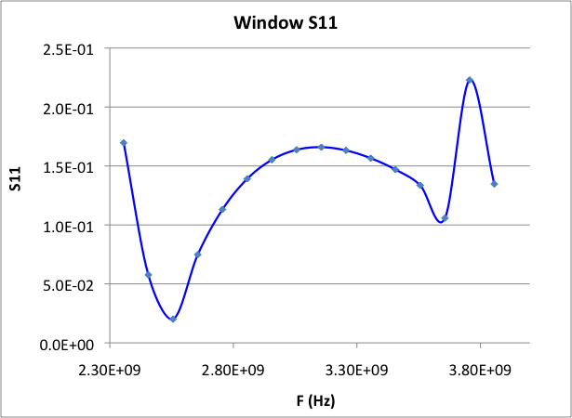
S3P – Window: result – S11
S11 plot

Slide 35
S3P – Window: window.rfpost
RFField
{
ResultDir = jobdir // Jobname
FreqScanID = 2 // For S3P only: frequency scan index
ModeID = 0
xsymmetry = magnetic // [none, electric, magnetic]
ysymmetry = magnetic // [none, electric, magnetic]
gradient = -1
cavityBeta = 1.00000 //for R/Q, V integral
reversePowerFlow= 0 // [1=charging 0=decaying]
x0 = 0.00000
y0 = 0.00000
gz1 = -0.03500
gz2 = 0.03500
npoint = 300
fmnx = 10
fmny = 10
fmnz = 50
}
ALLFieldOnLine
{
ionoff = 1
modeID1 = -1
modeID2 = -1
npoint = 300
filename = field1
rfphase = 0.00000
x1 = 0.00000
x2 = 0.00000
y1 = 0.00000
y2 = 0.00000
z1 = 100000000.00000
z2 = 100000000.00000
}

Slide 36
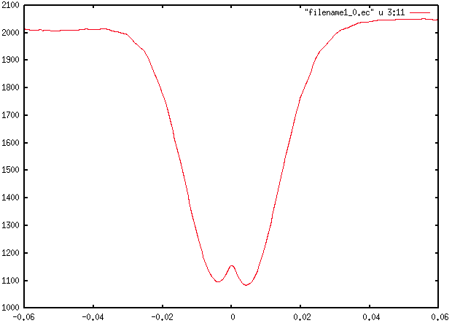
S3P – Window: rfpost field
FreqScanID = 2 (F=2.556GHz)
Field file: field1_0.ec //”0” first port mode
The following figure is Ey along (0,0), window is at z=0

Slide 37
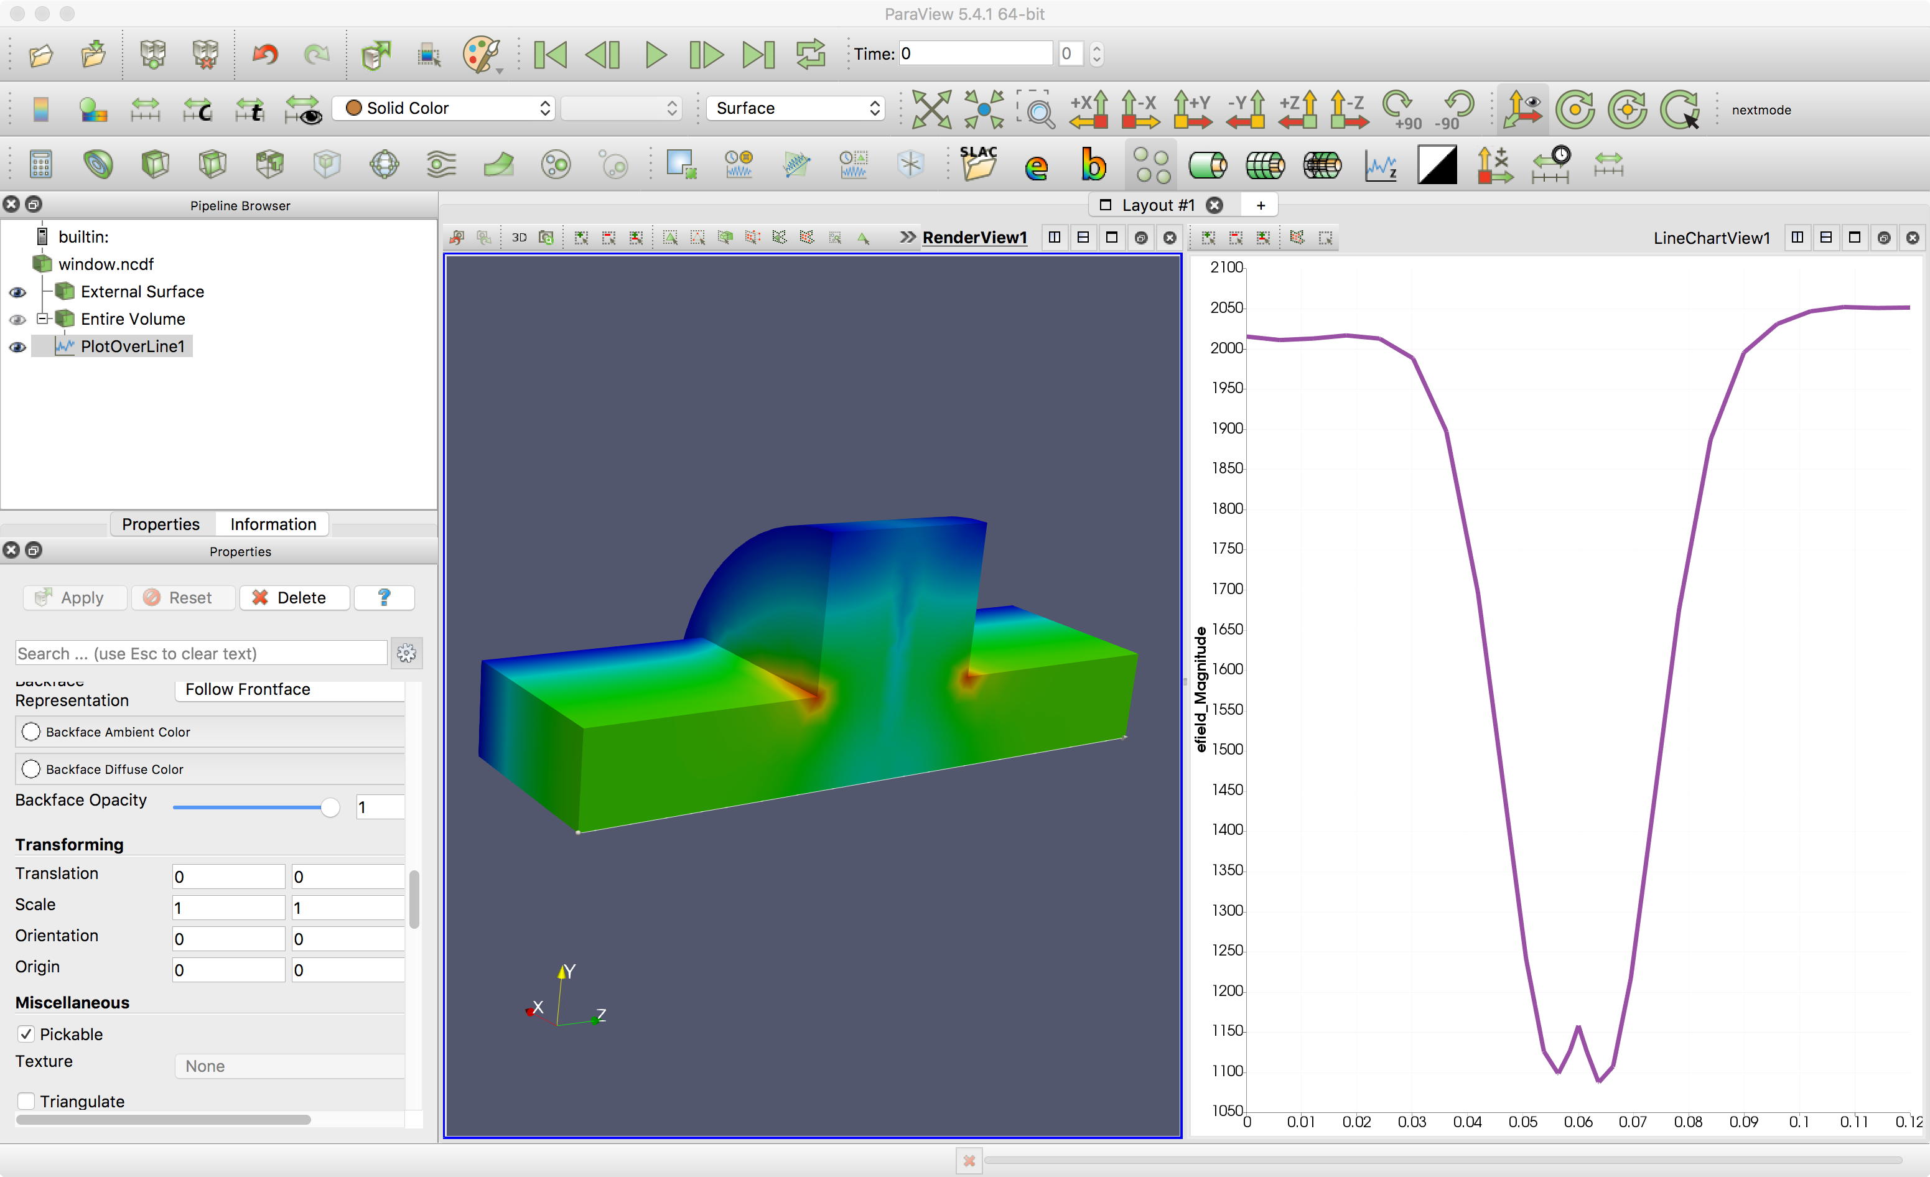
S3P – Window: Paraview Visualization
Field amplitude contour
Ey plot along (0,0), window is at z=0

