Slide 1
Omega3P Tutorials
CW23 - Stanford, March 27-31, 2023
Computational Electrodynamics Department
SLAC National Accelerator Laboratory

Slide 2
Omega3P Capability
Calculate resonant modes in a cavity
Real eigenvalue problems for lossless cavities
      PEC & PMC boundary conditions
      Periodic boundary condition
Complex eigenvalue problems for cavities with open boundary or lossy materials
      Absorbing boundary condition (simple ABC)
      Waveguide boundary condition for waveguides
      Surface impedance boundary condition
      Lossy material in volume (e.g. load)

Slide 3
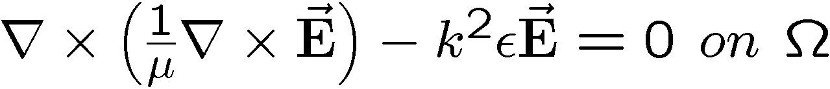
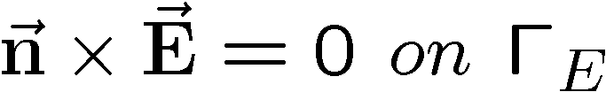
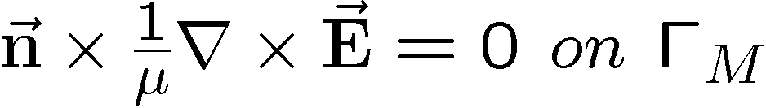



RF Cavity Eigenvalue System
Maxwell’s Eqns in Frequency Domain
Γ_{E}
Closed
Cavity
Γ_{M}
Discretization using Nedelec-type Element
“Real” eigenvalue problem

Slide 4
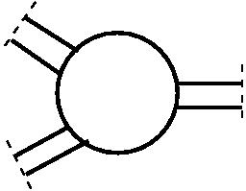
Cavity with Open Ports
Waveguide BC
Open
Cavity
Vector wave equation with waveguide boundary conditions can be modeled by a non-linear eigenvalue problem
“Complex” eigenvalue problem
With
Many ports with only one cutoff – quadratic eigenvalue system
More than one cutoff – Non-linear eigenvalue system (non-linear eigenvalue & PML)
Notes:
Closed cavity is an approximation for the real model. Usually the cavity has some sort of openings. For example, in accelearator cavity, we need put power into cavity and damp high-order-modes. These external coupling requires waveguide connected to cavity. Waveguide shape can be circular, rectangular or coax.
To model the open cavtity with waveguides, we can introduce a virtual BC on waveguide as shown.
The problem is emerged from a cavity with external coupling through waveguides. We can put waveguide boundary conditions on the virtual boundaries. Curl-curl equation along with waveguide boundary conditions will be discretized using finite-element methods (Electric field E is expanded by a set of vector basis functions.) and becomes a non-linear eigenvalue problem, where matrix K corresponds to curl-curl operator. M is mass matrix. Matrix W is waveguide matrix and has nonzero entries only on waveguide boundary. Note that k_cj is a physical known quantity called cutoff.

Slide 5
Workflow For ACE3P Codes
CUBIT – generate model
CUBIT – mesh the model
Acdtool – convert “GEN” mesh to “netcdf” format
Run Omega3P/S3P …
Postprocessing
  Paraview
  Acdtool postprocess rf

Slide 6
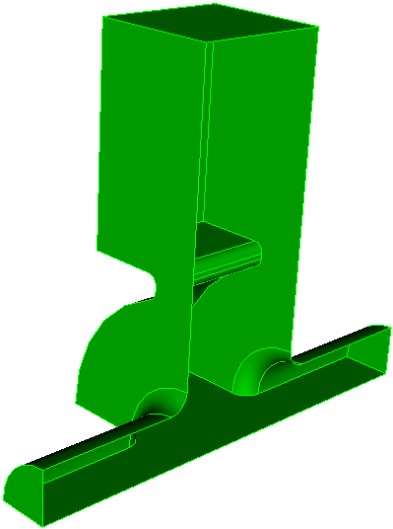
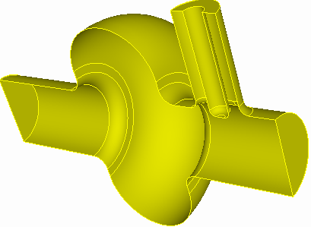
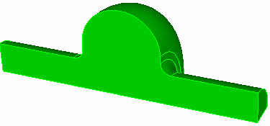
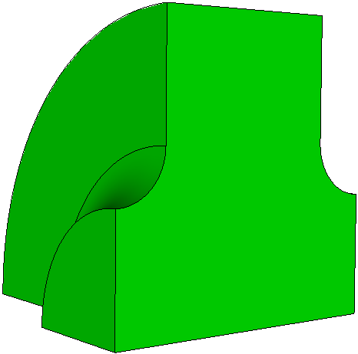
Omega3P Examples
Rounded top pillbox cavity
Pillbox cavity with waveguide coupler & lossy material
Traveling wave structure
Rounded top pillbox cavity with coax coupler

Slide 7
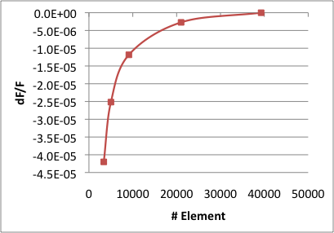
Omega3P – example 1
Rounded top cavity (Pillbox-rtop)
  Demo
    Mesh,
    Omega3p
    Postprocessing
  Mesh convergence study
    To understand necessary mesh density for certain accuracy!

Slide 8
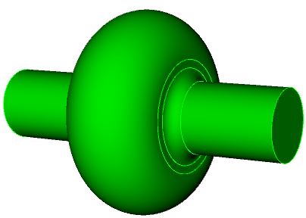
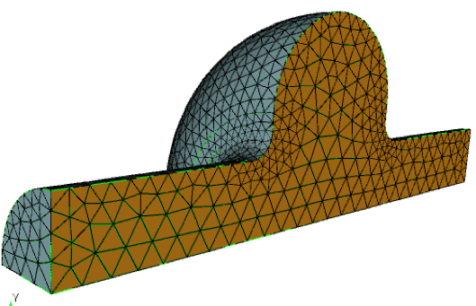
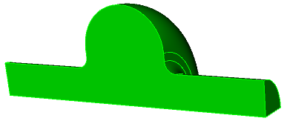
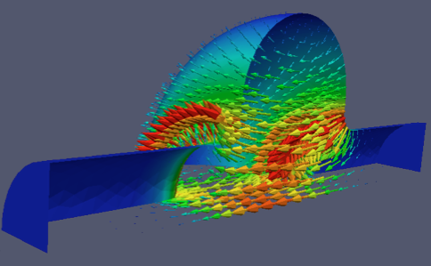
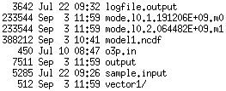
Pillbox RTOP
1) model 2) symmetry cut 3) mesh
“pillbox-rtop.ncdf”
Run Omega3P
4) Solver 5) postprocess

Slide 9
Model and Meshing with Journal Files
File directory: pillbox-rtop
  step1-Make-pillbox-rtop.jou
  step2-Mesh-pillbox-rtop.jou
  Pillbox-rtop.omega3p
  Pillbox-rtop.rfpost
In CUBIT, run “step1” and “step2” journal files to make and mesh the pillbox-rtop model
Copy files to NERSC
Convert CUBIT mesh to ACE3P format
Run solvers
Postprocessing (acdtool on NERSC, Paraview on local)

Slide 10
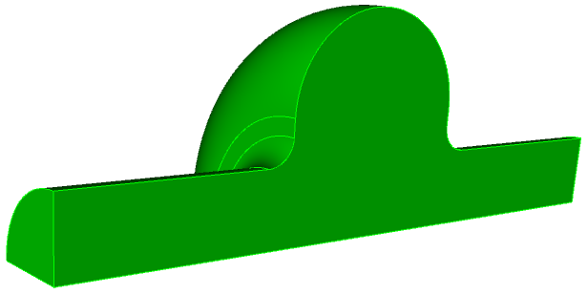
Omega3P Practice – 1: pillbox-rtop
Single cavity cell parameters
100mm
rounding
12mm
90mm
35mm
300mm

Slide 11
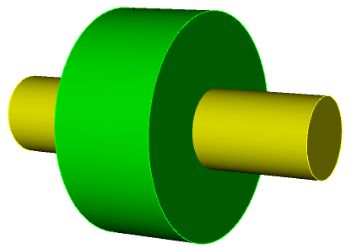
Generate pillbox-rtop model using .jou file
step1-Make-pillbox-rtop.jou
reset
#{cav_length = 90}
#{cav_radius = 100}
#{bp_length = 300}
#{bp_radius = 35 }
#{iris_rounding = 12}
create Cylinder height {cav_length} radius {cav_radius}
create Cylinder height {bp_length} radius {bp_radius}
unite volume all
compress ids
modify curve 6 5 blend radius {iris_rounding}
modify curve 1 2 blend radius {0.5*cav_length}
export acis "pillbox-rtop0.sat" overwrite
webcut volume 1 with plane xplane offset 0 noimprint nomerge
delete volume 2
compress ids
webcut volume 1 with plane yplane offset 0 noimprint nomerge
delete volume 1
compress ids
export acis "pillbox-rtop4.sat" overwrite

Slide 12
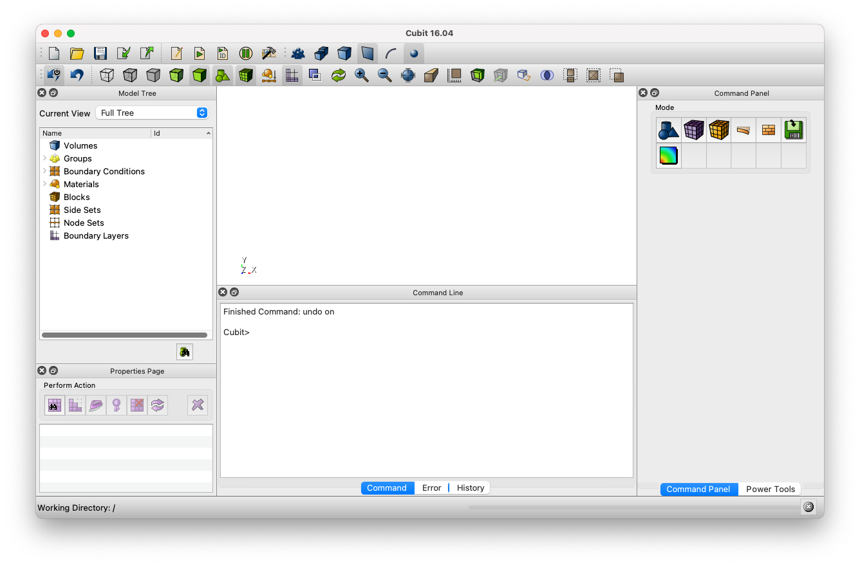
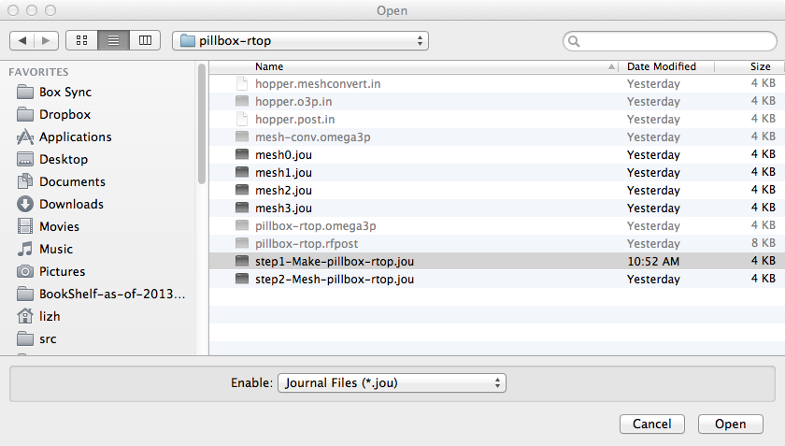
“play” step1-Make-pillbox-rtop.jou
1
use CUBIT “play” botton
find the .jou file
“open”
2
3

Slide 13
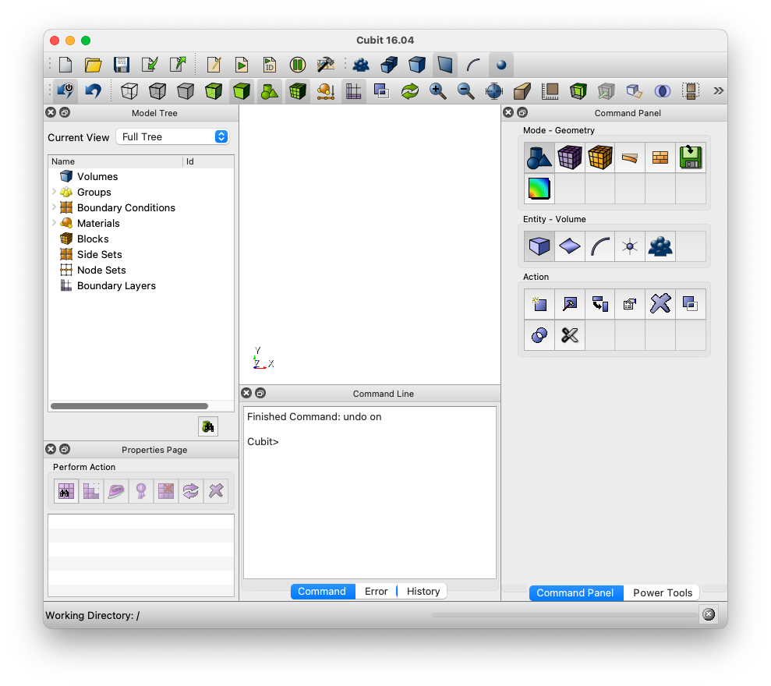
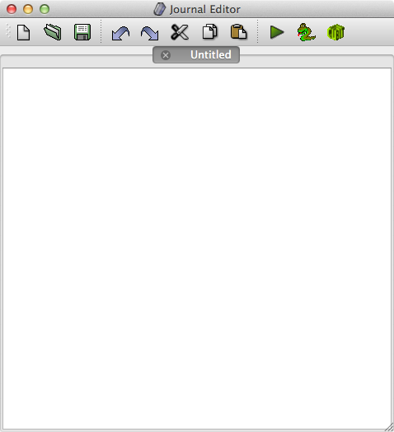
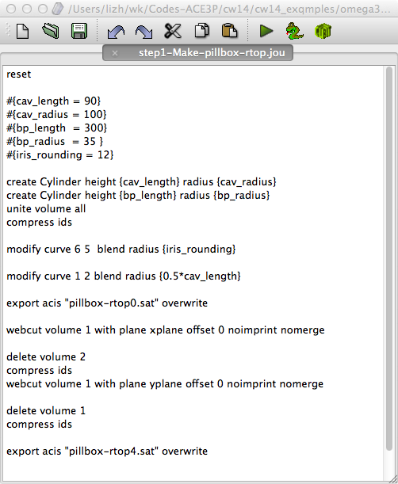
OR open step1-Make-pillbox-rtop.jou in JOURNAL Editor
1 (Journal Editor)
2
Graphics
window
Command
Panels
Command
line
3
“tools” -> “Journal editor”
find the .jou file and “open”
“play” (or edit)

Slide 14
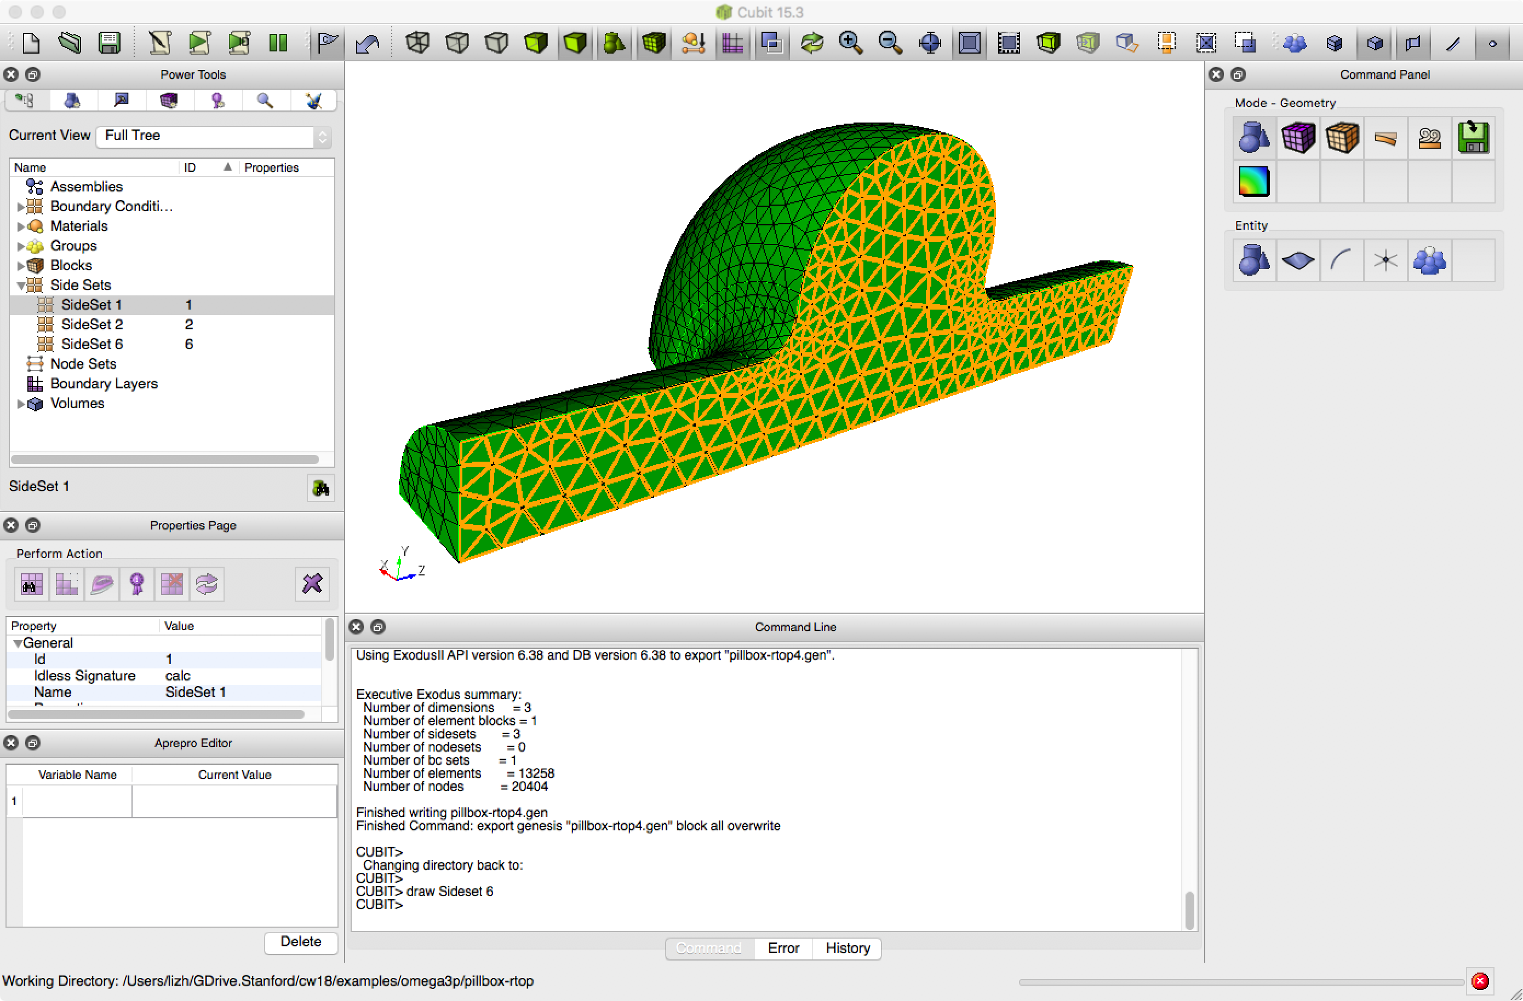
Mesh pillbox-rtop model using .jou file
Using CUBIT to “play”: step2-Mesh-pillbox-rtop.jou
reset
import acis "pillbox-rtop4.sat”
volume all scheme Tetmesh
volume all sizing function type skeleton scale 5 time_accuracy_level 2 min_size auto max_size 12 max_gradient 1.2
mesh volume all
Sideset 1 surface 7
Sideset 2 surface 1
## Sideset 3 surface 11
## Sideset 4 surface 8
Sideset 6 surface all except 7 1
block 1 volume all
block 1 element type tetra10
volume all scale 0.001
export Genesis "pillbox-rtop4.gen" block all overwrite

Slide 15
Copy mesh “pillbox-rtop4.gen” to edison and Convert “.gen” to “netcdf” format
$ scp pillbox-rtop4.gen <username>@pilmutter-p1.nersc.gov:<dir>/.
<dir> is your local directory on perlmutter
On perlmutter: Submit a job to convert mesh from “.gen” format (pillbox-rtop4.gen) to “.ncdf” format (pillbox-rtop4.ncdf)
$ sbatch run-meshconvert.batch
#!/bin/bash -l
#SBATCH -C cpu
#SBATCH -q shared
#SBATCH -A m349
#SBATCH -N 1
#SBATCH -t 00:10:00
#SBATCH -J dump
#SBATCH -e myjob.%j.err
#SBATCH -o myjob.%j.out
export DIR=$PWD
cd $DIR
srun -n 1 -c 1 --cpu-bind=cores /global/cfs/cdirs/ace3p/perlmutter/CPU/acdtool meshconvert pillbox-rtop4.gen
run-meshconvert.batch

Slide 16
Mesh Convert output file: my_job.***.out
Input: pillbox-rtop4.gen (contains quadratic 10-point elements)
Reading took 4.6066 seconds
Output: pillbox-rtop4.ncdf
Writing took 0.594721 seconds
Now calling 'acdtool mesh stats pillbox-rtop4.ncdf':
TOTALS:
elements: 13382
coordinates: 2955
EULER CHARACTER:
Surf Euler Char = 2
Vol Euler Char = 1
Euler Char is OK.
ASPECT RATIO:
min = 1.03213
max = 2.53273 <- GREAT
average = 1.56098
std dev = 0.202705
SHAPE MEASURE:
min = 0.26181 <- GREAT
max = 0.999332
average = 0.82041
std dev = 0.101908
ELEMENT VOLUME:
min = 3.87855e-09
max = 4.10282e-07
average = 5.88061e-08
std dev = 4.64707e-08
BOUNDING BOX:
min = (0, 0, -0.15)
max = (0.0999999, 0.0998816, 0.15)
EDGE LENGTH:
min = 0.00289644
max = 0.0207435
average = 0.00800165
std dev = 0.00243162
Existing boundary IDs:
1 2 6
Material IDs Number of Elems:
1: 13382
Now calling 'acdtool mesh check pillbox-rtop4.ncdf':
Reading the mesh and midpoints ...
*******************************************
Check whether there are invalid quadratic tetrahedral elements...
*******************************************
Total Volume is 0.000789758
Total Number of invalid second order tetrahedral elements (ISOTE) is: 0

Slide 17
Eigensolver Omega3P input
pillbox-rtop.omega3p
ModelInfo : {
File: ./pillbox-rtop4.ncdf
BoundaryCondition : {
Magnetic: 1, 2
Exterior: 6
}
SurfaceMaterial : {
ReferenceNumber: 6
Sigma: 5.8e7
}
}
FiniteElement: {
Order: 2
CurvedSurfaces: on
}
EigenSolver : {
NumEigenvalues: 2
FrequencyShift: 1.0e9
// Tolerance: 1e7
// MaxIterations: 300 // default: 200
}
Specify the file name of the mesh (in netcdf format)
Specify boundary conditions on each set of reference surfaces – in Cubit, they are called sideset.
Exterior surface conductivity for Q0 calculation
ReferenceNumber: identified by sideset ID in cubit
Volume Material (default vacuum)
Material : {
Attribute: 1 //identified by the block ID in cubit
Epsilon: 1.0
Mu: 1.0
// EpsilonImag: -0.2 //lossy material
}
finite element basis order
use curved elements
Number of eigenvalues to calculate
Frequency of interest

Slide 18
Eigensolver Omega3P input (Postprocess)
Write out the field files for visualization
/*
PostProcess : {
Toggle: on //switch, set off to turn off postprocessing
ModeFile: mode //mode file prefix (default: omega3p)
}
*/

Slide 19
Run Eigensolver Omega3P
Submit batch job
  $sbatch run-omega3p.batch
#!/bin/bash -l
#SBATCH -C cpu
#SBATCH -q debug
#SBATCH -A m349
#SBATCH -N 1
#SBATCH -t 00:10:00
#SBATCH -J dump
#SBATCH -e myjob.%j.err
#SBATCH -o myjob.%j.out
export DIR=$PWD
cd $DIR
srun -n 4 -c 4 --cpu-bind=cores /global/cfs/cdirs/ace3p/perlmutter/CPU/omega3p pillbox-rtop.omega3p
  run-omega3p.batch

Slide 20
After Submitting Jobs
Check job queue status
  $sqs –u <username>
JOBID ST USER NAME NODES TIME_LIMIT TIME SUBMIT_TIME QOS START_TIME FEATURES NODELIST(REASON
6248309 PD zli dump 1 10:00 0:00 2023-03-20T11:05:24 debug N/A cpu (Priority)
(PD -> waiting in the queue)
(when it runs)
6248323 R zli dump 1 10:00 0:10 2023-03-20T11:07:03 debug 2023-03-20T11:07:28 cpu nid004326
Cancel a job
$scancel <Job ID> (e.g., scancel 6248309)

Slide 21
Files In “omega3p_results” Directory
.mod files for Paraview visualization of fields
  -rw-r----- 1 zli zli 276776 Oct 1 12:18 omega3p.l0.m0000.1.3138129e+09.mod
  -rw-r----- 1 zli zli 276776 Oct 1 12:18 omega3p.l0.m0001.2.3291363e+09.mod
  -rw-r----- 1 zli zli 6398 Oct 1 12:18 omega3p.log
  -rw-r----- 1 zli zli 6728 Oct 1 12:18 omega3p.out
  -rw-r----- 1 zli zli 337 Oct 1 12:18 omega3p.warn
  -rw-r----- 1 zli zli 325 Oct 1 12:18 pillbox-rtop.omega3p
  drwx----- 2 zli zli 4096 Oct 1 12:18 VECTOR
Run info files
Eigenvector files

Slide 22
Omega3p_results/omega3p.log and on Screen Output (1)
*************************************************************
Omega3P
ACE3P Codes Source Date: Fri Aug 1 00:53:41 2014 -0700
ACE3P Codes Source Branch: master
ACE3P Codes Source Tag: ad61b63f7975b22f06eafd2f9ff055e7c1e11782
Support Lib Source Date: Mon Nov 18 16:38:09 2013 -0800
Support Lib Source Branch: master
Support Lib Source Tag: f9a355a2bc8510e02bbc219dde80dc0ad2730a56
Compilation Date: Fri Aug 1 16:13:35 PDT 2014
*************************************************************
Copyright 2014, Stanford University
Authors make no representations or warranties, expressed or
implied. By way of example, but not limitation, authors make
no representatinos or warranties of merchantibility or
fitness for any particular purpose or that the use of the
software componentns of documentation will not infringe any
patents, copyrights, trademarks or other rights.
The Authors shall not be held liable for any liability
nor for any direct, indirect or consequential damages with
respect to any claim by users or any third party on account
of or arising from the use of this software.
*************************************************************
Advanced Computations Department
SLAC National Accelerator Laboratory
https://slacportal.slac.stanford.edu/sites/ard_public/acd/Pages/Default.aspx
Contact: ace3p@slac.stanford.edu
Thank you for citing ACE3P when publishing related results.
*************************************************************
Starting master process on nid01837
Number of MPI processes: 24
Number of compute nodes: 1
Number of processes per node: 24
Data precision: 64 bits
Compiler: 4.8.2 20131016 (Cray Inc.)
Boundary conditions:
0 = INTERIOR
1 = MAGNETIC
2 = MAGNETIC
6 = EXTERIOR
Boundary 6 has surface conductivity of 58000000 S/m
Read Mesh: /scratch2/scratchdirs/zli/omegs3p/pillbox-rtop/pillbox-rtop4.ncdf
Time for reading the model: 0.08769106864929199
Using curved quadratic tetrahedrons
Setting global vector finite element basis order to p=2
Partitioning Method: parmetis
***********************************************************
* Total Number of Elements read: 13382
* Total Number of Elements used: 13382
* Total Number of DOFs: 82592
***********************************************************
Time for setting up finite element framework: 0.08461093902587891
/********************************/
/* input parameters, KVC syntax */
/********************************/
Mesh : {
ReplicatedElementDistribution : {
min : 130
total : 13342
stddev : 207.50838991245
max : 866
average : 555.91666666667
}
File : /scratch2/scratchdirs/zli/omegs3p/pillbox-rtop/pillbox-rtop4.ncdf
MeshCoords : 2955
ElementDistribution : {
min : 516
total : 13382
stddev : 15.813908756058
max : 585
average : 557.58333333333
}
}
/********************************/

Slide 23
Omega3p_results/omega3p.log and on Screen Output (2)
Checking Mesh Quality:
TETRAHEDRAL ELEMENTS:
number = 13382
INVERTED SECOND-ORDER ELEMENTS:
number = 0 <- GOOD!
ASPECT RATIO:
min = 1.032129014647081
max = 2.532733290970477 <- GREAT
average = 1.560982235198543
std dev = 0.2027046184231938
SHAPE MEASURE:
min = 0.2877280448751948 <- GREAT
max = 1.097919806255252
average = 0.826718906890085
std dev = 0.1080313717179665
ELEMENT VOLUME:
min = 3.86689649664578e-09
max = 4.10281701992557e-07
average = 5.901645481108432e-08
std dev = 4.645120956925392e-08
BOUNDING BOX:
min = (0, 0, -0.15)
max = (0.1000049592734751, 0.1001232565433149, 0.15)
EDGE LENGTH:
min = 0.002896441887301828
max = 0.02074353881994173
average = 0.008001650464629721
std dev = 0.002431617510853002
Time for checking the mesh quality: 0.01152610778808594
Time for save/load ComputationalMesh: 0.001888036727905273
Total Volume of the structure is : 0.0007897581982819304
Calling real solver
No. Sum Average Max Min Std_dev
Diagonal: 2970576 1.24e+05 134512 114244 5.59e+03
Offdiagonal: 351288 1.46e+04 21924 3848 4.87e+03
Nonlocal v: 44080 1.84e+03 2850 440 6.40e+02
Number of Grad DOFs: 14959
**********************************************************
ARPACK Loop:
Shift = 4.392566356039645e+02
**********************************************************
factorizing the matrix using MUMPS ...
Using ParMETIS for ordering...
Use 16 processors to do parallel reordering (ParMetis)
Partition of Processors: 0 1 2 3 4 5 6 7 8 9 10 11 12 13 14 15 24
Processor 0: 0, 3570
…
Processor 14: 48396, 51904
Processor 15: 51904, 82592
total: 82592 16
Generate ordering using parmetis...
Finished generating ordering using parmetis
Memory usage:
used mem per MPI process: min: 4.8156e+01 MB, max: 9.1207e+01 MB, avg: 6.1474e+01 MB, stddev: 8.9861e+00 MB, total: 1.4754e+03 MB
used mem per node in GB : min: 2.1207e+00 GB, max: 2.1207e+00 GB, avg: 2.1207e+00 GB, stddev: 0.0000e+00 GB, total: 2.1207e+00 GB
used mem per node in % : min: 6.7214e+00 %, max: 6.7214e+00 %, avg: 6.7214e+00 %, stddev: 9.0728e-16 %
ncv=6 nev=2
Linear Solver Preparation Time: 1.4194e+00
Solver Time: 1.3953e+00
Number of converged eigenpairs = 2
Eigenvalue: 7.5820282086930956e+02
Frequency: 1.3138129324430773e+09
Residual: 6.5335448815967775e-12
Eigenvalue: 2.3829128237424666e+03
Frequency: 2.3291363418303027e+09
Residual: 9.3027133617524046e-09
**********************************************************
Total number of OP*x operations: 45
Total number of B*x operations if BMAT='G': 139
Total number of steps of re-orthogonalization: 38
**********************************************************
COMMIT MODE: 0 FREQ = 1.3138129324430773e+09 k= 2.7535482942365647e+01 norm(v[0]) = 2.2455960457599691e+01
COMMIT MODE: 1 FREQ = 2.3291363418303027e+09 k= 4.8815088074717906e+01 norm(v[1]) = 2.1455838766398781e+01

Slide 24
Omega3p_results/omega3p.out - more info on modes
Mode : {
TotalEnergy : 4.4270939088102e-12
QualityFactor : 28875.569774495
File : omega3p_results/omega3p.l0.m0000.1.3138129e+09.mod
PowerLoss : 1.2656148816654e-06
Frequency : 1313812932.4431
}
Mode : {
TotalEnergy : 4.4270939088102e-12
QualityFactor : 33836.912665763
File : omega3p_results/omega3p.l0.m0001.2.3291363e+09.mod
PowerLoss : 1.9147090242043e-06
Frequency : 2329136341.8303
}

Slide 25
Visualization Using Paraview
Copy mesh file (pillbox-rtop.ncdf) and mode fields back to your laptop
on your laptop, in pillbox-rtop directory, type
$ scp <username>@perlmutter-p1.nersc.gov:<dir>/pillbox-rtop4.ncdf ./.
$ scp <username>@ perlmutter-p1.nersc.gov:<dir>/omega3p_results/\*.mod ./.
Visualize fields using Paraview

Slide 26
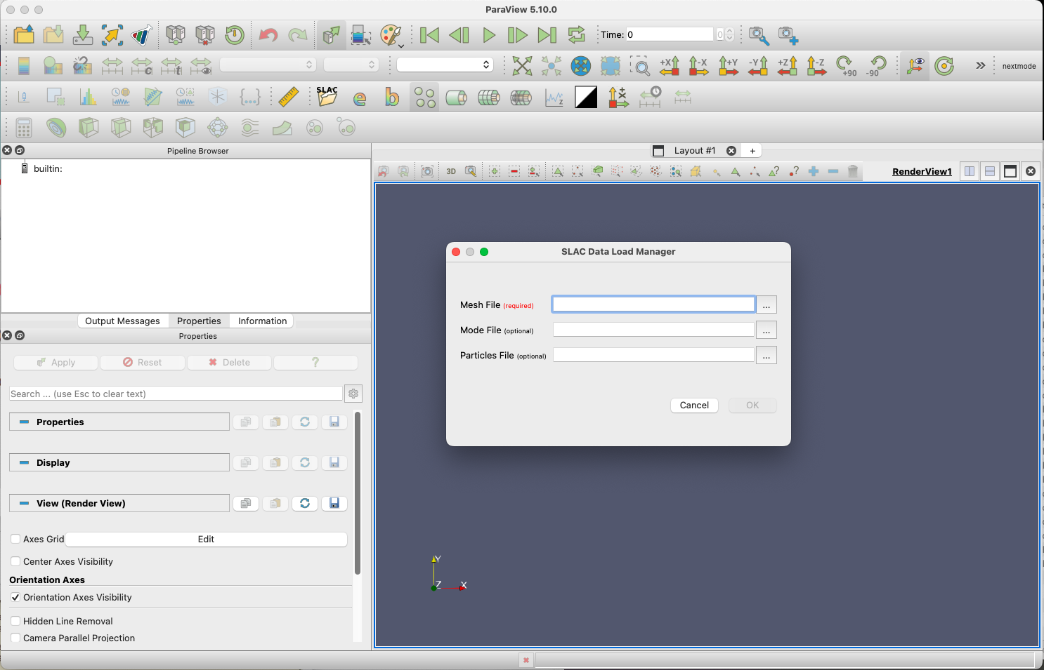
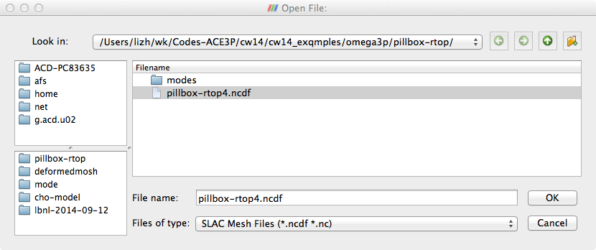
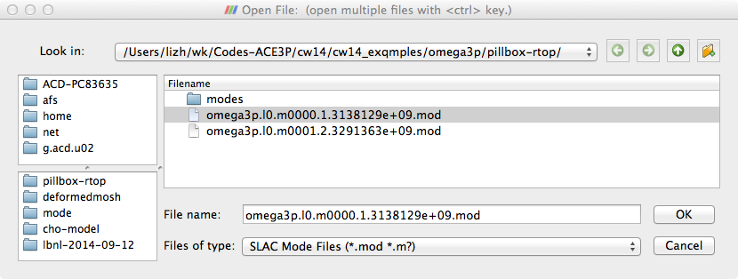
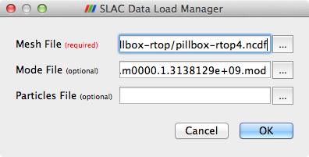
Load Mesh and Field Files Using SLAC Toolbar
Paraview: Field and Arrow plot

Slide 27
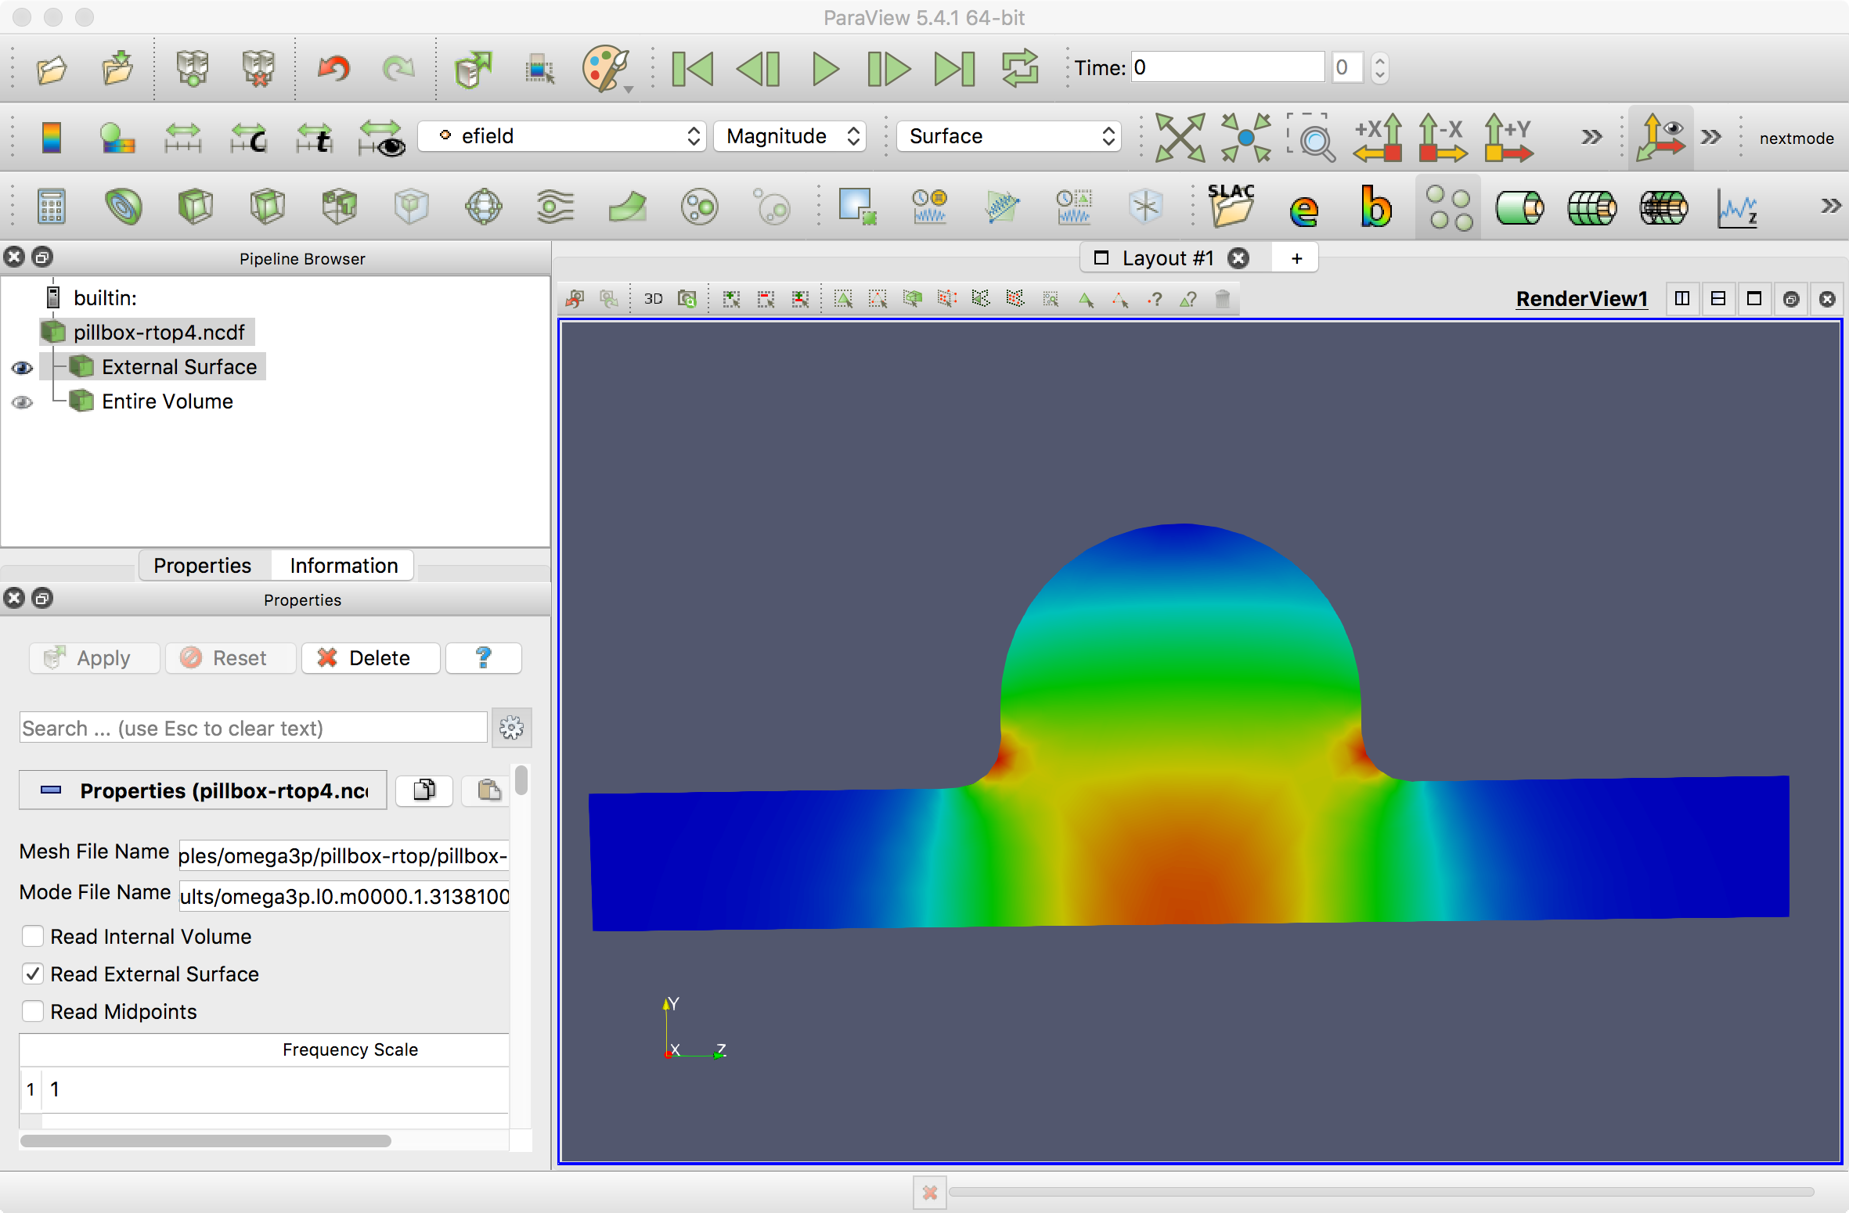
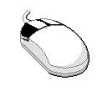
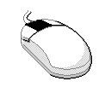
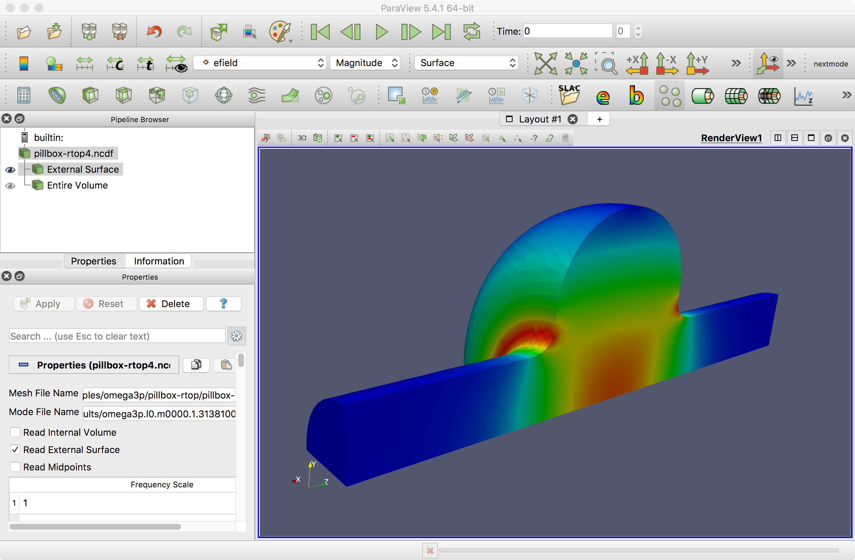
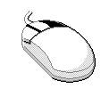
Field Plot – Electric field Contour
Left-button to Rotate
Mid-button to Pan
Right-button to Zoom

Slide 28
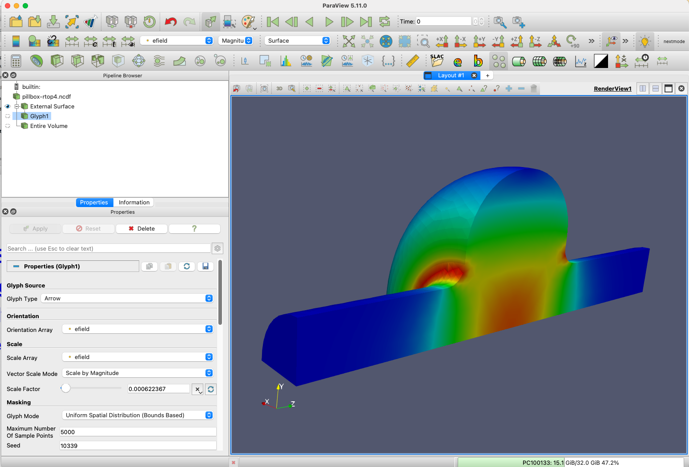
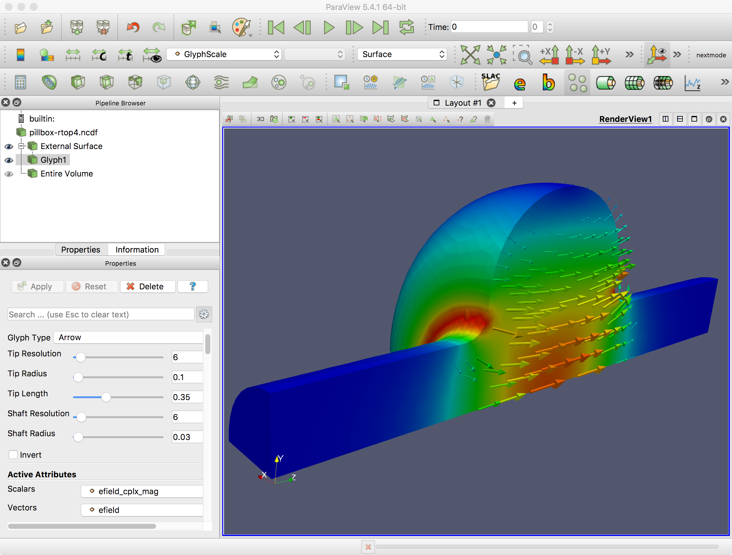
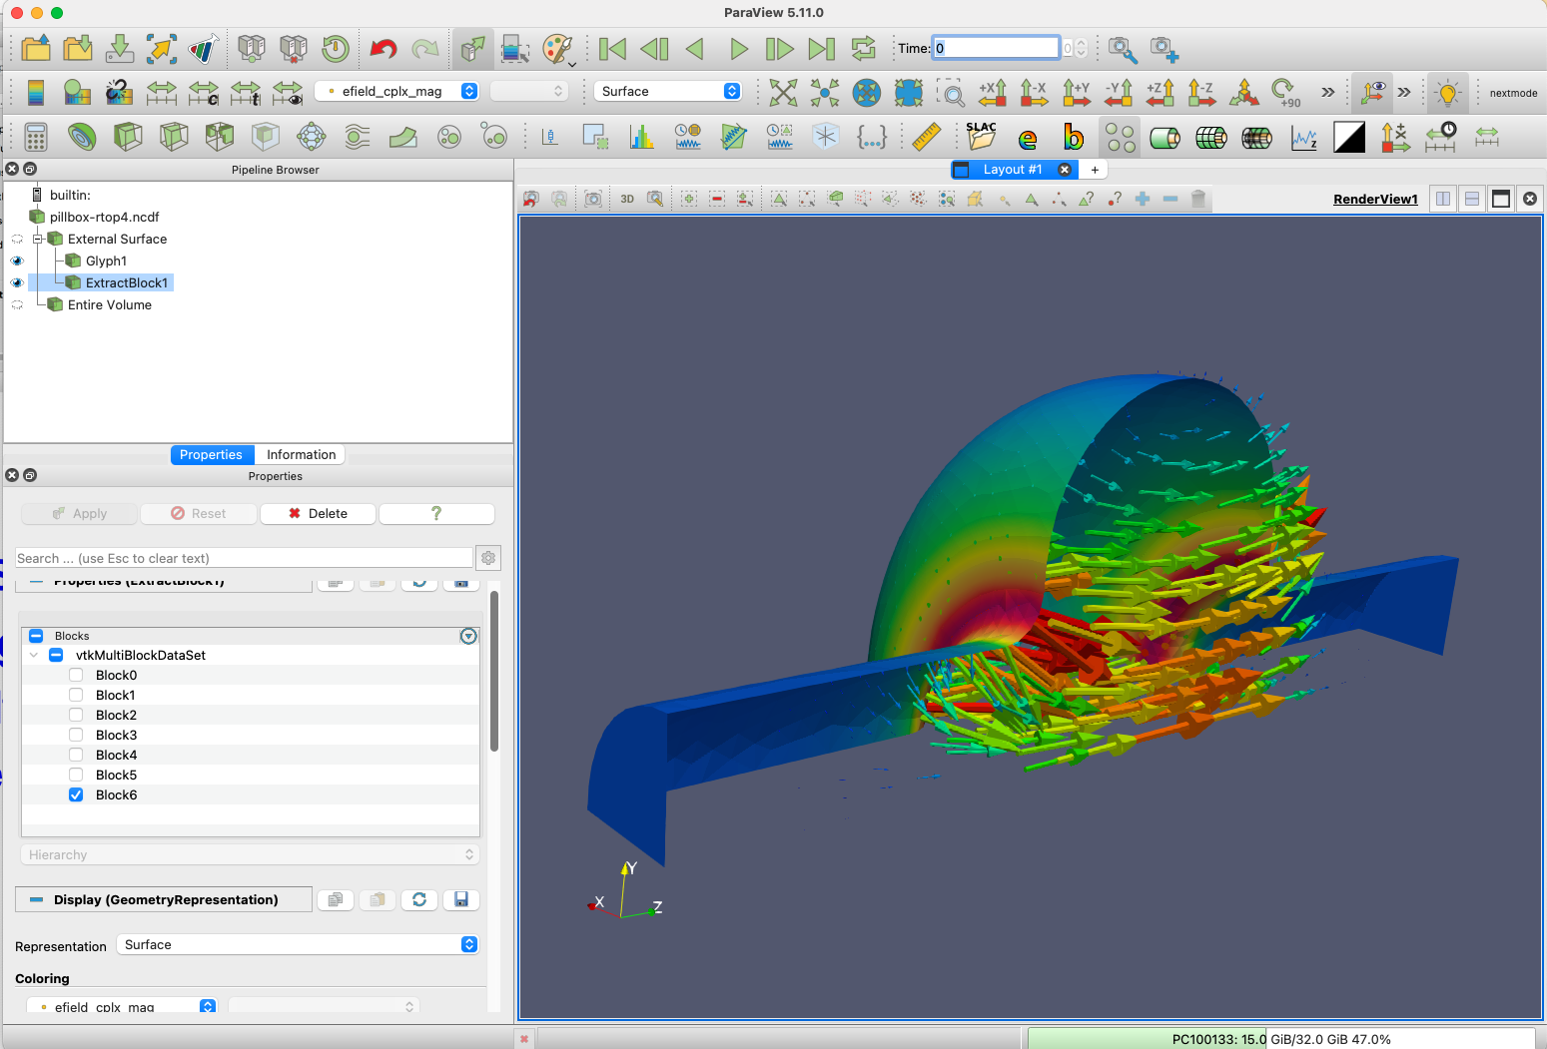
Arrow Plot
Filters -> Alphabetical -> Glyph
Select
  orientation array “efield” ->
  scale array “efield” ->
  Set scale factor
To see through the symmetry plane
  High light “External Surface”
  Filter -> Alphabetical -> Extract Block
  select “[DataSet 6]”

Slide 29
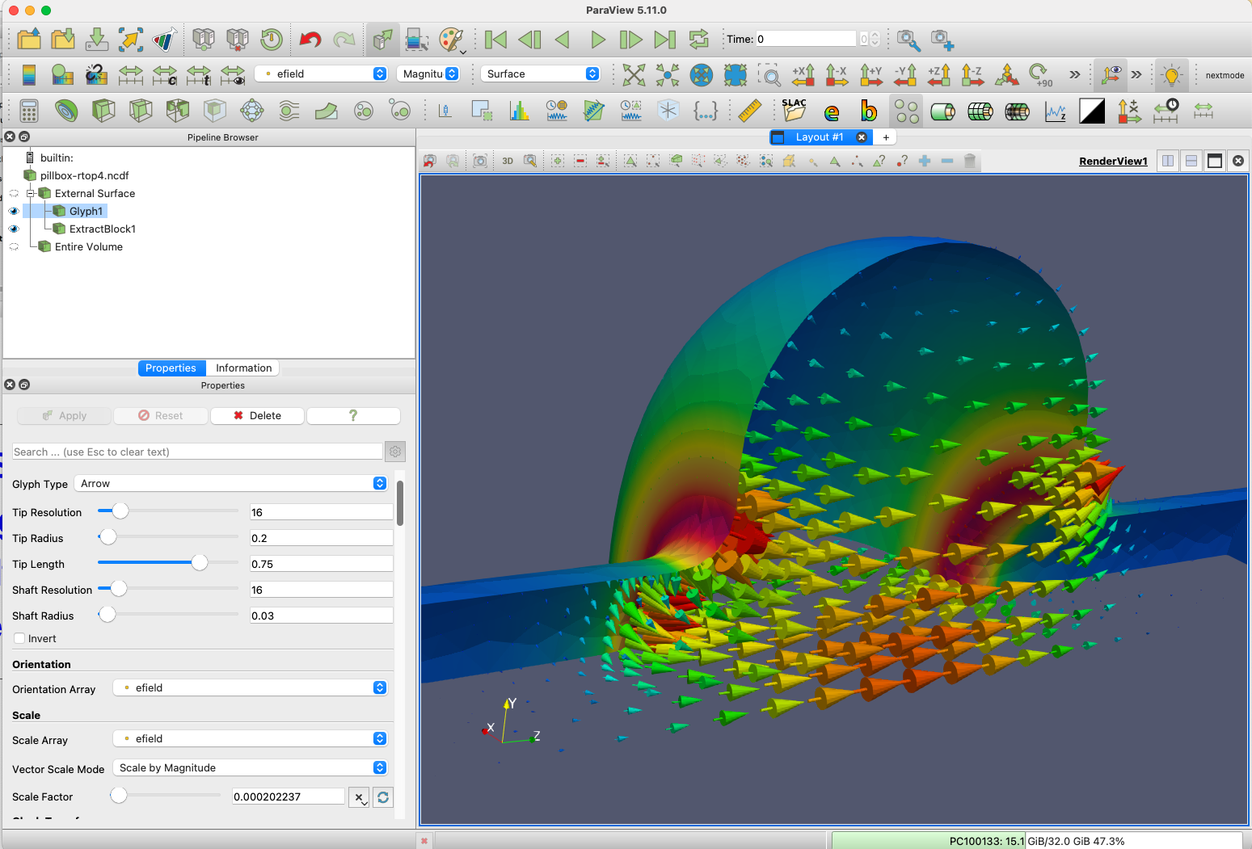
Use settings to fine tune the plot

Slide 30
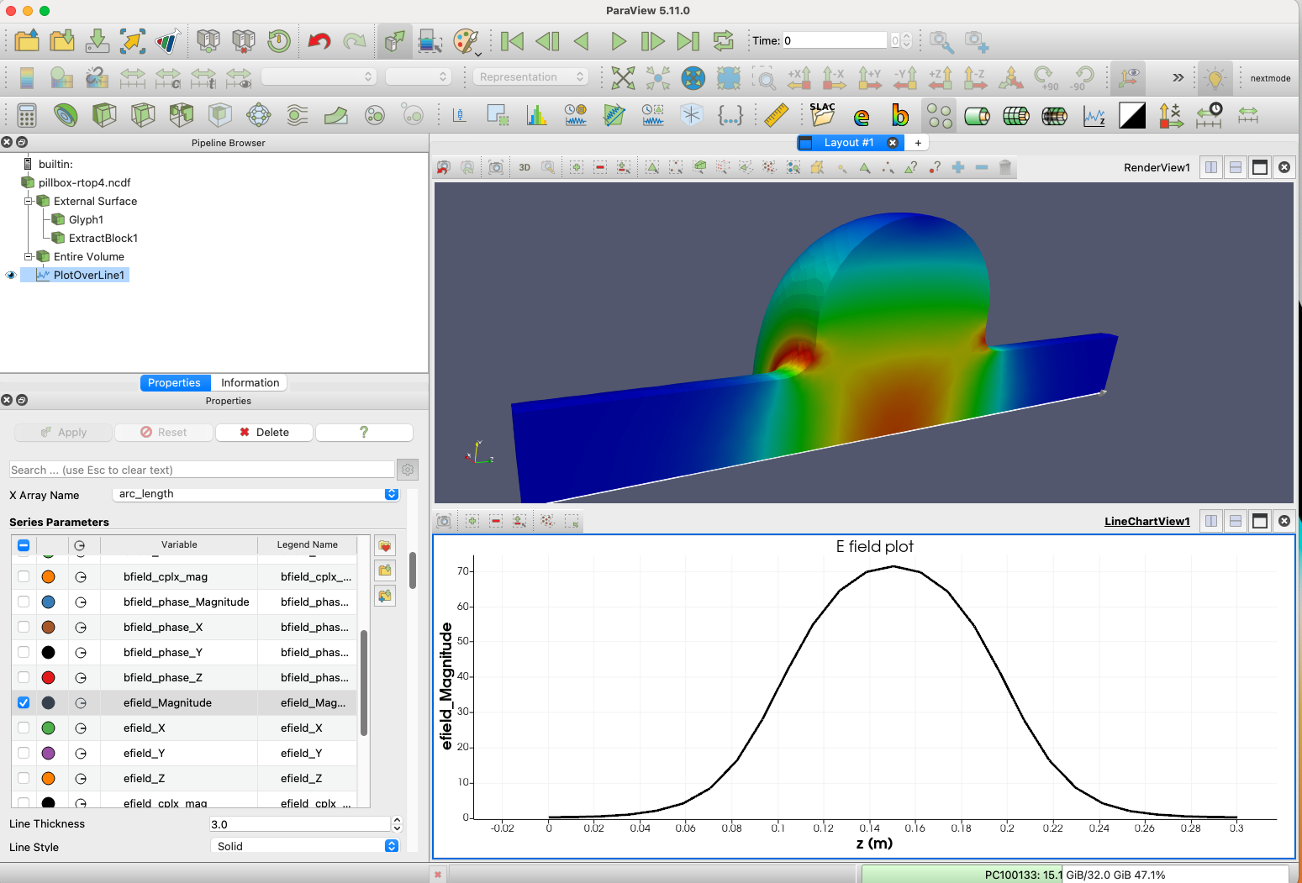
Line Plot
“Line plot”
button
One can arrange the layout of these plots
Select item to plot

Slide 31
Postprocessing Using ACDTOOL
Shunt impedance
Kick factor
Surface fields
Field map
…

Slide 32
Postprocess Using ACDTool
On NERSC machine, in the pillbox-rtop directory
$sbatch run –acdtool.batch
#!/bin/bash -l
#SBATCH -C cpu
###SBATCH -q debug
#SBATCH -q shared
#SBATCH -A m349
#SBATCH -N 1
#SBATCH -t 00:10:00
#SBATCH -J dump
#SBATCH -e myjob.%j.err
#SBATCH -o myjob.%j.out
export DIR=$PWD
cd $DIR
srun -n 1 -c 1 --cpu-bind=cores /global/cfs/cdirs/ace3p/perlmutter/CPU/acdtool postprocess rf pillbox-rtop.rfpost

Slide 33
ACDTOOL usage
(in the sbatch script)
srun -n 1 -c 1 --cpu-bind=cores /global/cfs/cdirs/ace3p/perlmutter/CPU/acdtool postprocess rf
    produce a “sample.rfpost” file containing inputs for all functions
    Modify and rename it to pillbox-rtop.rfpost
srun -n 1 -c 1 --cpu-bind=cores /global/cfs/cdirs/ace3p/perlmutter/CPU/ /acdtool postprocess rf pillbox-rtop.rfpost
  perform calculations specified in “pillbox-rtop.rfpost”

Slide 34
Sample.rfpost (see details next)
RFField
{
ResultDir = omega3p_results
ModeID = 0
xsymmetry = none // [none, electric, magnetic]
ysymmetry = none // [none, electric, magnetic]
gradient = -1
cavityBeta = 1.00000 //for R/Q, V integral
reversePowerFlow= 0 // [1=charging 0=decaying]
x0 = 0.00000
y0 = 0.00000
gz1 = -0.057
gz2 = 0.057
npoint = 300
fmnx = 10
fmny = 10
fmnz = 50
}
RoverQ
{
ionoff = 1
modeID1 = -1
modeID2 = -1
x1 = 0.00000
x2 = 0.00000
y1 = 0.00100
y2 = 0.00100
z1 = 100000000.00000
z2 = 100000000.00000
}
RoverQT
{
ionoff = 0
modeID1 = -1
modeID2 = -1
x0 = 0.00000
y0 = 0.00000
z1 = 100000000.00000
z2 = 100000000.00000
}
kickFactor
{
ionoff = 0
modeID1 = -1
modeID2 = -1
x0 = 0.00000
y0 = 0.00000
z1 = 100000000.00000
z2 = 100000000.00000
}
FieldMap
{
ionoff = 0
nx = 20
ny = 20
nz = 50
x1 = 0.00000
x2 = 0.00000
y1 = 0.00100
y2 = 0.00100
z1 = 100000000.00000
z2 = 100000000.00000
}
FieldAtPoint
{
ionoff = 0
x0 = 0.00000
y0 = 0.00000
z0 = 0.00000
}
ALLFieldAtPoint
{
ionoff = 0
modeID1 = -1
modeID2 = -1
x0 = 0.00000
y0 = 0.00000
z0 = 0.00000
}
FieldOnLine
{
ionoff = 0
npoint = 300
filename = filename1
rfphase = 0.00000
x1 = 0.00000
x2 = 0.00000
y1 = 0.00100
y2 = 0.00100
z1 = 100000000.00000
z2 = 100000000.00000
}
ALLFieldOnLine
{
ionoff = 0
modeID1 = -1
modeID2 = -1
npoint = 300
filename = filename1
rfphase = 0.00000
x1 = 0.00000
x2 = 0.00000
y1 = 0.00100
y2 = 0.00100
z1 = 100000000.00000
z2 = 100000000.00000
}
fieldOn2DBoundary
{
ionoff = 0
filename = filename1
surfaceID = 6
}
fieldOnSurface
{
ionoff = 0
filename = filename1
surfaceID = 6
output = amplitude // [component, amplitude]
}
maxFieldsOnSurface
{
ionoff = 1
surfaceID = 6
}
…

Slide 35
ACDTOOL Postprocess RF Functions
RoverQ
RoverQT
kickFactor
FieldMap
FieldAtPoint
ALLFieldAtPoint
FieldOnLine
ALLFieldOnLine
fieldOn2DBoundary
fieldOnSurface
maxFieldsOnSurface
Multipole field analysis
….

Slide 36
Sample.rfpost in detail
RFField
{
ResultDir = omega3p_results
FreqScanID = 0 // For S3P only: frequency scan index
ModeID = 0
xsymmetry = magnetic // [none, electric, magnetic]
ysymmetry = magnetic // [none, electric, magnetic]
gradient = -1 //20e7
cavityBeta = 1.00000 //for R/Q, V integral
reversePowerFlow= 0 // [1=charging 0=decaying]
x0 = 0.00000
y0 = 0.00000
gz1 = -0.057
gz2 = 0.057
npoint = 300
fmnx = 10
fmny = 10
fmnz = 50
}
RFField
  Mode information
  Always be the first input

Slide 37
Shunt Impedance & Kickfactor
RoverQ
{
ionoff = 1
modeID1 = -1
modeID2 = -1
x1 = 0.00000
x2 = 0.00000
y1 = 0.00100
y2 = 0.00100
z1 = 100000000.00000
z2 = 100000000.00000
}
RoverQT
{
ionoff = 0
modeID1 = -1
modeID2 = -1
x0 = 0.00000
y0 = 0.00000
z1 = 100000000.00000
z2 = 100000000.00000
}
kickFactor
{
ionoff = 0
modeID1 = -1
modeID2 = -1
x0 = 0.00000
y0 = 0.00000
z1 = 100000000.00000
z2 = 100000000.00000
}

Slide 38
Field Map
FieldMap
{
ionoff = 0
nx = 20
ny = 20
nz = 50
x1 = 0.00000
x2 = 0.00000
y1 = 0.00100
y2 = 0.00100
z1 = 100000000.00000
z2 = 100000000.00000
}
FieldAtPoint
{
ionoff = 0
x0 = 0.00000
y0 = 0.00000
z0 = 0.00000
}
ALLFieldAtPoint
{
ionoff = 0
modeID1 = -1
modeID2 = -1
x0 = 0.00000
y0 = 0.00000
z0 = 0.00000
}

Slide 39
Field on a line
FieldOnLine
{
ionoff = 0
npoint = 300
filename = filename1
rfphase = 0.00000
x1 = 0.00000
x2 = 0.00000
y1 = 0.00100
y2 = 0.00100
z1 = 100000000.00000
z2 = 100000000.00000
}
ALLFieldOnLine
{
ionoff = 0
modeID1 = -1
modeID2 = -1
npoint = 300
filename = filename1
rfphase = 0.00000
x1 = 0.00000
x2 = 0.00000
y1 = 0.00100
y2 = 0.00100
z1 = 100000000.00000
z2 = 100000000.00000
}

Slide 40
Field on a Surface
fieldOn2DBoundary
{
ionoff = 0
filename = filename1
surfaceID = 6
}
fieldOnSurface
{
ionoff = 0
filename = filename1
surfaceID = 6
output = amplitude // [component, amplitude]
}
maxFieldsOnSurface
{
ionoff = 1
surfaceID = 6
}

Slide 41
Postprocess Output
***************************** Omega3P/S3P Mode Summary ************************************
** Omega3P/S3P Mode Summary:
**
** Total number of modes : 2
** ModeID Frequency(r,i) Qext
** 0 1.31381e+09, 0.00000e+00 0.00000e+00
** 1 2.32914e+09, 0.00000e+00 0.00000e+00
**
** Model bounding box: ( 0.00000e+00, 0.00000e+00 -1.50000e-01)
** ( 1.00005e-01, 1.00123e-01 1.50000e-01)
**
** ------------
** Mode used:
** ModeID = 0
** Frequency = 1.31381e+09, 0.00000e+00
***************************************************************************************
[scaling]
{
ModeID: 0
Integral: x0 = 0.0000e+00, y0 = 0.0000e+00
gz1 =-5.7000e-02, gz2 = 5.7000e-02
V =(-6.0358e-03, -4.5814e+00) (normalized field)
ga = 4.01881e+01 (normalized field)
E,B m_factor = 4.97660e+05
}

Slide 42
Output – R/Q & surface field
RoverQ
{
ionoff = 1
modeID1 = -1
modeID2 = -1
x1 = 0.00000
x2 = 0.00000
y1 = 0.00100
y2 = 0.00100
z1 = -0.15000
z2 = 0.15000
}
[RoverQ]
{ // RoverQ=V^2/(omega*U)
Integral: x1 = 0.0000e+00, y1 = 1.0000e-03, z1 =-1.5000e-01
x2 = 0.0000e+00, y2 = 1.0000e-03, z2 = 1.5000e-01
ModeID Frequency (V_r, V_i) |V| RoQ(ohm/cavity)
0 1.31381e+09 ( 2.2980e+00, 3.4925e+00) 4.18073e+00 1.19567e+02
1 2.32914e+09 (-7.2671e-04, 6.2729e-04) 9.59998e-04 3.55621e-06
}
maxFieldsOnSurface
{
ionoff = 1
surfaceID = 6
}
[maxFieldsOnSurface]
{
surfaceID : 6
ModeID : 0
Emax : 4.22488e+07 (V.m) at ( 3.9627e-02, 1.8486e-02, -4.5454e-02)
Hmax : 5.80786e+04 (A/m) at ( 3.3116e-02, 7.9193e-02, 3.2771e-02)
}
Surface field value corresponds to gradient specified in RFField

Slide 43
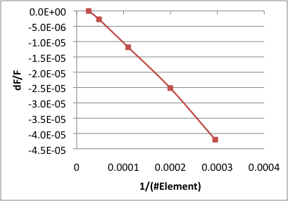
Omega3P Practice – 1 : Convergence Study
Refine the mesh to study convergence
  Sample meshing files (with different mesh levels – uniform refinement)
  Mesh0.jou, mesh1.jou, mesh2.jou, mesh3.jou, mesh4.jou
Run all the mesh levels and plot dF/F₀ vs #elements (assuming F0=F_level4)

Slide 44
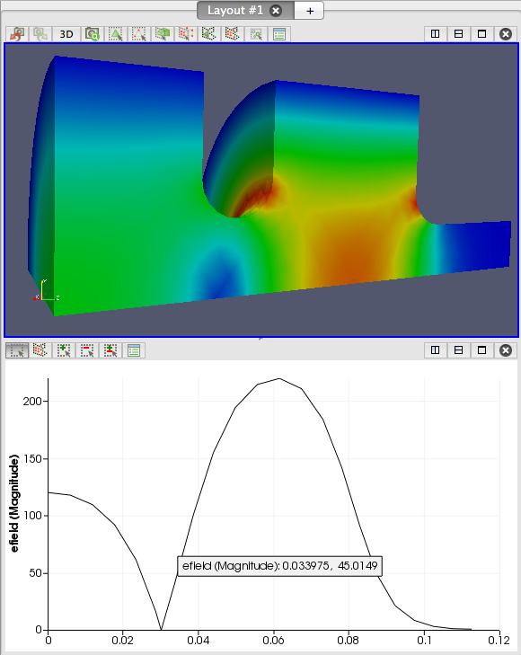
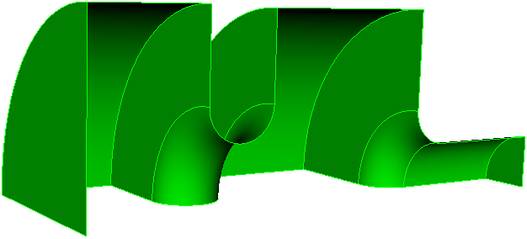
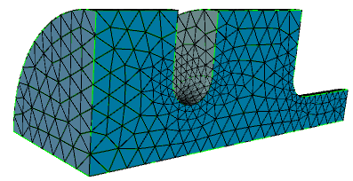
Omega3P – exercise 1
File directory: omega3p/omega3p-exercise-1
1.5 gun exercise
  Dimensions given
  Build model
  Adjusting dimensions to get the right frequency and field balance
Adjust cell dimensions to make pi-mode field flat

Slide 45
Omega3P Tutorials
pillbox-rtop+coax
SLAC CW23 3/27-31/2023

Slide 46
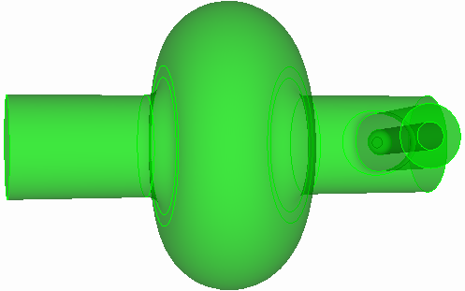
Omega3P example - 2
Add coax coupler to the rounded pillbox cavity
Coax inner conductor radius: 8.7 mm
Outer conductor radius: 20.0 mm
At z location 100 mm
Inner conductor tip 30 mm from the beam axis
Round the inner conductor tip with 5 mm radius
Round the outer conductor and beampipe connection with 7 mm radius
Set ID for the “Port” surface

Slide 47
Omega3P Practice – 2: File dir: pillbox-rtop+coax
Steps:
Build pillbox-rtop model
  step1-Make-pillbox-rtop.jou
Add coax to the pillbox-rtop model
  step2-ADD-coax.jou
Mesh with pillbox-rtop+coax
  step3-Mesh-pillbox-rtop+coax.jou
  Remember to define sideset for the port surface
Convert and check mesh
  acdtool meshconvert pillbox-rtop+coax
Run omega3p
  omega3p pillbox-rtop+coax
Postprocessing – paraview and “acdtool postprocess rf”
TIP:
build complex models in multi-steps

Slide 48
Step1-Make-pillbox-rtop.jou
reset
#{cav_length = 90}
#{cav_radius = 100}
#{bp_length = 300}
#{bp_radius = 35 }
#{iris_rounding = 12}
create Cylinder height {cav_length} radius {cav_radius}
create Cylinder height {bp_length} radius {bp_radius}
unite volume all
compress ids
modify curve 6 5 blend radius {iris_rounding}
modify curve 1 2 blend radius 45
export acis "pillbox-rtop0.sat" overwrite
webcut volume 1 with plane xplane offset 0 noimprint nomerge
delete volume 2
compress ids
webcut volume 1 with plane yplane offset 0 noimprint nomerge
delete volume 1
compress ids
export acis "pillbox-rtop4.sat" overwrite

Slide 49
step2-ADD-coax.jou
reset
create Cylinder height 120 radius 20
create Cylinder height 120 radius 8.7
body 1 2 rotate 90 about y
body 1 2 move -60 0 100
body 2 move -30 0 0
import acis "pillbox-rtop0.sat”
unite body 1 3
compress ids
subtract body 2 from 1
compress ids
modify curve 10 blend radius 7
modify curve 12 blend radius 5
export acis "pillbox-rtop+coax.sat" overwrite
webcut volume 1 with plane yplane offset 0
delete body 1
compress ids
export acis "pillbox-rtop+coax2.sat" overwrite

Slide 50
step3-Mesh-pillbox-rtop+coax.jou
reset
import acis "pillbox-rtop+coax2.sat”
volume all scheme Tetmesh
volume all sizing function type skeleton scale 7 time_accuracy_level 2 min_size auto max_size 15 max_gradient 1.5
mesh volume all
Sideset 2 surface 1
Sideset 3 surface 3
Sideset 4 surface 2
Sideset 7 surface 17
Sideset 6 surface all except 1 3 2 17
block 1 volume all
block 1 element type tetra10
volume all scale 0.001
export Genesis "pillbox-rtop+coax2.gen" block all overwrite

Slide 51
Omega3P Input with Port
ModelInfo : {
File: ./pillbox-rtop+coax2.ncdf
BoundaryCondition : {
Magnetic: 2
Electric: 3, 4
Exterior: 6
Waveguide: 7
}
SurfaceMaterial : {
ReferenceNumber: 6
Sigma: 5.8e7
}
}
FiniteElement: {
Order: 2
CurvedSurfaces: on
Tolerance: 1e-7
}
EigenSolver : {
NumEigenvalues: 1
FrequencyShift: 1.0e9
}
Port : {
ReferenceNumber : 7
NumberOfModes : 1
}
PostProcess : {
Toggle: on
ModeFile: mode
}

Slide 52
Omega3P Practice – 2: Solve and postprocess
Steps:
Copy mesh “.gen” file to NERSC computer
Convert and check mesh
$sbatch run-meshconvert.batch
  (will run “acdtool meshconvert pillbox-rtop+coax.gen”)
Run omega3p
$sbatch run-omega3p.batch
  (will run “omega3p pillbox-rtop+coax.omega3p”)
Postprocessing
  Paraview (copy mesh and .mod files back to laptop)
  Postprocess
  $sbatch run-acdtool.batch
  (will run “acdtool postprocess rf pillbox-rtop+coax.rfpost”)

Slide 53
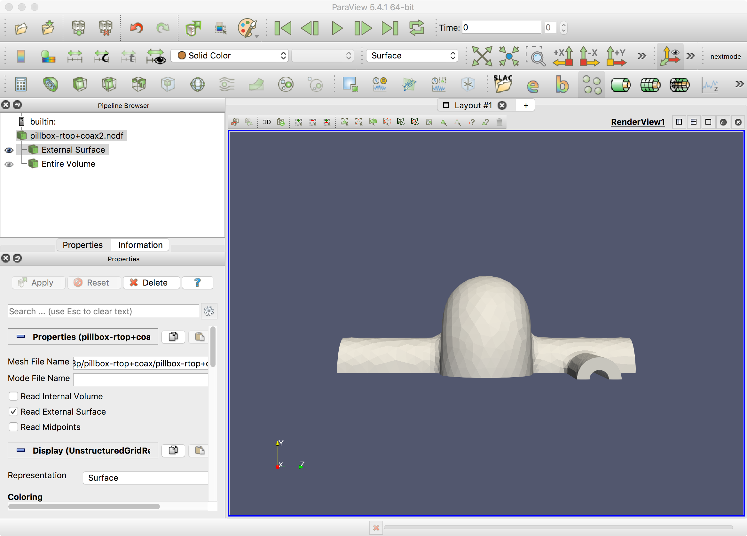
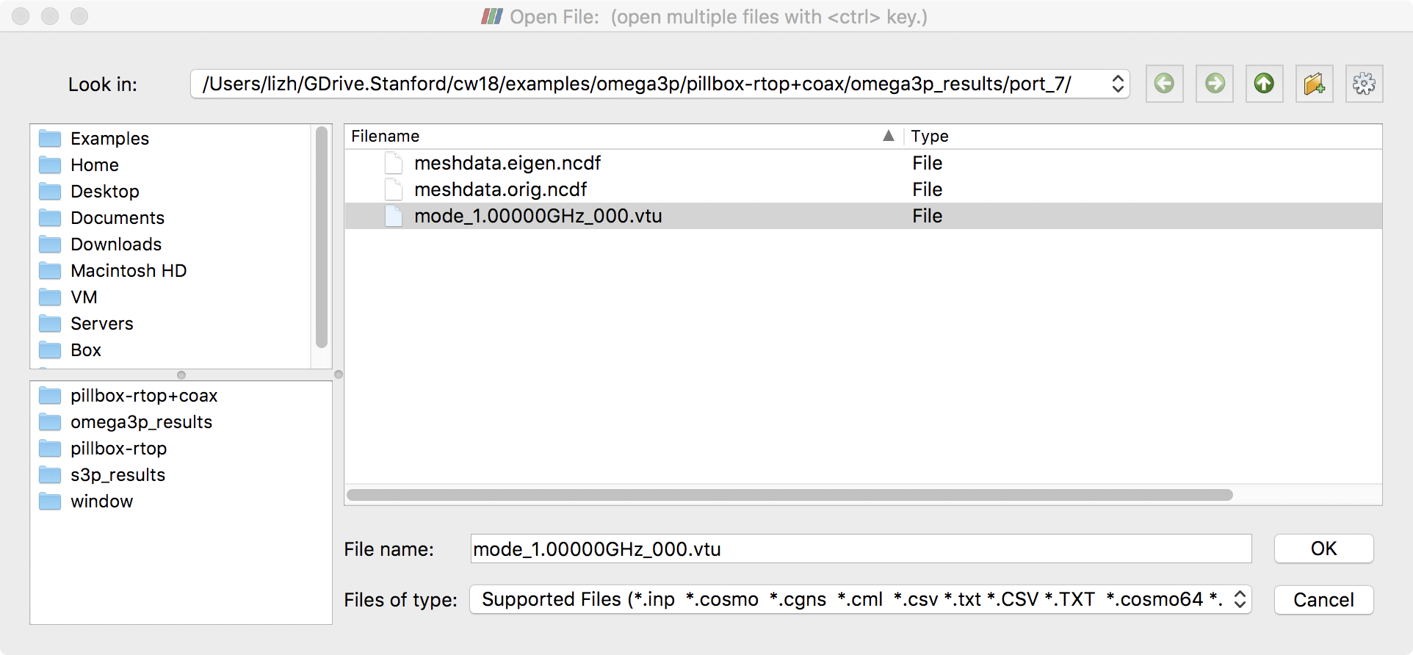
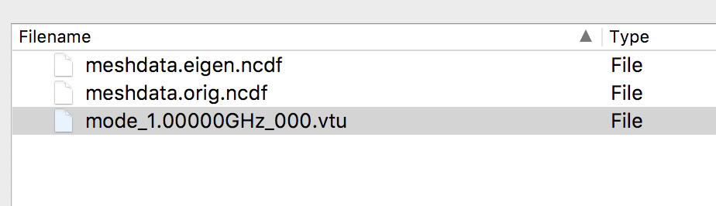
Paraview: Visualize 2D port mode
1. Load the 3D mesh from the SLAC toolbar
2. Load the 2D port mode (.vtu file)
File->open -> Omega3p_results -> port7
-> mode_1.00000GHz_000.vtu
-> OK - Apply

Slide 54
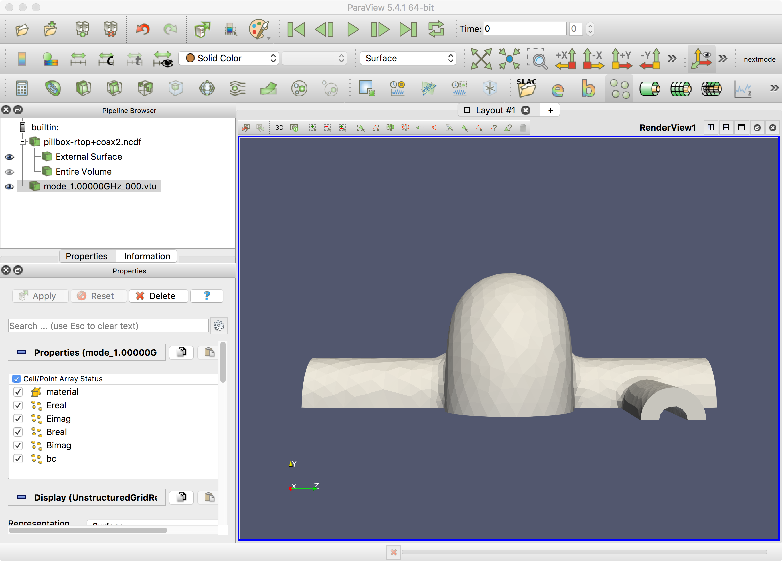
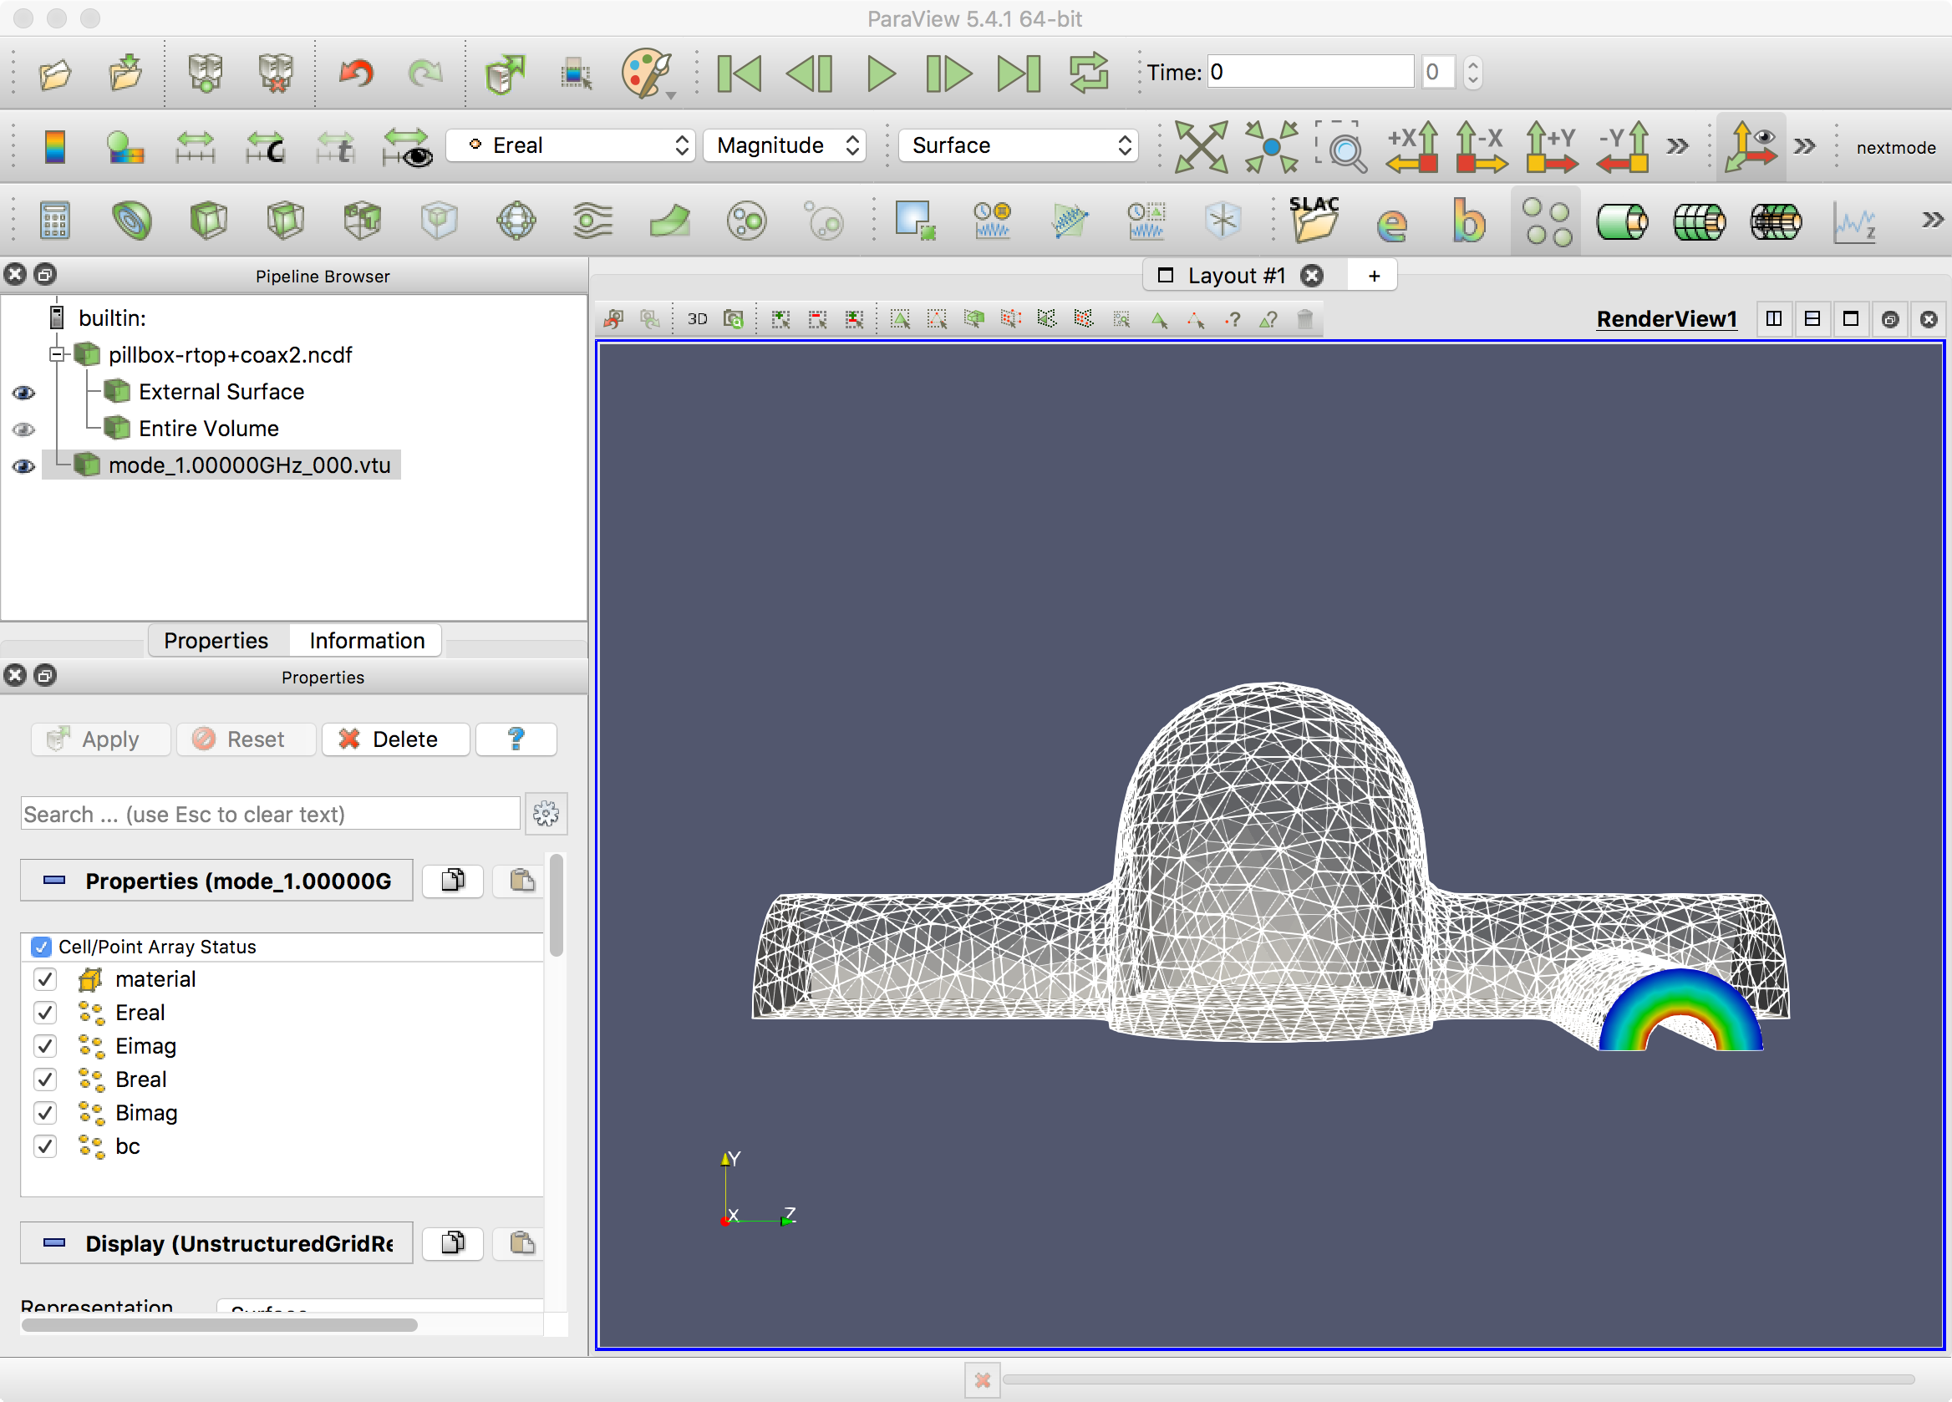
Display 2D Port Mode on 3D model
1
Select “Ereal”
Switch to wireframe mode (if do not see the field)
2

Slide 55

Omega3P – Practice – 3
File dir: pillbox+recWG
Run step1 to make pillbox model
Create “step2-ADD-recWG-to-pillbox.jou” file to add waveguide coupler to the pillbox cavity
165X90
250
60
R6.5
15
calculate

Slide 56
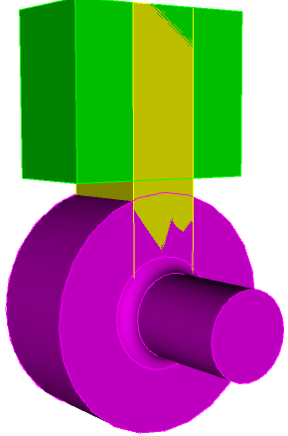

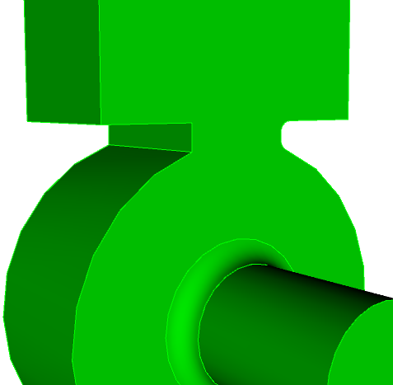
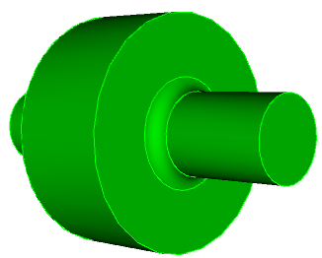
Model Steps
Pillbox cavity
Add coupler blocks
Unite all
Round iris corners
Webcut
1/4
model

Slide 57
Practice 3 – step1-Make-pillbox.jou
reset
#{cav_length = 90}
#{cav_radius = 100}
#{bp_length = 300}
#{bp_radius = 35 }
#{iris_rounding = 12}
create Cylinder height {cav_length} radius {cav_radius}
create Cylinder height {bp_length} radius {bp_radius}
unite volume all
compress ids
modify curve 6 5 blend radius {iris_rounding}
export acis “pillbox0.sat" overwrite

Slide 58
Practice 3 – step2-ADD-recWG-to-pillbox.jou (1)
reset
#{cav_radius = 100}
#{wguide = 165.0 }
#{hguide = 90.0 }
#{lguide = 250}
#{wiris = 60 }
#{diris = 15}
#{rround = 6.5 }
#{sth = 0.5*wiris/cav_radius}
#{cth = sqrt(1.0 - sth*sth)}
#{rguide = cth*cav_radius + diris}
brick x {wguide} y {lguide-rguide} z {hguide}
body 1 move 0 {0.5*(lguide-rguide)+rguide} 0
brick x {wiris} y {lguide} z {hguide}
body 2 move 0 {0.5*lguide} 0

Slide 59
Practice 3 – step2-ADD-recWG-to-pillbox.jou (2)
import acis “pillbox0.sat”
unite all
compress ids
modify curve 30 17 blend radius {rround}
webcut volume 1 with plane yplane offset 0 noimprint nomerge
delete volume 1
compress ids
webcut volume 1 with plane xplane offset 0 noimprint nomerge
delete volume 2
compress ids
export acis “pillbox+recWG4.sat" overwrite

Slide 60
Practice 3 – step3-Mesh-pillbox+recWG4.jou
reset
import acis “pillbox+recWG4.sat"
volume all scheme Tetmesh
volume all sizing function type skeleton scale 7 time_accuracy_level 2 min_size auto max_size 12 max_gradient 1.2
mesh volume all
Sideset 1 surface 1
Sideset 2 surface 7
Sideset 3 surface 2
Sideset 4 surface 8
Sideset 7 surface 6
Sideset 6 surface all except 1 7 2 8 6
block 1 volume all
block 1 element type tetra10
volume all scale 0.001
export Genesis “pillbox+recWG4.gen" block all overwrite

Slide 61
Practice 3 – pillbox-recWG4.omega3p (1)
ModelInfo : {
File: ./pillbox+recWG4.ncdf
BoundaryCondition : {
Magnetic: 1, 2
Electric: 3, 4
Exterior: 6
Waveguide: 7
}
SurfaceMaterial : {
ReferenceNumber: 6
Sigma: 5.8e7
}
}
FiniteElement: {
Order: 1
CurvedSurfaces: on
}
EigenSolver : {
NumEigenvalues: 1
FrequencyShift: 0.9e9
}
PostProcess : {
Toggle: on
ModeFile: mode
}
// if no Port specified here,
// will use 1 port mode for default
/*
Port : {
ReferenceNumber : 7
NumberOfModes : 1
}
*/

Slide 62
Practice 3 – More on Open port specification
BoundaryCondition : {
Magnetic: 1, 2
Electric: 3, 4
Exterior: 6
Waveguide: 7
}
Port : {
ReferenceNumber : 7
NumberOfModes : 1
}
// if no Port specified
// will use 1 port mode as default
BoundaryCondition : {
Magnetic: 1, 2
Electric: 3, 4
Exterior: 6
Absorbing: 7
}
// 1D absorbing boundary (ABC)
// 1) no Port specified: vp=c
// 2) ABC with a finite cutoff frequency
Port : {
ReferenceNumber : 7
CutoffFrequency : 1e9
}

Slide 63
Practice 3 – Omega3p Results
----------------------------------------------------------
Iteration: 12
Solving Projected System...
Linear Solver Preparation Time: 59.47317409515381 Solver Time: 0
==========================================================
COMMIT MODE: 0 FREQ = (1162083595.933087,1668914.182504398) k = (24.35547119628069,0.03497785481466404) Q = 348.1555876615675
Memory usage:
used mem per MPI process: min: 213 MB, max: 213 MB, avg: 213 MB, stddev: 0 MB, total: 213 MB
used mem per node in GB : min: 4.97 GB, max: 4.97 GB, avg: 4.97 GB, stddev: 0 GB, total: 4.97 GB
used mem per node in % : min: 40.7 %, max: 40.7 %, avg: 40.7 %, stddev: 0 %

Slide 64
Important TIPs !!!
When using multi ports
I) To be solved as quadratic eigenvalue problem
one mode per port
all port have the same cutoff
ModelInfo : {
File: ./pillbox+recWG4.ncdf
BoundaryCondition : {
Magnetic: 1
Electric: 2
// Electric: 3, 4
Exterior: 6
Waveguide: 7 3 4
// Absorbing: 7 3 4
}
II) In case need to use multi-port with different cutoff frequencies
use simple 1D absorbing boundary (ABC) – this is an approximation
use PML – a good approximation
use non-linear eigenvalue solver – solve accurately, but hard to solve

Slide 65
Non-linear Eigensolver Parameters
SolverMode: CORK
Invokes the non-linear eigenvalue solver CORK.
TargetFrequencyMin: The minimal frequency of the search region
TargetFrequencyMax: The maximum frequency of the search region
TargetFrequencyImag: The maximum of the imaginary component of the frequency
MaxIterations: Maximum iterations for the non-linear iteration
ApproxTolerance: Tolerance of the non-linear solver
ApproxMaxDegree: Max degree of polynomial interpolation
OneRKSShift:
EigenSolver : {
NumEigenvalues: 10
Tolerance: 1e-10
FrequencyShift: 2.4e9
SolverMode: CORK
CORK : {
TargetFrequencyMin: 2.4e9
TargetFrequencyMax: 2.8e9
TargetFrequencyImag: 0.100e9
MaxIterations: 500
ApproxTolerance: 1e-12
ApproxMaxDegree: 28
OneRKSShift: 1
}

Slide 66
Omega3P – Practice 3 – Hands on
Change “wiris” in “step2-ADD-recWG-to-pillbox.jou”
Regenerate & mesh the coupler model
Run omega3p to obtain Qext
Find “wiris” such that Qext ~ 4000
165X90
250
“wiris”
60
R6.5
15
calculate

Slide 67


Omega3P – practice 4 - with load
File dir: pillbox+recWG+load
Run: step1-Make-pillbox.jou & step2-ADD-recWG-to-pillbox.jou
to build pillbox+recWG4.sat
Run: step3-ADD-load.jou
webcut at y=200 to 2 volumes, one will be the load

Slide 68
Omega3P – with load – Mesh (1)
“imprint, merge”
The interface surfaces between volumes become ONE single surface
Reset
import acis “pillbox+recWG+load.sat”
imprint body 1 2
merge body 1 2
volume all scheme Tetmesh
volume 1 sizing function type skeleton scale 7 time_accuracy_level 2 min_size auto max_size 15 max_gradient 1.2
volume 2 sizing function type skeleton scale 7 time_accuracy_level 2 min_size auto max_size 10 max_gradient 1.2
mesh volume all

Slide 69
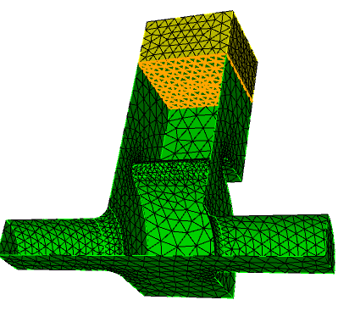
Omega3P – with load – Mesh (2)
Sideset 1 surface 4 20
Sideset 2 surface 9
Sideset 6 surface all except 4 20 9 1
block 1 volume 1
block 2 volume 2
block all element type tetra10
volume all scale 0.001
export Genesis “pillbox+recWG+load.gen" block all overwrite
Check if the interface surface a single surface

Slide 70
Omega3P – with load - Input
ModelInfo : {
File: ./pillbox+recWG+load.ncdf
BoundaryCondition : {
Magnetic: 1, 2
Exterior: 6
}
Material : {
Attribute: 1
Epsilon: 1.0
Mu: 1.0
}
Material : {
Attribute: 2
Epsilon: 10.0
EpsilonImag: -1.52
Mu: 1.0
}
SurfaceMaterial : {
ReferenceNumber: 6
Sigma: 5.8e7
}
}
FiniteElement: {
Order: 1
CurvedSurfaces: on
}
EigenSolver : {
NumEigenvalues: 2
FrequencyShift: 1.1e9
}
/*
PostProcess : {
Toggle: on
Compute Total Energy: 1
ModeFile: mode
}
*/

Slide 71
Omega3P – with load - result
Number of converged eigenpairs = 2
Eigenvalue: (591.2395988707802,0.1200579050951992)
Frequency: (1160172571.152617,117793.09714004)
Residual: 9.072339764288597e-12
**********************************************************
Total number of OP*x operations: 93
Total number of B*x operations if BMAT='G': 273
Total number of steps of re-orthogonalization: 61
**********************************************************
Eigenvalue: (600.8495902547749,90.41431550096833)
Frequency: (1172850486.101091,87749817.12126675)
Residual: 2.109758200395918e-10
**********************************************************
Total number of OP*x operations: 93
Total number of B*x operations if BMAT='G': 273
Total number of steps of re-orthogonalization: 61
**********************************************************
COMMIT MODE: 0 FREQ = (1160172571.152617,117793.09714004) k = (24.31541907855096,0.002468760762612236) Q = 4924.620369618644
COMMIT MODE: 1 FREQ = (1172850486.101091,87749817.12126675) k = (24.58112852788583,1.839100173907774) Q = 6.682922680512592

Slide 72


Omega3P – practice 5: PBC
Disk loaded waveguide structure
Build ¼ and 1/8 model of a disk loaded cell as shown bellow
File dir: dlwg-pbc
1/4 1/8
t/2=1.95062
11.10551
4.547
10.93431

Slide 73

Omega3P – PBC - MESH
The PBC boundary must have identical mesh !!!
slave
master
Mesh “master” first, then copy mesh to “slave”
(1 surface, 1 or 2 curves, 1 vertex)

Slide 74
Omega3P – PBC - MESH
reset
import acis "ds-cell-1fourth.sat"
volume 1 scheme tetmesh
volume 1 size 2.0
surface 5 6 size 1.
surface 9 size 1.
mesh surface 2
copy Mesh Surface 2 Onto Surface 4 source curve 10 target curve 17 source vertex 9 target vertex 10 Nosmoothing
mesh volume 1
##smooth vol 1
##smooth surface all except 5 7
……..

Slide 75
Omega3P – PBC - input
ModelInfo : {
File: ./pbc-4.ncdf
BoundaryCondition : {
HFormulation: 0
Exterior: 6
Magnetic: 2,1
Periodic_M: 3
Periodic_S: 4
Theta: -150
}
SurfaceMaterial: {
ReferenceNumber: 6
Sigma: 5.8e7
}
}
FiniteElement: {
Order: 2
CurvedSurfaces: on
}
EigenSolver : {
NumEigenvalues: 1
FrequencyShift: 1.10e9
}
/*
PostProcess : {
Toggle: on
Compute Total Energy: 1
ModeFile: mode
}
*/

Slide 76
Time to run all examples
Run omega3P practice examples
Mesh convergence
Paraview visualization
Acdtool postprocessing

