Slide 1
ACE3P/TEM3P – Multi-Physics
Stanford, March 27 – 31, 2023
Computational Electrodynamics Department
SLAC National Accelerator Laboratory

Slide 2
Multiphysics Design Process
Model
EM Analysis
Thermal Analysis
Structural Analysis
Mechanical Mode Analysis

Slide 3
TEM3P Capabilities
Integrated electromagnetic, thermal and mechanical effects
Conduction and convection boundary conditions
Non-linear thermal conductivity in near superconducting condition
Non-linear convection boundary condition for fluid-solid interface
Shell elements for surface coating
Thermal and mechanical transient effects
Lorenz force effects
Solving mechanical eigenmodes
Mechanical harmonic analysis
Electro-Mechanical interaction with external loads

Slide 4
TEM3P Examples (Thermal)
1. Static thermal elastic analysis – NC RF Gun Coupler Cell
Generate the meshes for RF Gun coupler cell vacuum and metal regions
Prepare Omega3P/TEM3P input files for EM/thermal/structural simulations
Run Omega3P/TEM3P on NERSC
Visualize Omega3P/TEM3P results in Paraview
2. Non-linear thermal conductivity & shell elements – SRF Coupler
Prepare S3P/TEM3P input files for EM and thermal simulations
Run S3P/TEM3P on NERSC
Visualize S3P/TEM3P results in Paraview

Slide 5
TEM3P Examples (Mechanical)
3. Lorentz force detuning - SRF cell
Generate the meshes for SRF cell vacuum and shell regions
Prepare Omega3P/TEM3P input files for EM and structural simulations
Run Omega3P/TEM3P on NERSC
Visualize Omega3P/TEM3P results in Paraview
4. Mechanical eigenmodes - TESLA cavity
Generate the meshes for TESLA cavity mechanical model
Prepare TEM3P input file for mechanical eigenmode simulation
Run TEM3P on NERSC
Visualize TEM3P results in Paraview

Slide 6
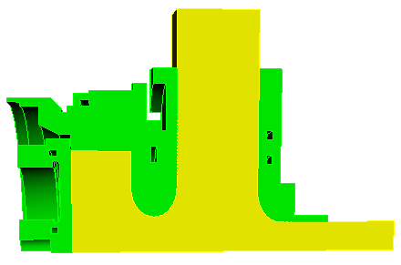
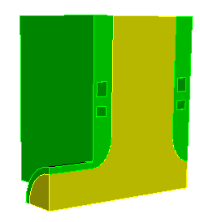
Example 1: RF Gun Coupler Cell
    Strong EM heating causes structural deformation to the cavity
    Frequency shift caused by structural deformation reduces operating efficiency
LCLS RF GUN
RfGun-CouplerCell.sat

Slide 7
Prepare Meshes and ACE3P Input Files
Go to working directory on local machine:
  Under “RfGun-Coupler” directory, check the following files:
  RfGun-CouplerCell.sat, mesh-RfGunVacuum.jou, mesh-RfGunBody.jou
Generate meshes in Cubit:
  Launch Cubit, set the current directory as working directory
  Play “mesh-RfGunVacuum.jou” to generate vacuum meshes “RfGunVacuum.gen”
  Play “mesh-RfGunBody.jou” to generate body meshes “RfGunBody.gen”

Slide 8
mesh-RfGunVacuum.jou
Reset
import acis "RfGun-CouplerCell.sat"
##only keep vacuum part
del body 1
compress ids
volume all scheme Tetmesh
vol 1 sizing function skeleton scale 3
min_size 0.5 max_size
mesh vol 1
block 1 vol 1
block all element type tetra10
group "beampipe" add surface 6
group "disk" add surface 1
group "sym1" add surface 3
group "sym2" add surface 2
group "wgport" add surface 7
group "rest" add surface all
rest subtract beampipe from rest
rest subtract disk from rest
rest subtract sym1 from rest
rest subtract sym2 from rest
rest subtract wgport from rest
sideset 1 surface in beampipe
sideset 2 surface in disk
sideset 3 surface in sym1
sideset 4 surface in sym2
sideset 5 surface in wgport
sideset 6 surface in rest
transform mesh output scale 0.001
export genesis "RfGunVacuum.gen" overwrite
quality vol all distortion high 0.0 draw mesh

Slide 9
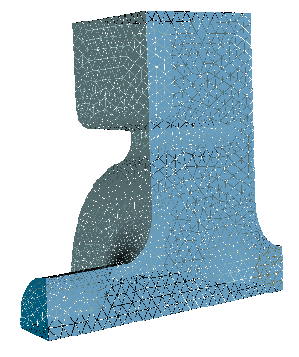

RfGunVacuum.omega3p
ModelInfo: {
File: RfGunVacuum.ncdf
BoundaryCondition: {
Electric: 1
Magnetic: 2 3 4
Electric: 5
Exterior: 6 // default copper
}
}
FiniteElement: {
Order: 2
Curved Surfaces: on
}
EigenSolver: {
NumEigenvalues: 1
FrequencyShift: 2.8e9
}
WG port: Id 5
Exterior: Id 6
disk: Id 2
Beampipe: Id 1
Sym. planes: Id 3 & 4

Slide 10
mesh-RfGunBody.jou
Reset
import acis "RfGun-CouplerCell-2018.sat"
del body 2 //delete vacuum part
compress ids
volume all scheme Tetmesh
vol 1 sizing function skeleton scale 3
min_size 0.5 max_size 3
mesh vol 1
block 1 vol 1
block all element type tetra10
group “beampipe" add surface 14
group "sym1" add surface with x_coord<0.001
group "sym2" add surface with y_coord<0.001
group “outwall" add surface 12 15 16 18 19
group "cooling" add surface 20 to 35
group "rf" add surface all
rf subtract beampipe from rf
rf subtract sym1 from rf
rf subtract sym2 from rf
rf subtract outwall from rf
rf subtract cooling from rf
sideset 1 surface in beampipe
sideset 2 surface in sym1
sideset 3 surface in sym2
sideset 4 surface in outwall
sideset 5 surface in cooling
sideset 6 surface in rf
transform mesh output scale 0.001
export genesis "RfGunBody.gen" overwrite
quality vol all distortion high 0.0 draw mesh

Slide 11
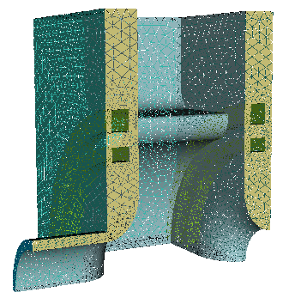
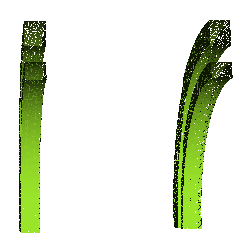
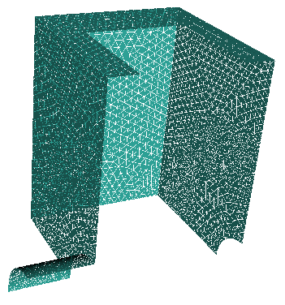
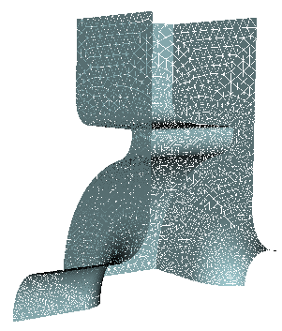
Surface Boundary IDs
Cooling channels: Id 5
Outer wall faces: Id 4
symmetry planes:
Id 2 & 3
beampipe end:
Id 1
RF surfaces: Id 6

Slide 12

Boundary Conditions in TEM3P
Thermal Problem:
Dirichlet (conduction): fixed temperature is imposed
Neumann (conduction): heat flux is imposed
Convection: Robin heat transfer Q=hA(T_{h}-T_{c})
RF Heating: power loss from omega3p/s3p used as the heat flux
Elastic Problem:
Dirichlet: displacement is imposed in all three directions
Neumann: normal loading is imposed
Mixed: displacements are imposed in some directions others are free
LFDetuning: radiation pressure from omega3p/s3p used as the normal loading

Slide 13
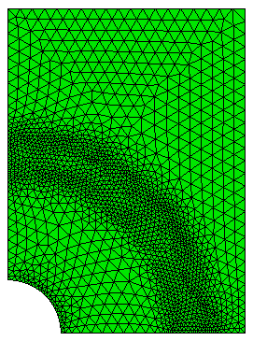
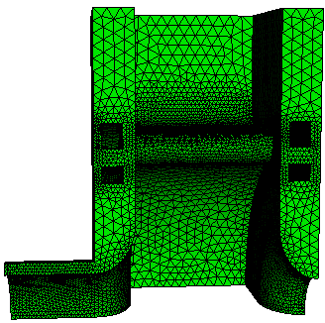
Boundary Conditions for TEM3P
Thermostatic Solver :
  Conduction: 1 ~ 4
  Convection: 5 (22⁰C)
  RF Heating: 6
Elastic Solver :
    Fix X: 2
    Fix Y: 3
    Fix Z: 1
    Free: 4 5
    Lorentz Force: 6
Y-Axis
ID 2
X-Axis
ID 3
ID 5
ID 1
Z-Axis

Slide 14
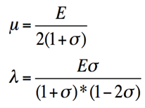
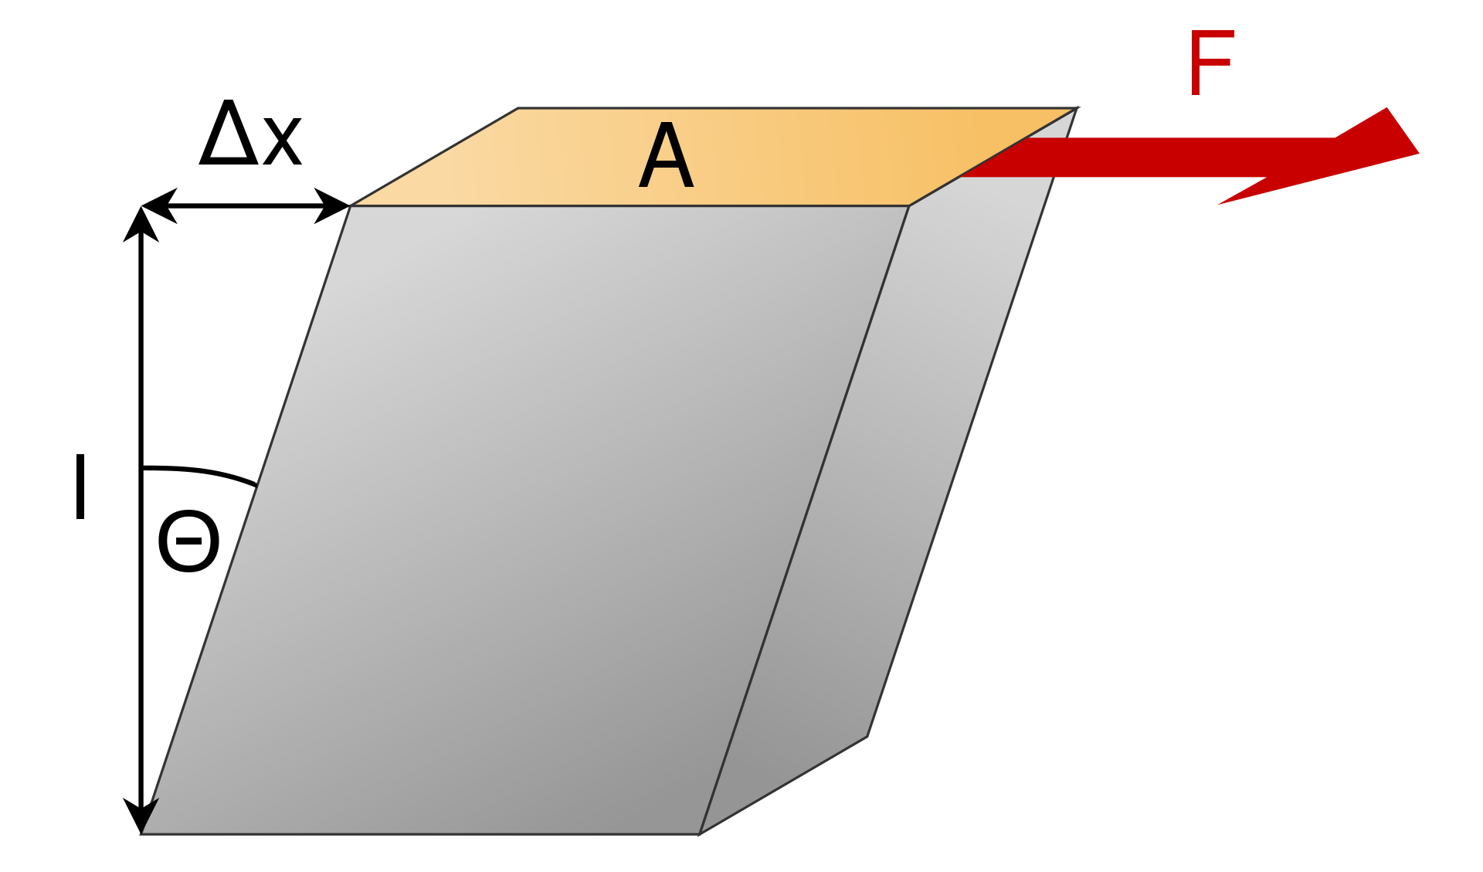

Thermal and Structural Properties
Block Id | Material | K (W/mk) | Shear modulus, μ (N/m²) | Lame constant, λ (N/m²) | Expansion coefficient,α (1/°C)
1 | Copper | 391 | 4.3363e10 | 8.1244e10 | 1.7e-5
In TEM3P, λ and μ are used to calculate the Stress-Strain relationship instead of Young‘s modulus E and Poisson‘s ratio (σ)
You can specify any of these two in TEM3P input file.
𝞵

Slide 15
RfGunBody.tem3p – Thermal Problem Specification
//Thermal-Elastic problem specification
ThermoElasticProblem: {
RunId: 3
}
// Thermal solver specification
ThermostaticProblem: {
MeshFile: RfGunBody.ncdf
BasisOrder: 2
CurvedSurfaces: on
LinearSolver: {
Solver: CG
Preconditioner: DIAGONAL
AbsoluteTolerance: 1.0e-18
Tolerance: 1.0e-10
MaxIterations: 5000 // check the result if the actual iteration is less than the MaxIteration.
}
// ---Thermal property specification ThermalConductivity: {
Id: 1 // copper
Value: 391
}
  // thermal BCs: conduction: 1 ~ 4
Boundary: {
Id: 1 // beampipe end
ConditionType: Neumann
NeumannValue : 0.0
}
Boundary: {
Id: 2 // symmetry in x
ConditionType: Neumann
NeumannValue : 0.0
}
Boundary: {
Id: 3 // symmetry in y
ConditionType: Neumann
NeumannValue : 0.0
}
Boundary: {
Id: 4 // out wall
ConditionType: Neumann
NeumannValue : 0.0
}
// Convection/Robin heat transfer
Boundary: {
Id: 5 // cooling channel, 22 C
ConditionType: Robin
RobinConstantFactor: 20000.0 //h
RobinConstantValue: 440000.0 //h.T
}
//Rf heating:
Boundary: {
Id: 6 // Multi-physics interface
ConditionType: RFHeating
WhichMode: 0
Sigma: 5.8e7
Directory: omega3p_results
Method: Gradient
TargetGradient: 60e6
DutyFactor: 0.00036
StartPoint: 0.0001, 0.0001 -0.017018
EndPoint: 0.0001, 0.0001 0.017018
}

Slide 16
RfGunBody.tem3p - Elastic Problem Specification
// Elastic problem specification======
ElasticProblem: {
MeshFile: RfGunBody.ncdf
BasisOrder: 2
CurvedSurfaces: on
ReferenceT: 25
MeshDump: {
WriteDeformedMesh: on
WriteDeformedEMMesh: on
EMMeshInputDir:omega3p_results
WriteStressStrain: on
}
LinearSolver: {
Solver: CG
Preconditioner: DIAGONAL
AbsoluteTolerante: 1.00e-16
Tolerance: 1.00e-10
MaxIterations: 50000
}

Slide 17
RfGunBody.tem3p - Structural Properties and BCs
VolumeMaterial: {
Id: 1 //copper
ElasticMu: 4.3363e+10
ElasticLambda: 8.1244e+10
ElasticAlpha: 1.70000e-5
}
// -------Neumann type -------
Boundary: {
Id: 4 // outwall
ConditionType: Neumann
NeumannValue: 0.
}
Boundary: {
Id: 5 // cooling channel
ConditionType: Neumann
NeumannValue: 0.
}
// --------Mixed type--------
Boundary: {
Id: 1 // beampipe end -- fixed z direction
ConditionType: Mixed
MixedType: NEUMANN NEUMANN DIRICHLET
MixedValue: 0., 0., 0.
}
Boundary: {
Id: 2 // symmetry -- fixed x direction
ConditionType: Mixed
MixedType: DIRICHLET NEUMANN NEUMANN
MixedValue: 0., 0., 0.
}
Boundary: {
Id: 3 // symmetry -- fixed y direction
ConditionType: Mixed
MixedType: NEUMANN DIRICHLET NEUMANN
MixedValue: 0., 0., 0.
}
// ------Lorentz force----
Boundary: {
Id: 6 // Multi-physics surface
ConditionType: LFDetuning // RFinterface
WhichMode: 0
Directory: omega3p_results
Omega3PId: 6
Method: Gradient
TargetGradient: 60e6
StartPoint: 0.0001, 0.0001, -0.017018
EndPoint: 0.0001, 0.0001, 0.017018
}

Slide 18
Run Omega3P/TEM3P on NERSC
  Copy the following files to NERSC
  RfGunVacuum.gen, RfGunBody.gen, RfGunVacuum.omega3p, RfGunBody.tem3p, DeformedRfGunVacuum.omega3p,
  run-mesh.sh, run-ace3p.sh
Run jobs on NERSC
  Run acdtool to generate RfGunVacuum.ncdf and RfGunBody.ncdf
  sbatch run-mesh.sh
  Check output file acdtool.log for mesh correctness and mesh quality.
  Run omega3p to obtain EM fields under omega3p_results
  Run tem3p to obtain thermal, and structural fields under tem3p_results
  Run omega3p to get new EM fields under omega3p_results_deformed using deformed vacuum mesh
  sbatch run-ace3p.sh

Slide 19
Run Script Files on NERSC
#!/bin/bash -l
#SBATCH -C cpu
#SBATCH -q debug
#SBATCH -A m349
#SBATCH -N 1
#SBATCH -t 00:10:00
#SBATCH -J myjob
#SBATCH -e ace3p.e%j
#SBATCH -o ace3p.o%j
export DIR=$PWD
cd $DIR
srun -n 1 /global/cfs/cdirs/ace3p/perlmutter/CPU/acdtool meshconvert RfGunVacuum.gen
srun -n 1 /global/cfs/cdirs/ace3p/perlmutter/CPU/acdtool meshconvert RfGunBody.gen
run-mesh.sh
#!/bin/bash -l
#SBATCH -C cpu
#SBATCH -q debug
#SBATCH -A m349
#SBATCH -N 1
#SBATCH -t 00:10:00
#SBATCH -J myjob
#SBATCH -e ace3p.e%j
#SBATCH -o ace3p.o%j
export DIR=$PWD
cd $DIR
srun -n 16 -c 16 --cpu-bind=cores /global/cfs/cdirs/ace3p/perlmutter/CPU/omega3p RfGunVacuum.omega3p omega3p_results
srun -n 16 -c 16 --cpu-bind=cores /global/cfs/cdirs/ace3p/perlmutter/CPU/tem3p RfGunBody.tem3p tem3p_results
srun -n 16 -c 16 --cpu-bind=cores /global/cfs/cdirs/ace3p/perlmutter/CPU/omega3p DeformedRfGunVacuum.omega3p omega3p_results_deformed
run-ace3p.sh

Slide 20
Simulation Results
Copy the following files to local machine for visualization
RfGunVacuum.ncdf, RfGunBody.ncdf
omega3p_results/omega3p.l0.m0000.2.8533884e+09.mod
tem3p_results/Temperarure.mod, Displacement.mod, ResultFile
omega3p_results_deformed/omega3p.l0.m0000.2.8534358e+09.mod

Slide 21
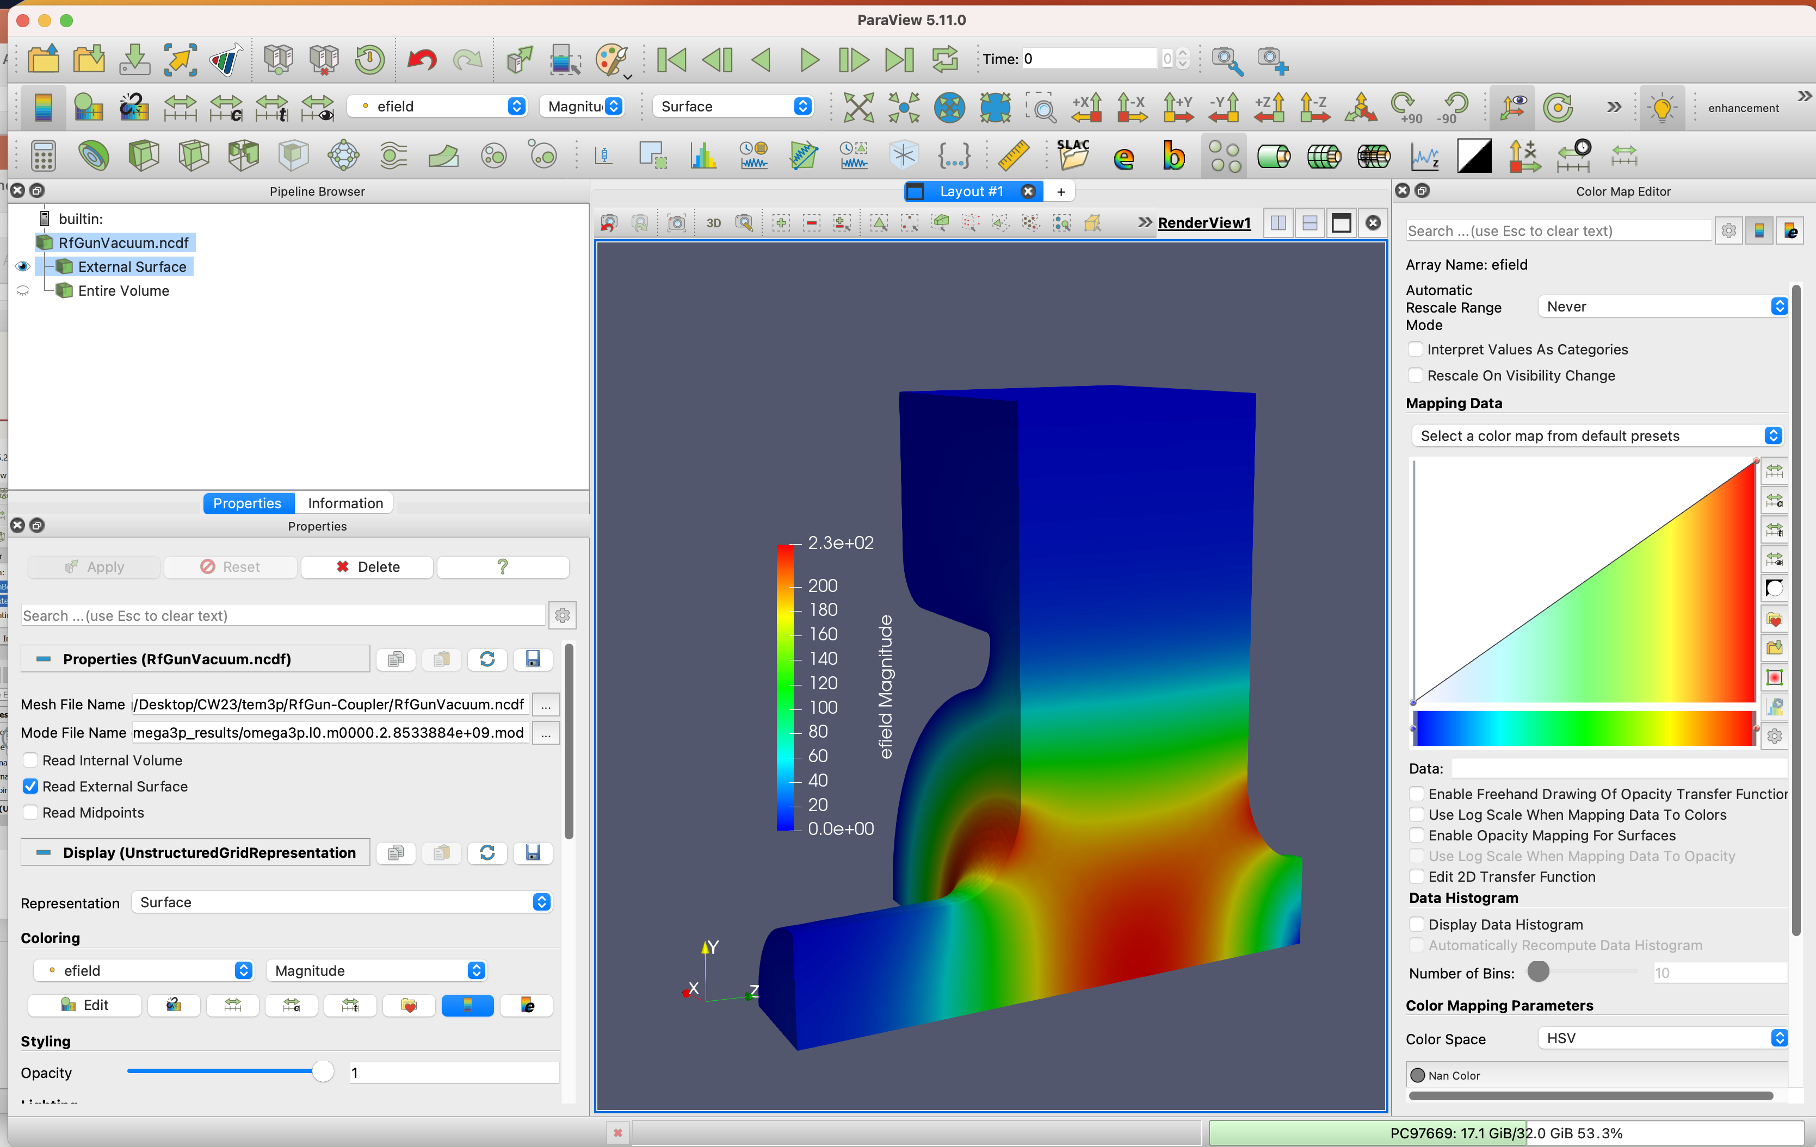
Visualize Eigenmode in Paraview

Slide 22
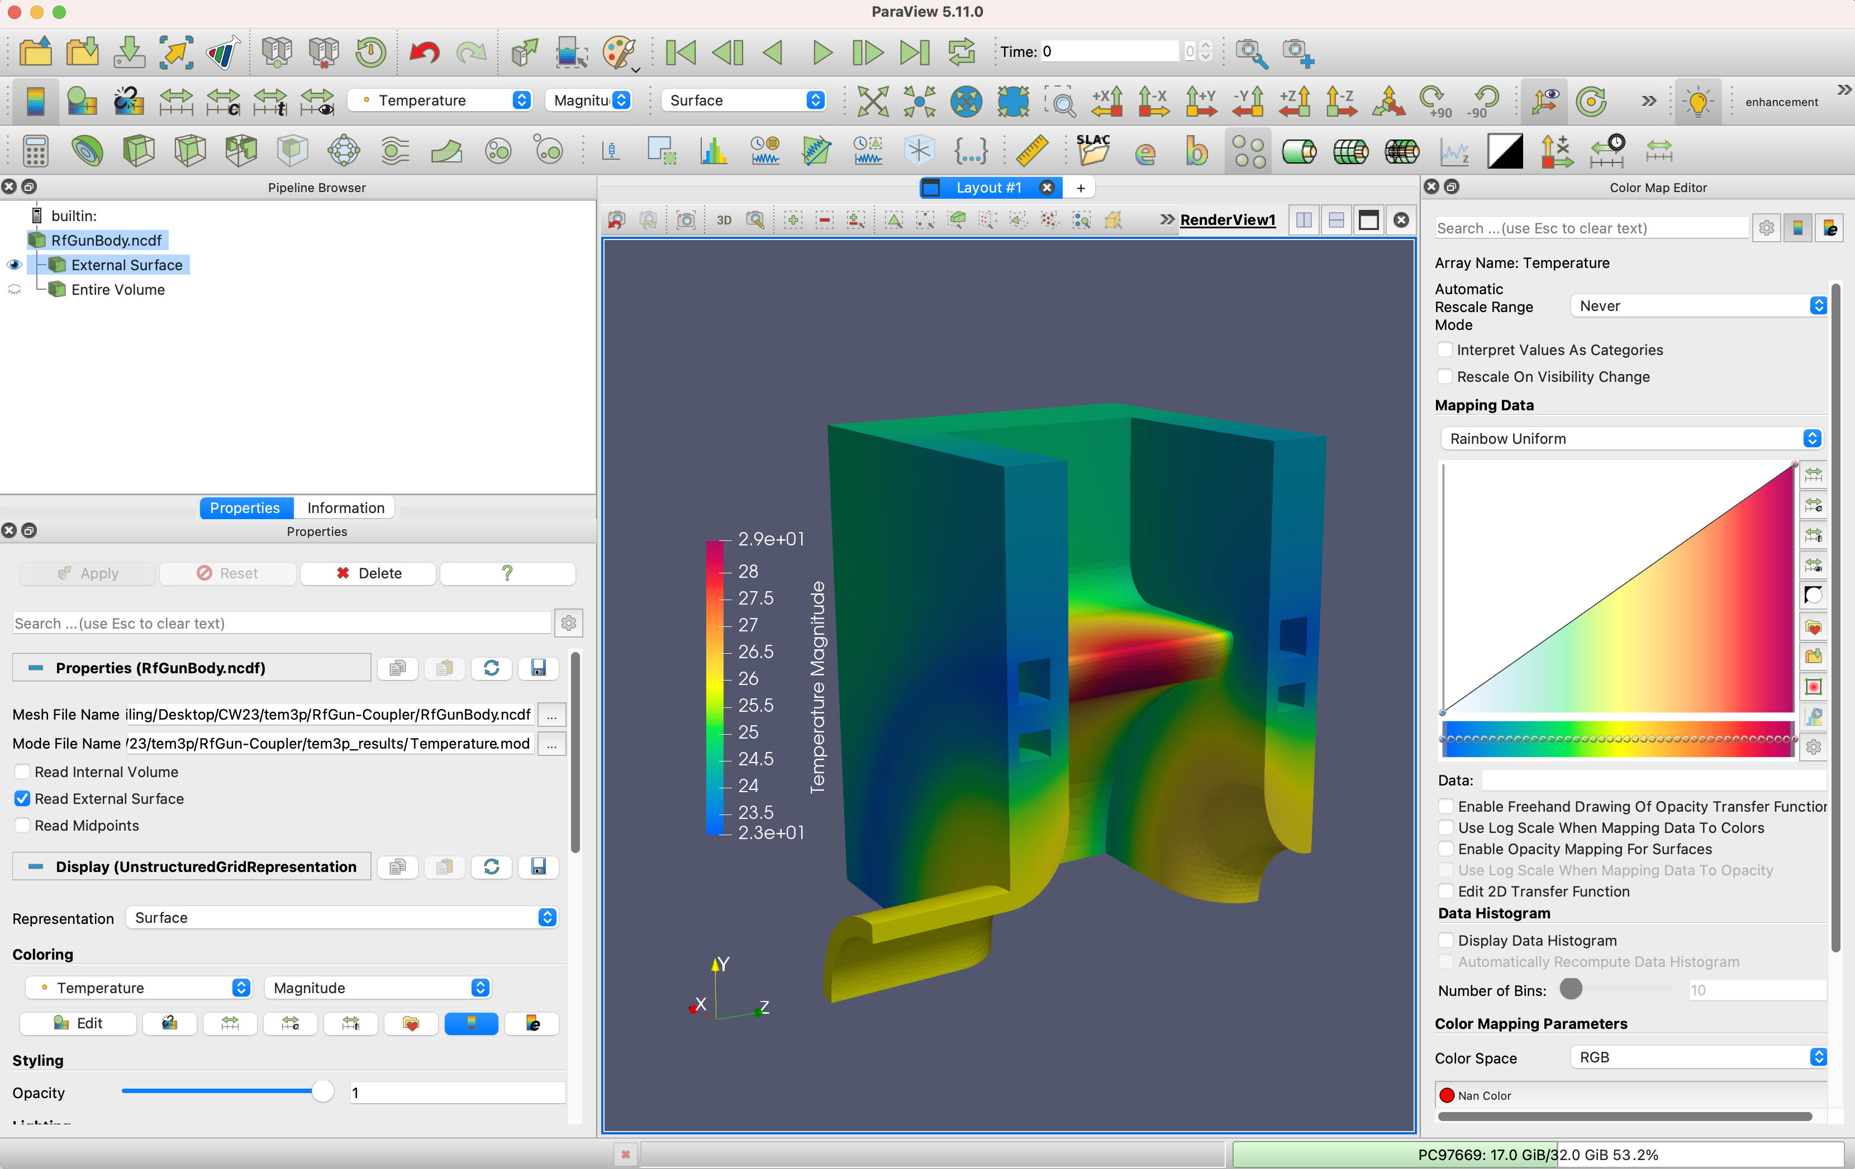
Visualize Temperature in Paraview

Slide 23
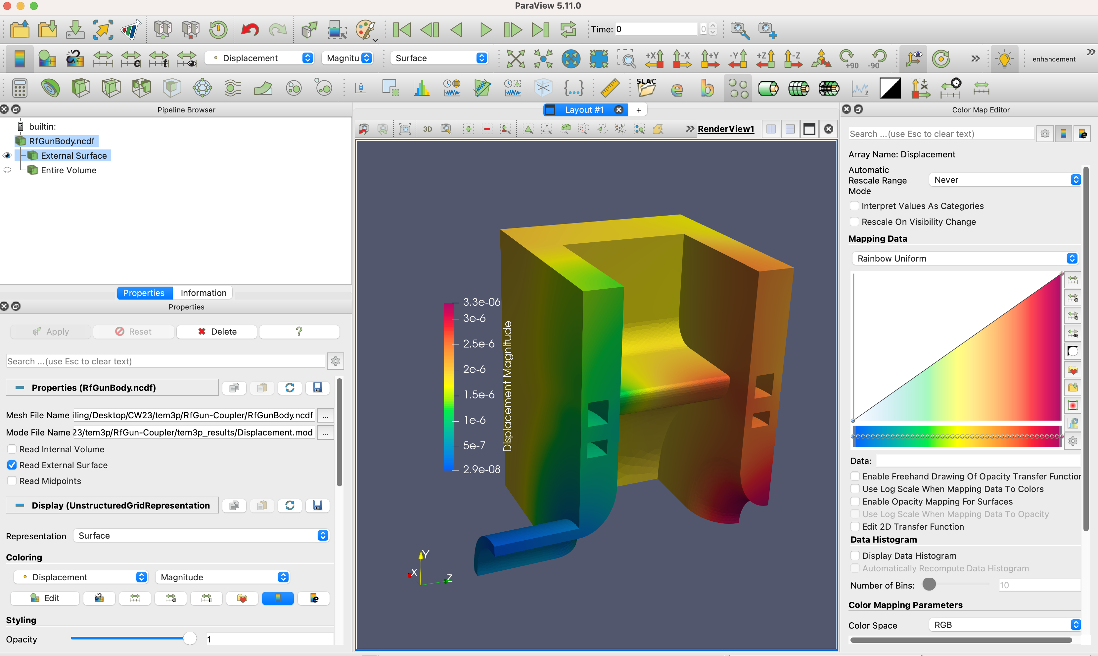
Visualize Displacement in Paraview

Slide 24
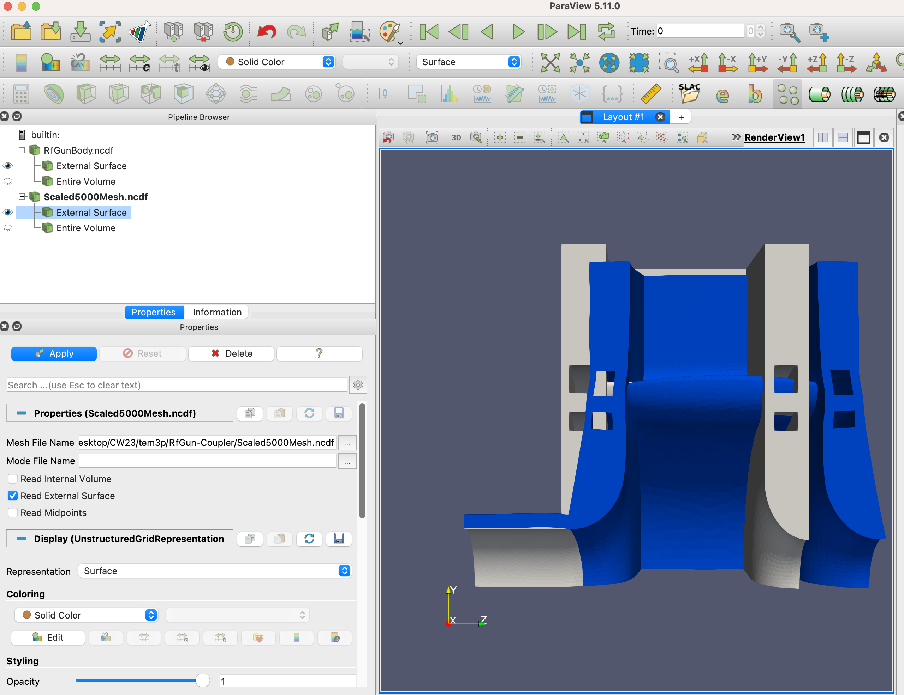
Visualize Disformed Mesh in Paraview
Sbatch run-scale-deformed-mesh.sh
Scale the deformed mesh larger for visualization using acdtool
acdtool mesh deform DeformedMesh.ncdf Scaled5000Mesh.ncdf 5000

Slide 25
Input File for Thermal Transient Simulation
ThermostaticProblem: {
MeshFile: RfGunBody.ncdf
BasisOrder: 2
CurvedSurfaces: on
// Time domain
Transient:
{
TimeStepping:
{
Type: Thermal
Scheme: BackwardEuler
MaximumTime: 8.e1
DT: 4.e-1
InitialT: 0
InitialTemp: 25
}
Excitation:
{
Power: 1.
Pulse:
{
Type: Monochromatic
Frequency: 1.
Rise periods: 10
T0: 0.
}
}
}
LinearSolver: {
Solver: CG
Preconditioner: DIAGONAL
AbsoluteTolerance: 1.0e-18
Tolerance: 1.0e-10
MaxIterations: 5000
}
ThermalConductivity: {
Id: 1 // copper
Value: 391
}
Boundary: {
Id: 1 // beampipe end
ConditionType: Neumann
NeumannValue : 0.0
}
Boundary: {
Id: 2 // symmetry in x
ConditionType: Neumann
NeumannValue : 0.0
}
Boundary: {
Id: 3 // symmetry in y
ConditionType: Neumann
NeumannValue : 0.0
}
Boundary: {
Id: 4 // out wall
ConditionType: Neumann
NeumannValue : 0.0
}
// cooling channel
Boundary: {
Id: 5 // channel, 22 Celcius
ConditionType: Robin
RobinConstantFactor: 20000.0
RobinConstantValue: 440000.0
}
Boundary: {
Id: 6 // Multi-physics interfaces
ConditionType: RFHeating
WhichMode: 0
Sigma: 5.8e7
Directory: omega3p_results
Method: Gradient
TargetGradient: 60e6
DutyFactor: 0.00036
StartPoint: 0.0001, 0.0001 -0.017018
EndPoint: 0.0001, 0.0001 0.017018
}
}\\

Slide 26
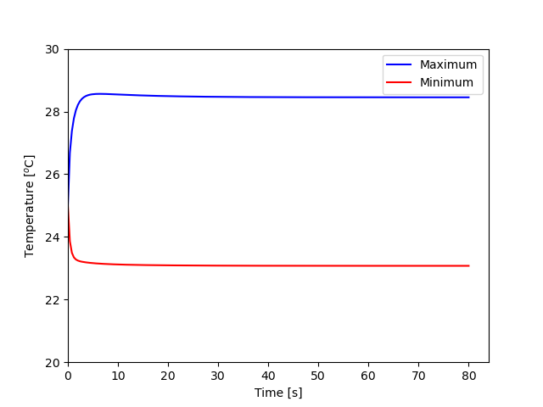
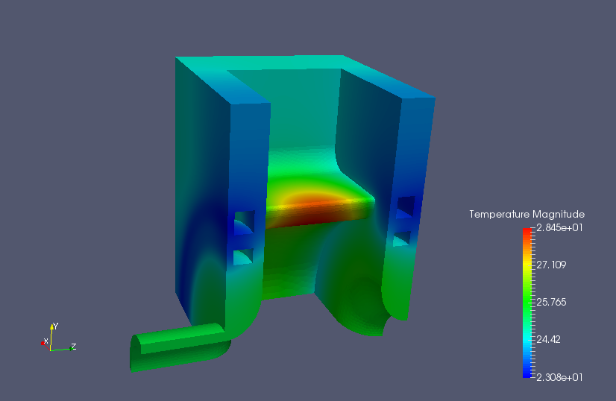
Time Domain Simulation: Maximum Time 80s
Steady state values same as static solution
Initial temperature 25ºC everywhere
Converge to temperature of static solution

Slide 27
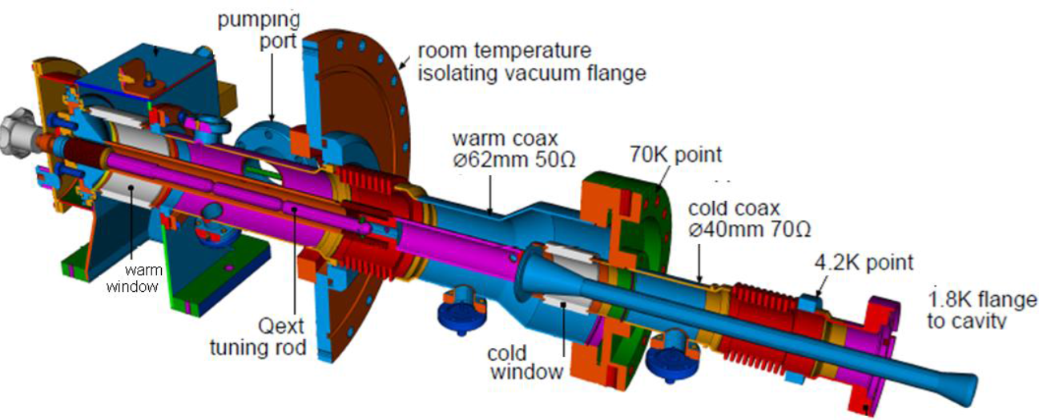
Example 2: SRF Cavity Power Coupler
    High temperature gradient between srf cavity coupler and the ambient requires the thermal analysis with nonlinear material properties
    Using shell elements for copper coating on stainless steel that improves thermal conduction between cold-warm transition
TTF3 coupler for LCLS-II application:
pulsed –> CW -> increase the copper coating thickness on the SS

Slide 28
Srf Coupler Example Overview
Aim:
    EM simulation for the coupler vacuum region with S3P
    Thermal simulation for the cavity metal with TEM3P thermal non-linear solver
    Check the max. temperature and heat load at the interceptions
Files under tem3p/SrfCoupler:
    2D-TTF3-FPC-Vacuum.ncdf, 2D-TTF3-FPC-Body.ncdf
    FPC-Vacuum.s3p
    FPC-Body.tem3p
    run-ace3p.sh

Slide 29

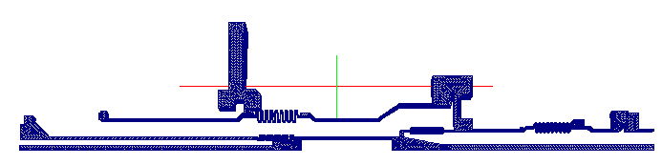
Meshes
2D-TTF3-FPC-Vacuum.ncdf
2D-TT3-FPC-Body.ncdf
ACE3P allows high-fidelity modeling of the geometry with large disparate scales.

Slide 30
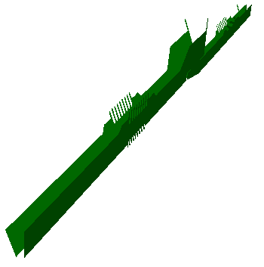
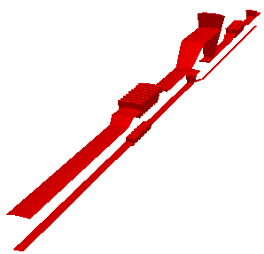

Boundary IDs and Block IDs in Vacuum Mesh
Exterior: Id 1
Symmetry planes: Id 2&3
port: Id 4 (warm)
port: Id 5 (cold)
Block 1: ceramic
Block 2: cold and warm vacuum parts

Slide 31
FPC-Vacuum.s3p
ModelInfo: {
File: 2D-TTF3-FPC-Vacuum.ncdf
BoundaryCondition :{
Impedance: 1 //exterior surfaces
Magnetic: 2 3 //two sym. planes
Waveguide: 4 5 //two coax ports
}
Material : { //ceramic
Attribute: 1 //block 1
Epsilon: 9.0
EpsilonImag: -9.0e-4
}
}
FiniteElement: {
Order: 2
Curved Surfaces: on
}
WaveguideFrequency: 1.3e+9
PostProcess : {
Toggle: on
PortNumber: 4 //power source side
ModeFile: mode
}

Slide 32

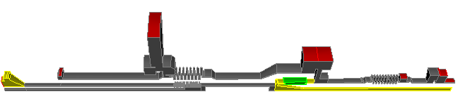




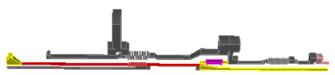
Surface Boundary IDs in Body Mesh
Fixed T at interceptions
Id 4 (70k)
Id 2 (2k)
Id 5 (300k)
Id 3 (4k)
Shell elements
ID 6: coating 10um on outer ss RF surfaces
ID 7: coating 100um on inner ss RF surfaces

Slide 33
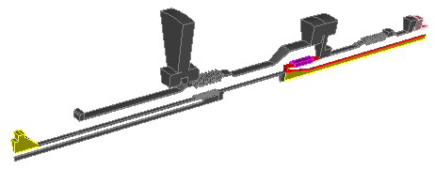

Surface Boundary IDs in Body Mesh
ID 9: NbTi flange
Cu & NbTi RF surfaces
ID 8: cu antenna/rings
ID 10 & 11: symmetry planes,
ID 1: the rest

Slide 34
Boundary Conditions for TEM3P
Thermostatic Solver :
  Conduction (Neumann): 1 10 11
  Conduction (Dirichlet): 2 (2k), 3 (4k), 4 (70k), 5 (300k)
  RF Heating: 6 & 7(out & inner conductor coating)
  8 (on antenna) 9 (NbTi flange)
  Conduction (Neumann): 10 11

Slide 35
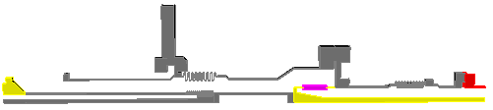
Volume Blocks for TEM3P
Block Id | Material
1: beampipe between 2k flange and cavity | Nb
2: 2k flange | NbTi
3: FPC coax wall and flange | SS304
4: antenna | Cu-RRR100
5: window | Al₂O₃

Slide 36
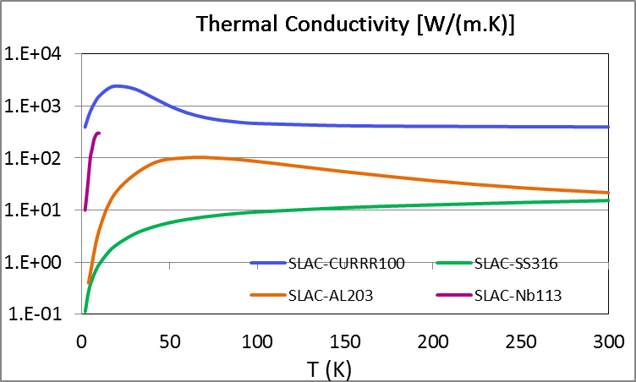
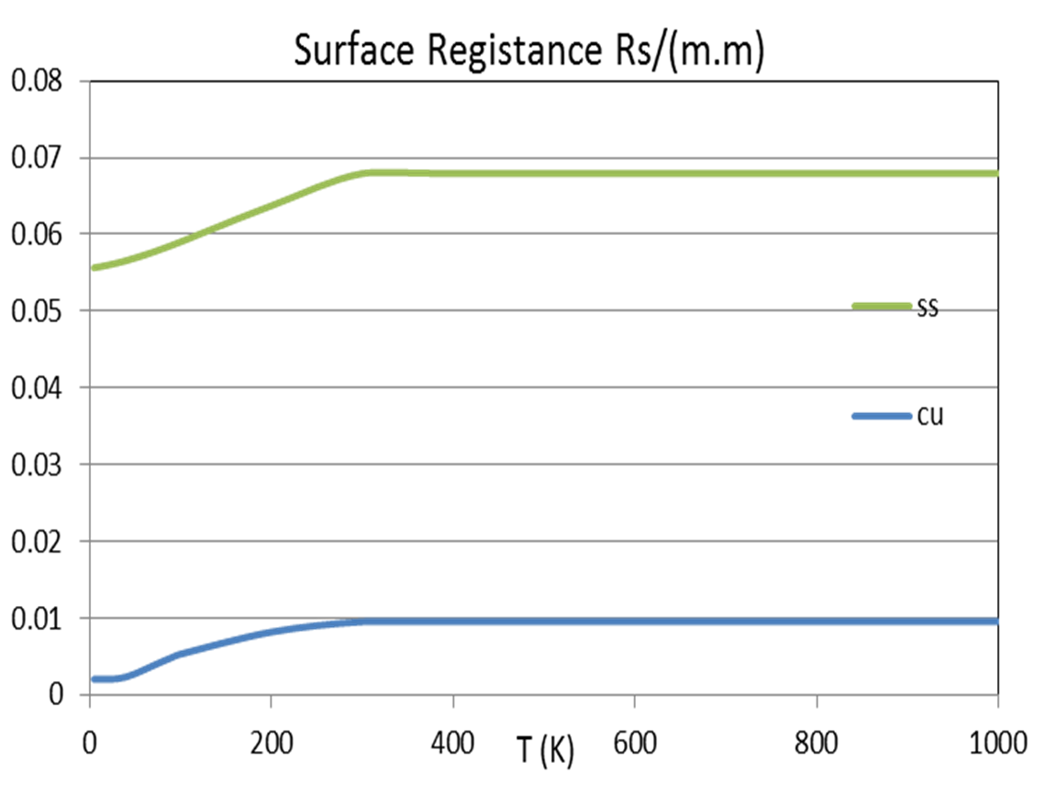
Non-Linear Thermal Material Properties
@F=1.3GHz
Material non-linear function specification is under directory of “functions” and follows: T_{start} T_{end} f(T), where T_{start} < T < T_{end} , K(T) = f(T).

Slide 37
Thermostatic Simulation with TEM3P
//-- Thermostatic problem
ThermostaticProblem: {
MeshFile: 2D-TTF3-FPC-Body.ncdf
BasisOrder: 2
CurvedSurfaces: on
// --------------------
// solution controls
// --------------------
LinearSolver:
{
Solver: GMRES
Preconditioner: ILU
AbsoluteTolerance: 1.0e-18
Tolerance: 1.0e-10
MaxIterations: 100000
}
// --------------------
// solution controls
// --------------------
NonlinearSolver:
{
Solver: Newton
PicardIteration: 100
MaxIterations: 500
Abs tolerance: 2.33e-10
Rel tolerance: 1.0e-8
}
PicardSolver:
{
Solver: CG
Preconditioner: DIAGONAL
AbsoluteTolerance: 1.0e-18
Tolerance: 1.0e-10
MaxIterations: 100000
}

Slide 38
FPC-Body.tem3p – Shell Element Specification
// ==========================
// shell boundary property
// ==========================
Shell:
{
Bd: 6 // where thermal shell bd is
Material: 221 // material id for shelll, should be defined later
BasisOrder: 1 // basis order can be different
Thickness: 1e-5 // thickness of the shell
}
Shell:
{
Bd: 7 // where thermal shell bd is
Material: 221 // material id for shelll, copper
BasisOrder: 1 // basis order can be different
Thickness: 1e-4 // thickness of the shell
}
// ==========================
// shell material property
// ==========================
ThermalConductivity:
{
Id: 221 // shell, copper
Function: functions/CURRR100
}

Slide 39
FPC-Body.tem3p - Thermal Property Specification
ThermalConductivity:
{
Id: 1 // Nb
Function: functions/HighRRRNb
}
ThermalConductivity:
{
Id: 2 // NBti
Function: functions/NbTi
}
ThermalConductivity:
{
Id: 3 //ss
Function: functions/ss304
}
ThermalConductivity:
{
Id: 4 // cu
Function: functions/CURRR100
}
ThermalConductivity:
{
Id: 5 // window
Function: functions/al300
}

Slide 40
FPC-Body.tem3p - Dielectric Heat Loss Specification
HeatSource: {
Id: 5 //window volume
ConditionType: RFHeating
WhichMode: 0
DielectricConstantE: 9
LossTangentE: 0.0001
Directory: s3p_results
Method: Powerinput
TargetPowerinput: 437.5 //1/16 of 7kW total power
}

Slide 41
FPC-Body.tem3p - Thermal BC Specification
// Natural conduction
// symmtry planes
Boundary:
{
Id: 10 // sym1
ConditionType: Neumann
NeumannValue: 0.0
}
Boundary:
{
Id: 11 // sym2
ConditionType: Neumann
NeumannValue: 0.0
}
// rest
Boundary:
{
Id: 1 // rest
ConditionType: Neumann
NeumannValue: 0.0
}
// Fixed T: Conduction BC
Boundary:
{
Id: 2 // 2k
ConditionType: Dirichlet
DirichletValue: 2
}
Boundary:
{
Id: 3 // 4k
ConditionType: Dirichlet
DirichletValue: 4
}
Boundary:
{
Id: 4 // 70k
ConditionType: Dirichlet
DirichletValue: 70
}
Boundary:
{
Id: 5 // 300k
ConditionType: Dirichlet
DirichletValue: 300
}

Slide 42
FPC-Body.tem3p - Thermal BC Specification
// RF heating
Boundary:
{
Id: 6 // shell w/ coating
ConditionType: RFHeating
WhichMode: 0
Directory: s3p_results
Method: Powerinput
TargetPowerinput: 437.5
SurfaceResistance: functions/SRinnerCU
}
Boundary:
{
Id: 7 // shells w/ coating
ConditionType: RFHeating
WhichMode: 0
Directory: s3p_results
Method: Powerinput
TargetPowerinput: 437.5
SurfaceResistance: functions/SRinnerCU
}
// RF heating
Boundary:
{
Id: 8 // cu_antenna_rf
ConditionType: RFHeating
WhichMode: 0
Directory: s3p_results
Method: Powerinput
TargetPowerinput: 437.5
SurfaceResistance: functions/SRinnerCU
}
Boundary:
{
Id: 9 // nbti_rf //2k NbTi flange
ConditionType: RFHeating
WhichMode: 0
Directory: s3p_results
Method: Powerinput
TargetPowerinput: 437.5
SurfaceResistance: functions/SRinnerNbTi
}

Slide 43
Run S3P/TEM3P on NERSC
Copy the following files and directory to NERSC:
  2D-TTF3-FPC-Vacuum.ncdf and 2D-TTF3-FPC-Body.ncdf
  FPC-Vacuum.s3p and FPC-Body.tem3p
  functions directory
  run-ace3p.sh
  Run jobs on NERSC
  Run s3p to obtain EM fields under s3p_results
  Run tem3p to obtain thermal results under tem3p_results
  sbatch run-ace3p.sh

Slide 44

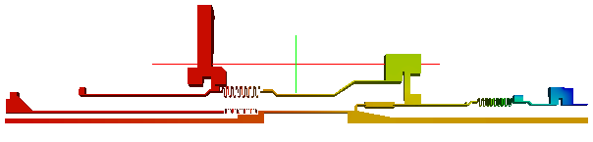
Simulation Results
Copy the following files to local machine
Under s3p_results: s3p.port1.mode.f1.300000E+09.mod
Complex E fields
Under tem3p_results: ResultFile
Temperature.mod
Temperature Field

Slide 45

Example 3: Lorentz Force Detuning
    SRF cavities can be distorted by the radiation pressure from the electromagnetic fields inside the cavity as well as the fluctuations of pressure in the helium tank
    More RF power is required to maintain the accelerating gradient as the cavity detunes changing the resonant frequency.
SRFCell3mmThick.sat

Slide 46
SRF Cell Example Overview
Simulation of the Lorentz force detuning for the SRF cell:
Omega3p simulation to identify the RF resonant frequency
TEM3P simulation to calculate the cell deformations due to the Lorentz force
Omega3p simulation for the deformed cell to calculate the new frequency
Calculation of the frequency shift due to the Lorentz force detuning
Files under ‘tem3p/SRFCell’:
SRFCell3mmThick.sat
meshSRFCellVacuum.jou , meshSRFCellShell.jou
SRFCell.omega3p, SRFCell.tem3p, SRFCellDeformed.omega3p
run-mesh.sh, run-ace3p.sh

Slide 47
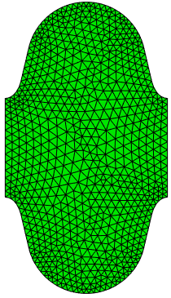
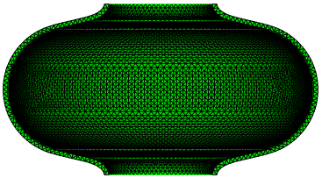
Surface IDs in Vacuum & Shell Meshes
BC6: Exterior wall PEC
BC5: outer wall
BC1: cross-cut
BC2:
Beampipe
BC3: Beampipe
BC2: Beam pipe
BC3: Beam pipe
BC1: Sym. Plane
BC4: Interior
SRFCellVacuum.gen
meshSRFVacuum.jou
SRFCellShell.gen
meshSRFShell.jou

Slide 48
SRFCell.omega3p
Model Info: {
File: SRFCellVacuum.ncdf
BoundaryCondition: {
Magnetic: 1 //
Magnetic: 2 3 //
Electric: 6 //Nb
}
}
FiniteElement: {
Order: 2
Curved Surfaces: on
}
EigenSolver: {
NumEigenvalues: 1
FrequencyShift: 1.2e9
}

Slide 49
SRFCell.tem3p
//================================
ElasticProblem: {
MeshFile: SRFCellShell.ncdf
BasisOrder: 2
CurvedSurfaces: on
MeshDump: {
WriteDeformedEMMesh: on
EMMeshInputDir: omega3p_results
}
LinearSolver: {
Solver: CG
Preconditioner: DIAGONAL
AbsoluteTolerante: 1.00e-16
Tolerance: 1.00e-10
MaxIterations: 150000
}
//Nb cell shell
VolumeMaterial: {
Id: 1
ElasticLambda : 13.5386473e+10
ElasticMu : 4.2736232e+10
ElasticAlpha : 6.50000e-6
}

Slide 50
SRFCell.tem3p
// cavity symmetry plane
Boundary: {
Id: 1
ConditionType: Mixed
MixedType: NEUMANN DIRICHLET NEUMANN
MixedValue: 0., 0., 0.
}
// cavity disk : fix one side at z
Boundary: {
Id: 2
ConditionType: Dirichlet
DirichletValue: 0.
}
// cavity disk : another free moving
Boundary: {
Id: 3
ConditionType: Neumann
NeumanValue: 0.
}
// cavity outer surface : free boundary
Boundary: {
Id: 4
ConditionType: Neumann
NeumanValue: 0.
}
// cavity inner surface :
Boundary: {
Id: 5
ConditionType: LFDetuning
Directory: omega3p_results
Omega3PId: 6 //surf. in SRFVacuum.ncdf
WhichMode: 0
Method: Gradient
TargetGradient: 35e6
StartPoint: 0.0, 0.0, -0.0577
EndPoint: 0.0, 0.0, 0.0577
}
}

Slide 51
Run Omega3P/TEM3P on NERSC
Files needed for running omega3p and tem3p:
  Copy SRFCellVacuum.gen and SRFCellShell.gen to NERSC
  Copy SRFCell.omega3p, SRFCell.tem3p, SRFCellDeformed.omega3p to NERSC
  Copy run-mesh.sh, run-ace3p.sh to NERSC
  Run jobs on NERSC
  Run acdtool to generate SRFCellVacuum.ncdf, SRFCellShell.ncdf
  sbatch run-mesh.sh
  Run omega3p to obtain EM fields under omega3p_results, tem3p to obtain structural fields under tem3p_results, and omega3p to get new EM fields under omega3p_deformed_results using deformed vacuum mesh
  sbatch run-ace3p.sh

Slide 52
Simulation Results
Copy the following files and directories to local machine
SRFCellVacuum.ncdf, SRFCellShell.ncdf
/omega3p_results/omega3p.out
omega3p.l0.m0000.1.3009577e+09.mod
/tem3p_results/ResultsFile
DeformedVacuumMesh.ncdf
Displacement.mod
/omega3p_deformed_results/omega3p.out and
omega3p.l0.m0000.1.3009506e+09.mod

Slide 53
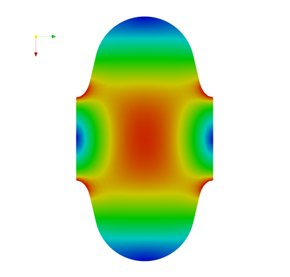
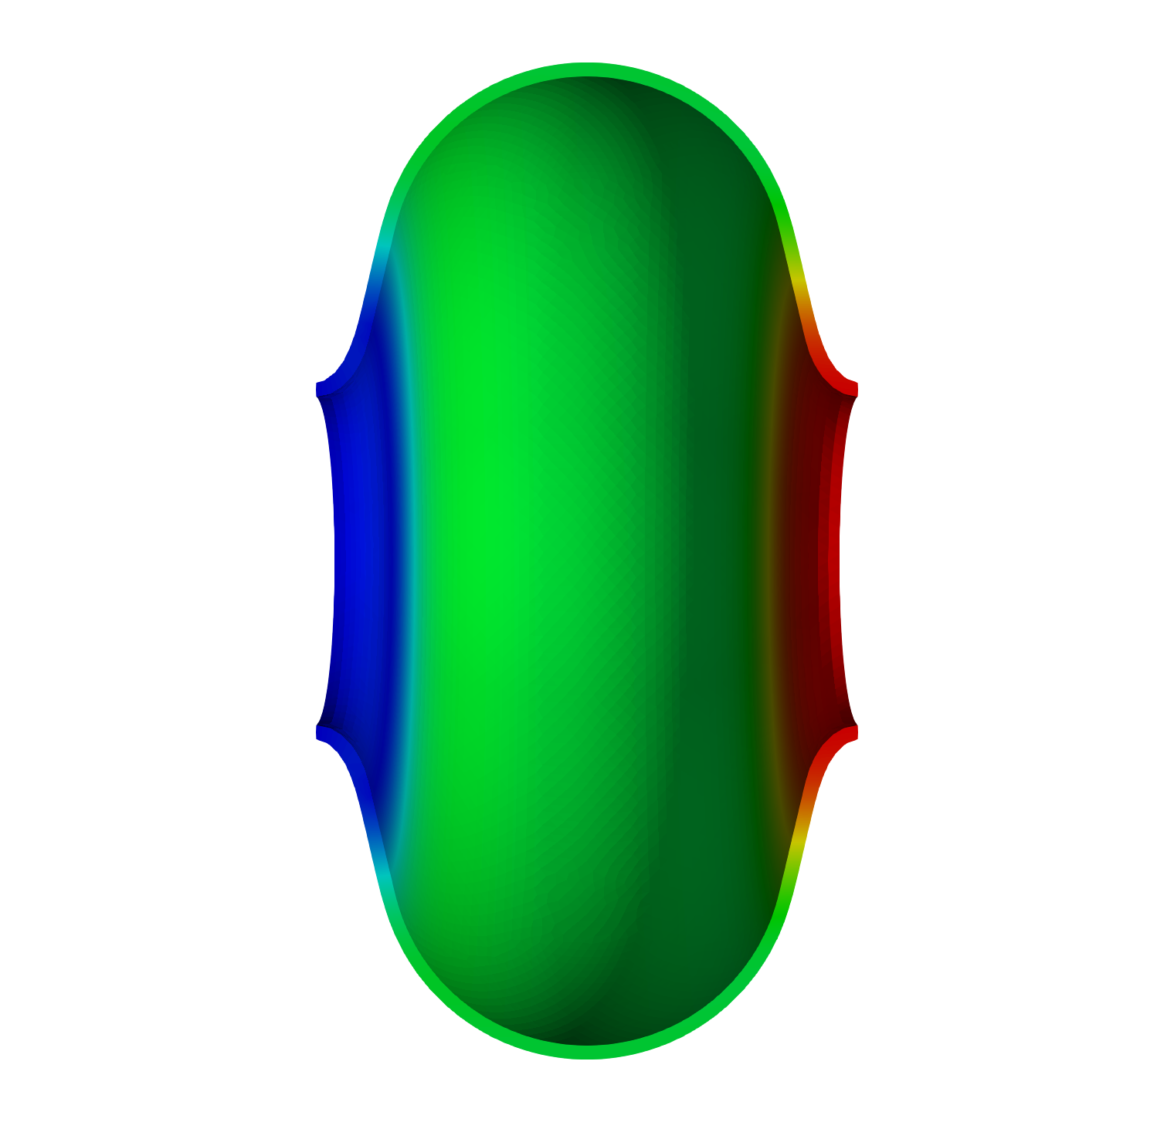
Visualize Results in Paraview
Efield
Displacements [m]

Slide 54
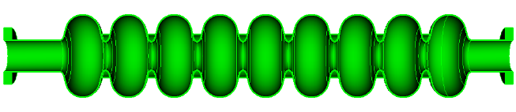

Example 4: TESLA Cavity Mechanical Modes
If the mechanical modes in SRF cavities are excited by external sources, the mechanical vibration may result in RF detuning, which could lead to cavity instability or increase in RF power requirement.
Exterior: Free, i.e. Neumann
Beam-pipe
Fixed
Beam-pipe
Fixed
Cross-cut: Mixed (Neumann, Dirichlet, Neumann)
The cavity is azimuthally symmetrical, so we simulate only ½.
  longitudinal and transverse modes (x polarization) are calculated.

Slide 55
TESLA Cavity Example Overview
TEM3P simulation to calculate the mechanical modes in TESLA cavity
Files under ‘tem3p/TeslaCavity’:
TeslaCavity.sat
TeslaCavity.jou
TeslaCavity.tem3p
run-mesh.sh, run-ace3p.sh

Slide 56
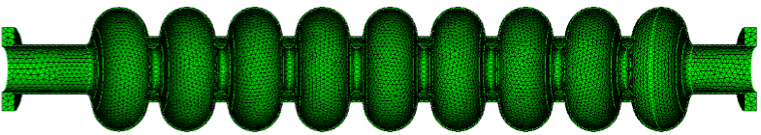
Surface IDs in Body Mesh
ID 4:
Exterior: Free, i.e. Neumann
ID 1:
Beam-pipe
Fixed
TD2 :
Beam-pipe
Fixed
ID 3:
Cross-cut: Mixed (Neumann, Dirichlet, Neumann)
TeslaCavity.gen
TeslaCavity.jou

Slide 57
TeslaCavity.tem3p
ElasticProblem:
{
MeshFile: TeslaCavity.ncdf
BasisOrder: 2
CurvedSurfaces: on
MeshDump: {
WriteDeformedMesh: on
MeshDeformScale: 0.2
}
EigenSolver : {
NumEigenvalues: 5
FrequencyShift: 5
}
VolumeMaterial:
{
Id: 1
ElasticLambda : 20.9512e+10
ElasticMu : 5.77227e+10
ElasticAlpha : 6.50000e-6
Density: 8570
}
Boundary:
{
Id: 1
ConditionType: Dirichlet
DirichletValue: 0.
}
Boundary:
{
Id: 2
ConditionType: Dirichlet
DirichletValue: 0.
}
Boundary:
{
Id: 3
ConditionType: Mixed
MixedType: Neumann Dirichlet Neumann
MixedValue: 0., 0., 0.
}
Boundary:
{
Id: 4
ConditionType: Neumann
NeumannValue: 0.
}
}

Slide 58
Run TEM3P on NERSC
Files needed for running tem3p:
  Copy TeslaCavity.gen to NERSC
  Copy TeslaCavity.tem3p to NERSC
  Copy run-mesh.sh, run-tem3p.sh to NERSC
  Run jobs on NERSC
  Run acdtool to generate TeslaCavity.ncdf
  sbatch run-mesh.sh
  Run tem3p to obtain mechanical eigenmodes under tem3p_results
  sbatch run-ace3p.sh

Slide 59
Simulation Results
/Tem3p_results/ResultFile
# Frequency [Hz] u_x min [m] u_x max [m] u_y min [m] u_y max [m] u_z min [m] u_z max [m] u_mag max [m] block_id
62.822941 -0.44492086 0.00016858157 -0.0025499007 0.0026511475 -0.12532522 0.12523272 0.44516552 1
167.12759 -0.41393689 0.4092585 -0.0053549146 0.0051031721 -0.28438939 0.28260496 0.4147662 1
242.46092 -0.016593697 0.017161336 -0.016938683 0.016114706 -1.2855237e-05 0.41375152 0.41375219 1
307.64515 -0.40210617 0.3529317 -0.0081538808 0.008145305 -0.33878416 0.34097046 0.4067986 1
468.56376 -0.40723536 0.41783503 -0.012635801 0.012000945 -0.45602865 0.44588751 0.4608655 1
Field of displacements – Displacement_ModeX_FreqY.mod
Deformed mesh – DeformedMesh_ModeX_FreqY.ncdf

Slide 60
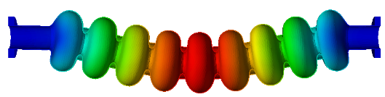
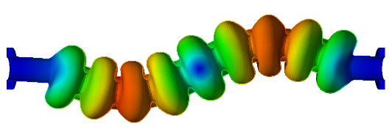

Visualize Results in Paraview
Displacement magnitude for the Mode 1 at 63 Hz
Displacement magnitude for the Mode 2 at 167 Hz
Displacement magnitude for the Mode 3 at 242 Hz

