Slide 1
Cubit for Accelerator Modeling
Stanford, March 27-31, 2023
Computational Electrodynamics Department
SLAC National Accelerator Laboratory
More information at
https://cubit.sandia.gov/tutorials
Or
https://coreform.com/products/coreform-cubit/tutorials/

Slide 2
Outlook
CUBIT Basics
Modeling – A Pillbox Cavity
  Model generation with GUI
  Model generation with command syntax in journal file
Meshing – A Quarter of Pillbox Cavity
  Create mesh journal file
  Edit mesh journal file with GUI
  Tips for meshing
Acdtool – Converting Mesh Format (*.gen -> *.ncdf)
Paraview – Visualize meshes (Option)

Slide 3
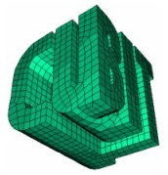
Cubit Basics
CUBIT is a geometry and mesh generation toolkit developed by Sandia National Laboratories
CUBIT can import and create geometries in many formats such as ACIS, IGES, and STEP
CUBIT can generate meshes for finite element codes such as ACE3P

Slide 4
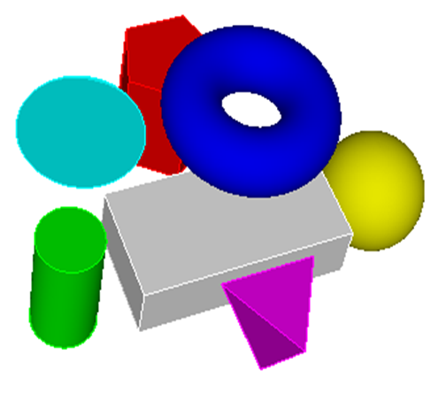
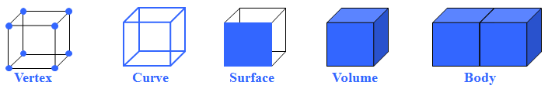
Cubic - Model Generation
Seven primitive types are available and accessed with the Create button in GUI or command syntax.
CUBIT can create many analytic geometry types
from scratch and in decomposition.
CUBIT can create Bottom-Up geometries from a collection of lower order entities, such as creating vertices, then curves, then surfaces. Volumes can be created by sweeping or bonding surfaces .

Slide 5
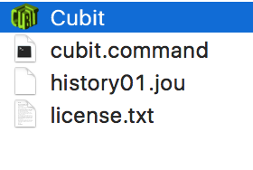
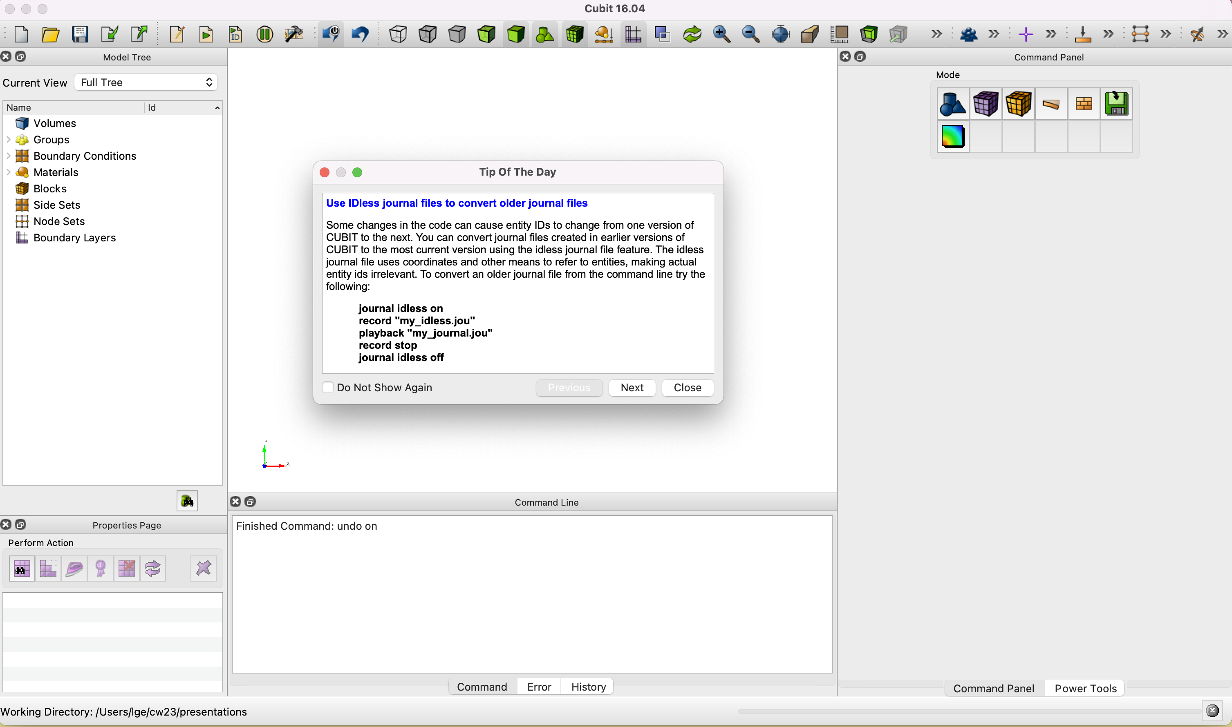
Cubit - User Interfaces (GUI)
Launch cubit (double click Cubit icon)
Toolbars
Command Panels
Properties Page
Read “Tip Of The Day” and Close it
Graphics Window
Command Line
Entity Tree

Slide 6

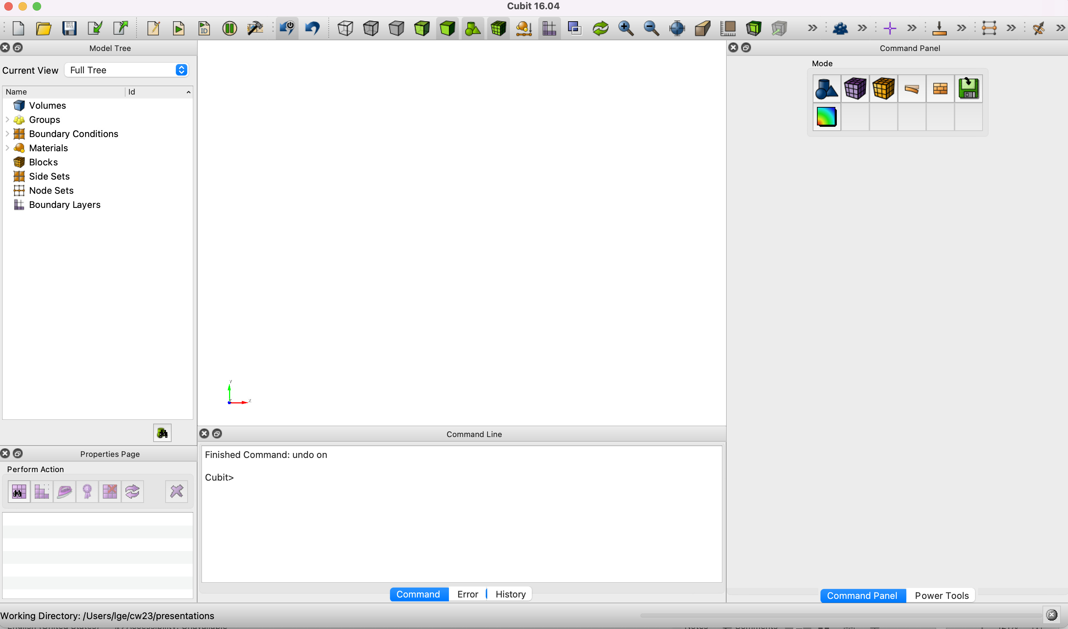
Selecting Your Working Directory
Click File -> Set Directory,
select working directory (/pillbox)
Click “Select Folder”
Or type the directory in command line

Slide 7
Drop Down Menus
Drop Down Menus provide functions such as file management, edit controls, user preferences, display options, journal file management, and help.

Slide 8


Toolbars
Toolbars provide the most commonly used features by clicking toolbar icons.
Display modes
Zoom in, out, and fit
undo
Geometry entity Selection Filter
When an entity is selected, that entity will become highlighted.
Mesh entity selection
Boundary condition selection

Slide 9
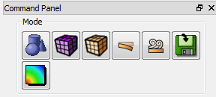





Command Panels
Every command entered with buttons in the GUI version is available in CUBIT’s command language in the command line workspace.
Press an Icon to enter a new mode, each button press takes you to a lower level
- Geometry: Create, modify, cleanup…
- Meshing: Intervals, schemes, smoothing…
- Materials and BCs: sidesets, blocks …
- Analysis Setup: Export mesh
- Post Processing: Customizable shortcut

Slide 10
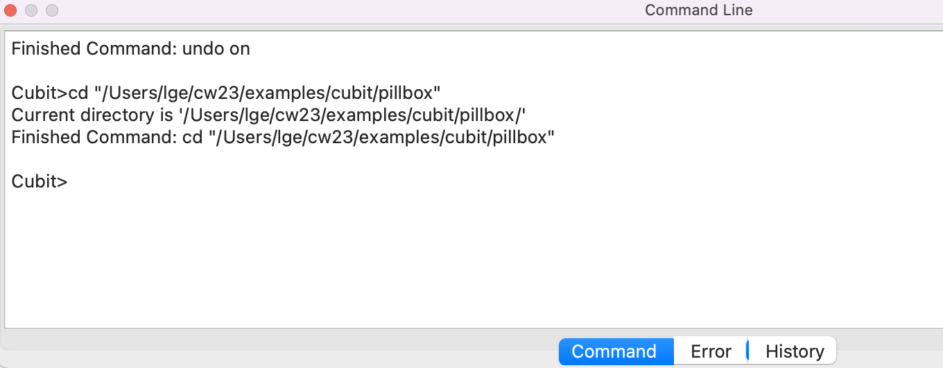
Command Line Workspace
All commands can be entered in the command window at the CUBIT>prompt. Partly words OK. Need help? CUBIT> Help XXX
Error window: lists error information.
History window: lists the last 100 command lines.

Slide 11
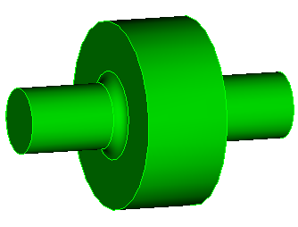
Pillbox Cavity
L-Band Pillbox:
Height = 90 mm
Radius = 100 mm
Beam pipe:
Radius = 35 mm
Disk:
Radius=12mm
TM010: f ~ 1.2GHz,
λ~ 250mm

Slide 12
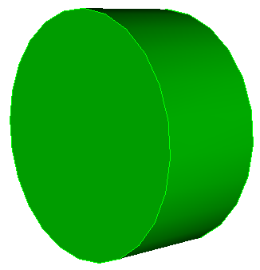
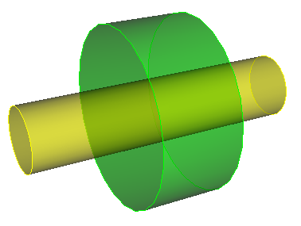
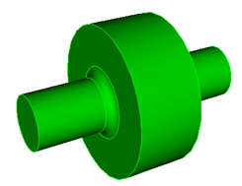
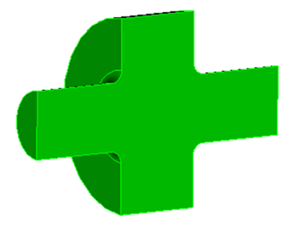

Modeling a Pillbox Cavity with GUI
Step 1
Step 2
Step 3
Step 4
Step 5

Slide 13
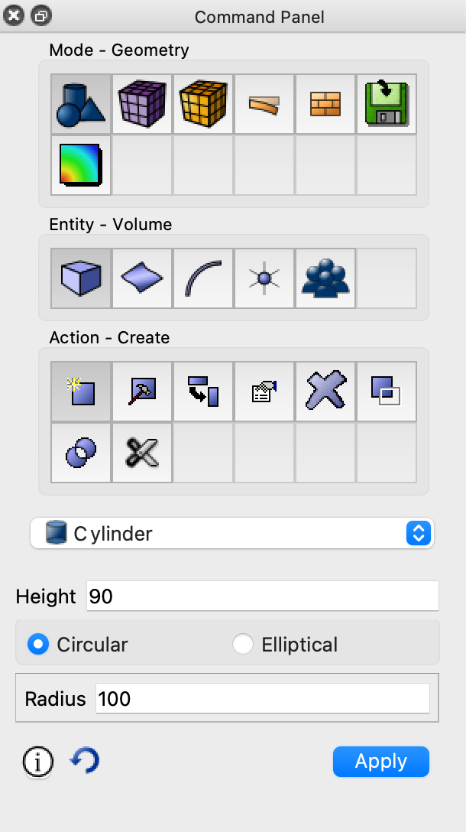
Step 1: Create a Pillbox Cell
1
click Mode-Geometry
click Entity-Volume
click Action-Create
select Cylinder
enter Values for Circular
hit Apply
2
3
4
Use smaller units when creating and meshing the model to avoid tolerance problems, and scale to meters later for ACE3P calculation.
5
6

Slide 14
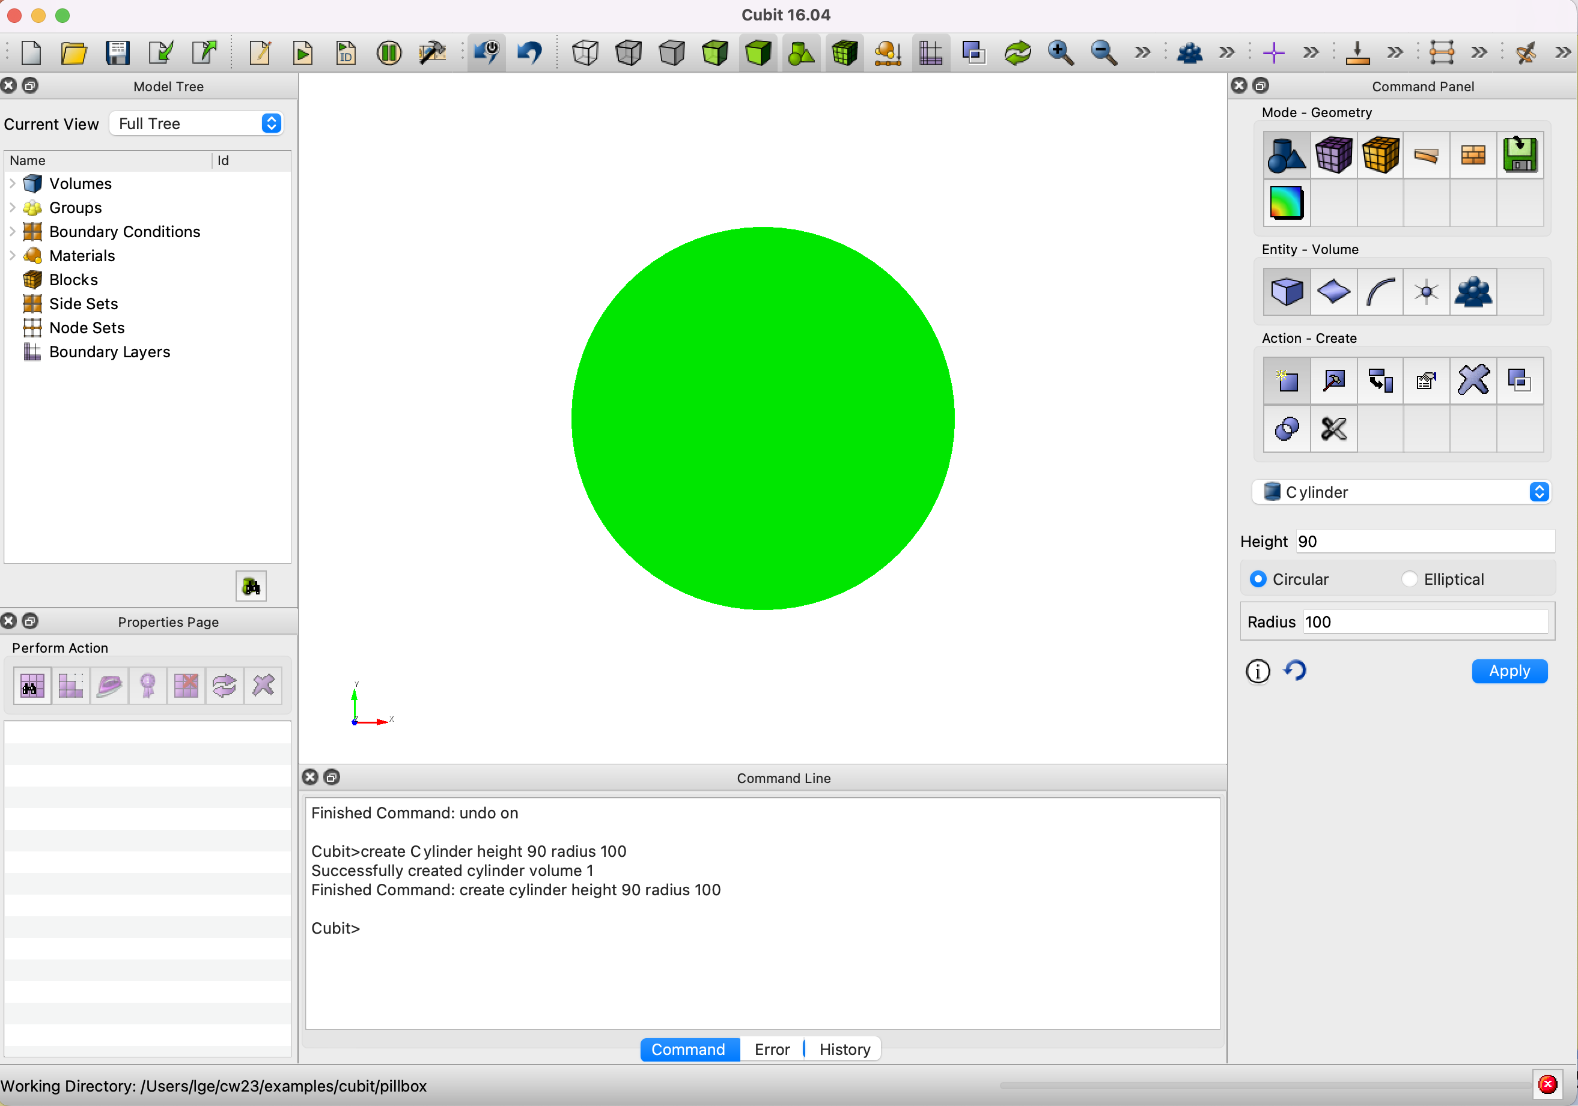
Display the Pillbox Cell
Or type “create cylinder height 90 radius 100” in the command line window.

Slide 15

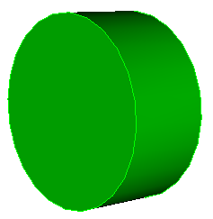
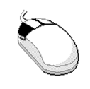
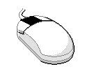
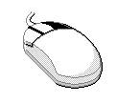
Adjust the Graphics Display
Using 3 button mouse
right-button to Pan
left-button to Rotate
middle-button to Zoom

Slide 16
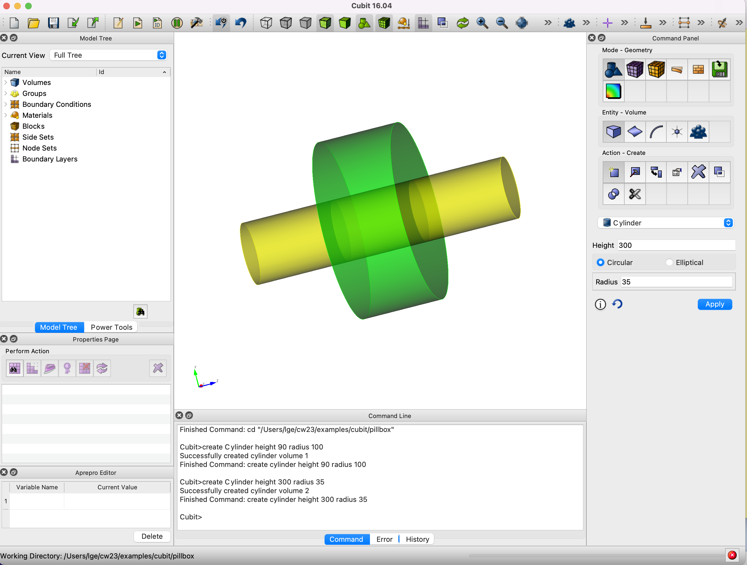
Step 2: Add Beampipe to the Pillbox Cell
Transparency view
Or type “create cylinder height 300 radius 35” in the command line window.

Slide 17
Geometry Booleans
Geometry Booleans define the shape of a body based on overlapping regions :
  Subtract
    Remove regions of overlap
  Intersect
    Remove regions that don’t overlap
  Unite
    Combine all regions into one body

Slide 18
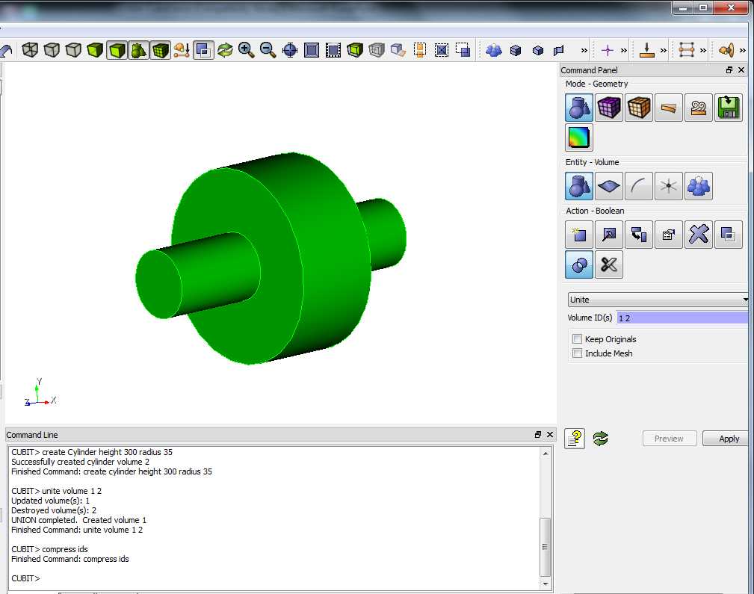
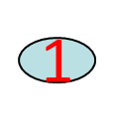
Step 3: Unite Beampipe and Pillbox Cell
Under Geometry Mode-Volume Entity,
click Action-Boolean
select Unite
enter Volume IDs {1 2}
hit Apply
2
3
4
5
Good to “compress ids” after “unite” or “delete” entries
Or type “unite vol 1 2”, and then “compress ids” in the command line window.

Slide 19


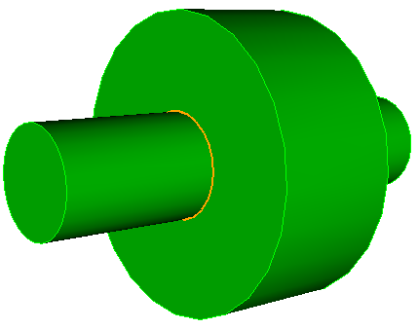
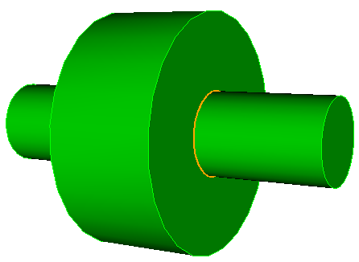
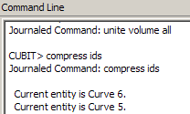
Select One or a Group of Curves
Selecting Curve
Put curser on curve, click Left button to pick, the curve ID will be shown in Command Line window.
Similarly for selecting a surface or volume

Slide 20
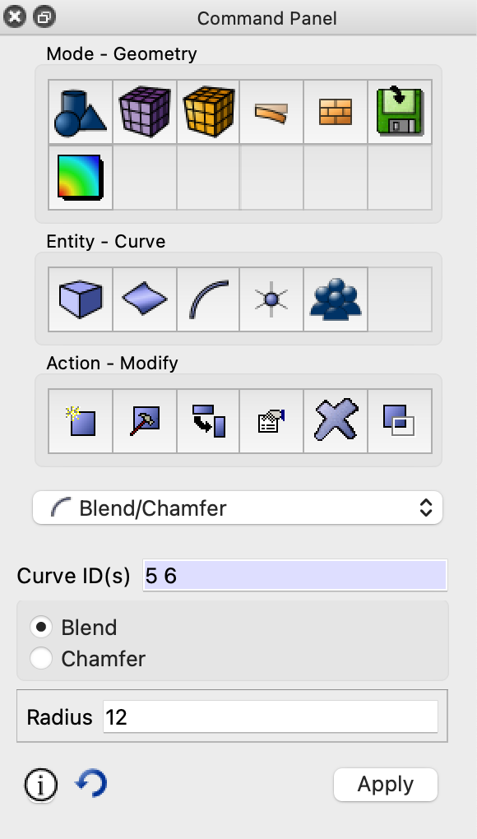
Rounding the Iris of the Pillbox Cavity
Under Geometry Mode,
click Entity-Curve
click Action-Modify
select Blend/Chamfer
enter Curve IDs {5 6}
Select Blend
Enter value {12} for Blend radius
hit Apply
1
2
3
4
Or type “modify curve 5 6 blend radius 12” in the command window.
5
6
7

Slide 21
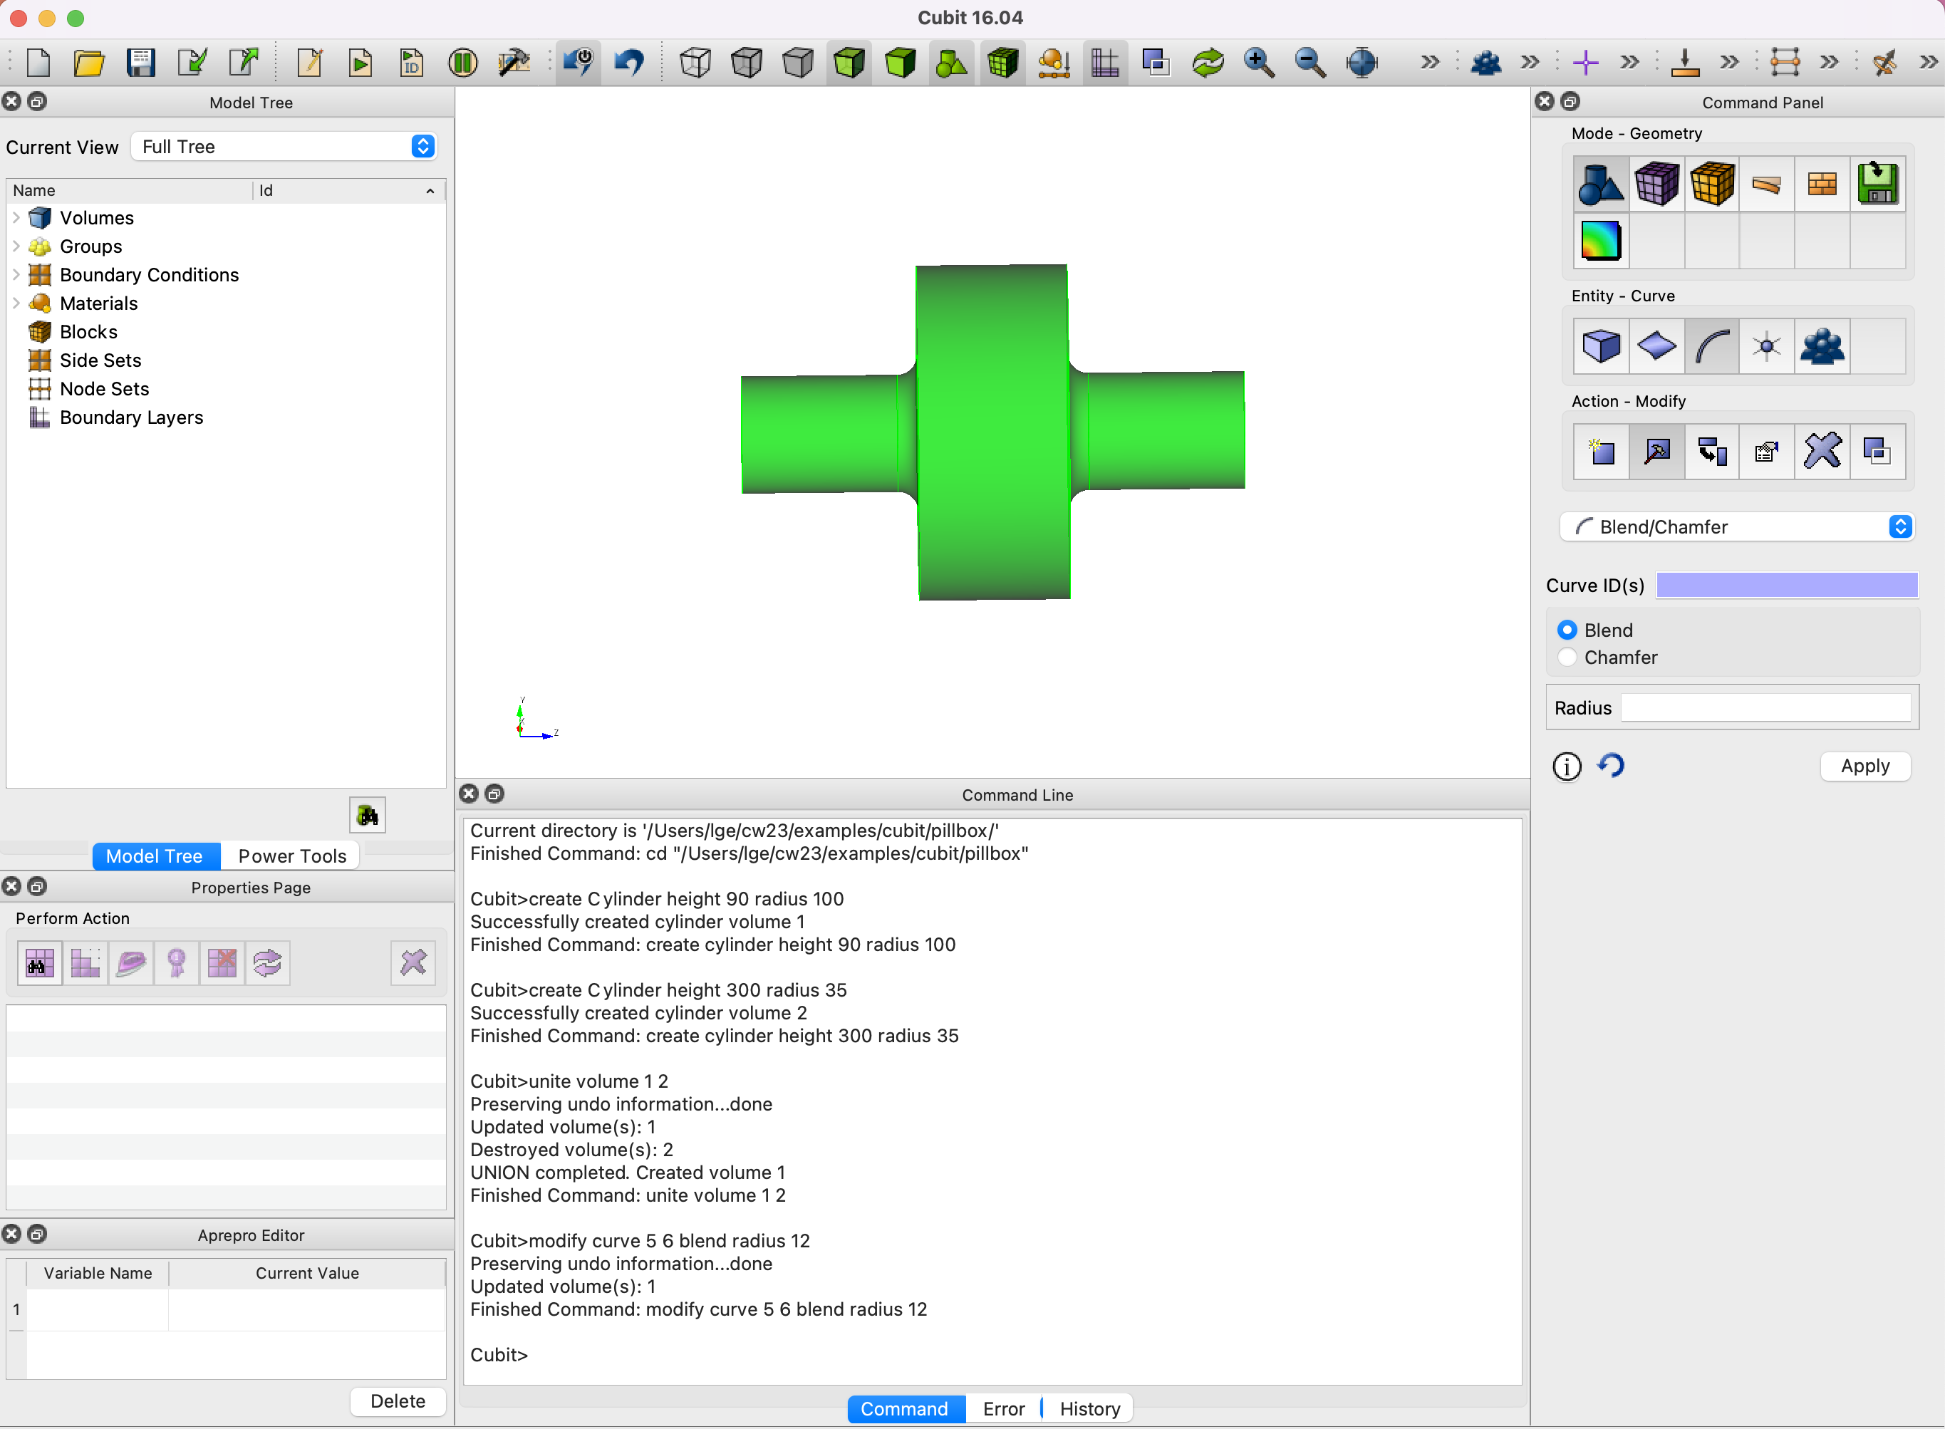
Display the Pillbox Cavity

Slide 22
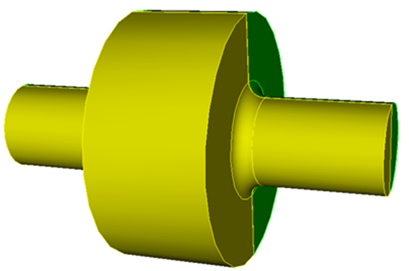


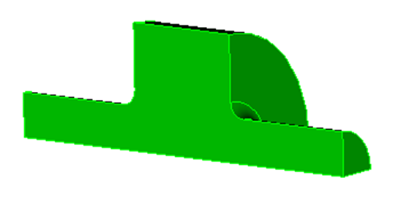
Geometry Webcutting
Geometry Webcutting slices 1 Body into 2 Bodies
  - Plane
  - Cylindrical surface
  - Extended surface
  - Intersection with “Tool” body
Webcut with yzplane, delete unneeded body
Webcut with xzplane, delete unneeded body

Slide 23
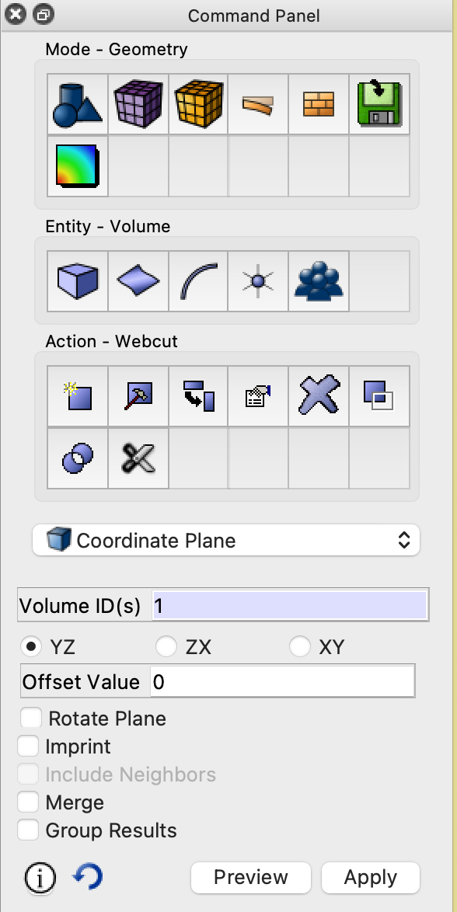

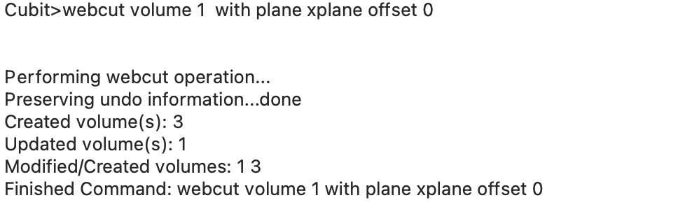
Step 4: Reduce ½ of the Pillbox Cavity
Under Geometry Mode
Click Entity-Volume
Click Action-Webcut;
Select Coordinate Plane;
Enter Volume ID {1};
Choose YZ Plane;
Offset value 0 (default)
Apply
1
2
3
4
6
5
7
Or type “webcut vol 1 with xplane ” in the command window.

Slide 24
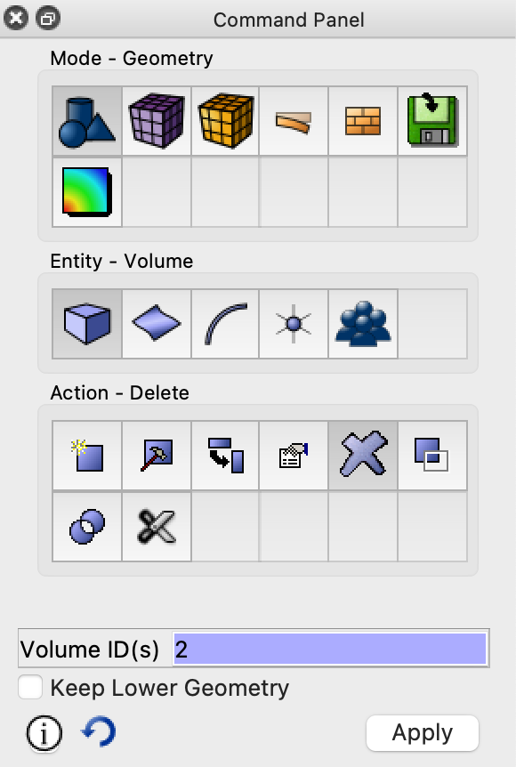

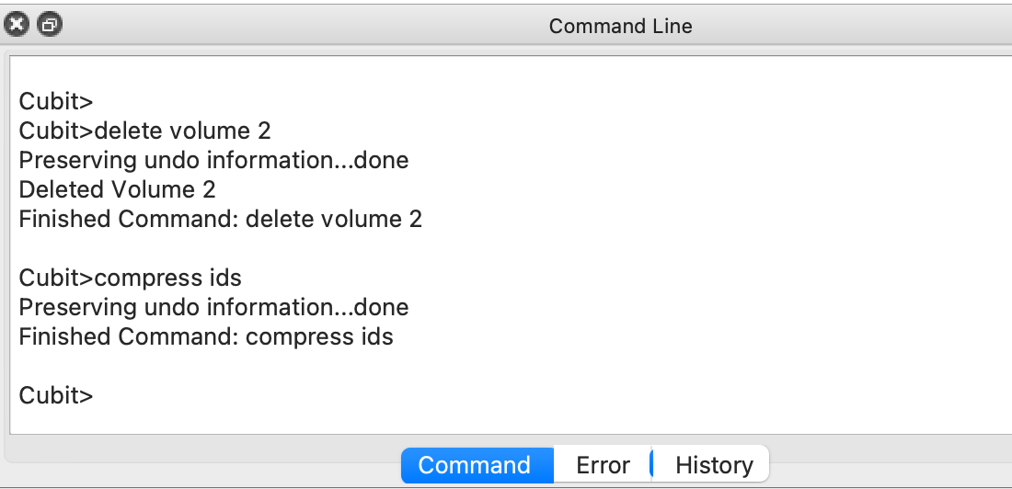
Delete Unneeded Volume
Under Mode-Geometry, Volume-Entity
Click Action-Delete;
Enter Volume ID {2};
Apply
1
del vol 2
compress ids
2
4
Good to “compress ids” after “unite” or “delete” entries
3

Slide 25
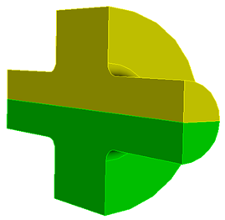
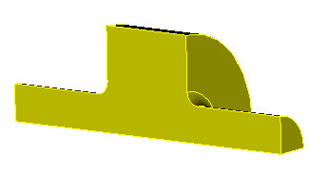

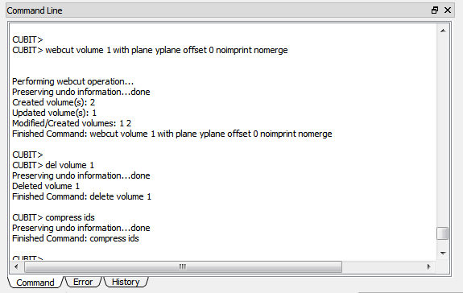
Step 5: Reduce 1/4 of the Pillbox Cavity
Del volume 1
Compress ids
1
webcut vol 1 with yplane
2
3
Good to “compress ids” after “unite” or “delete” entries

Slide 26
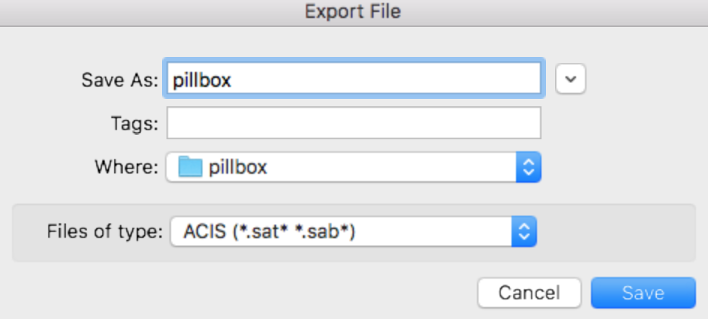
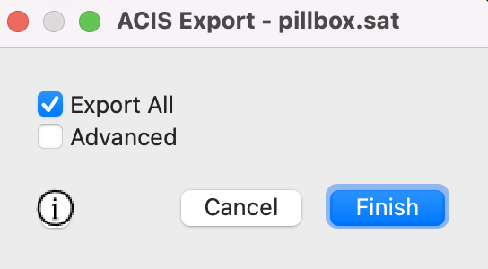

Save the Model in ACIS (.sat) Format
Click File option from Drop Down Menu
Choose Export…
Choose *.sat format
Enter file name: pillbox
Hit “Save”
Choose Export all
Hit Finish

Slide 27
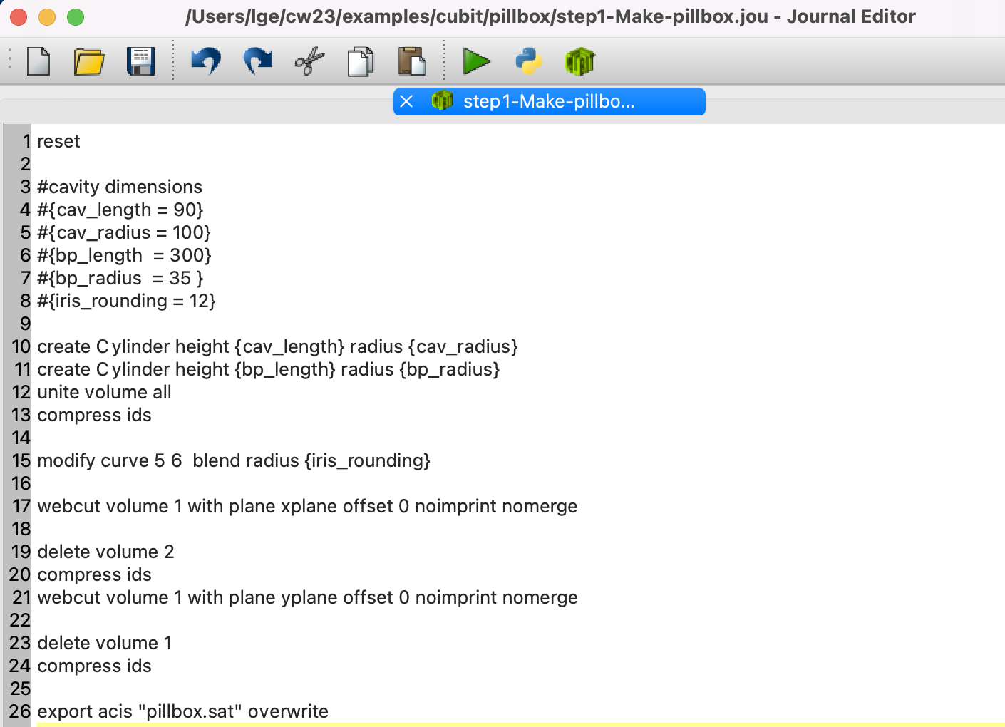
Modeling a Pillbox Cavity with Journal Files
Every command entered with buttons in the GUI version or typed in command window has been recorded in CUBIT’s command language in command tab as well as listed in history tab
Collect and edit these commands in a journal file, and run through the commands in the journal file by “play” it

Slide 28
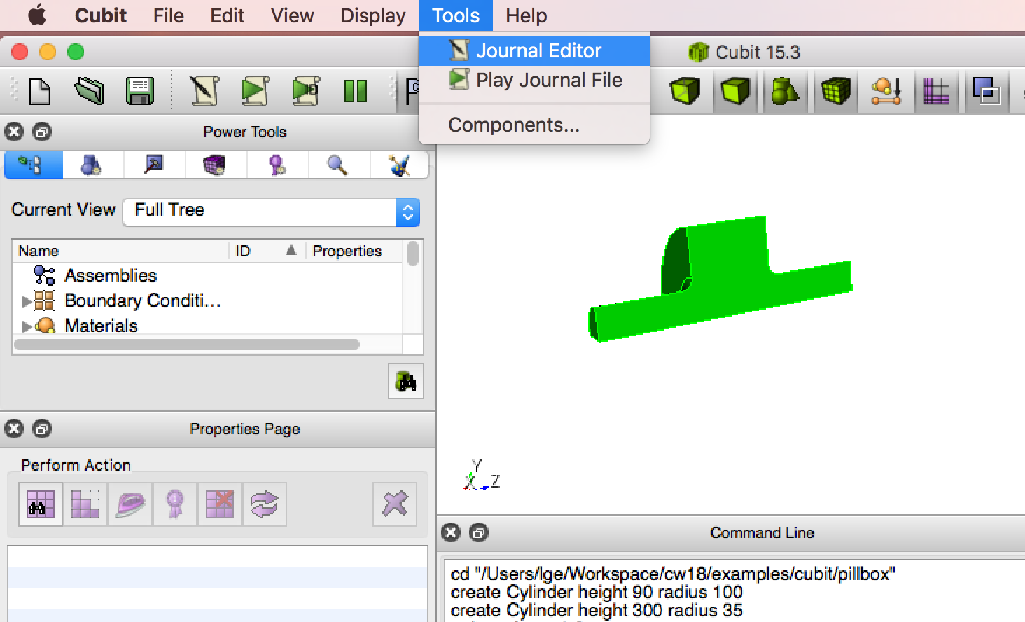
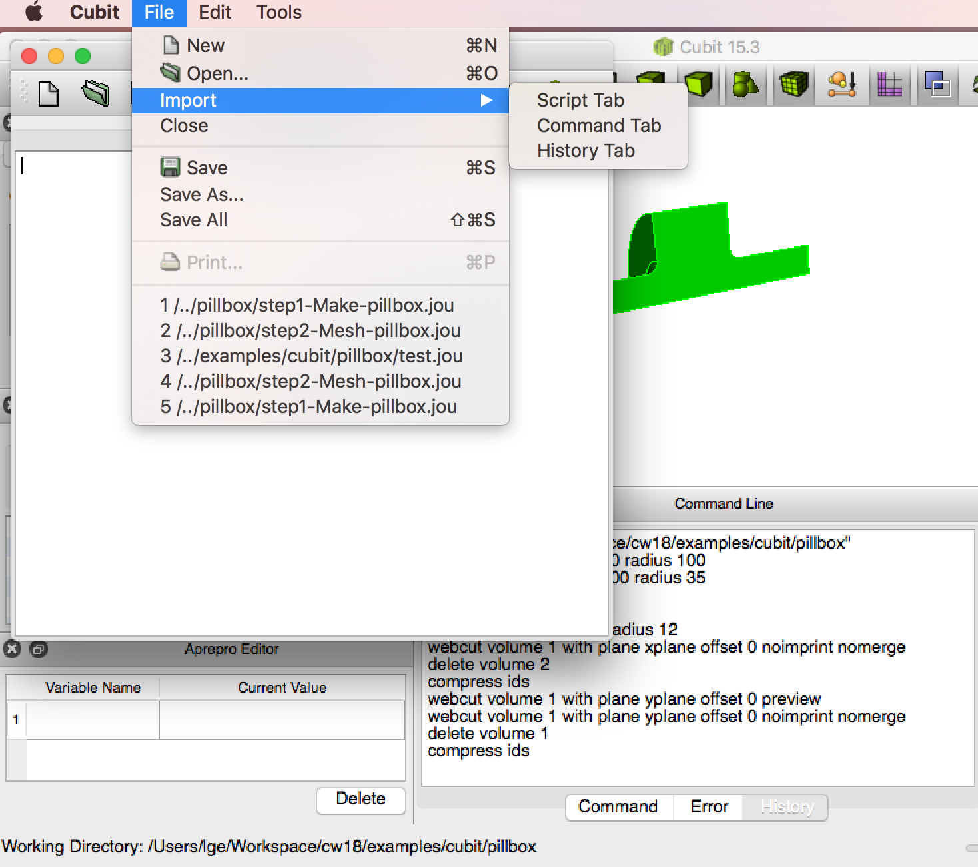

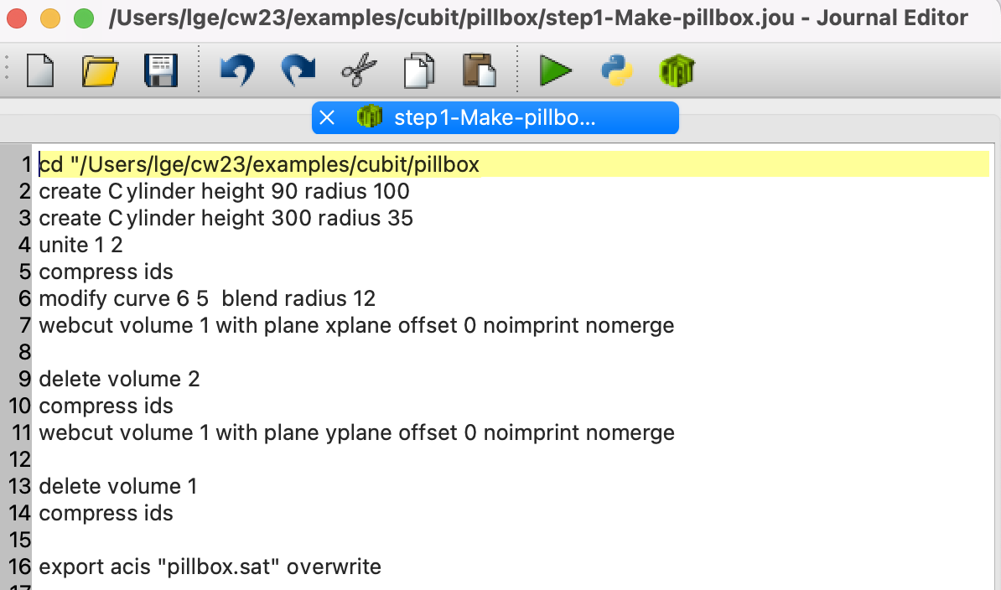
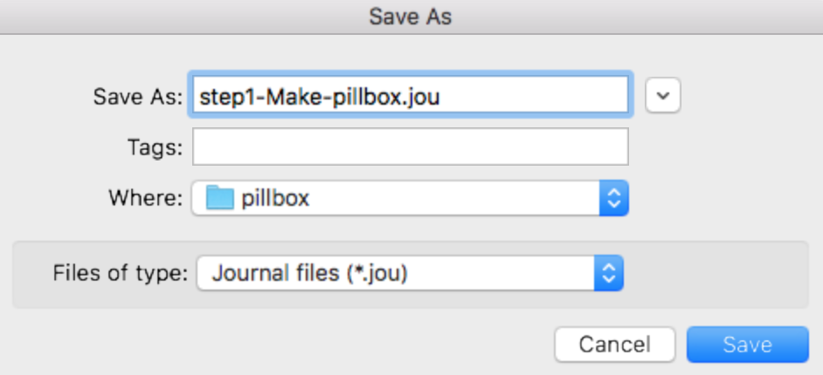
Create Pillbox Cavity Journal File
Tools
Tools -> Journal Editor
In Journal Editor window: File -> Import -> Command Tab
save to a file as *.jou format (eg. step1-Make-pillbox.jou)

Slide 29
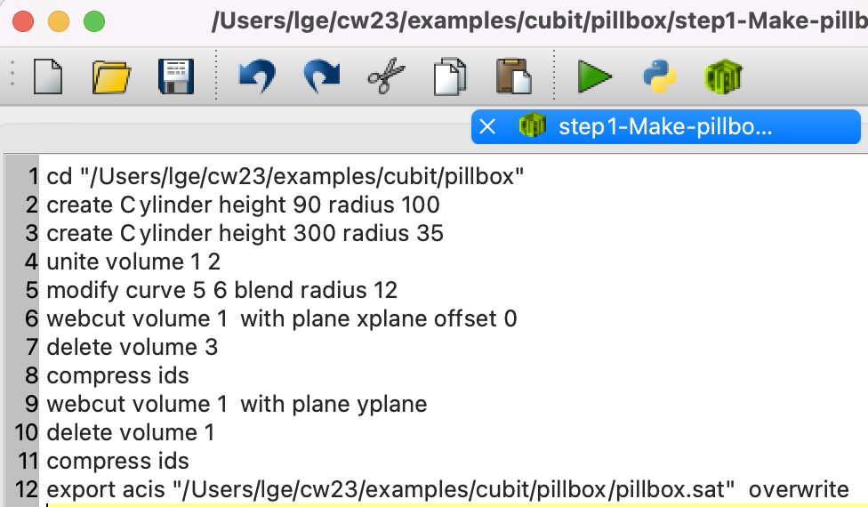
Edit Journal File: step1-Make-pillbox.jou
reset
#cavity dimensions
#{cav_length = 90}
#{cav_radius = 100}
#{bp_length = 300}
#{bp_radius = 35 }
#{iris_rounding = 12}
create Cylinder height {cav_length} radius {cav_radius}
create Cylinder height {bp_length} radius {bp_radius}
unite volume 1 2
compress ids
modify curve 6 5 blend radius {iris_rounding}
webcut volume 1 with plane xplane offset 0 noimprint nomerge
delete volume 2
compress ids
webcut volume 1 with plane yplane offset 0 noimprint nomerge
delete volume 1
compress ids
export acis "pillbox.sat" overwrite
Add “reset” at top to clean up the workspace when “play” the step1-Make-pillbox.jou
Define variables
Replace numbers with variables in {}
step1-Make-pillbox.jou
Add “overwrite” to replace previous one

Slide 30
Play the Journal file to Create a Pillbox Cavity
Tools->play journal files: select “step1-Make-pillbox.jou”
play

Slide 31
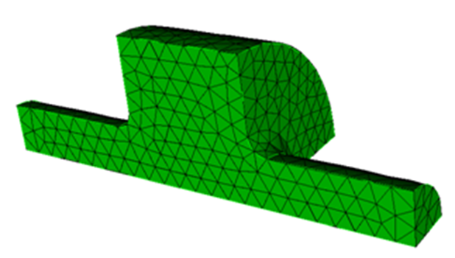
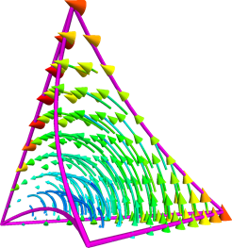
Cubic - Mesh Generation
Solid model: pillbox.sat
vol all scheme tetmesh
block all element type tetra10
tetrahedral mesh with quadratic surface for complicated structure modeling

Slide 32
Import the Solid Model (*.sat)
- check and fix bad geometries using power tools (see tips for meshing)
- imprint and merge body all if there are multi volumes
Choose Tet mesh scheme
Set the mesh interval (~wavelength/10, ~bunch length/3) and generate tetrahedral mesh - check mesh quality
Apply BCs at interior & exterior surfaces - check sidesets
Set block IDs for volume material attributes - check blocks
Set element type tetra10
Scale units if needed export the mesh (*.gen)
Meshing Process
Orders can be exchanged

Slide 33
Create Mesh Journal File
Reset
Cd: “your working directory”// pillbox in this directory
##import model
import acis "pillbox.sat"
##choose Tet mesh
vol all scheme tetmesh
##uniform or adaptive meshes
##Volume 1 size 10
volume 1 sizing function type skeleton
mesh volume 1
##apply BC (1 & 2: ends of beampipe, 3& 4: sym. Planes)
sideset 1 surface X
sideset 2 surface X
sideset 3 surface X
sideset 4 surface X
#exterior surfaces
sideset 6 surface all except XXXX
##set block ID
block 1 volume all
##set block element type
block 1 element type tetra10
##scale units and export mesh
volume 1 scale 0.001
export genesis "pillbox.gen" overwrite
step2-Mesh-pillbox.jou

Slide 34
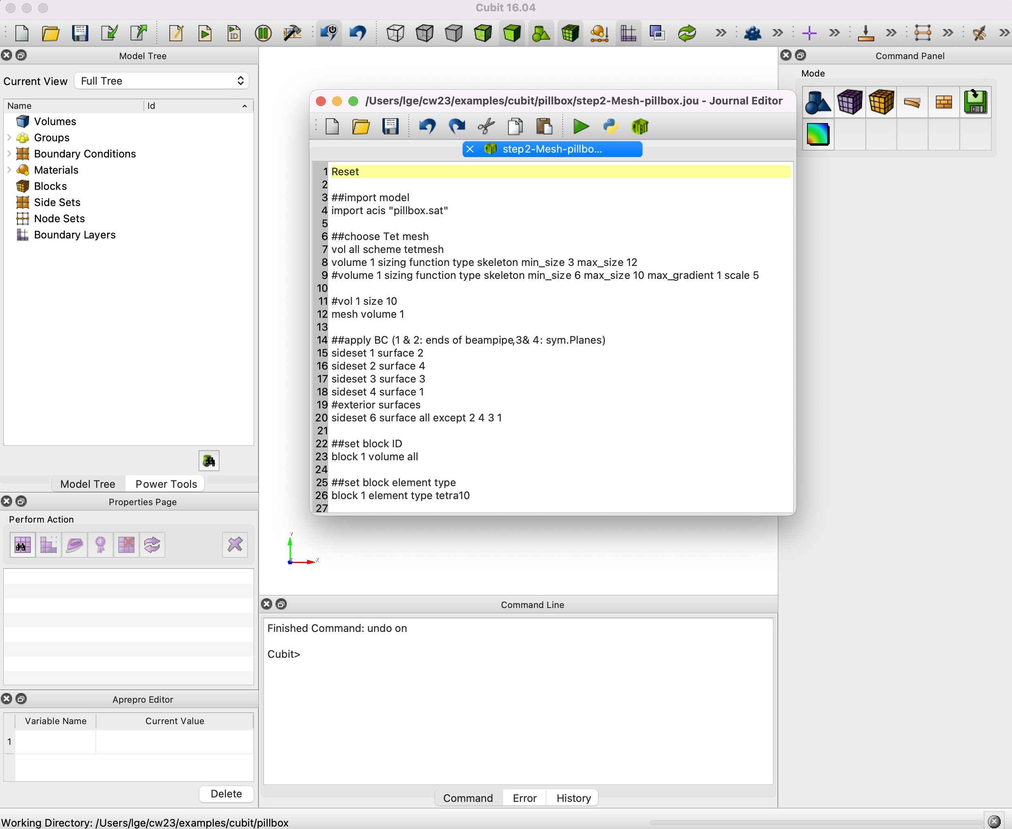
Open the Mesh Journal File
1. Click File -> Set Directory,
select working directory
2. Click Tools -> Journal Edit
3. Click Open- >
open step2-Mesh-pillbox.jou

Slide 35
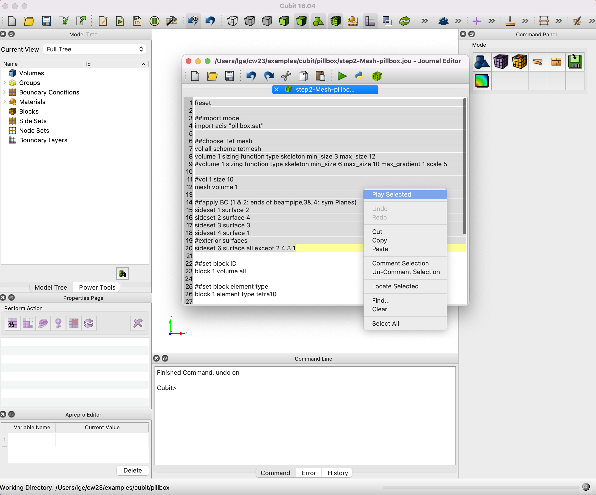
Play and Edit the Mesh Journal File
Play the commands in step2-Mesh-pillbox.jou and edit as needed.
Highlight through each command, right click, select “Play Selected”

Slide 36
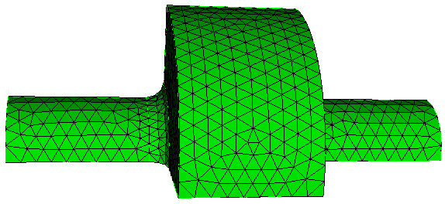
Uniform Meshes
vol 1 size 10
Mesh vol 1
Generate a few meshes with different mesh qualities and do mesh convergence study

Slide 37
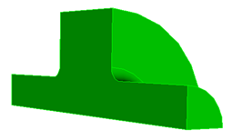


Delete Unsatisfied Mesh
1
2
Mode-Mesh
Entity-Volume
Action-Delete
Volume ID(s) {1}
Apply
3
4
5
Or type “del mesh vol 1” in the command window.

Slide 38

Adaptive Meshes
file:///Applications/Cubit-16.04/Cubit.app/Contents/MacOS/help/cubithelp.htm
Basic Arguments
max_size (default=auto): The value for max_size is calculated automatically by default.
min_size(default=auto): The value for min_size is calculated automatically by default.
max_gradient (1.0 to 3.0, default 1.5): The transition in element size is controlled using this parameter. Larger values of max_gradient result in fewer elements, but also lead to more abrupt transitions in size and possibly poorer quality elements.
Scaling and Accuracy Arguments:
scale (1 to 10, default 7): The overall size of the elements is controlled by this argument. A coarser mesh can be generated by increasing the value of scale up to 10.0. To get a finer mesh, decrease the value of the scale (minimum value = 1).
time_accuracy_level (1 to 3, default 2): This controls the computational time and accuracy level by adjusting various internal parameters of the skeleton sizing function. Users should try levels in increasing order. Level 1 takes the shortest time to compute the skeleton sizing function and Level 3 takes the longest time to compute the skeleton sizing function.
volume 1 sizing function type skeleton min_size 6 max_size 10 max_gradient 1 scale 5

Slide 39


Select One or a Group of Surfaces

Slide 40

Apply BCs at Interior & Exterior Surfaces
Define the end of the right beampipe
Sideset 1 surface 2
Define the end of the left beampipe
Sideset 2 surface 4
Define symmetry plane 1
Sideset 3 surface 3
Define symmetry plane 2
Sideset 4 surface 1
Define exterior surfaces
Sideset 6 surface all except 2 4 3 1

Slide 41


Set Block ID for Volume Material Attributes
Mode-Exodus ->Manage Material and Exodus Entity ;
Entity-Block -> Manage Exodus Block;
Action-Manage -> Action Block;
Add;
Block ID {1};
Volume;
IDs {all}; or {1}
Apply
1
2
3
4
5
6
7
8
Or type “block 1 vol 1” in the command window.

Slide 42


Check BCs and Mesh Quality

Slide 43
Tips for Meshing
Check and clean models first using power tools
Imprint and merge body all before meshing for a multivolume model
Group merged surfaces using command group “name” add surface with is_merged
Mesh smaller surfaces first, which have good mesh representation
Sometimes it is good to separate one volume into multi-volumes and mesh them with different mesh element sizes and sizing functions
Smooth transition from coarse to dense regions
Start with a coarse mesh and refine the mesh to check accuracy
  Check mesh quality using “quality vol all distortion”

Slide 44



Working Flow Before Running ACE3P
Step1-Model-pillbox.jou -> pillbox.sat → step2-Mesh-pillbox.jou -> pillbox.gen
Cubit on local machine
acdtool
Acdtool and ACE3P on NERSC
ACE3P
pillbox.ncdf
Paraview on local machine

Slide 45

acdtool is a collection of tools to do prep/post processing.
Acdtool for prep-processing: acdtool meshconvert *.gen
Acdtool - Converting Mesh Format
convert cubit mesh in GENESIS format to SLAC ncdf format mesh
exam mesh statistics, quality, and correctness
check and remove invalid second order tetrahedral elements
Invalid element

Slide 46
Your Working Directory on NERSC-Perlmutter
Logging to Perlmutter
  from the terminal run the command
      Local $ ssh <username>@perlmutter-p1.nersc.gov
      <username> is you NERSC user ID
Go to your cw23/example/cubit/pillbox cubit directory
  cd cw23/exercise/cubit/pillbox
Transfer files to NERSC Computer
  scp <srcfile> <username>@Perlmutter-p1.nersc.gov:<dstpath>
  scp pillbox.gen <username>@ Perlmutter-p1.nersc.gov: /pscratch/sd/l/lge/cw23/exercise/cubit/pillbox
  scp run-meshconvert.batch <username>@ Perlmutter-p1.nersc.gov: /pscratch/sd/l /lge/cw23/exercise/cubit/pillbox

Slide 47
Run acdtool on NERSC-Edison
Submit job: sbatch run-meshconvert.batch
#!/bin/bash -l
#SBATCH -C cpu
#SBATCH -q shared
#SBATCH -A m349
#SBATCH -t 00:10:00
#SBATCH -J myjob
#SBATCH -e ace3p.e%j
#SBATCH -o ace3p.o%j
export DIR=$PWD
cd $DIR
srun -n 1 --cpu-bind=cores /global/cfs/cdirs/ace3p/perlmutter/CPU/acdtool meshconvert pillbox.gen
Once your job done, pillbox.ncdf will be generated.
Check acdtool.log for mesh quality

Slide 48

Acdtool.log
If Euler Char is not OK, do not use it for ACE3P simulation. The mesh has some problems. For example, sidesets are incomplete or overlap each other.
If aspect ratio > 20, shape measure <0.01, it might take longer time to get the results from ACE3P.

Slide 49

Visualize Meshes in Paraview
Transfer back your mesh file (pillbox.ncdf) to your local machine
Launch paraview
Load SLAC tool box from tool menu -> manage plugin -> SLACTools

Slide 50


Visualize Imperfect Meshes in Paraview
If there are some bad elements in mesh, there will be a warning in acdtool.log, such as larger aspect ratio, small shape measure, and *.vtu files will be generated.
Load these files in Paraview to see where they are, and where you should refine the mesh.
Load *.ncdf file;
File -> open, select one *.vtu file to open;
Edit *.vtu mesh color
Make *.ncdf mesh in transparent

