Slide 1
Computer Setup
Accelerator Code Workshop
Stanford, March 27 – 31, 2023
Computational Electrodynamics Department
SLAC National Accelerator Laboratory

Slide 2
Contents
Internet Connection & Workshop Materials
Required Software & Introduction to NERSC
Connecting to NERSC (Linux/iOS/Windows)
Working on NERSC (Unix commands/editors)
Transferring Files (SCP)
Configuring sshproxy for logins
ACE3P modules and files
Submitting Jobs on NERSC
ParaView Setup

Slide 3
Internet Access
Wi-Fi ‘SLAC-VISITOR’ network is available in the meeting room
Open your browser to any non-encrypted web page
such as http://www.google.com/
Complete the registration form and press the ‘I agree’ button

Slide 4
Workshop Materials
CW23 Website:
  https://conf.slac.stanford.edu/cw
Tutorials:
  https://confluence.slac.stanford.edu/display/AdvComp/Materials+for+CW23
ACE3P-CW23 SLACK:
  Check your email for signup information

Slide 5
Required Software: Pre- and Post-processing
Cubit v. 16.08
Pre-processing tool for solid modeling and meshing
https://cubit.sandia.gov/
Requires a license
ParaView v. 5.11.0
Post-processing and data visualization tool
http://www.paraview.org/
Free software

Slide 6
Working at NERSC
The National Energy Research Scientific Computing Center (NERSC) is a High Performance Computing user facility operated by Lawrence Berkeley National Laboratory. Perlmutter is NERSC’s primary computing system (Cori will be retired very soon).
Perlmutter has 1792 GPU nodes and 3072 CPU nodes
  GPU nodes: 1x AMD EPYC 7763 + 4x NVIDIA A100 processors
  CPU nodes: 2x AMD EPYC 7763 processors
ACE3P currently only runs on CPU processors
  64 cores per CPU (128 per node)
  512GB DDR4 memory per node
  39.2 GFlops per core (2.51 TFlops per CPU)
  Additional information can be found at: https://docs.nersc.gov/systems/perlmutter/architecture/

Slide 7
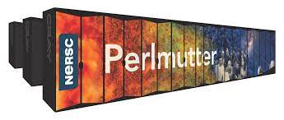
ACE3P Workflow on NERSC systems
Most pre- and post-processing will be performed on your own local laptop
Simulations will be run on National Energy Research Scientific Computing Center (NERSC) systems
Secure SSH Connection
Your Laptop
Cubit
ParaView
NERSC Perlmutter
acdtool
ACE3P

Slide 8
Secure Connection to NERSC
  Linux/iOS: normally installed by default in Unix terminals
  ssh – secure shell client
  scp – secure file transfer tool
  Windows 10+: ssh/scp available via cmd or PowerShell
  Optional software:
  PuTTY – secure shell client (alternative option) http://www.putty.org
  WinSCP – secure file transfer tool (GUI for file transfers)
  http://winscp.net
  NoMachine – virtual desktop client (GUI for NERSC)
  http://www.nomachine.com
  Text Editor: gedit, emacs, vi, notepad, notepad++, etc.

Slide 9
Unix Basics
  Copy files using cp
  cp <source_file> <destination_file>
Tip: Use cp -r to recursively copy directories
Remove files using rm
rm <file_name>
Tip: use rm -r to recursively delete directories
Make directories using mkdir
mkdir <directory_name>
View current working directory using pwd
Change file permissions using chmod <code>
chmod 755 <file_name>
Tip: use chmod -R 755 to recursively update directories
Tip: 755 code permissions are typical for most users

Slide 10
Editing files with vi
Open ‘vi’ editor (built-in on NERSC systems) with
vi <file_name>
Basic Operations
‘i’ – enter ‘insert’ (edit) mode
‘Esc’ – exit ‘insert’ (edit) mode
‘dd’ – remove the current line
‘u’ – undo previous command
‘:w’ – save the file
‘:q!’ – quit without saving
‘:qw’ – quit and save the file
‘G’ – go to the end of the file
‘gg’ – go to the beginning of the file

Slide 11
Logging into Perlmutter
From a suitable terminal run the command:
  ssh <username>@perlmutter-p1.nersc.gov
  Replace <username> with your NERSC user ID without angle brackets <>
Type ‘yes’ when asked “Are you sure you want to continue connecting (yes/no)?”
Enter your password+OTP when prompted
  You might not see any * when you are typing
  Your 6-digit one-time-password (OTP) is to be concatenated to your password without spaces

Slide 12
Setting up a working directory
Once logged in, the base directory is your home directory ‘~’ also linked with $HOME
  Copy ACE3P environment script to your home directory
    cp $CFS/ace3p/perlmutter/CPU/perlmutter-ace3p.sh .
  Create a folder cw23 on your scratch space
    mkdir $SCRATCH/cw23
  Tip: use echo $SCRATCH to view actual path
  Create a symlink ‘cw23’ for the scratch folder
  ln -s $SCRATCH/cw23 .
  Change directories using cd
  cd ~/cw23
  List the contents of a directory using ls
  ls ~/cw23

Slide 13
Transferring Files to/from NERSC with scp
Files can be transferred between your local computer and NERSC computers using the ‘scp’ command
Prefix ‘<username>@dtn01.nersc.gov:’ for remote files and directories (‘dtn01’ – ‘dtn04’ are data transfer nodes)
To copy from your computer to the remote directory, use:
scp <local_file> <username>@dtn01.nersc.gov:<remote_file>
To copy from the remote directory to your computer, use:
scp <username>@dtn01.nersc.gov:<remote_file> <local_file>
To copy your entire NERSC home directory, use ‘-r’ option:
scp -r <username>@dtn01.nersc.gov:~/ <local_dir>
Tip: use ‘.’ for <local_dir> to copy to your current directory

Slide 14
Using sshproxy for repeated logins for Linux/iOS
Use sshproxy instead of repeatedly using OTP
Linux/iOS: download sshproxy.sh from NERSC:
  scp <username>@dtn01.nersc.gov:/global/cfs/cdirs/mfa/NERSC-MFA/sshproxy.sh .
Run sshproxy.sh to generate a key
  ./sshproxy.sh -u <username>
Enter your password+OTP as before
  Three files will be created locally in ~/.ssh/nersc
Login with ssh using the generated key ‘nersc’
ssh -l <username> -i ~/.ssh/nersc perlmutter-p1.nersc.gov
Generated keys last 24 hours

Slide 15
Using sshproxy for repeated logins for Windows
Use sshproxy instead of repeatedly using OTP
Windows 10+: download sshproxy.exe from NERSC:
  scp <username>@dtn01.nersc.gov:/global/cfs/cdirs/mfa/NERSC-MFA/sshproxy.exe .
Run sshproxy.exe to generate a key in openssh format
  sshproxy.exe -u <username> --format openssh -o nersc
Enter your password+OTP as before
  The key file ‘nersc’ will be in the same directory
Login with ssh using the generated key ‘nersc’
  ssh -l <username> -i nersc perlmutter-p1.nersc.gov
Generated keys last 24 hours
PuTTY-formatted keys (.ppk) can be generated with
  sshproxy.exe -u <username> -o nersc

Slide 16
ACE3P Code Path
The path for ACE3P executables are located at
$CFS/ace3p/perlmutter/CPU/<ace3p_module>
Note: no need to download these (linking automatic)!
ACE3P modules (replace <ace3p_module> with a name):
acdtool – pre- and post-processing tool
omega3p – electromagnetic eigenmodes solver
s3p – s-parameters solver
t3p – time domain electromagnetic solver
tem3p – multiphysics analysis
track3p – multipacting and dark current solver
gun3p – space-charge and beam optics solver

Slide 17

ACE3P Input Files and Results
  ACE3P environment must be loaded once per session
  source ~/perlmutter-ace3p.sh
  ACE3P example input files and results at NERSC
  Input Files: $CFS/ace3p/cw23/exercises
  Examples: $CFS/ace3p/cw23/examples
  For CW23 you will need a local copy of the input files
    To download them visit the workshop materials page:
    https://confluence.slac.stanford.edu/display/AdvComp/Materials+for+CW23
    The bottom of the page has links
    to compressed file archives

Slide 18
ACE3P Input File Structure
ACE3P input files use the format: <project>.<ace3p_module>
For example: cw23/examples/omega3p/pillbox/pillbox.omega3p
ModelInfo : {
File: ./pillbox4.ncdf
BoundaryCondition : {
Magnetic: 1, 2
Exterior: 6
}
SurfaceMaterial : {
ReferenceNumber: 6
Sigma: 5.8e7
}
}
FiniteElement: {
Order: 2
CurvedSurfaces: on
}
…
…
EigenSolver : {
NumEigenvalues: 2
FrequencyShift: 1.0e9
}
PostProcess : {
Toggle: on
ModeFile: mode
}

Slide 19
NERSC Batch Script File Structure
NERSC uses the SLURM batch system
ACE3P batch scripts are typically named: run-<ace3p_module>.batch
For example: cw23/examples/omega3p/pillbox/run-omega3p.batch
#!/bin/bash -l
#SBATCH -C cpu
#SBATCH -q debug
#SBATCH -A m349
#SBATCH -N 1
#SBATCH -t 00:10:00
#SBATCH -J myjob
#SBATCH -e ace3p.e%j
#SBATCH -o ace3p.o%j
srun -n 16 -c 16 --cpu-bind=cores /global/cfs/cdirs/ace3p/perlmutter/CPU/omega3p PillboxCoax.omega3p
See https://docs.nersc.gov/jobs/#commonly-used-options for additional information
Run bash
Specify CPU nodes for Perlmutter
Use ‘debug’ queue for testing, ‘regular’ for larger jobs
Use ‘m349’ allocation
Request 1 computing node (128 cores per node)
Request 10 minutes of computing time
Set the job name
Write errors to .err file
Write output to .out file
Run solver using 16 tasks across 128 cores

Slide 20
Running Jobs on Perlmutter
  Submit the job to queue using sbatch
  sbatch <your_batch_script>
Check job status using squeue or sqs
squeue -u <username>
sqs
Cancel jobs using scancel
scancel <job_id>
Check the job log/output as it runs using tail
tail -f <job_log_file>
Tip: the job log/output files use the .log/.out suffixes

Slide 21
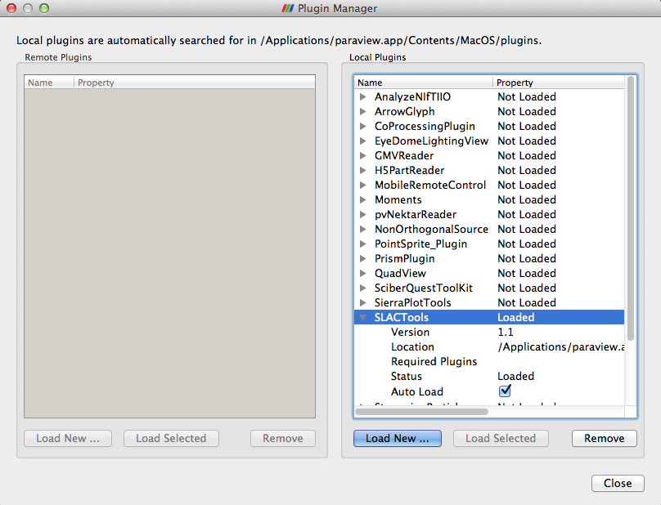
Configuring ParaView
  Enable SLAC toolbar
    Tools > Manage Plugins…
    Select SLACTools
    SLACTools > Auto Load
    Load macros
        Macros > Add new macro…
        Go to ‘cw23/macros’
        Load the following macros one by one:
          Track3P: enhancement.py, resonant_lineplot.py,
          resonant_location.py, trajectory.py
          T3P: wakeplot.py, timeFFT.py, fft.py

Slide 22
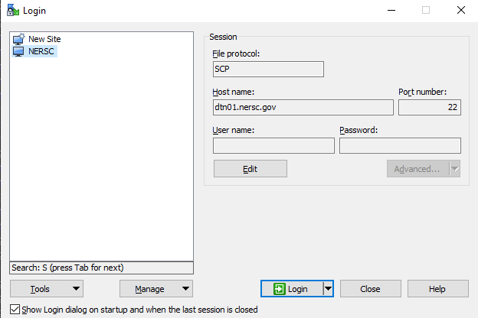
Transferring Files to/from NERSC with WinSCP
Run WinSCP
Create a new connection
Set file protocol: ‘SCP’
Set host name and port:
‘dtn01.nersc.gov’ and ‘22’
  Set your username
  Leave password blank
  Click save and login
  Enter your NERSC password+OTP when prompted
  Once connected, copy files from one panel to another
  Tip: a built-in text editor is included in WinSCP

Slide 23
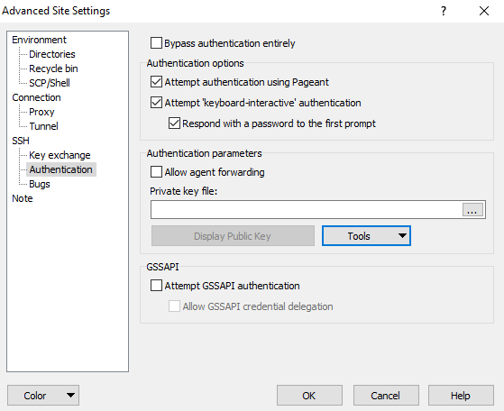
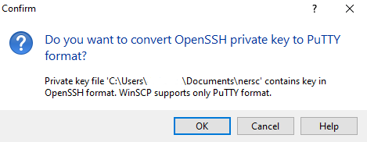
Using sshproxy with WinSCP
Select NERSC connection
Click ‘Edit’ > ‘Advanced’
Select SSH > Authentication
Select private key file
  Click ‘…’ to browse
Enter the ‘nersc’ key file path
  If browsing, view all files (*.*)
Agree to convert to PuTTY format
With ‘nersc.ppk’ file created/set
Click ‘OK’ > Click ‘Save’
Note: this process must be redone daily, alternatively a new .ppk key can be created with sshproxy.exe daily

Slide 24
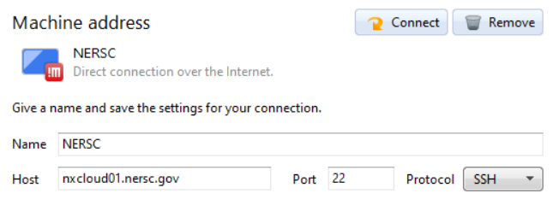
Setting up NoMachine
Download and install the NoMachine Enterprise Client:
https://www.nomachine.com/download-enterprise
Run NoMachine and add a connection with these details:
Under configuration select to use a user-provided key:

Slide 25
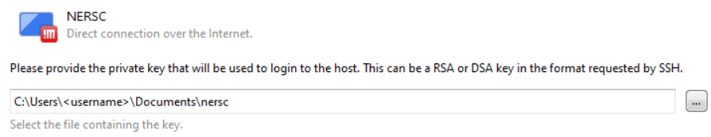
Setting up NoMachine
Locate the NERSC sshproxy key (openssh format):
Replace this path with where sshproxy.exe is installed!
Save these settings and close NoMachine
Locate the “player.cfg” file and open it for editing:
  C:\Users\<username>\.nx\config\player.cfg
Edit the “SSH client mode” key from “library” to “native”:
  <option key="SSH client mode" value="native" />
Save and close the “player.cfg” file

Slide 26
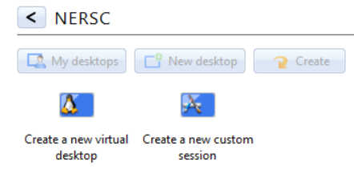
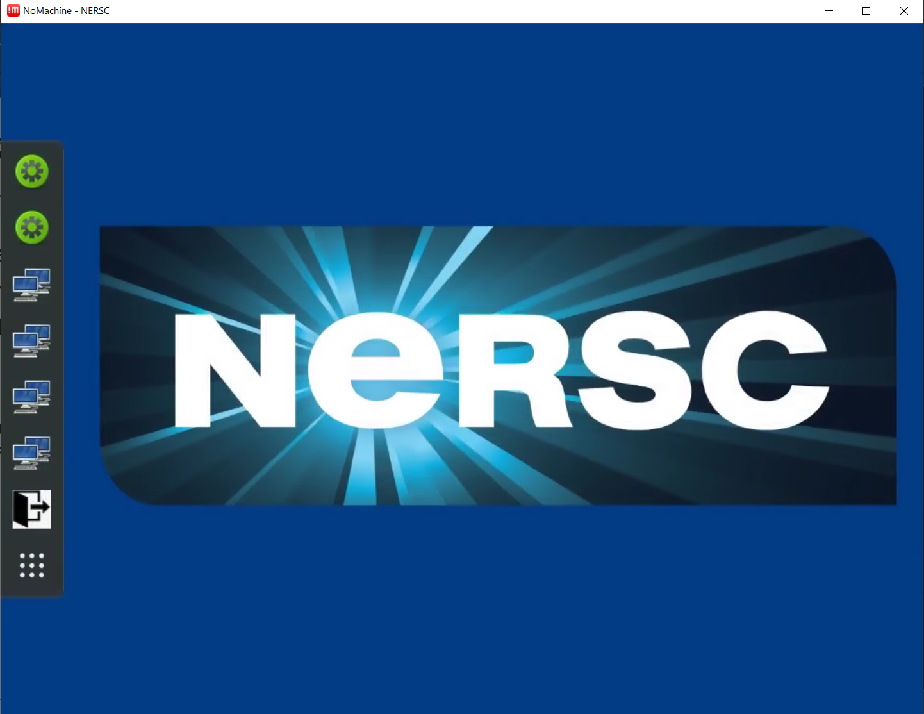
Setting up NoMachine
Reopen NoMachine: connect to the saved NERSC connection
Enter your NERSC username in the popup window
Select to “Yes” on the verify host authenticity window
Once connected create a
new virtual desktop
Tutorial popups can be skipped
These buttons open terminals
to Perlmutter, Cori, DTN nodes
For more information visit:
https://docs.nersc.gov/connect/nx/

