Slide 1
ACE3P-IMPACT Integration
Accelerator Code Workshop
Stanford, March 27 – 31, 2023
Computational Electrodynamics Department
SLAC National Accelerator Laboratory

Slide 2
Overview
Quick overview of IMPACT
Introduction to A3PI:
    ACE3P-IMPACT integration workflow tool
    SRF injector cavity example
How to use A3PI and configuring the setup file
Examining the workflow output data
Additional features of A3PI:
    MATLAB visualization tools
    Integration with libEnsemble¹ and DEAP²
    Multi-objective optimization
1: libEnsemble workflow manager: https://libensemble.readthedocs.io/en/main/
2: Distributed Evolutionary Algorithms in Python: https://deap.readthedocs.io/en/master/

Slide 3
Quick Overview of IMPACT
Integrated Map and Particle ACcelerator Tracking Code
  Two versions: IMPACT-T and IMPACT-Z
    T version: time as independent variable
    Z version: long. position as independent variable
  Full-3D space-charge tracking with wakefields and external fields
  Includes external beam elements in a lattice
  IMPACT-T version used for photoinjector simulations
  Accurately model particle bunches with multiple output monitors:
    Energy, energy spread, long./transverse emittance, etc.
  Built-in parallelism for HPC environments or local machines
  Flexible data structures with simple input/output file formats
  Written by Ji Qiang (LBL), 2016
Website with user guide: https://amac.lbl.gov/~jiqiang/IMPACT-T/index.html
Code source: https://github.com/impact-lbl/IMPACT-T

Slide 4
Quick Overview of IMPACT
IMPACT file formats:
  Input file format (.in file):
    Rows 1–9 specifying simulation and beam parameters
    Rows 10+ specifying lattice elements and in-line commands
  Output files (fort.__ files):
    Text file outputs for particles/bunch (see guide for more info)
    Column-based data easily imported to other viewers
  Field data input format (rfdata__ or data__.h5 files):
    Text file field data is modal or discrete (diff. IMPACT versions)
    Fields from “acdtool” in hdf5 need scaling and converting
    Phases must be carefully set to ensure acceleration
  A3PI will automatically convert, scale, and optimize phases for simulation set using A3PI setup file

Slide 5
Introduction to A3PI
A3PI is a workflow manager for ACE3P with IMPACT
  Created to interface codes for global end-to-end optimization
  Includes multi-objective optimization by interfacing with libEnsemble and DEAP libraries
  Written in Python (with MATLAB for visualization)
  Interfaces with Cubit, Omega3P, acdtool, IMPACT
    Manages input/output files/data for each code
    Executes steps sequentially in a task-chain
    Uses one single setup file for all codes together
    Facilitates changing parameters in a workflow
  Capable of task-chains to run in parallel
    Task chains are a sequence of codes/steps that are run

Slide 6
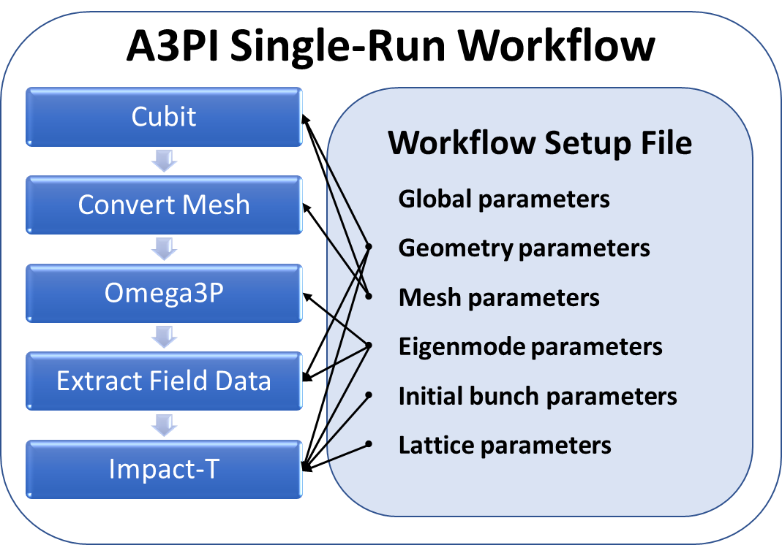
Introduction to A3PI
Typical A3PI workflow
Only one global setup file
Simple parameter changes
Modular code design:
  Tasks can be added/
  removed easily in chain
  Encapsulates workflow
  as a single “black-box”
  function for evaluation
  Python-based workflow can be run locally or on NERSC
Single-run workflows are run individually as a task-chain
Optimization using single-run workflows as functions possible with libEnsemble and DEAP libraries (more on this later)

Slide 7
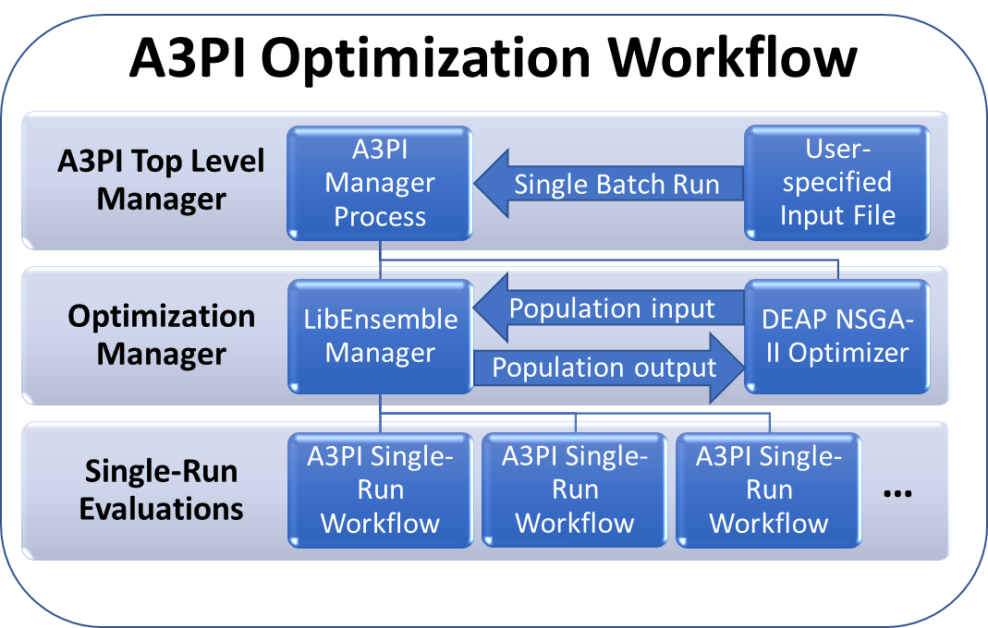
A3PI Multi-Objective Optimization
A3PI multi-objective optimization
  This feature not currently available on Perlmutter!
  LibEnsemble and DEAP python libraries required
  A3PI setup file includes [LIBENSEMBLE] section for optimization
  Multiple workflows run in parallel (serial task chain)
  [VARS] are updated
  each iteration to run
  new workflows
  History array output
  contain all relevant
  simulation data for
  optimization

Slide 8
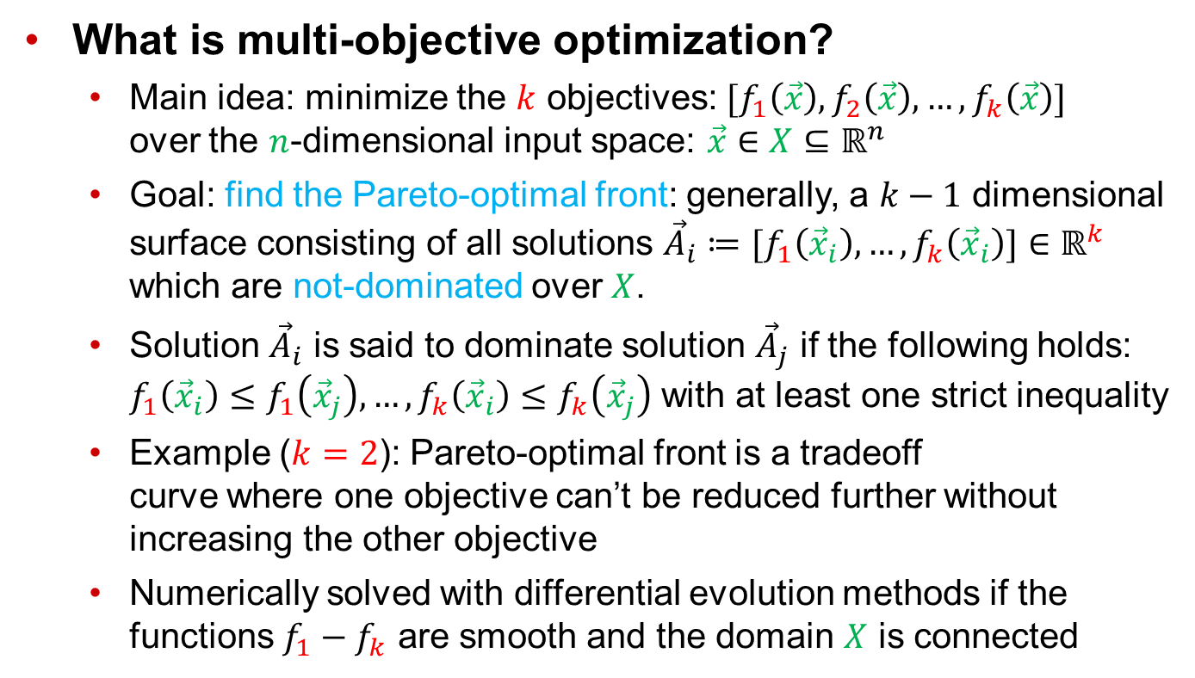
A3PI Multi-Objective Optimization
What is multi-objective optimization?
  Main idea: minimize the $k$ objectives: $[f_{1}\left(\vec{x}\right),f_{2}\left(\vec{x}\right),…,f_{k}\left(\vec{x}\right)]$
  over the $n$-dimensional input space: $\vec{x}∈X⊆ℝ^{n}$
  Goal: find the Pareto-optimal front: generally, a $k−1$ dimensional
  surface consisting of all solutions ${\vec{A}}_{i}≔[f_{1}\left({\vec{x}}_{i}\right),…,f_{k}\left({\vec{x}}_{i}\right)]∈ℝ^{k}$
  which are not-dominated over $X$.
  Solution ${\vec{A}}_{i}$ is said to dominate solution ${\vec{A}}_{j}$ if the following holds:
  $f_{1}\left({\vec{x}}_{i}\right)≤f_{1}\left({\vec{x}}_{j}\right), …,f_{k}\left({\vec{x}}_{i}\right)≤f_{k}\left({\vec{x}}_{j}\right)$ with at least one strict inequality
  Example ($k=2$): Pareto-optimal front is a tradeoff
  curve where one objective can’t be reduced further without
  increasing the other objective
  Numerically solved with differential evolution methods if the functions $f_{1}−f_{k}$ are smooth and the domain $X$ is connected

Slide 9
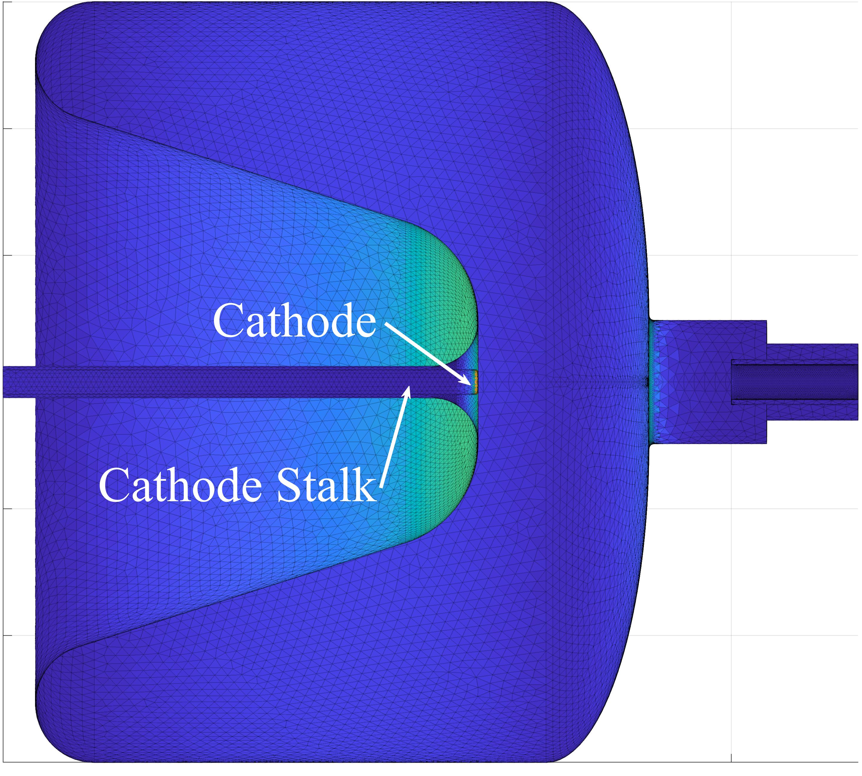
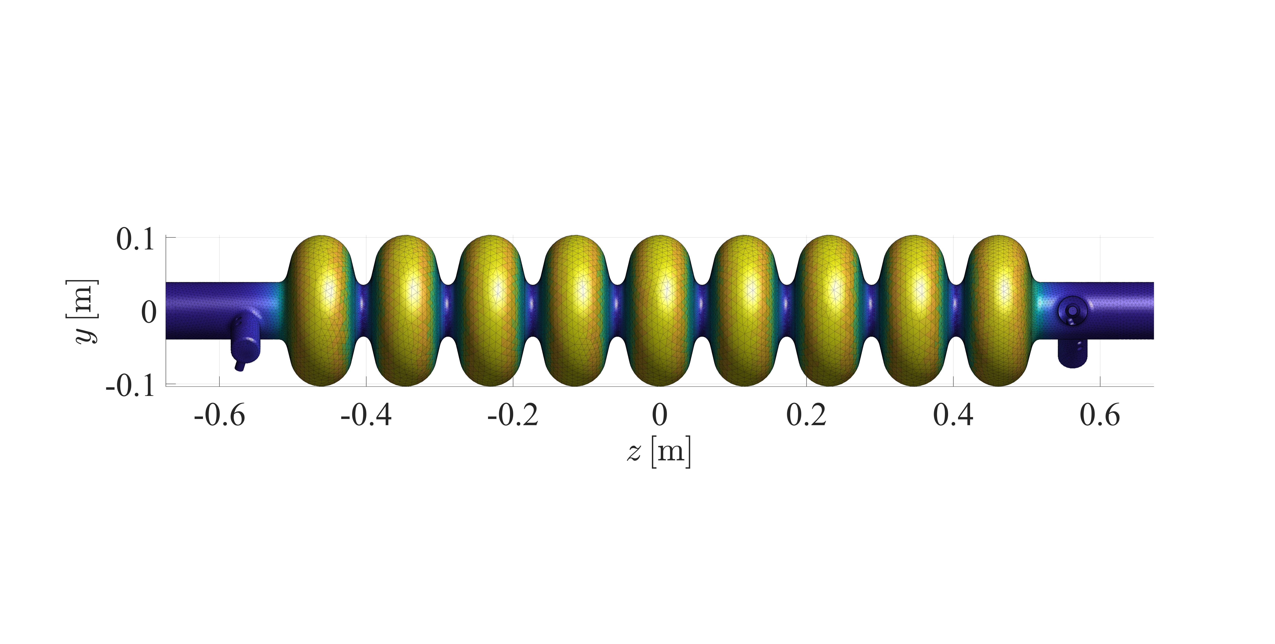
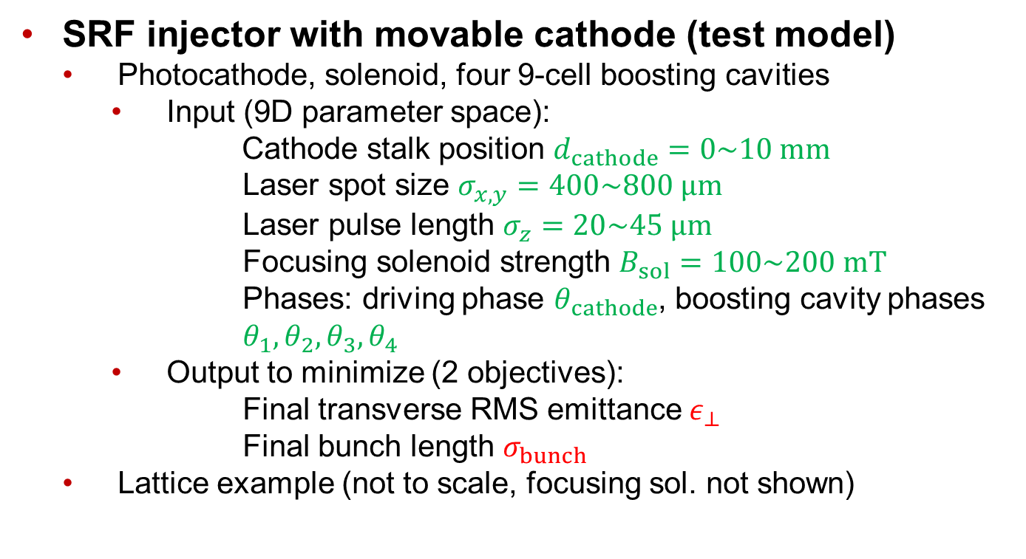
A3PI Multi-Objective Optimization Example
SRF injector with movable cathode (test model)
Photocathode, solenoid, four 9-cell boosting cavities
  Input (9D parameter space):
  Cathode stalk position $d_{cathode}=0\sim 10 mm$
      Laser spot size $σ_{x,y}=400\sim 800 μm$
      Laser pulse length $σ_{z}=20\sim 45 μm$
      Focusing solenoid strength $B_{sol}=100\sim 200 mT$
      Phases: driving phase $θ_{cathode}$, boosting cavity phases $θ_{1},θ_{2},θ_{3},θ_{4}$
  Output to minimize (2 objectives):
  Final transverse RMS emittance $ε_{⊥}$
  Final bunch length $σ_{bunch}$
Lattice example (not to scale, focusing sol. not shown)

Slide 10
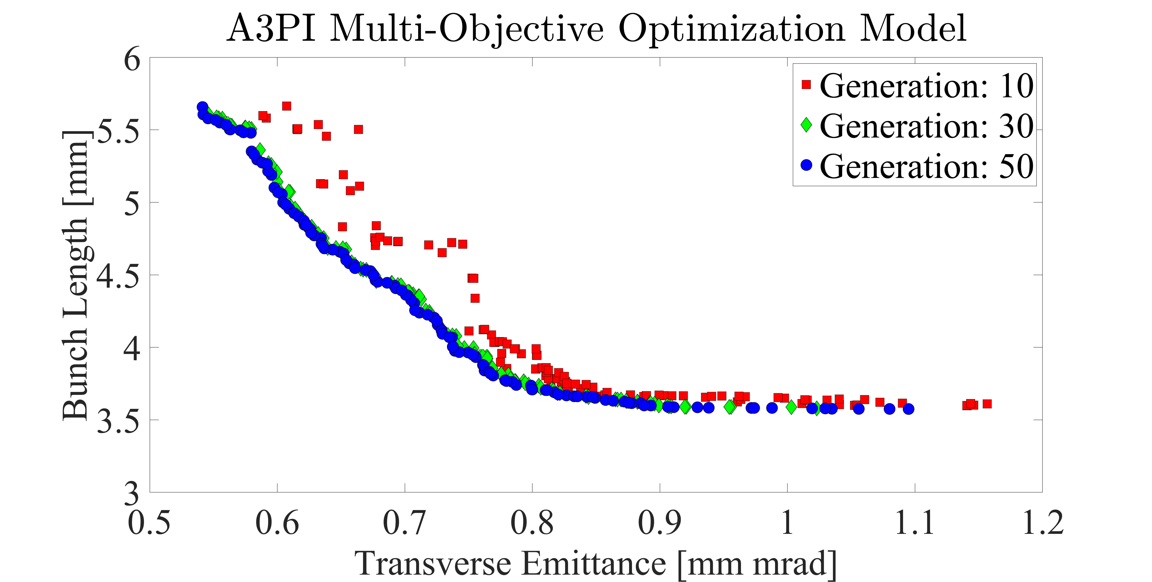
A3PI Multi-Objective Optimization Example
A3PI history array population by generation
  Plot of best 128 solutions at several generations
  Each data point represents a full workflow evaluation
  (adjusting the 9 selected parameters within the given ranges)

Slide 11
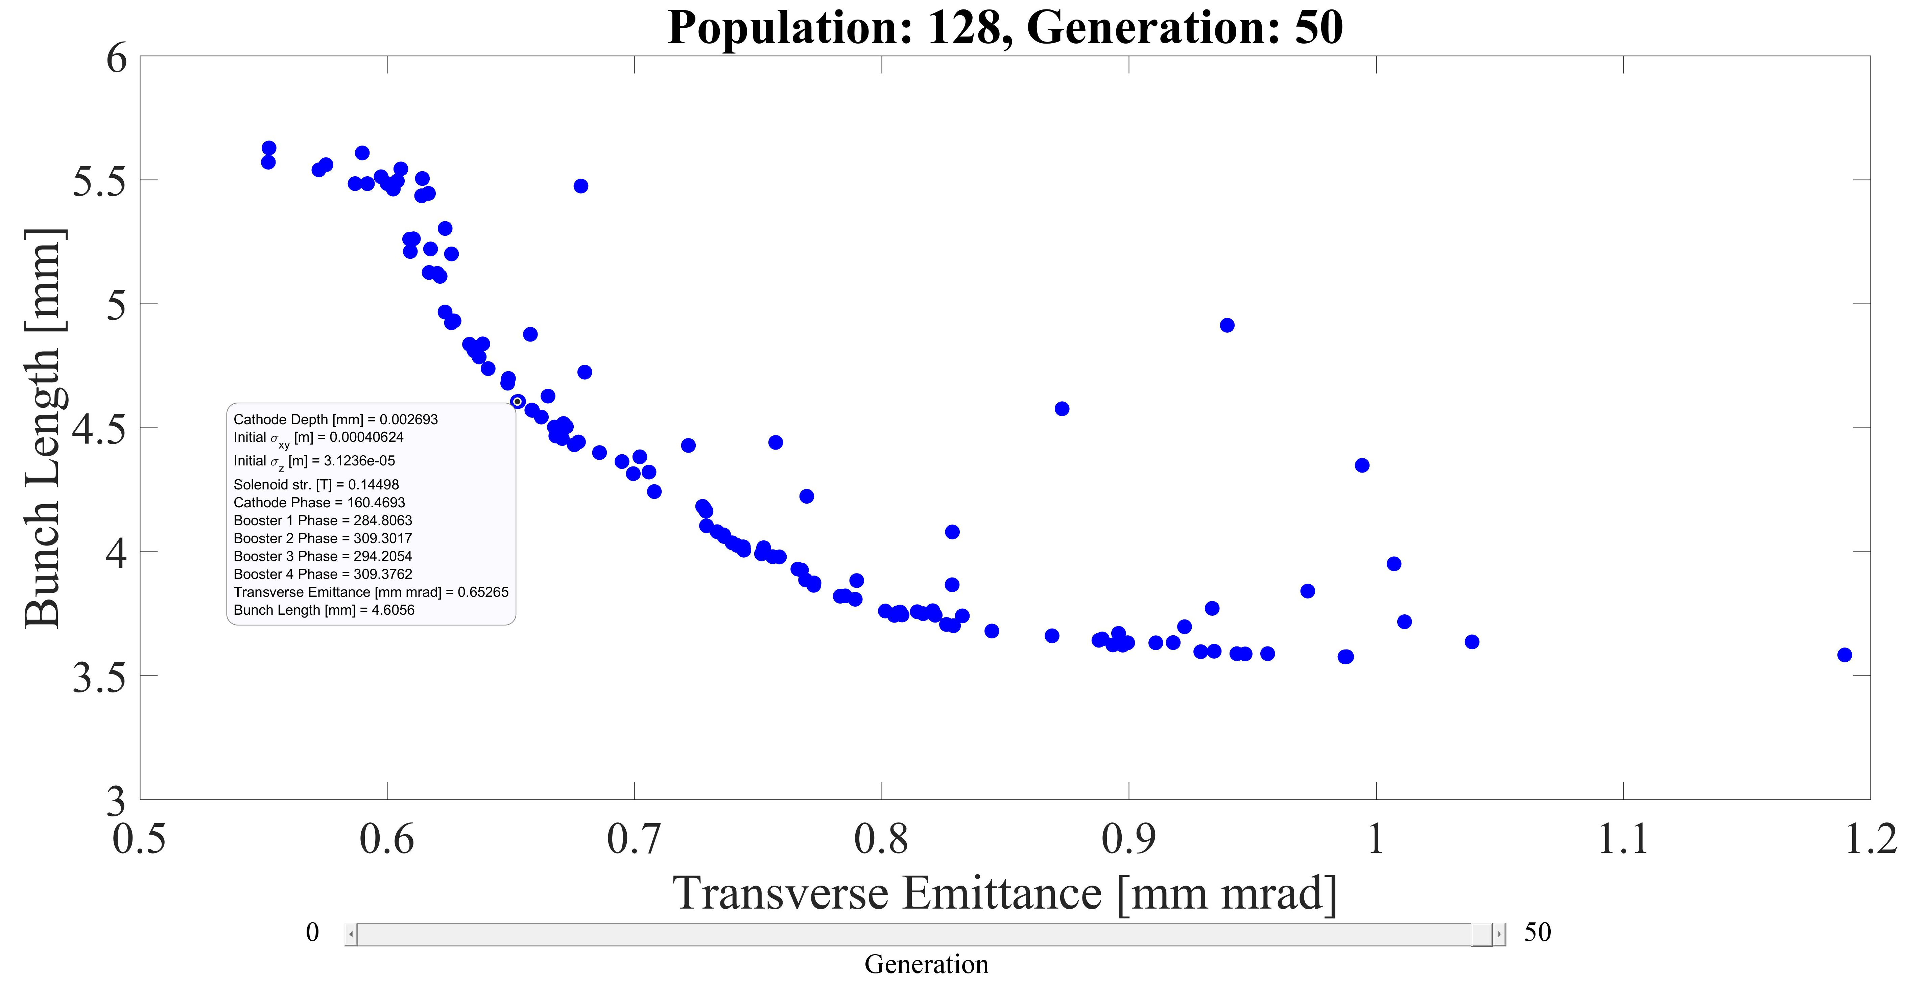
A3PI Multi-Objective Optimization Example
A3PI history array population by generation
  Interactive plotting by generation
  Custom data tooltip displays the input parameters

Slide 12
Setting up A3PI on Perlmutter
A3PI demo files: /global/cfs/cdirs/ace3p/cw23/exercises/A3PI
  A3PI example setup (text) file: A3PI_config_single
  A3PI example batch script: run-a3pi.batch
  Extra files for this demo: SRF-GUN-cathR10mm.ncdf
A3PI source files (batch file links this automatically):
  /global/cfs/cdirs/ace3p/cw23/examples/A3PI/src
To run this A3PI demo:
  Create a folder in your scratch workspace
  Copy the 3 listed exercise files into this created scratch folder
  Source ACE3P (only needed once per terminal to run ACE3P)
  Create a job with the command: sbatch run-a3pi.batch

Slide 13
How to use A3PI – Batch Script
Examining the process from the outer-most layer:
  Perlmutter batch script run-a3pi.batch in detail:
  Request 1 CPU node for 10 minutes
  Generate A3PI workflow from the setup file: A3PI_config_single
  Workflow automatically uses “srun” commands internally
#!/bin/bash
#SBATCH -C cpu
#SBATCH -q debug
#SBATCH -A m349
#SBATCH -N 1
#SBATCH -t 00:10:00
#SBATCH -J myjob
#SBATCH -e ace3p.e%j
#SBATCH -o ace3p.o%j
module load python
python /global/cfs/cdirs/ace3p/cw23/examples/A3PI/src/A3PI_WorkflowTemplate.py A3PI_config_single

Slide 14
A3PI Setup File – Variables
A3PI setup file and variables:
  A3PI uses the Python configparser class to define key/value pairs by section (each task in a workflow has its own section)
    Format sections: [section1]
    Format key/value pairs: key = value1 value2 …
    Format comments: #comment
  Examining the A3PI_config_single setup file in detail by section:
  The [VARS] section is used to
  define parameters that are
  to be adjusted several times
  Keys in the [VARS] section are
  used to replace quantities
  consistently throughout the
  workflow process for all codes at the same time!
[VARS]
sig_xy = 3.0e-4
sig_z = 6.0e-5
gun_scale = 2.00e6
gun_freq_shift = 1.98e6
gun_phase = 0.0
gun_fid = 300

Slide 15
A3PI Setup File – File/code paths
A3PI setup file paths and static files:
  The [PATH] section includes absolute paths where each executable is located (only those required for needed tasks)
  The workflow path is where A3PI is to run all the codes
  In this example, a folder named: workflow_test_single will be created in the directory where the demo files were placed
  All outputs except job log data will be in this workflow folder
[PATHS]
omega3p_path = /global/cfs/cdirs/ace3p/perlmutter/CPU/omega3p
acdtool_path = /global/cfs/cdirs/ace3p/perlmutter/CPU/acdtool
impactt_path = /global/cfs/cdirs/ace3p/perlmutter/CPU/ImpactTexeDisc
workflow_path = workflow_test_single

Slide 16
A3PI Setup File – Run parameters
A3PI setup file run parameters:
  The [RUN_PARAMETERS] section includes settings for A3PI such as mpi cores for some codes and static files
  Acdtool only uses multithreading for “postprocess rf”
  Workflow runs IMPACT-T only once (cores defined here)
  Static files can include fixed field data files, cubit journal files, mesh files, etc. (any extra files that any code needs to run)
  A3PI_mode can be set to “single” or “optimize” however, the “optimize” setting has not be implemented on Perlmutter yet
[RUN_PARAMETERS]
A3PI_mode = single
acdtool_cores = 128
impactt_cores = 64
static_files = SRF-GUN-cathR10mm.ncdf

Slide 17
A3PI Setup File – Omega3P
A3PI setup file Omega3P inputs:
  The [OMEGA3P_MODE_] sections contain run information to call Omega3P (each mode needs different section)
  Dynamic variables can be set with ${VARS:key} format
  Omega3P input file is generated automatically with this section (parsing is automatic, see A3PI guide for more details)
[OMEGA3P_MODE_1]
file = cavity_1.omega3p
tasks = 16
cores = 16
mode_fid = ${VARS:gun_fid}
ModelInfo_File = SRF-GUN-cathR10mm.ncdf
ModelInfo_Tolerant = 1
ModelInfo_BoundaryCondition = magnetic 1 2 5, electric 6
FiniteElement_Order = 2
FiniteElement_CurvedSurfaces = on
EigenSolver_NumEigenvalues = 1
EigenSolver_FrequencyShift = ${VARS:gun_freq_shift}

Slide 18
A3PI Setup File – Acdtool
A3PI setup file Acdtool postprocess inputs:
  The [RFPOST_MODE_] sections contain run information to call Omega3P (each mode needs different section)
  Mode numbers must match for acdtool and omega3p
    Multiple Omega3P and Acdtool “postprocess rf” runs per workflow possible (linking runs via mode numbers)
  Acdtool “postprocess rf” input file is generated automatically with this section (see A3PI guide for more details)
[RFPOST_MODE_1]
file = rfpost_1.in
RFField_ResultDir = omega3p_results
RFField_FreqScanID = 0
…
OpenPMD_IMPACT_z1 = 0.000
OpenPMD_IMPACT_z2 = 0.300

Slide 19
A3PI Setup File – IMPACT-T parameters
A3PI setup file IMPACT-T beam parameter inputs:
  The [IMPACTT_PARAMETERS] section contains first 9 rows in IMPACT-T input file as 9 key value pairs
  Dynamic variables can be set with ${VARS:key} format
  See IMPACT-T user guide for details on these 9 rows
  Entries in a line are separated with spaces
  Product of procs must equal “impactt_cores” (e.g. 8 x 8 = 64)
[IMPACTT_PARAMETERS]
procs = 8 8
steps = 4.0e-12 2000000 1
parts = 6 10000 1 0 2 0 0.02
mesh = 32 32 32 1 0.15 0.15 1.0e5
dist = 112 0 0 1300 6.5e-11
xdist = ${VARS:sig_xy} 0.001 0.0 1.0 1.0 0.0 0.0
ydist = ${VARS:sig_xy} 0.001 0.0 1.0 1.0 0.0 0.0
zdist = ${VARS:sig_z} 0.0014 0.0 1.186189e-6 1.0 0.0 0.002
beam = 0.26 1.0 0.511005e6 -1.0 1.3e9 0.0

Slide 20
A3PI Setup File – IMPACT-T lattice
A3PI setup file IMPACT-T lattice parameter inputs:
  The [IMPACTT_LATTICE] section contains rows 10+ in IMPACT-T input file as key value pairs for each lattice element
  Dynamic variables can be set with ${VARS:key} format
  See IMPACT-T user guide for details on these beam elements
  Lattice line key names “elem_xx” are arbitrary
    A3PI parses the lines in listed order
    Entries in a line are separated with spaces
    Beam element 111 uses the .h5 file format from acdtool
    Other IMPACT-T versions use element 111 in ascii file format
[IMPACTT_LATTICE]
elem_00 = 0.0 1 20 -5 -2.0 -2.0 -2.0
elem_01 = 0.3 105 20 111 0.0 ${VARS:gun_scale} 2.0E8 ${VARS:gun_phase} ${VARS:gun_fid} 0.1 0.0 0.0 0.0 0.0

Slide 21
A3PI Setup File – Workflow tasks
A3PI setup file workflow tasks:
  Workflow tasks in key/value pair (key names arbitrary)
  Workflow evaluates in order listed (task numbers not needed)
  Each task must use a code and argument
    “omega3p 1” → runs Omega3P using inputs in [OMEGA3P_MODE_1] section (number must match mode!)
    “rfpost 1” → runs acdtool postprocess rf using inputs in [RFPOST_1] section (number must match mode!)
    “impactt 2” → runs single-threaded IMPACT-T for phase scan routine followed by full particle multi-threaded IMPACT-T
    See A3PI guide for all
    possible arguments
[WORKFLOW]
task_01 = omega3p 1
task_02 = rfpost 1
task_03 = impactt 2

Slide 22
A3PI Setup File – Additional Options
A3PI setup file can include other sections:
  Cubit tasks: [CUBIT_ELEMENT_] can be included in task chain
    Link [VARS] to an existing journal file (.jou) and run (w/o GUI)
  Acdtool “meshconvert” can be included in task chain (after Cubit)
  Optimization options: [LIBENSEMBLE] section can be included
    Allows for optimization cycles over multiple concurrent workflows and manages which [VARS] to optimize over
    More details in later slides
  Field interpolation routines (speed-up optimization cycle)
    Alternative to running Cubit → Omega3P → Acdtool chain
    Not recommended anymore since Perlmutter nodes are better for running Omega3P with more memory
  See A3PI user guide for additional information

Slide 23
A3PI Outputs – What to expect
A3PI workflow folders will contain a lot of files!
  A copy of the A3PI workflow setup file itself
  All static files used (the .ncdf mesh in the demo example)
  Omega3p files (omega3_results folder)
  Acdtool files (rfpost_1.in, rfpost.out files, acdtool logs)
  Acdtool field output (large data__.h5 files)
  Some rfdata__ and .T7 files (converted from .h5 for phase scan)
  IMPACT-T file input (ImpactT.in file with corrected phases)
  IMPACT-T executable (since it must be run in same directory)
  IMPACT-T outputs (various fort.xx files)
  Phase_scan folders (used for calibrating the phases)
    Can be set to be automatically deleted but are usually small

Slide 24
A3PI Outputs – Checking the results
A3PI file outputs and visualization
  Omega3p outputs (omega3p_results with .mod file)
  Acdtool outputs (data__.h5 files can be viewed externally)
    FileID → real part of E field (e.g. data300.h5)
    FileID+1 → imag part of E field (e.g. data301.h5)
    FileID+2 → real part of B field (e.g. data302.h5)
    FileID+3 → imag part of B field (e.g. data303.h5)
    Warning: fileIDs must be 3+ digit numbers (at least 4 apart!)
  IMPACT-T outputs (fort.xx files) contain the data of interest
    See IMPACT-T user guide for more information on each file
  Included MATLAB scripts in can plot fields and particles
    Note: some MATLAB experience is recommended!

Slide 25
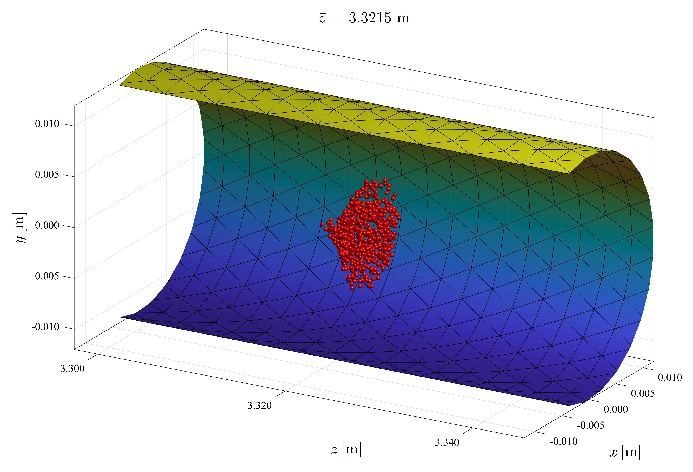
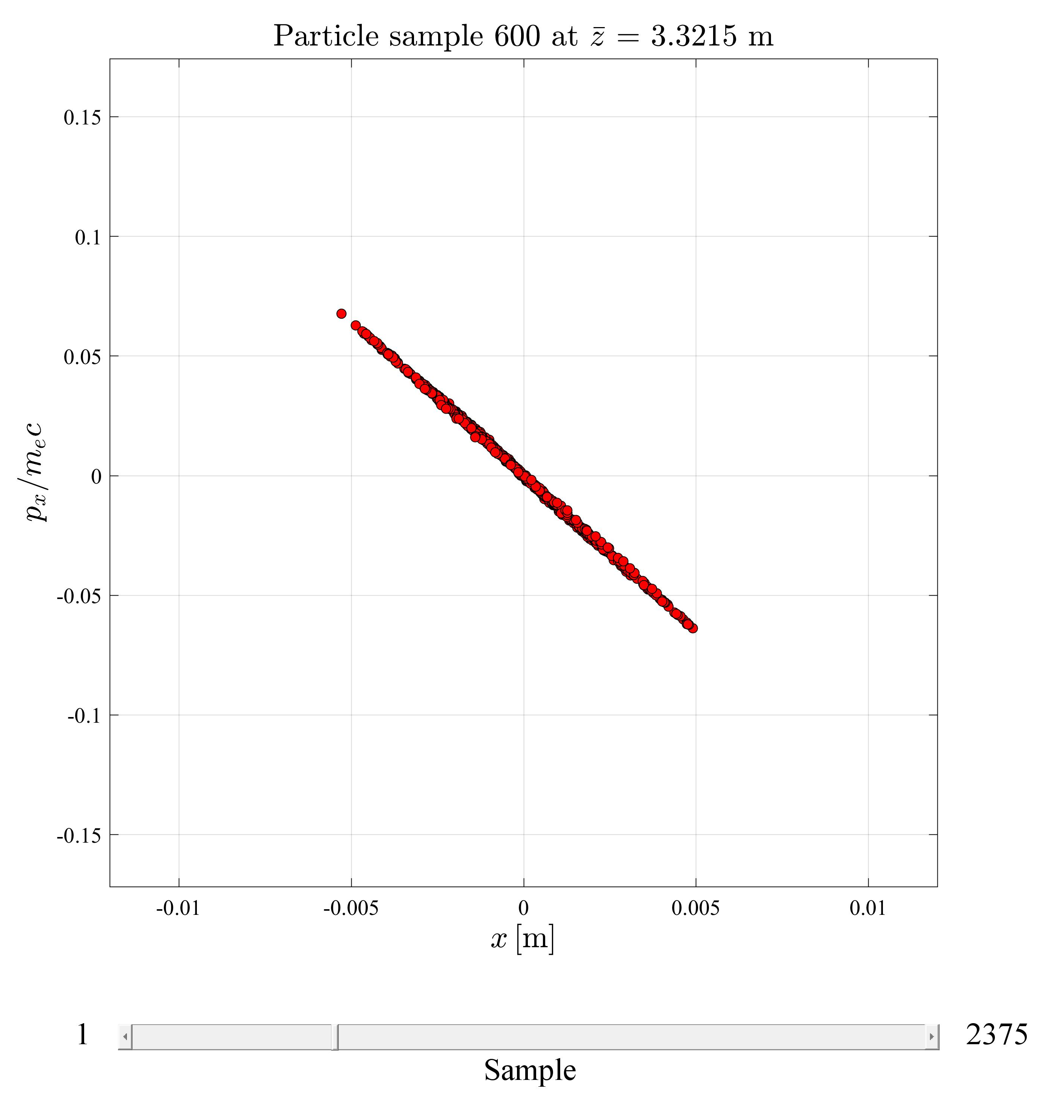
A3PI Example Plots
Particle position animation frames
Particle phase space plots

Slide 26
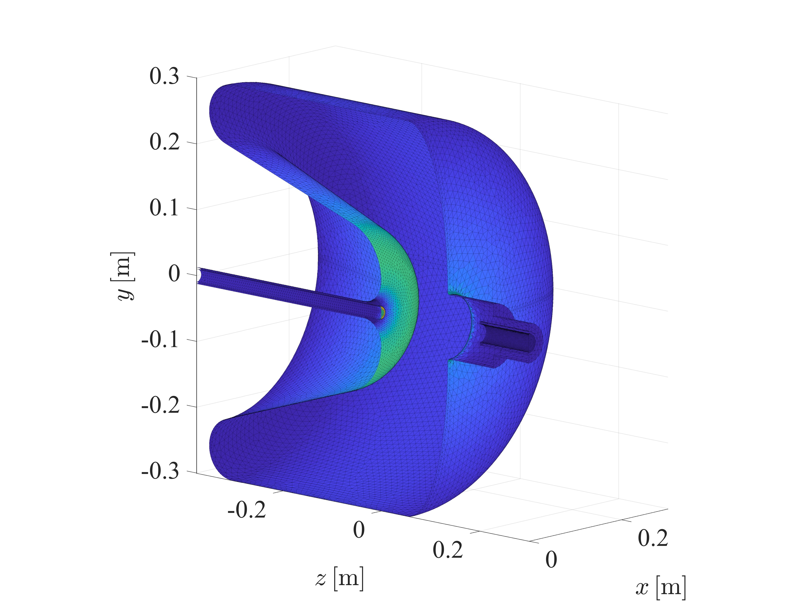
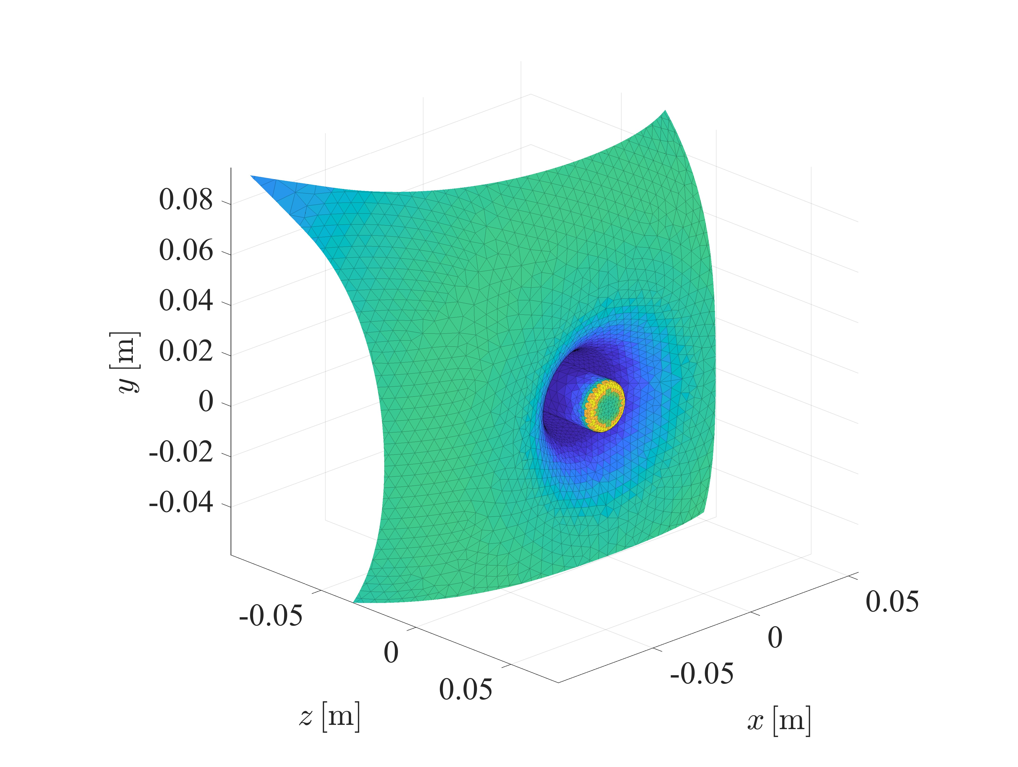
A3PI Example Plots
Field data overlay on mesh

Slide 27
Acknowledgements and References
This work was supported by the US Department of Energy under contracts
DE-AC02-05-CH11231 and DE-AC02-76-SF00515.
LibEnsemble was developed at Argonne National Laboratory and is available at: https://libensemble.readthedocs.io/
DEAP was developed at the Computer Vision and Systems Laboratory at Université Laval, in Quebec city, Canada and is available at: https://deap.readthedocs.io/
Cubit™ was developed at Sandia National Laboratories and is available at: https://cubit.sandia.gov/
IMPACT-T was developed by Ji Qiang at Lawrence Berkeley National Laboratory and is available at: https://amac.lbl.gov/~jiqiang/IMPACT-T/index.html
MATLAB™ is the property of The MathWorks Inc. and is available at: https://www.mathworks.com/

