Slide 1
ACE3P Updates (4/20/2023) – Running Jobs on Perlmutter
ACE3P executables located in /global/cfs/cdirs/ace3p/perlmutter/CPU/
Environment setup
  Copy /global/cfs/cdirs/ace3p/perlmutter/CPU/perlmutter-ace3p.sh to your home directory.
  Every time after login and before running ACE3P, execute the file
    source perlmutter-ace3p.sh
For updated tutorials, examples and command syntax, see
https://confluence.slac.stanford.edu/display/AdvComp/Materials+for+CW23

Slide 2
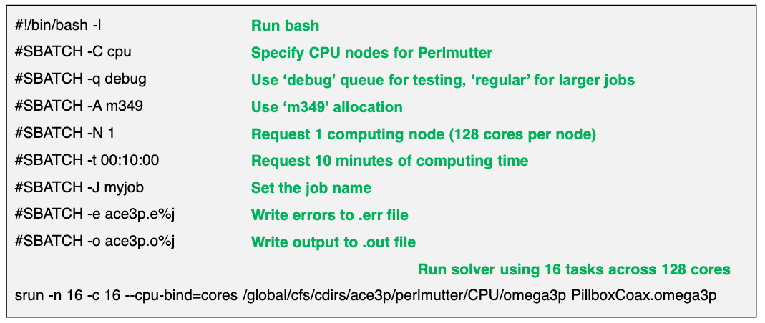
Sample Submit Script on Perlmutter
See https://docs.nersc.gov/jobs/#commonly-used-options
for additional information

Slide 3
NERSC Allocation for 2023
m349 and m1779 allocations
Make sure you use the correct repo, with m349 for High Energy Physics (HEP) applications and m1779 for Basic Energy Sciences (BES), Nuclear Physics (NP) and others.
Acknowledgement
Include the following in your publications for using NERSC resources.
This research used resources of the National Energy Research Scientific Computing Center (NERSC), a U.S. Department of Energy Office of Science User Facility operated under Contract No. DE-AC02-05CH11231.

