Slide 1
ACE3P Updates (3/25/2025)
Runing jobs on NERSC Perlmutter (slide 2-3)
Direct wakefield integration in T3P (slide 4)
User-defined input pulse in T3P (slide 5)
Dipole excitation in S3P - see S3P command syntax
Load particles from a file for particle tracking in Track3P (slide 6)
Add acdtool subtask meshconvertdirect for converting a mesh without fixes
Add nextmode.py ParaView macros for ACE3P postprocessing
lume-ace3p workflow for design parameter scans - see https://github.com/slaclab/lume-ace3p
Guidance for resource allocation on Perlmutter (slide 7)
How to acknowledge NERSC (slide 8)

Slide 2
Running jobs on NERSC Perlmutter
ACE3P executables located in /global/cfs/cdirs/ace3p/perlmutter/CPU/
Environment setup file: /global/cfs/cdirs/ace3p/perlmutter/CPU/perlmutter-ace3p-spack.sh
Every time you login, execute this script file
source /global/cfs/cdirs/ace3p/perlmutter/CPU/perlmutter-ace3p-spack.sh
Running Cubit
cubit or cubit & (running in background)
Job submission
sbatch <batch script>
Running ParaView
paraview or paraview & (running in background)
Running small jobs on the command line, e.g.
acdtool meshconvert <Cubit genesis file>
(after adding ace3p executable path: export path=“/global/cfs/cdirs/ace3p/perlmutter/CPU:$PATH”)

Slide 3
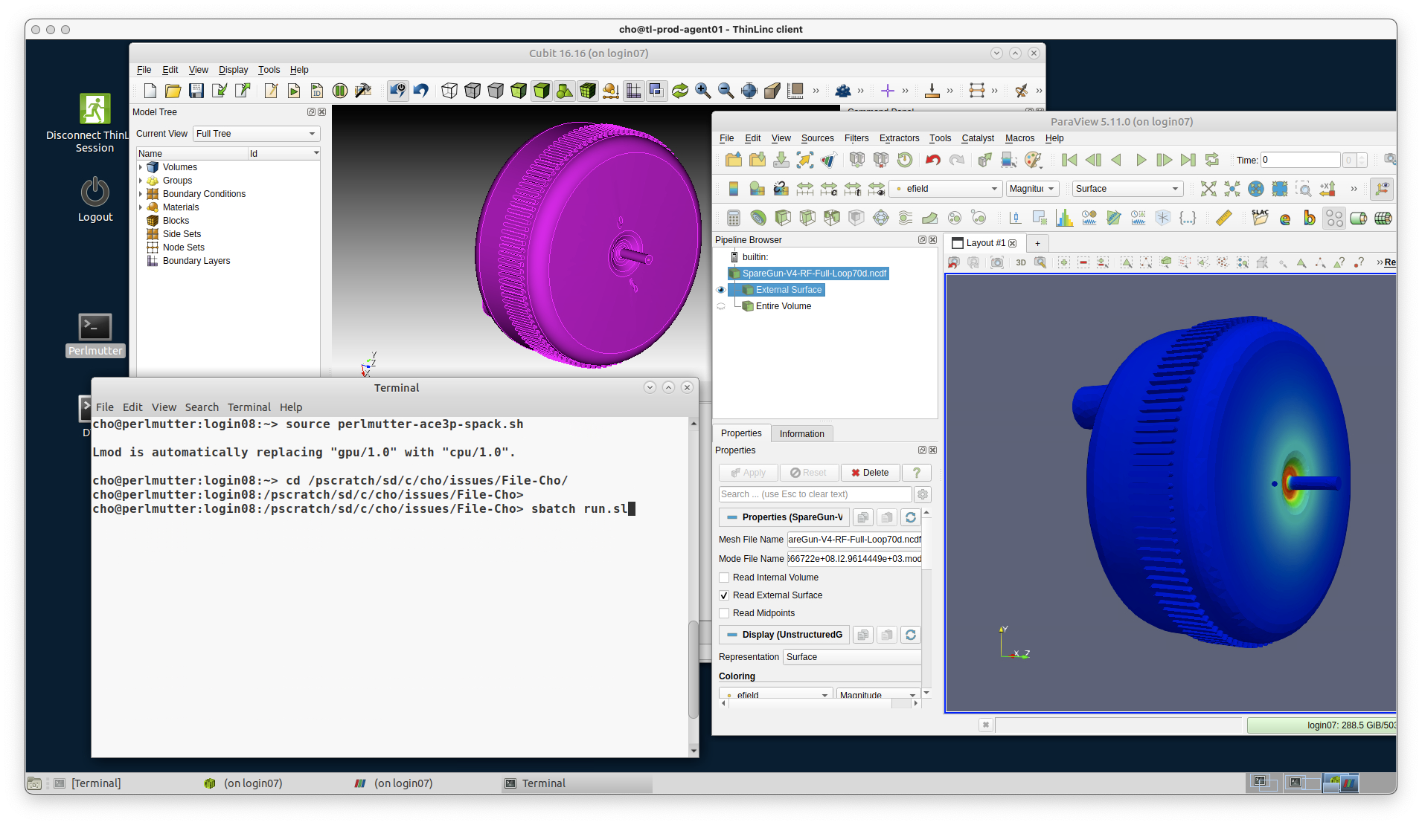
Remote Desktop at NERSC
ThinLinc remote desktop at NERSC: https://docs.nersc.gov/connect/thinlinc/
Simulation workflow entirely on Perlmutter without the need for data transfer
Cubit
ParaView
Job submission

Slide 4
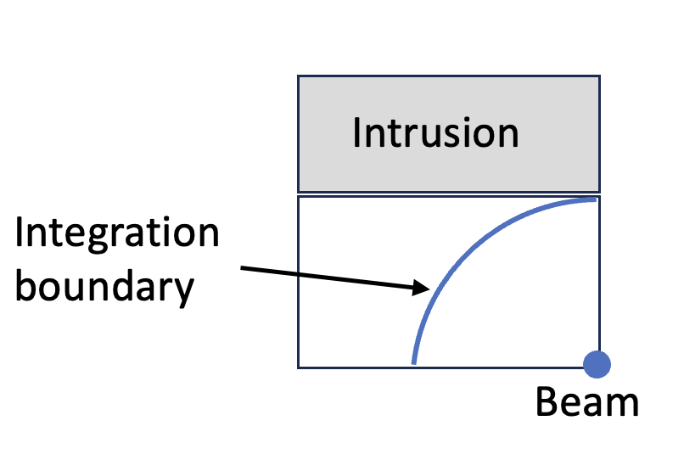
Direct wakefield integration in T3P
Collimator-type structures cannot use indirect wakefield integrations along beampipe boundary.
Use direct integrations along a circular boundary within the vacuum chamber to avoid direct integration on axis due to noise issues.
Choose large enough downstream catchup distance.
Command syntax
Monitor:
{
Type: WakeField
Name: wakefield
StartContour: 0.
EndContour: 0.6
Smax: 0.10
Grid:
{
Method: Circle
Radius: 0.0149 // Radius of circle
NPoints: 10. // Number of integration points
StartDense: 0. // Start angle
EndDense: 90. // End angle
Fraction: 1
}
}

Slide 5
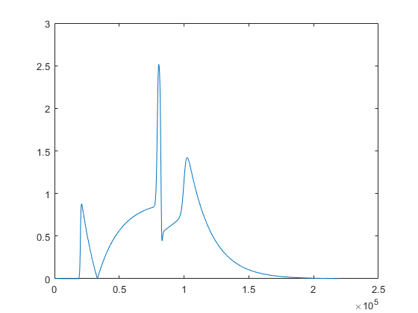
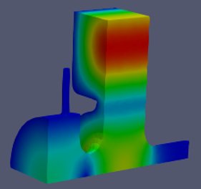
User-Defined Input Pulse in T3P
Syntax for defining pulse from file
Excitation: {
Power: 1 // Pulse Power
Pulse: {
Type: UserDefinedPulse
T0: 0 // Time offset
Scaling: 1 // Scale factor
Frequency: 11.424e9 // Frequency for port mode calculation
File: RFPulse.txt // ASCII file
}
}
Pulse envelope with a modulation frequency
Pulse loaded at waveguide port
ASCII file format in [time, pulse value]
0 0
1e-12 7.83889458863493e-07
2e-12 1.5848677730816e-06
3e-12 2.40311944995592e-06
4e-12 3.23882838422949e-06
… …

Slide 6
Load particles from a file for particle tracking in Track3P
Format of particle data
num. electrons/ energy(ev) / position_x(m) / position_y(m) / position_z(m) / momentum_x / momentum_y / momentum_z
10 1.0 0.01 0.01 0.01 1.0 0.0 0.0
20 10 -0.01 0.01 0.01 0.0 1.0 0.0
Command syntax
Emitter:{
BoundaryID: 6
Type: 10
ParticlesFile: particles.dat
XScale: 1
YScale: 1
ZScale: 1
EnergyScale: 1.0
XOffset: 0.0
YOffset: 0.0
ZOffset: 0.0
}

Slide 7
Guidance for resource allocation on Perlmutter
Omega3P using direct solver MUMPS
Usage:
acdtool resource inputfile
Num. Elems ( Million) | Num. DOFs (Million) | Node | CPUs/Node | Time (Minutes)
<1 | < 6 | 1 | 64 | <30
(1, 2) | (6, 13) | 2 | 64 | <30
(2, 4) | (13, 25 ) | 4 | 32 | <30
(4, 5) | (25, 32) | 6 | 32 | <30
(5, 6) | (32,38) | 10 | 8 | <60
(6, 7) | (38, 44) | 20 | 8 | <60
Output file
#!/bin/bash
#SBATCH -C cpu
#SBATCH -q regular
#SBATCH -A m349
#SBATCH -t 00:60:00
srun -N 16 -n 256 -c 16 /global/cfs/cdirs/ace3p/perlmutter/CPU/perlmutter/omega3p o3p.in
S3P using interactive solver with hierarchical preconditioner
Command syntax in S3P
Num. Elems ( Million) | Num. DOFs (Million) | Node | CPUs/Node | Time (Minutes)
7 | 43 | 4 | 32 | 10
11 | 71 | 4 | 32 | 17
25 | 157 | 8 | 16 | 44
47 | 300 | 32 | 8 | 119
// Set FinteElement Order 2
LinearSolver: {
Solver: GMRES
Preconditioner: MP
}

Slide 8
How to acknowledge NERSC
m349 and m1779 allocations
Make sure you use the correct repo, with m349 for High Energy Physics (HEP) applications and m1779 for Basic Energy Sciences (BES), Nuclear Physics (NP) and others.
Acknowledgement
Include the following in your publications for using NERSC resources
This research used resources of the National Energy Research Scientific Computing Center (NERSC), a Department of Energy Office of Science User Facility using NERSC award HEP-ERCAPm349 for 2025.
or
This research used resources of the National Energy Research Scientific Computing Center (NERSC), a Department of Energy Office of Science User Facility using NERSC award HEP-ERCAPm1779 for 2025.

