Slide 1
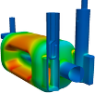
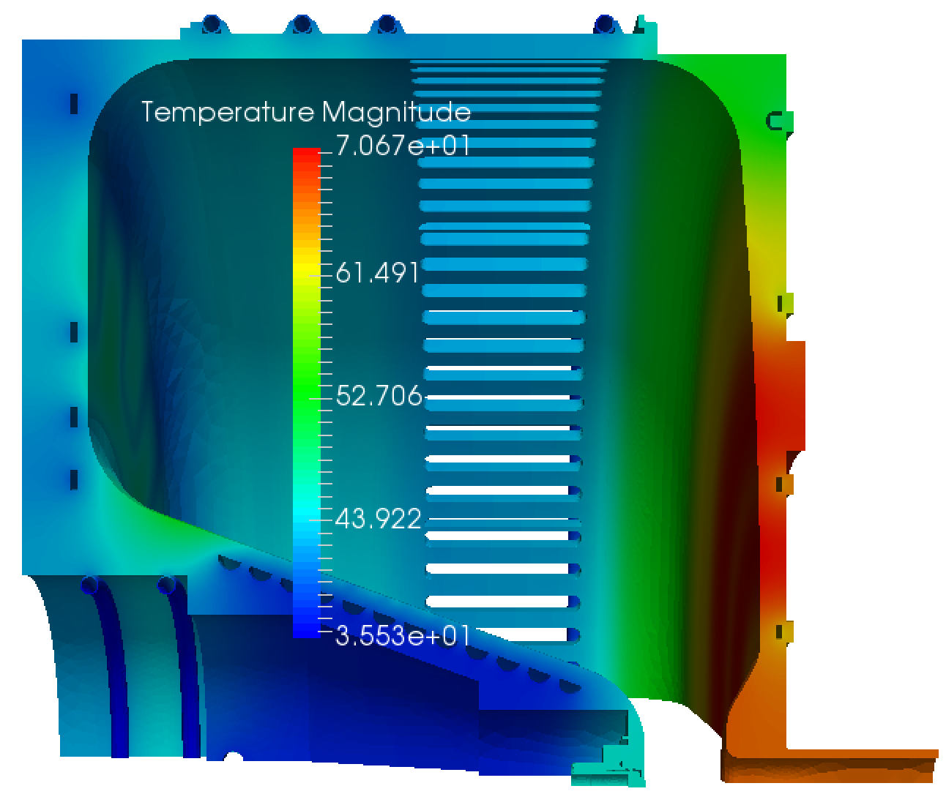
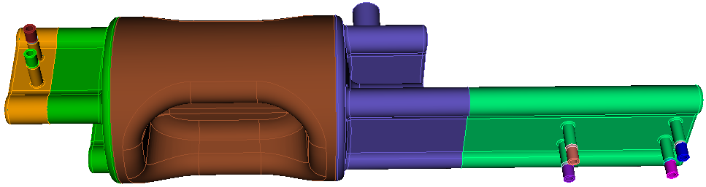
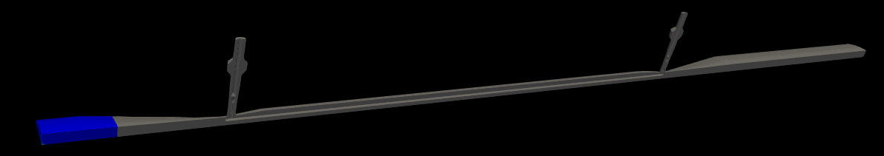
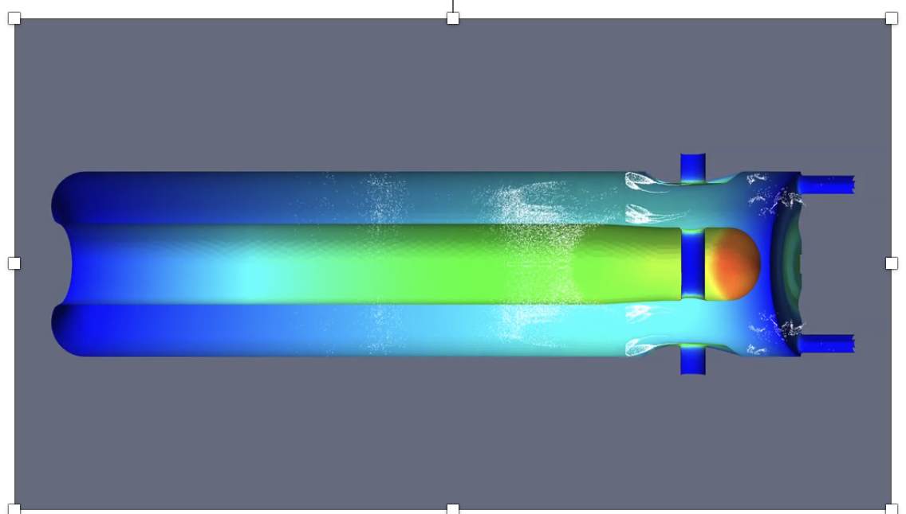
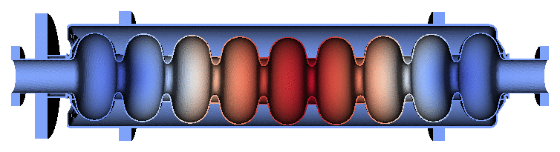
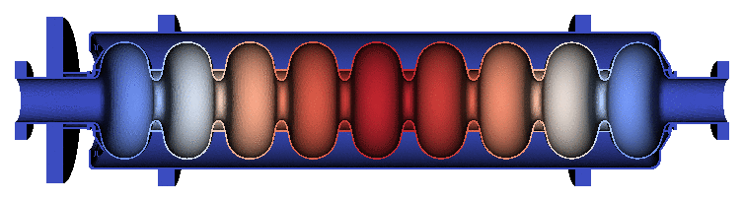
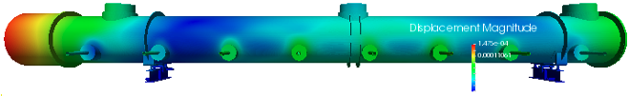
ACE3P for Scalable Multiphysics Modeling
ACE3P, developed at SLAC, is a comprehensive suite of conformal, high-order, C++/MPI based parallel finite-element (FE) multiphysics codes including electromagnetic (EM), thermal and mechanical capabilities.
Based on curved high-order finite elements for high-fidelity modeling
Implemented on massively parallel computers for increased memory (problem size) and speed
Software infrastructure facilitates linking to third-party numerical libraries (with GPU capabilities)
LHC-HL crab cavity
LCLS-II RF gun
EIC crab cavity
ACE3P (Advanced Computational Electromagnetics 3P)
Frequency Domain: Omega3P – Eigensolver (damping)
S3P – S-Parameter
Time Domain: T3P – Wakefields and Transients
Particle Tracking: Track3P – Multipacting and Dark Current
EM Particle-in-cell: Pic3P – RF guns & space charge effects
Multi-physics: TEM3P – EM, Thermal & Mechanical analysis
Static Particle-in-cell: Gun3P – DC guns & space charge effects
SPEAR3 kicker wakefield using moving window
FRIB multipacting
LCLS-II mechanical modes
LCLS-II cryomodule deformation

Slide 2
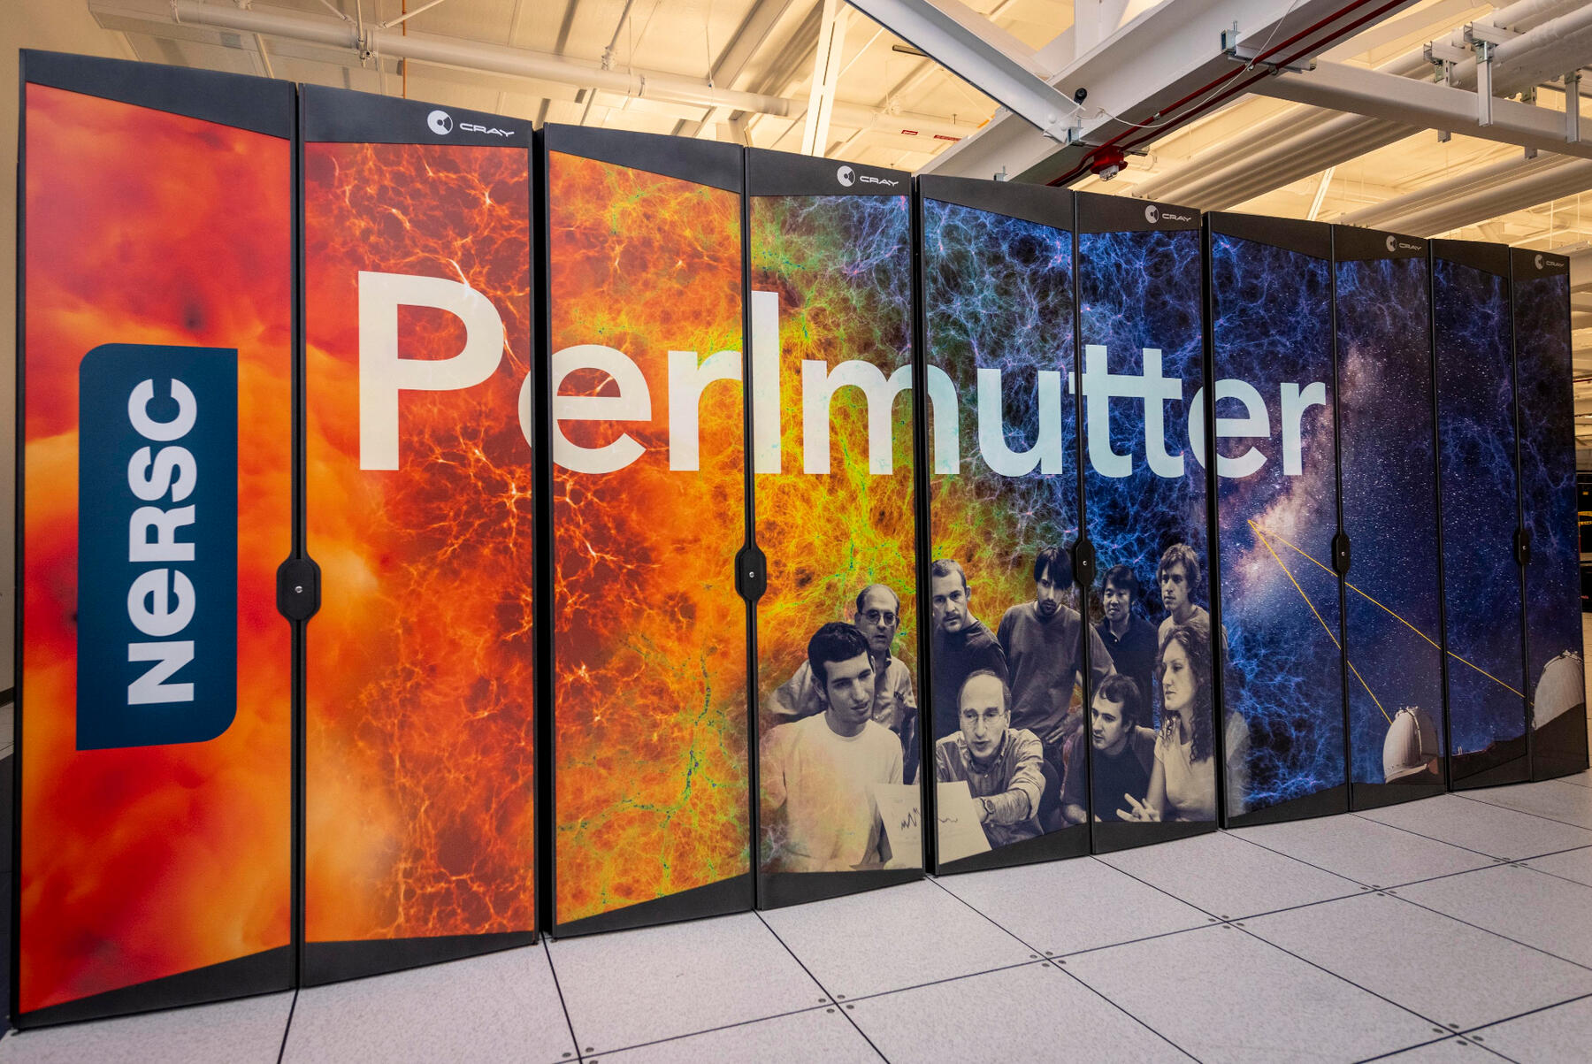
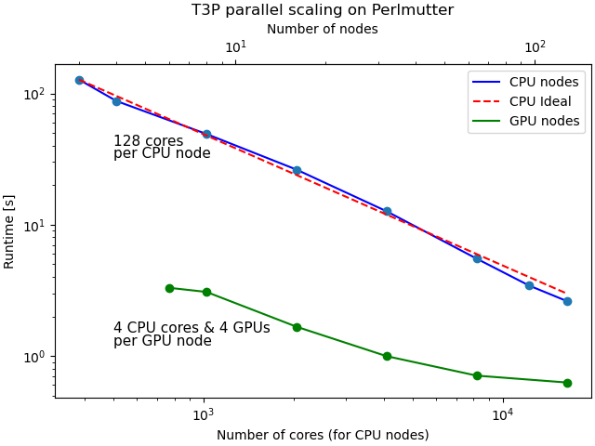
High Performance Computing (HPC) for High Fidelity Simulation
NERSC Perlmutter: Cray EX
3072 CPU-only nodes with a total of 196,608 cores
1536 GPU accelerated nodes
2.2 petabytes of memory
Omega3P w/ 12M DOF’s
Numerical libraries used in ACE3P
Libraries in linear algebra, linear solver, eigensolver, partitioning and data format
  BLAS, LAPACK, ScaLAPACK
  MUMPS, SuperLU, PETSc
  ARPACK
  ParMetis, Zoltan
  Netcdf, HDF5
Interfaced to PETSc GPU backend for linear/nonlinear solvers
OpenMP adopted for CPU threads and GPU offload
T3P w/ 130M DOF’s

Slide 3
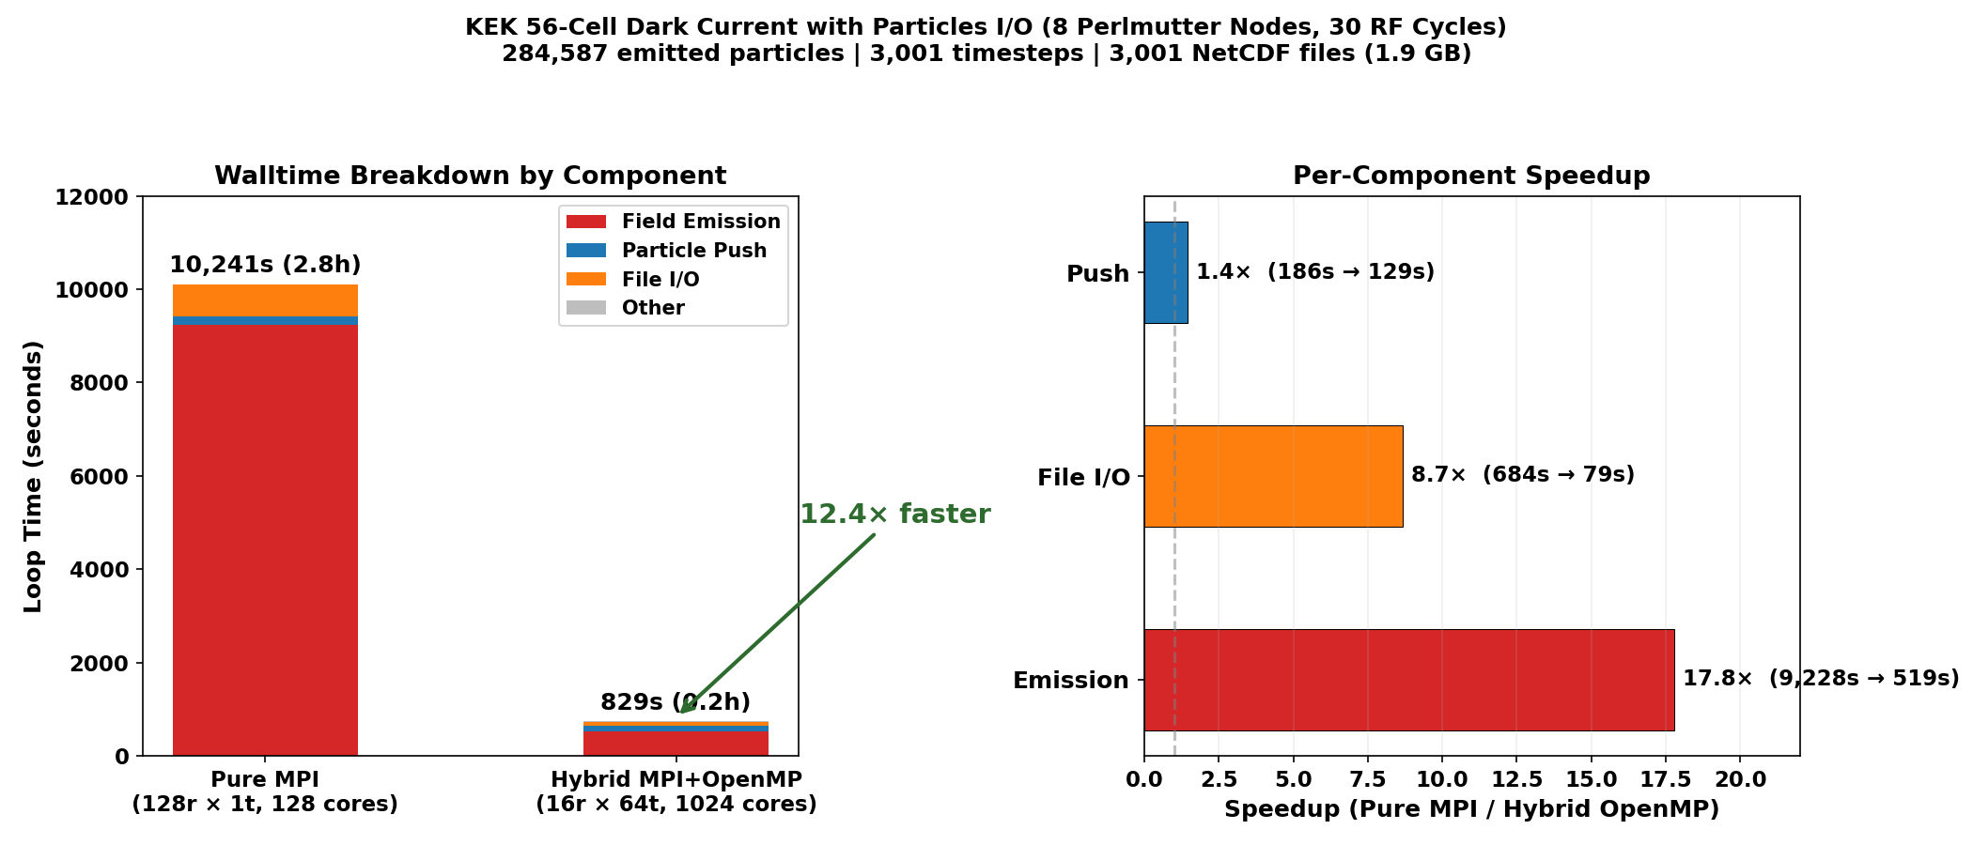
Hybrid MPI+OpenMP Parallelization of ACE3P Track3P
Track3P: Particle tracking for multipacting and dark current simulations
Pure MPI parallelism: Each rank holds a complete mesh and field data -> leads to idle cores on modern HPC nodes
Hybrid MPI+OpenMP: Enhance scalability and node-level efficiency by leveraging OpenMP threading
Hybrid MPI+OpenMP significantly improves node-level efficiency and overall performance

Slide 4
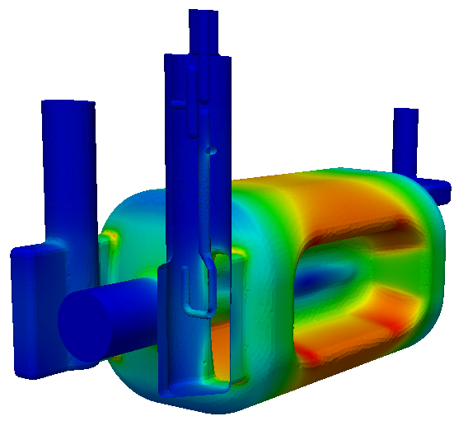
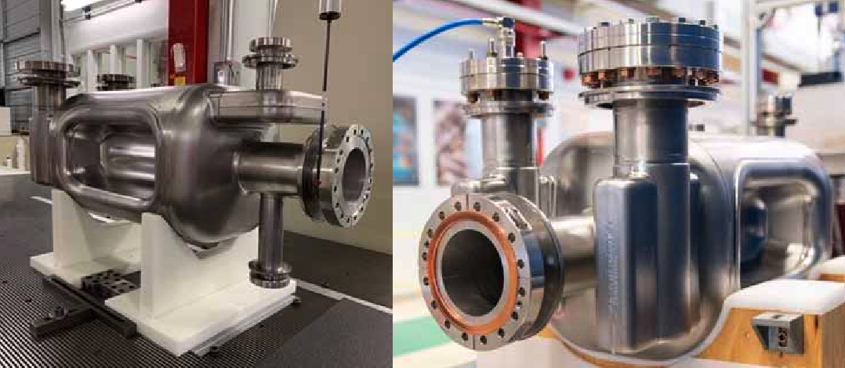
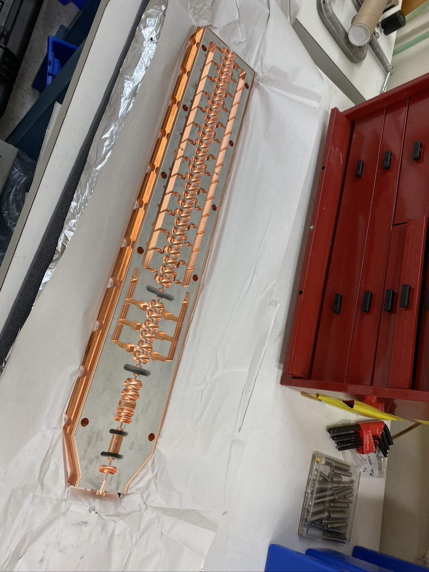
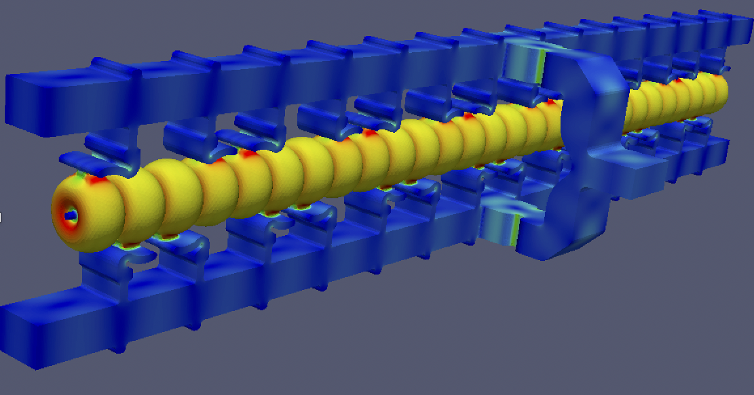
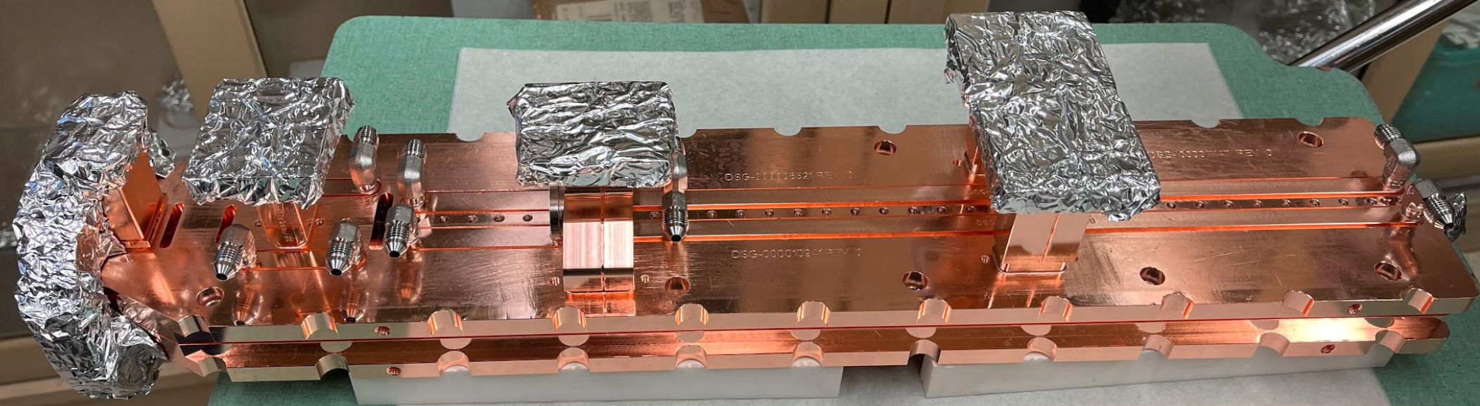
“Design-to-Prototype" of Accelerator and RF Components
Prototyping crab cavity for LHC HiLumi Upgrade
Cavity in production
Installation of rf crab cavities is a key for luminosity enhancement.
ACE3P used to optimize cavity rf design, and keep/update final cavity geometry for engineering
Distributed coupling Linac RF modeling
RF coupling and power distribution waveguide optimization
Full cavity system rf simulation

Slide 5
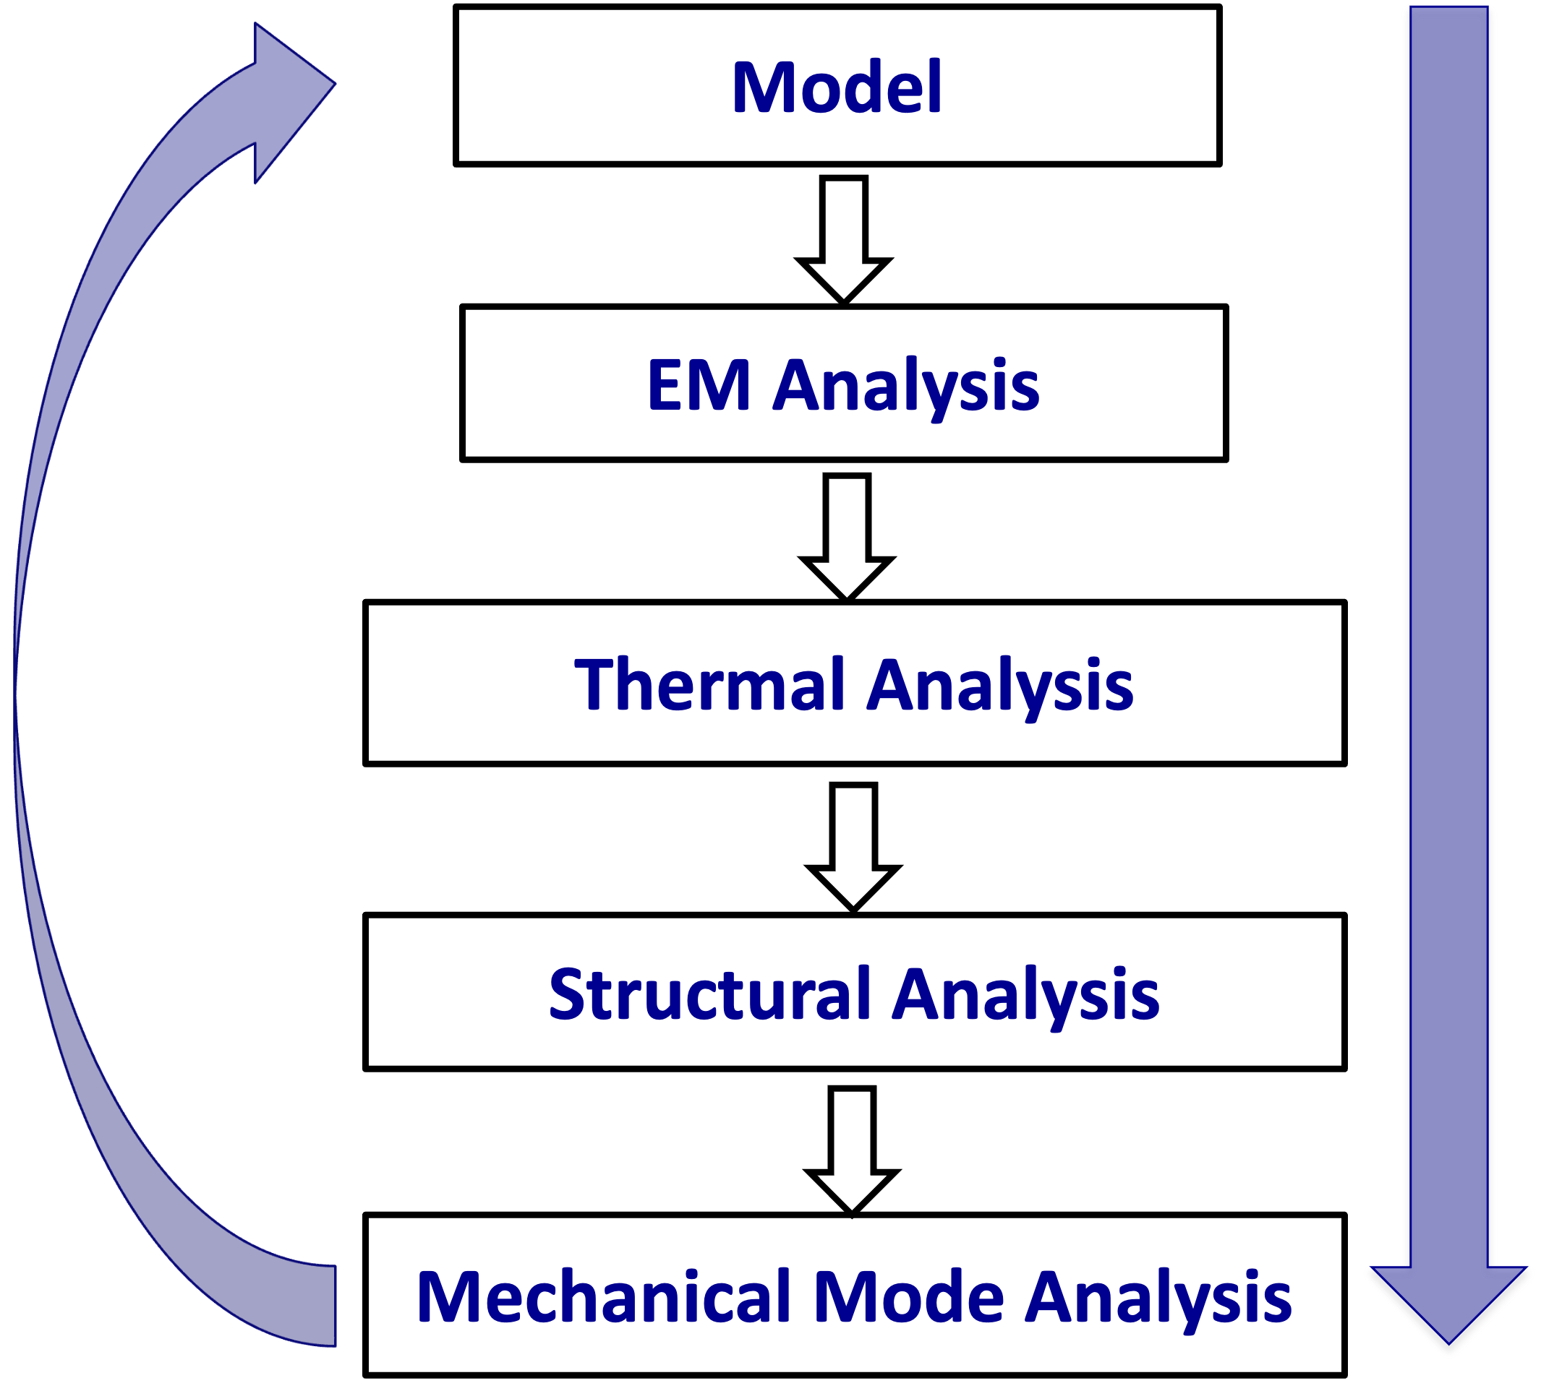
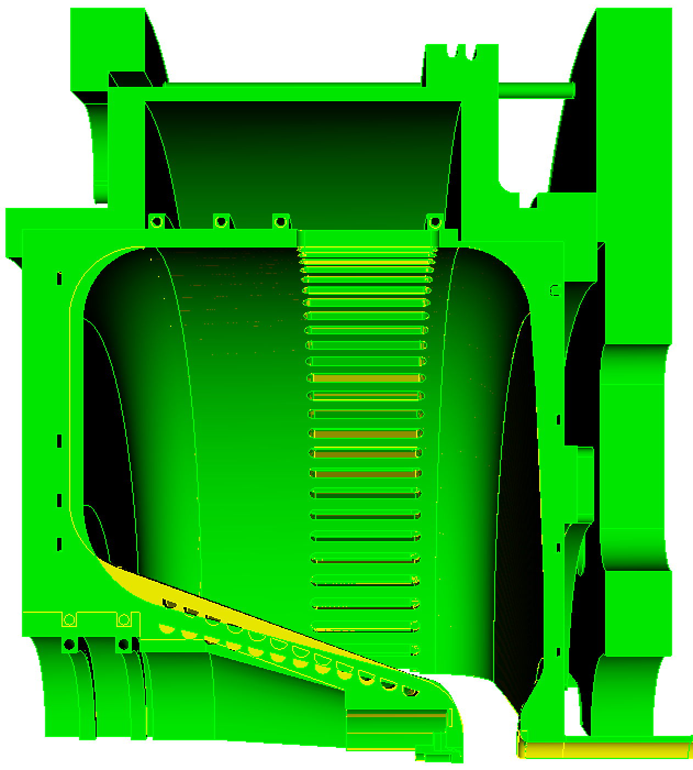
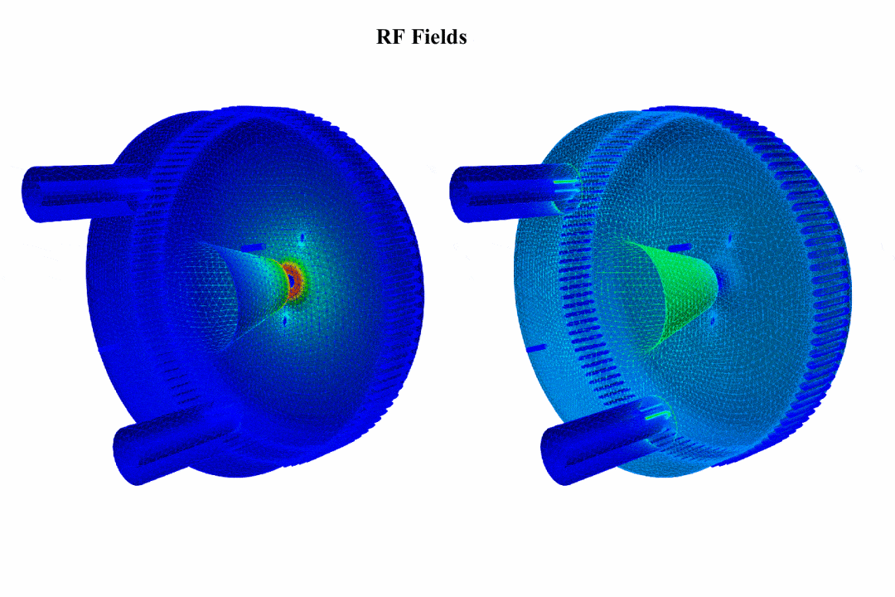
Virtual Prototyping through Multi-Physics Workflow
EM, thermal and mechanical analysis for rf gun
Spare gun design by modifying geometry to reduce dark current emission from cavity
Multiphysics analysis using Omega3P, TEM3P and Track3P
High-fidelity multi-physics calculations using ACE3P modules ensure reliable design.

Slide 6
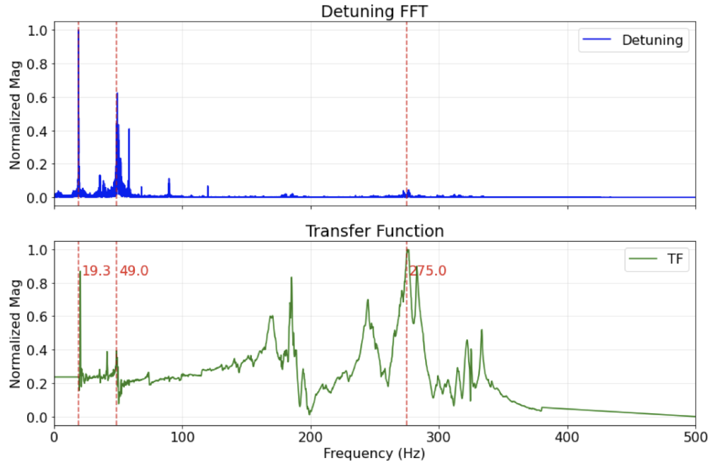
Dynamic Lorentz Force Detuning (LFD) for Resonance Control
Analysis of dynamic LFD is the most critical engineering task for pulsed operation of SRF cavities:
EM fields exert radiation pressure (Lorentz force) on thin niobium cavity walls
CW: static deformation → fixed frequency shift → compensated by tuner offset
Pulsed: time-varying field amplitude → dynamic Lorentz force (LF) → transient mechanical vibration → dynamic detuning
Detuning scales quadratically and hence grows rapidly with field gradient
Scenario of dynamic LFD for LCLS-II-HE
Cavity half-bandwidth: ~16 Hz
Dynamic detuning during pulse: several hundred Hz
Ratio: detuning/bandwidth ~ 10–30 times
RF system cannot efficiently fill cavity when detuned this far off resonance
Multi-cavity coupling in cryomodule alters the mechanical spectrum beyond single-cavity prediction
Mode not identified in a single cavity
LCLS-II SRF cavity

Slide 7
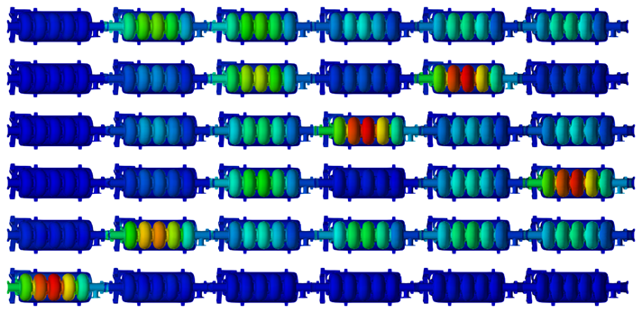
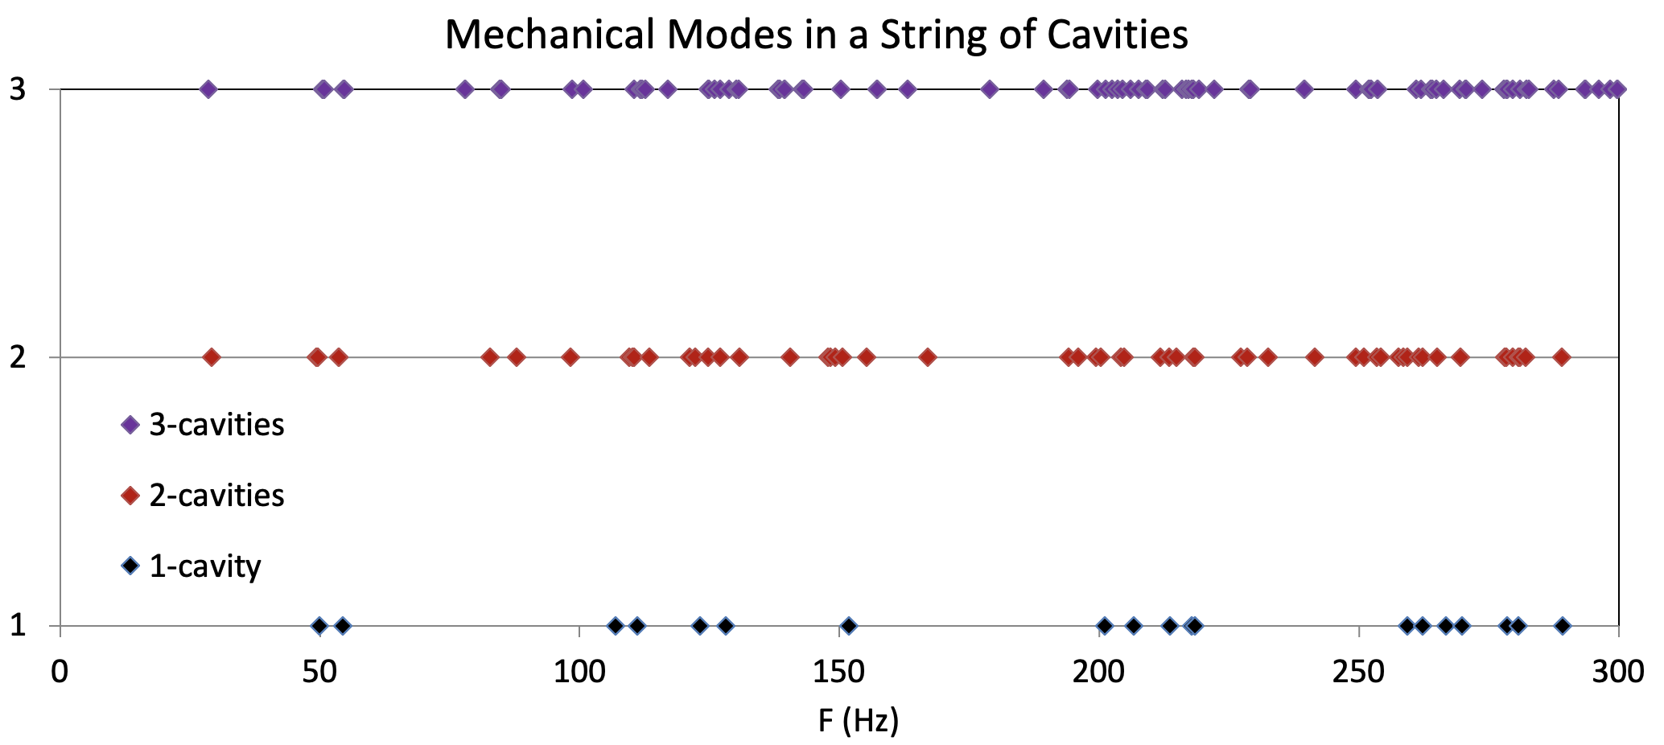
Single Cavity to Full Cryomodule LFD Analysis
The mode frequencies in a cryomodule differ from those in a single cavity.
If one cavity is vibrated by external force, the other cavities might be detuned due to the mechanical mode excitation.
The longitudinal modes have transverse displacement components due to HGR pipes and tuner which destroy the geometry symmetry.
PIP-II ß = 0.92, 650 MHz Cryomodule
Single cavity calculation:
EM eigenmode → LF pressure → mechanical eigenmodes → LFD mode decomposition → piezo transfer function
Full cryomodule calculation:
Identifies collective eigenmodes and quantifies inter-cavity coupling coefficients
Decomposes LF into collective mode contributions
Characterizes how piezo actuation on one cavity affects neighbors

Slide 8
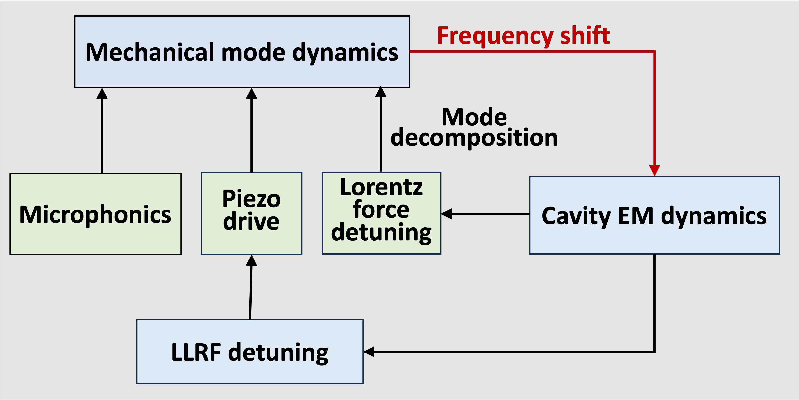
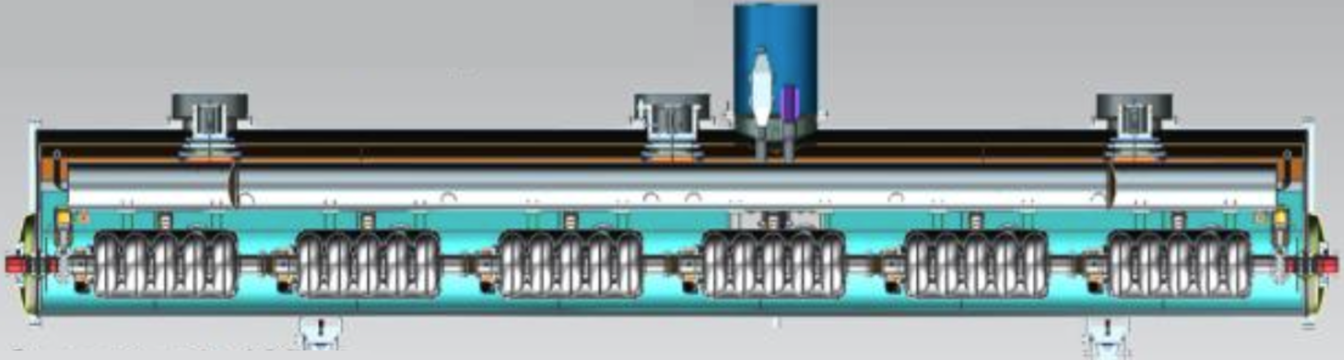
Predictive Physics-Informed AI Model for Accelerator Control
Existing digital twin framework
Cavity dynamic model
Predictive cavity dynamic parameters for optimization
Diagnostic feedback for model improvement
LLRF AI-enabled surrogate model for fast feedback
Optimization
LINAC
LLRF
Diagnostics
Control and operation
SRF
PIP-II cryomodule
Physics-informed SRF cavity multiphysics (ACE3P) model
First-principles simulation provides physical structure, bounds, and training data — making AI models robust, generalizable, and safe beyond purely data-driven approaches.

Slide 9
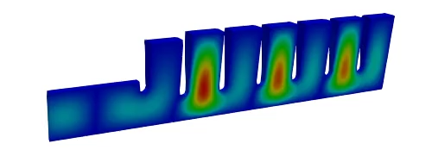
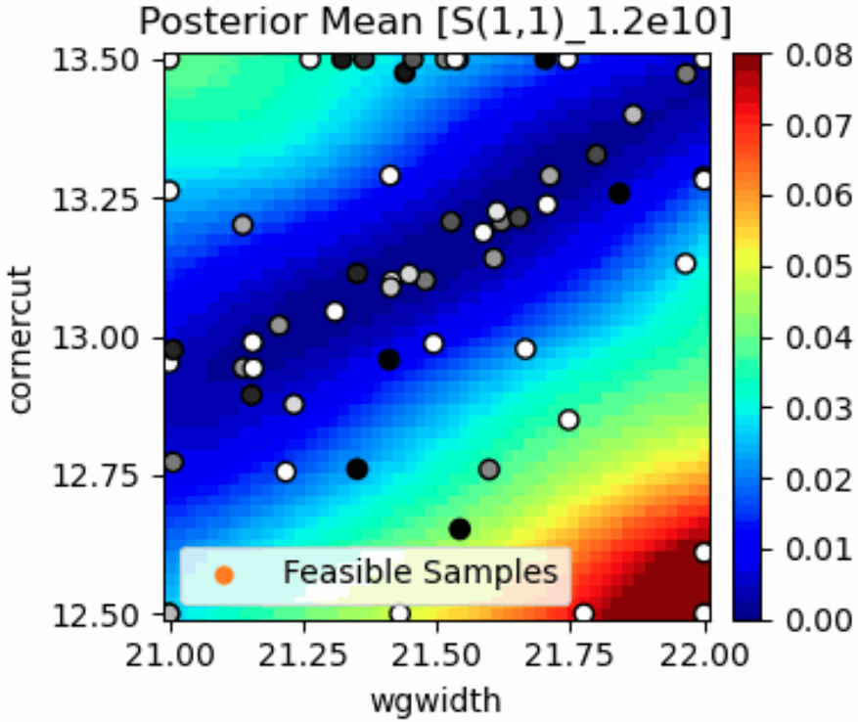
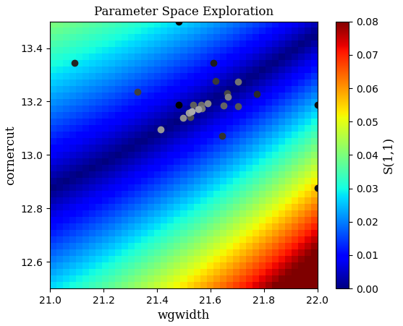
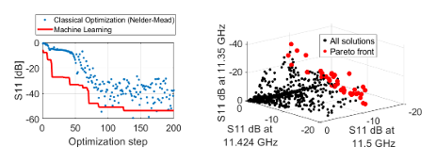
ML Bayesian Gaussian Process (GP) for RF Optimization
Bayesian Optimization with LUME-ACE3P-Xopt
Add fidelity parameter “s” (controls mesh resolution)
Train BO model of parameter space
Use low fidelity (fast) and high fidelity (slow)
Utilize Bayesian exploration to determine pareto fronts
Optimizing first cell (coupler cell)
r₁
r₁₀
Input TE01
circular waveguide mode
t₁
EM optimization of a waveguide bend with 2 design parameters
Symmetry boundary
Single and multi-objective optimization with GP models
MOBO
MF-BO converged with ~ 40 iterations (black and white dots for low- and high- fidelity, respectively)
”Brute-force” high fidelity scan with 1000 iterations
Faster optimal fronts via Machine Learning Exploration
Substantially reducing design cycles for RF cavities and components on HPC platforms

Slide 10
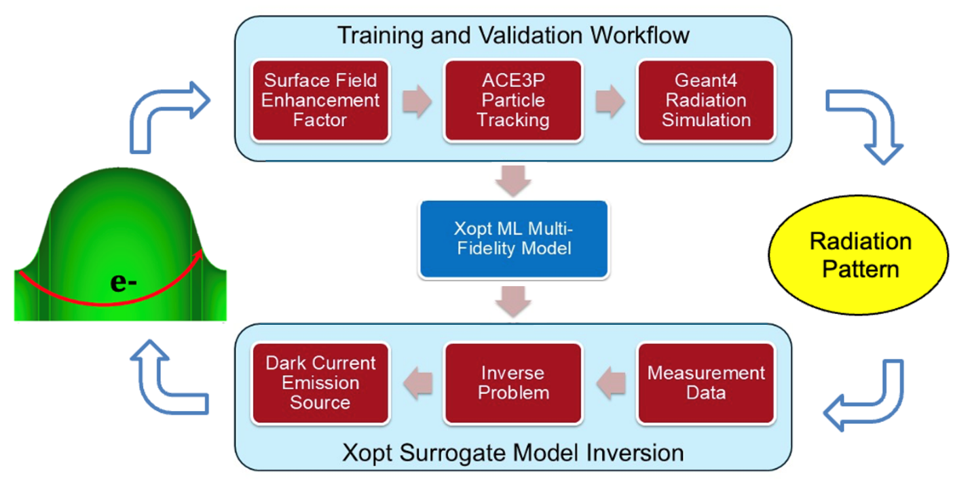
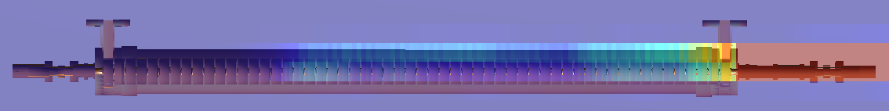
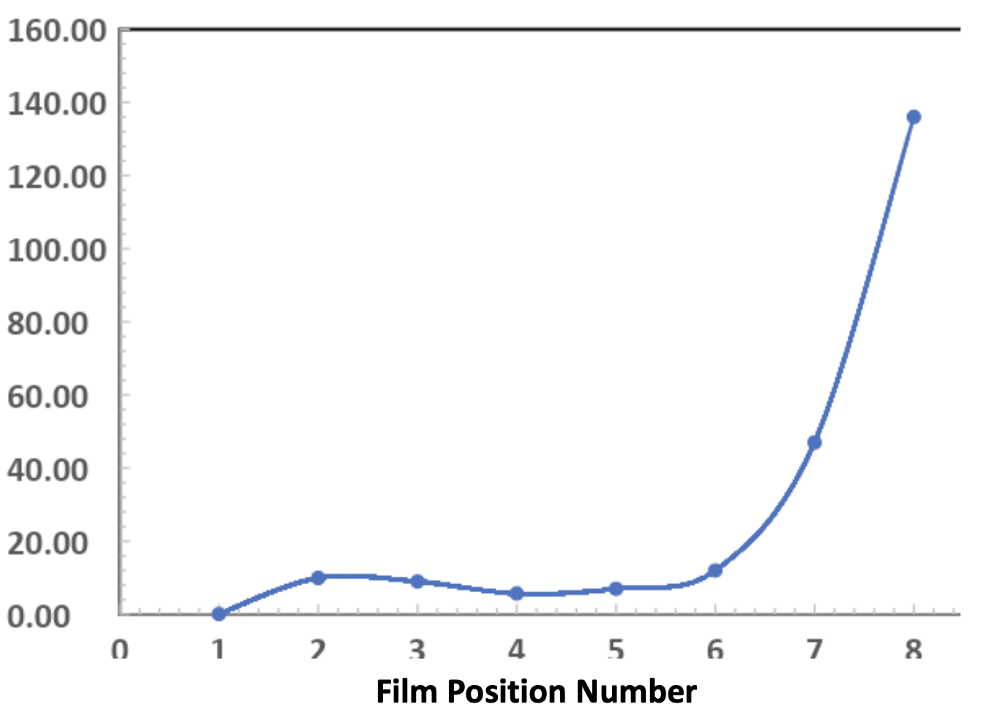
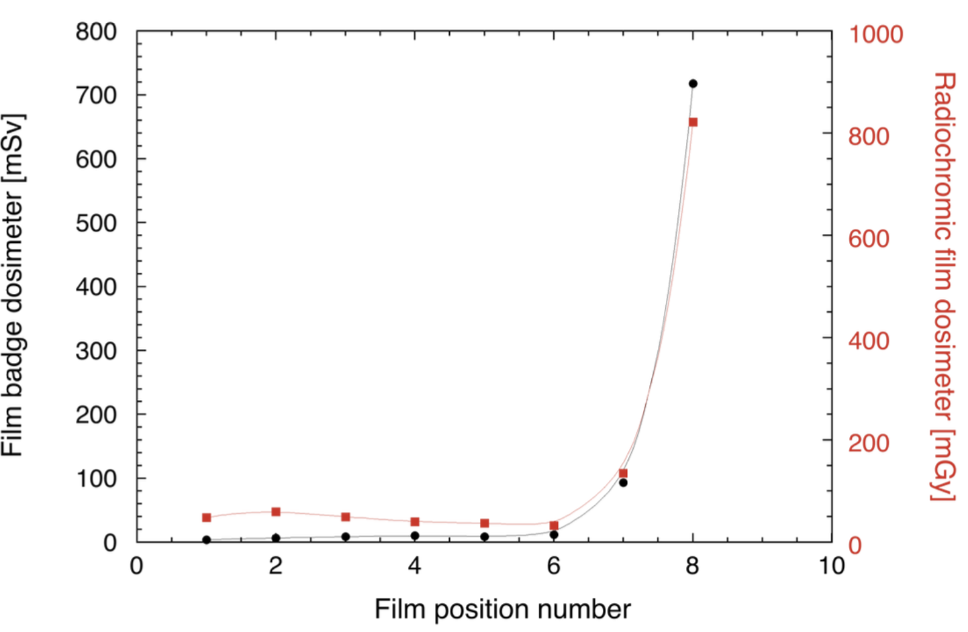
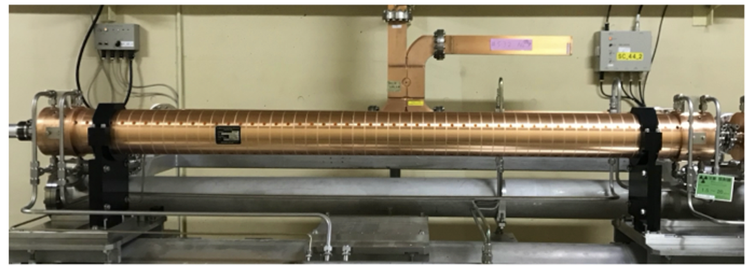
Integration of RF and Radiation Simulation – ACE3P + Geant4
Forward simulation
Electron trajectories from ACE3P
Radiation dose from Geant4
Simulation
β = 58
Measurement at KEK
Inverse problem
Radiation dose distribution
Matching of radiation pattern by varying local enhancement factor β for field emission by trial-and-error simulations – AI/ML inverse approach bypasses this daunting process to identify emission origins.
Bench test of S-band structure at KEK

Slide 11
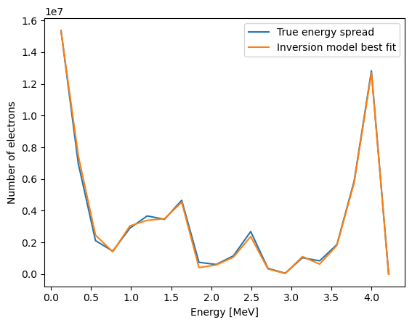
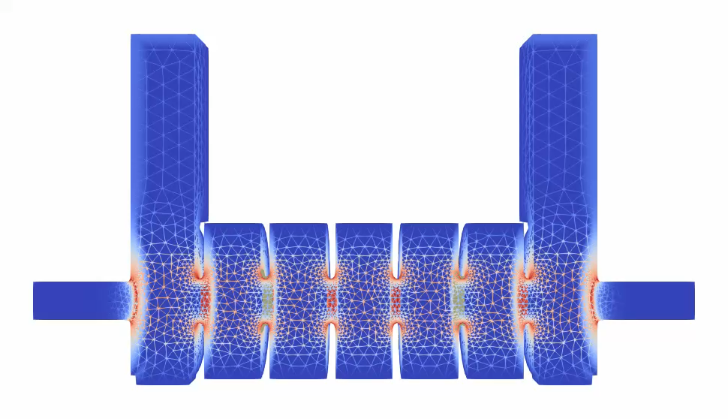
Surrogate Models for Inverse Problems – Field Emission Origin
KEK 7-cell structure example for dark current study
Particles emitted from 8 irises (high field regions)
  Each with unknown field emission factor β₁ to β₈
Fowler-Nordheim law used to estimate emission
Tracking and impacts monitored with Track3P
Particle data collected at downstream beampipe
Bayesian Gaussian process (GP) model built from synthetic data using forward simulations
Energy spectrum plotted at downstream
GP model inverted using validation data
Dark current energy spectrum
ACE3P simulation
Dark current simulation will be extended to include radiation using Geant4.
(true calculation) validation β = [55, 45, 55, 55, 45, 45, 45, 55]
GP model inversion β = [55, 47, 54, 54, 49, 40, 42, 54]

Slide 12
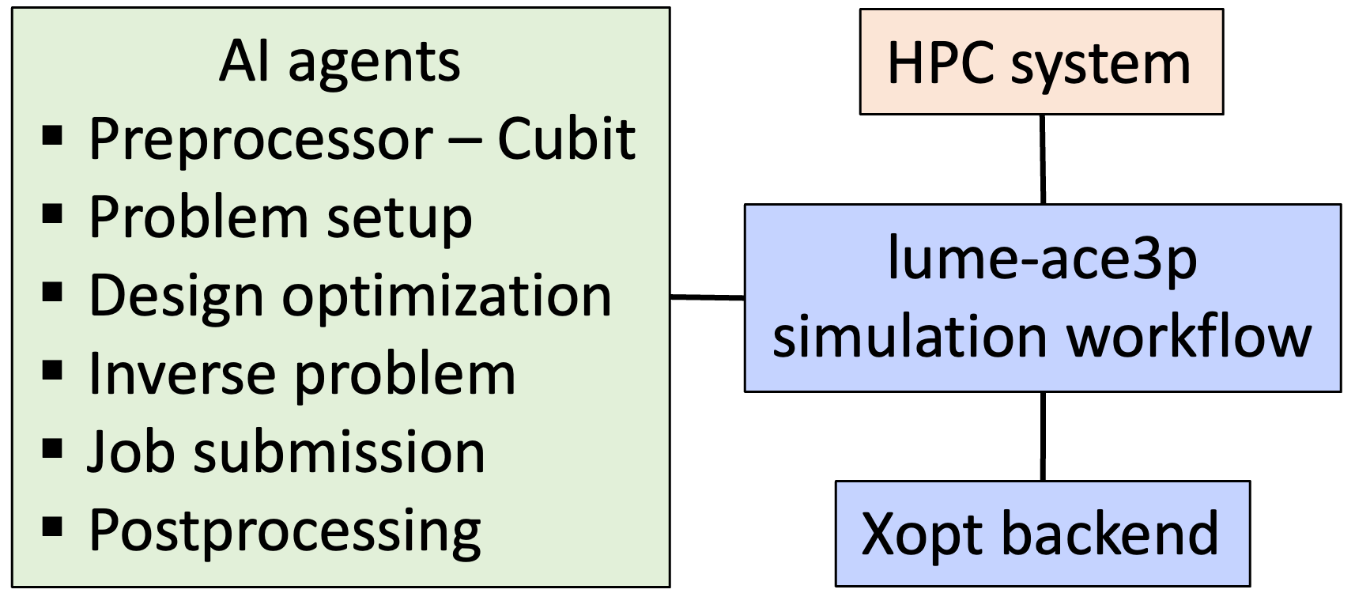
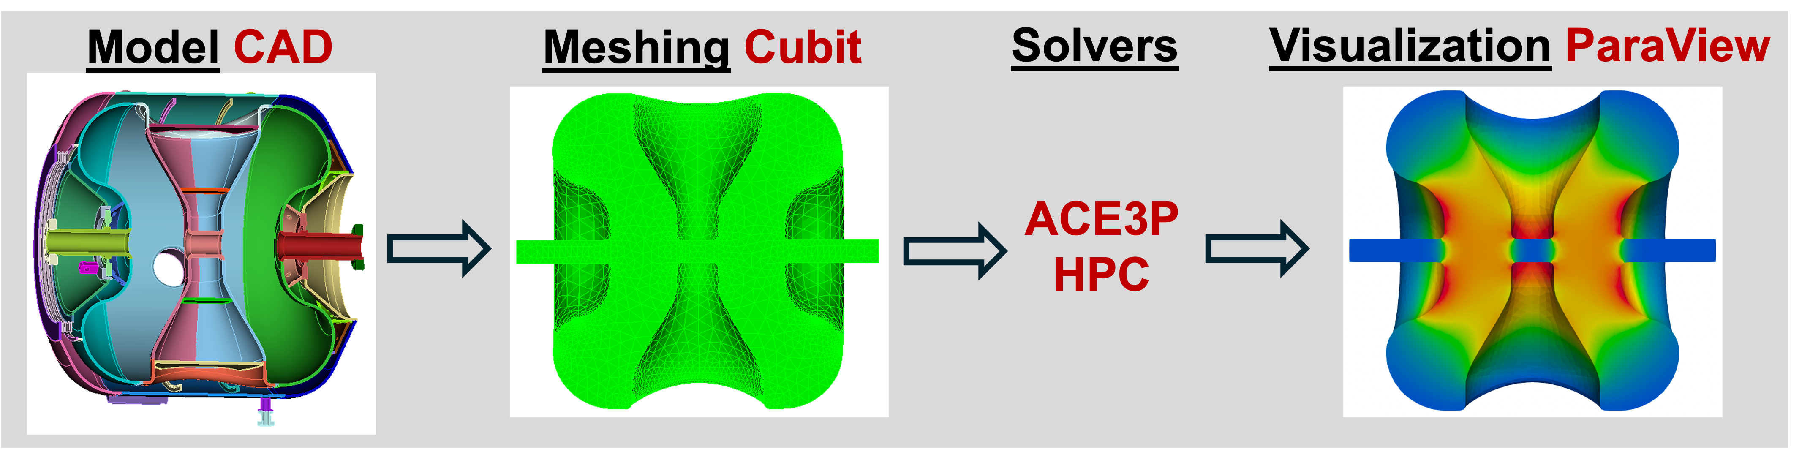
Agentic Workflow to Automate Multi-Physics Simulation
CADSAT (CAD to Simulation Agentic Toolkit) project under DOE NNSA-funded Genesis/AI4NS lighthouse initiative – LLNL & SNL
Approach applicable to ACE3P for accelerator modeling
  Cubit group at SNL for CAD-to-mesh pipeline
  MADA (Multi-Agent Design Assistant) group at LLNL for forward and inverse pipelines in MARBL inertial confinement fusion simulations

