Slide 1
Substation 7 & 8 Preventive Maintenance 2019 Winter Downtime
Site Impacts and Mitigations
Nov 2019

Slide 2
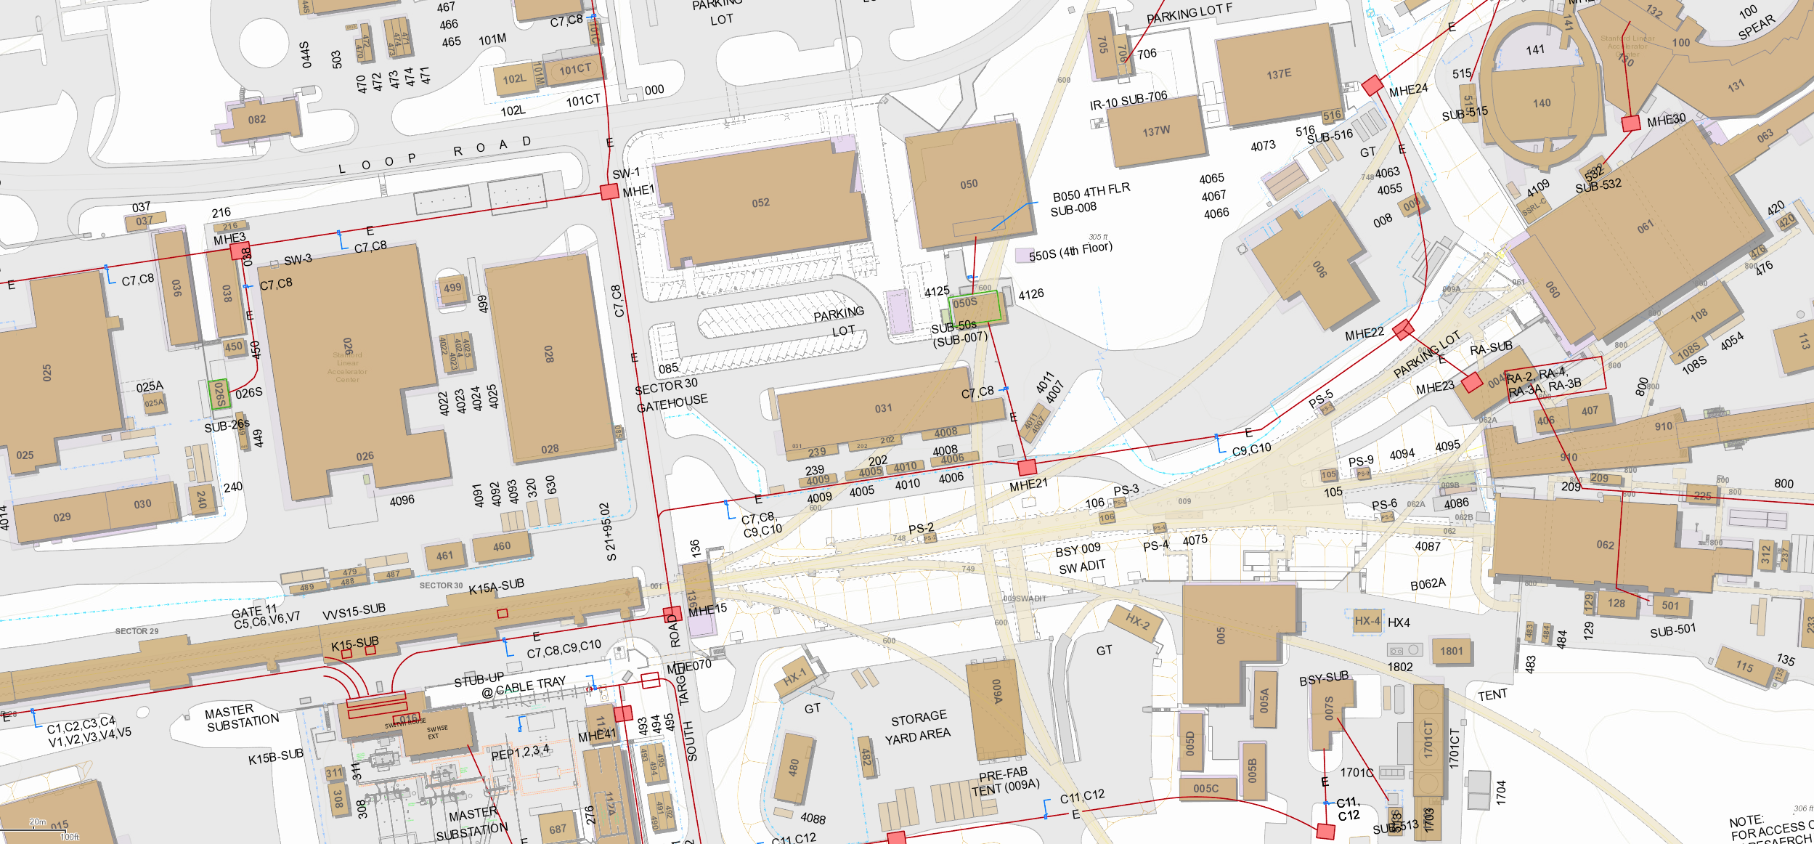
Site Orientation Substation 7 & 8
Bldg 50
Sub 8 (4th floor)
Sub 7
“RA” SubStation
Master SubStation (MSS)
2
Notes:
“Where”

Slide 3
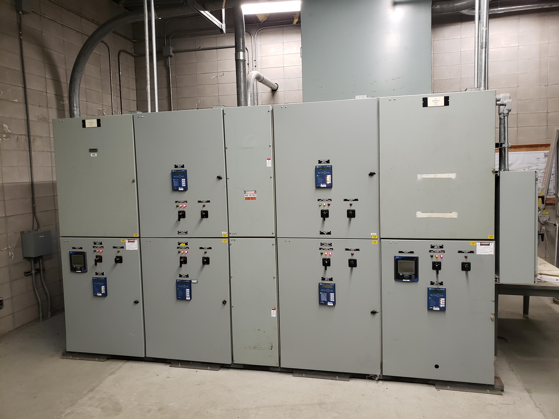
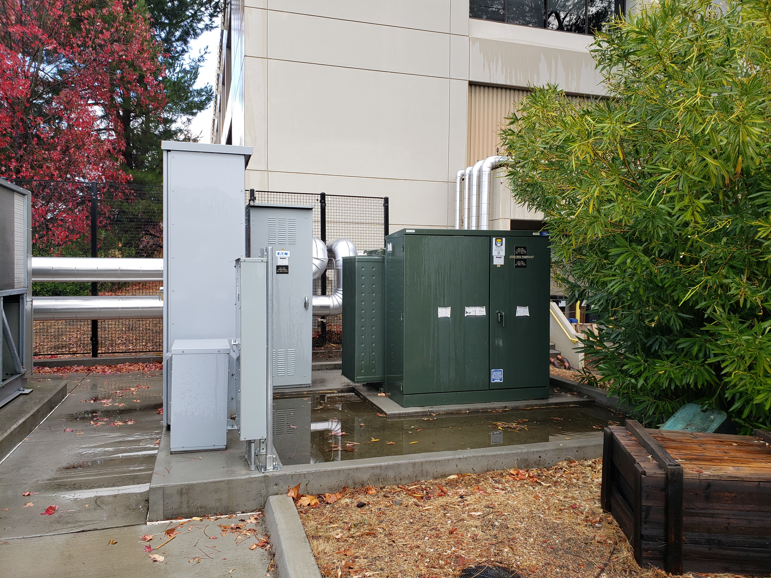
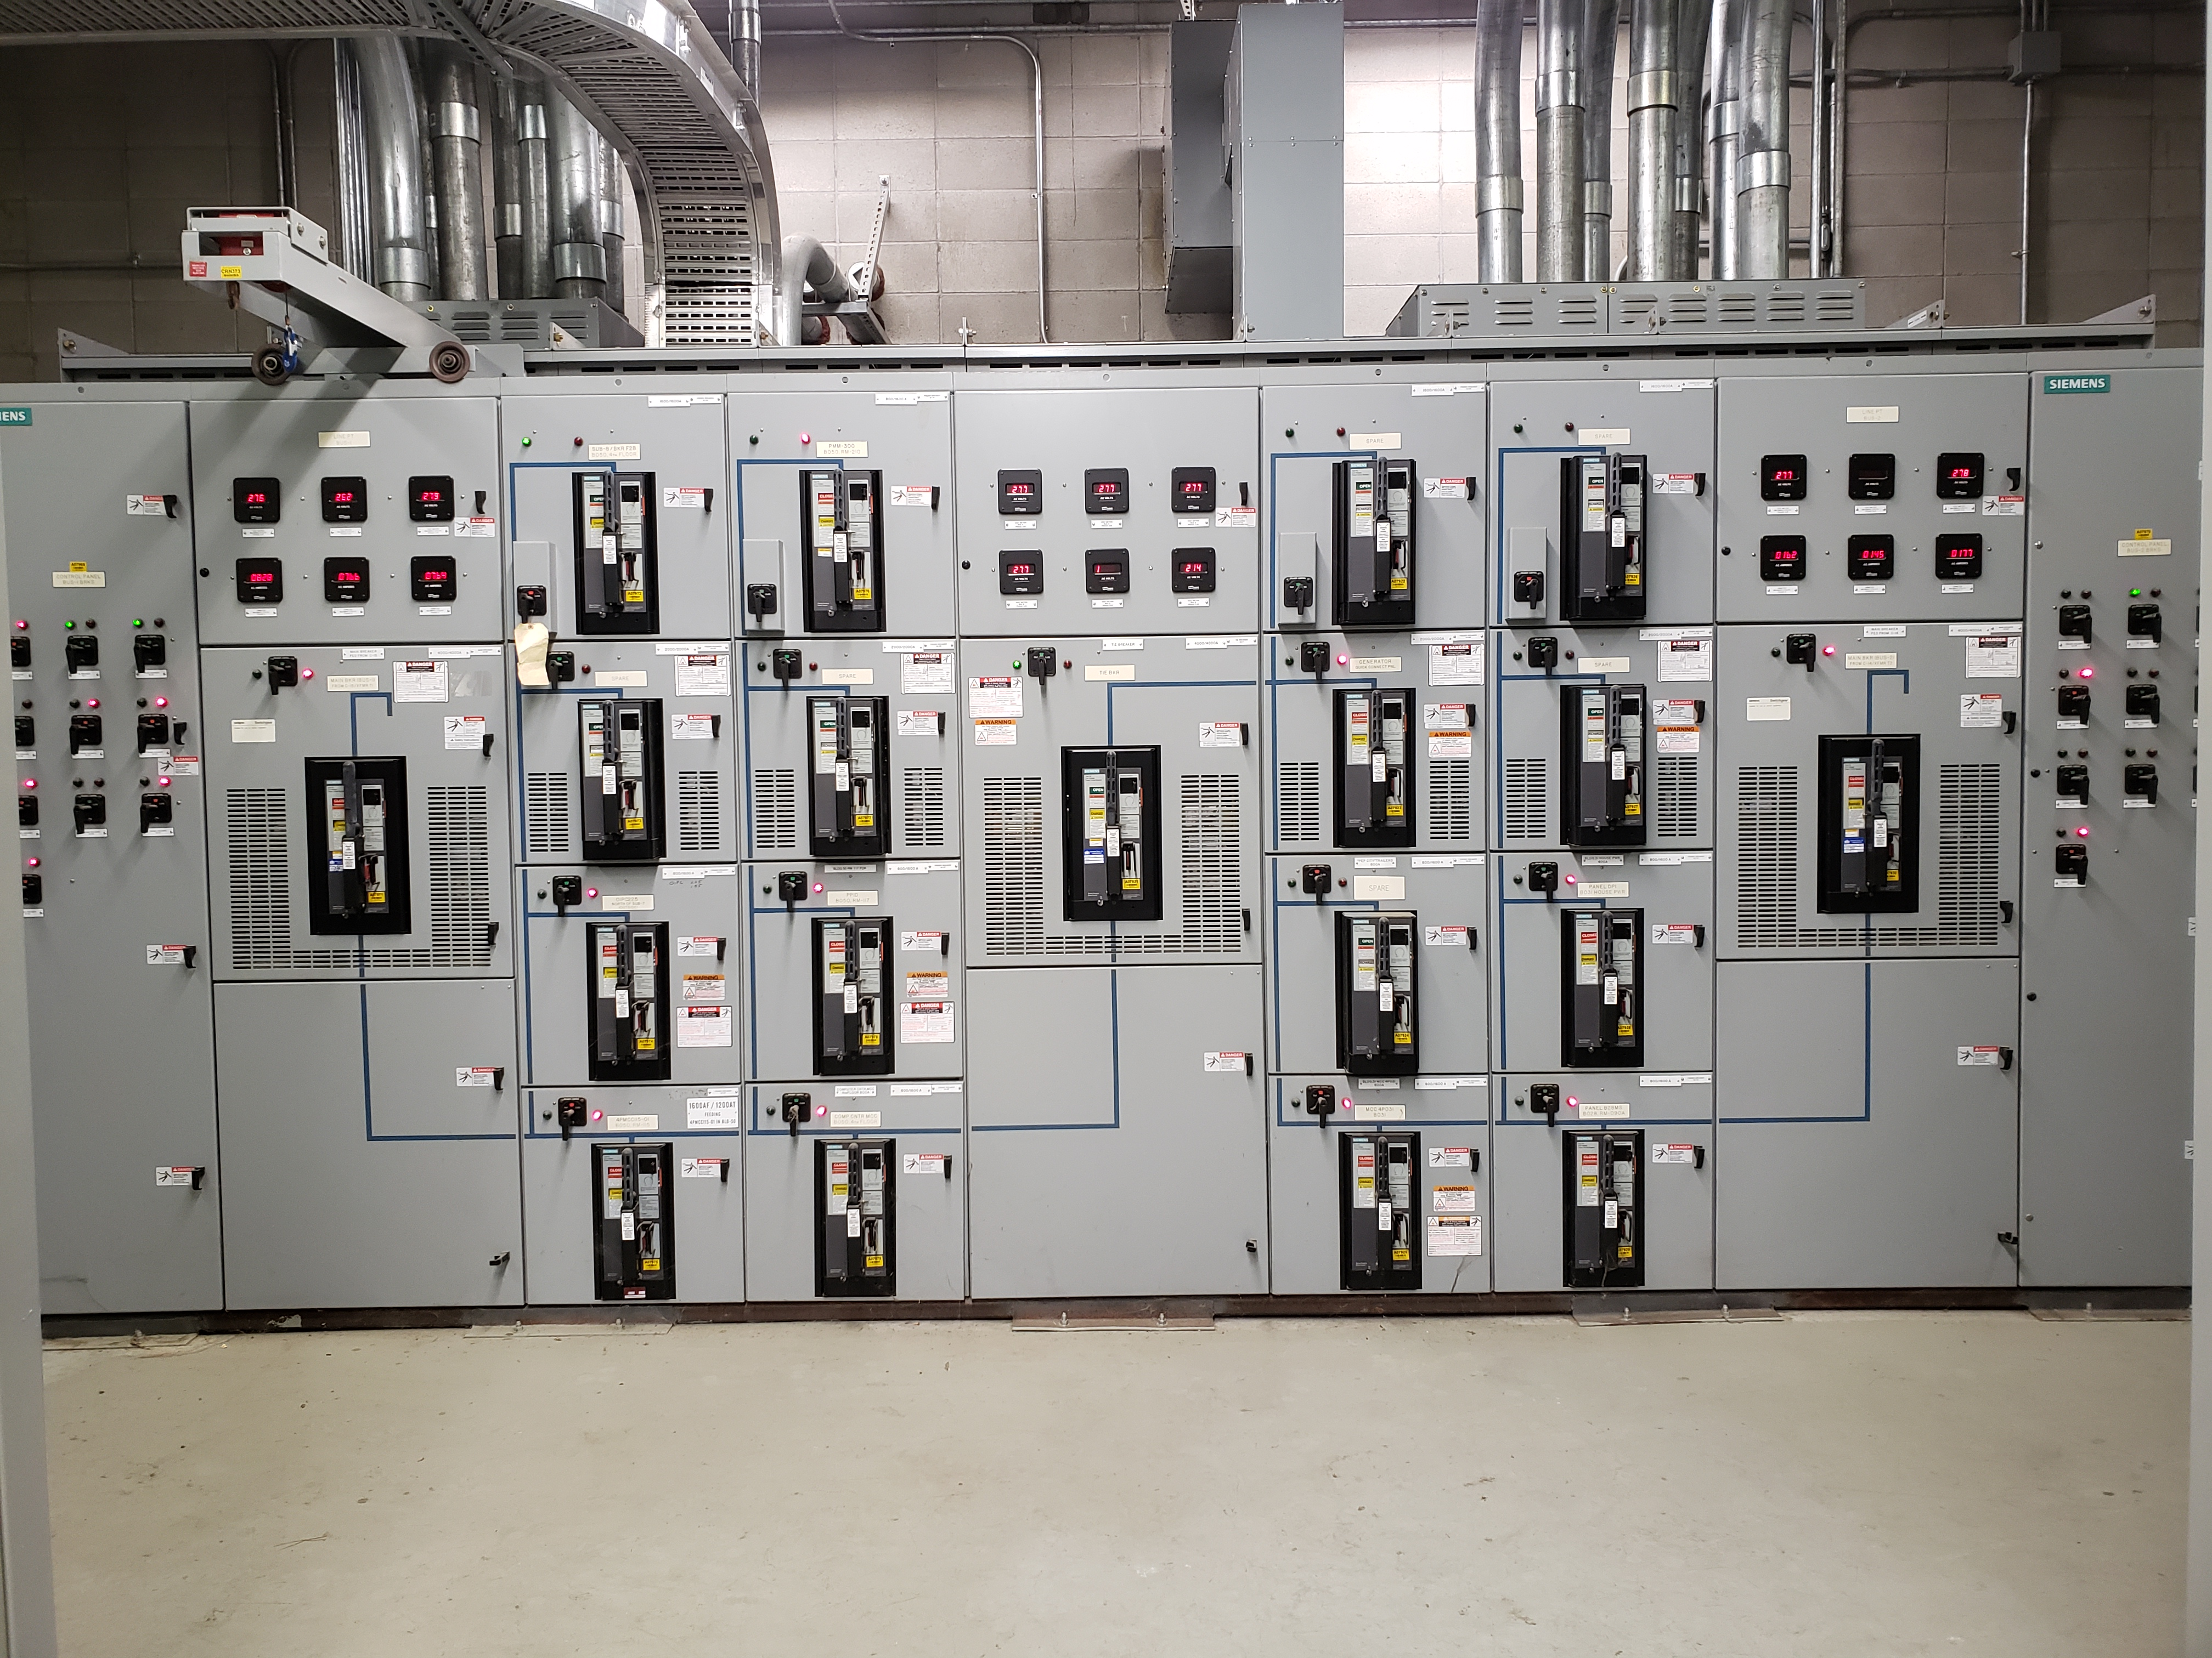
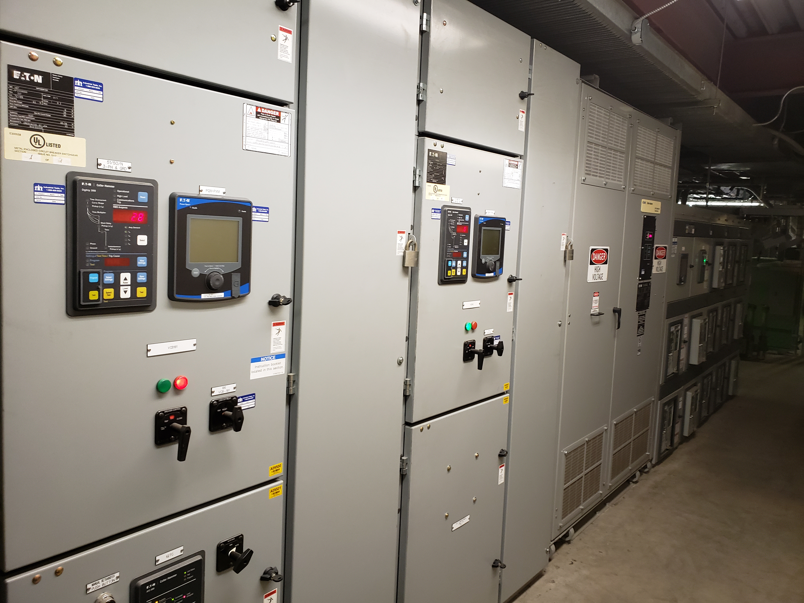
Substation 7 & 8 Components
Substation 7 Switchgear (B50S)
12kV
480V
Substation 8 Switchgear
B52 MV Transformer
480V (B50 4th Floor)
Notes:
“What, where”

Slide 4
Preventive Maintenance Plan Substations 7 & 8
Scope: Perform full preventive maintenance and testing for Substation 7 and 8.
Substation 7 (S7) installed 2002 (LV) & 2005 (MV), partial maintenance done in 2015
Substation 8 (S8) installed 2011, no maintenance since original installation
Standard maintenance cycle: 5 years
Risks:
Feeder cables tested in 2017, giving poor condition results. Recommended retest every 2 years.
Loss of substations results in site-wide outage, >2 weeks
Switchgear maintenance out of cycle; creating compounding outages
Equipment in S7/S8 cannot be operated while system is energized; requires isolation at MSS
Planned or unplanned outages of downstream equipment requires outage upstream of S7/8 – at Main Substation (MSS), affecting larger area
Timing:
Future outages of B50 & B52 requires outage > 9-10 days.
Next opportunity: December 2021? Due to operations
12kV line diagram
Notes:
“What, why”
- line diagram that shows what comes down if a catastrophic failure of S7/8 occurs (assume entire site)
·Substation 50s (sub 7) & 550s (Sub 8) Maintenance
·Substation 550s (Sub 8) has not had preventative maintenance done since original installation in 2011
·Sub 50s (sub 7) had a partial maintenance done on 3/2015 and will be due during the next user run
·12.47kV feeder cable C-14 for Subs 50s & 550s was tested on 12/2017 giving poor condition results. The recommendation to re-test is overdue and can only be completed during a winter closure without disrupting employees lab-wide.

Slide 5
Proposed PM Schedule Substations 7 & 8
F&O Stage Backup Generators, B50/52
7am: F&O shift to generator power, B50/B52
SPEAR Resumes Ops
IT Graceful Power Down |  |  |  |  |  | Substation Maintenance |  |  |  |  |  |  |  |  |  |  | IT Power Up
PPS Cx
Fri 20 Dec | Sat 21 Dec | Sun 22 Dec | Mon 23 Dec | Tue 24 Dec | Wed 25 Dec | Thu 26 Dec | Fri 27 Dec | Sat 28 Dec | Sun 29 Dec | Mon 30 Dec | Tue 31 Dec | Wed 1 Jan | Thu 2 Jan | Fri 3 Jan | Sat 4 Jan | Sun 5 Jan | Mon 6 Jan | Tue 7 Jan
5pm: F&O return site to normal power
2am: Last SPEAR run
F&O Remove Backup Generators
Notes:
”When, how”

Slide 6
Impacts to B52
Requirement: ACR support LCLS II PPS commissioning
IT Systems: all HA systems, FastX
Actions:
F&O provide N+1 generator support for ACR operations
F&O perform backup generator test to validate power for ACR, ANR, HVAC, and UPS
Scheduled 3 December, 5am (90 min)
CIO support FastX during outage

Slide 7
Impacts to B50
Requirement: Support required science and HA systems during outage
IT Systems:
All HA systems
Actions:
F&O install N+1 generator support for critical IT and HVAC systems
CIO perform graceful power down and power up of systems

Slide 8
B050 Services we expect will remain available
- Network switches/routers & core network services (dns, dhcp, etc.)
- Telecom devices
- Unix home directories
- EMC SAN storage
- Cyber services not listed below
- Site Security solutions
Additional generator supported services / equipment
- HVAC CRAC Units on B050 1st and 2nd floor
- B050 Standby lighting, Fire alarm & computer room control consoles
Cloud Services Dependent on HA and other Generator Supported Services:
- ServiceNow
- Nuvolo
- Office 365

Slide 9
B050 Services we expect will remain available (cont’d)
- High Availability (HA) Services
- Facilities Monitoring (including DCS control system)
- HVAC Web Control
- Confluence, Jira and Crowd
- www6, Intranet and other drupal websites; www.slac.stanford.edu
- CATER & CAPTAR
- Exchange & UNIX mailboxes; listserv
- SharePoint (SlacSpace, Portal)
- ERP
- Mobile Device Management (MDM)
- DUO
- psoft-printserv
- Operations E-log, Physics E-log, AIDA, IRMIS
- Splunk indexers for Cyber Security
- sec-splunk-es
- aegir (drupal-admin01)
- Active Directory (Authentication)
- Nagios and SCOM (UNIX/Windows monitoring)
- Fast-X
- Software license servers
- webauth

Slide 10
B050 Services that will be down (partial list)
- All scientific computing services (batch compute services)
- All Unix NFS, GPFS, and Lustre file services (except home directories)
- All interactive Unix login nodes (rhel6-64, iris, centos7)
- Unix printing
- Cron services (lnxcron, trscron, and syscron)
- FTP service
- Ganglia and Grafana monitoring
- Open stack virtualization platform
- SciDoc
- Red Hat package update service
- Squid proxy service for internal servers
- ZOOX (compute and storage)
- HVAC systems that cool B050 UPSes (4th floor)--need to shutdown units @ max. temperature of ~90 degrees F
- IDOL search
- Contract Manager
- Unix and Windows backups/restores
- Carbon Black Protection (Will not be able to modify whitelists)

Slide 11
B050 Services that will remain online with temporary generator
HVAC systems that cool B050 UPS (4th floor)
CryoEM
FERMI LAT
Team Center
Tape backup
Zoox (Network Only)
ERP back up solution

Slide 12

More details
PPS Certification for LCLS restart: UP, with a combination of IT services and a backup generator for B050 ACR.
NASA FERMI LAT Servers: DOWN. FIX: IT and F&O will plan for solutions (e.g., additional generators, etc.).
Security Access Control (Card readers, gates, CCTV, etc): UP, with a combination of IT services and a backup generator for B050 ACR.

Slide 13
Affected Science Experiments (partial list)
Accelerator
AOSD, Beam Physics, FACET, SPEAR, surrey04b NFS
Energy Sciences
PULSE, SIMES, SUNCAT
Fundamental Physics
ATLAS, BaBar, EXO, HPS, Neutrino, Theoretical Physics
Comp Astro, CMB, CDMS, DES
Fermi pipeline, LDMX, LSST, LZ

Slide 14
Affected Science Experiments (partial list)
LCLS
Anyone accessing GPU hosts and B050 batch nodes
SSRL
Anyone accessing GPU hosts and B050 batch nodes
Tape archive or backup/restore: only for ERP, FEMI and CryoEM.

Slide 15
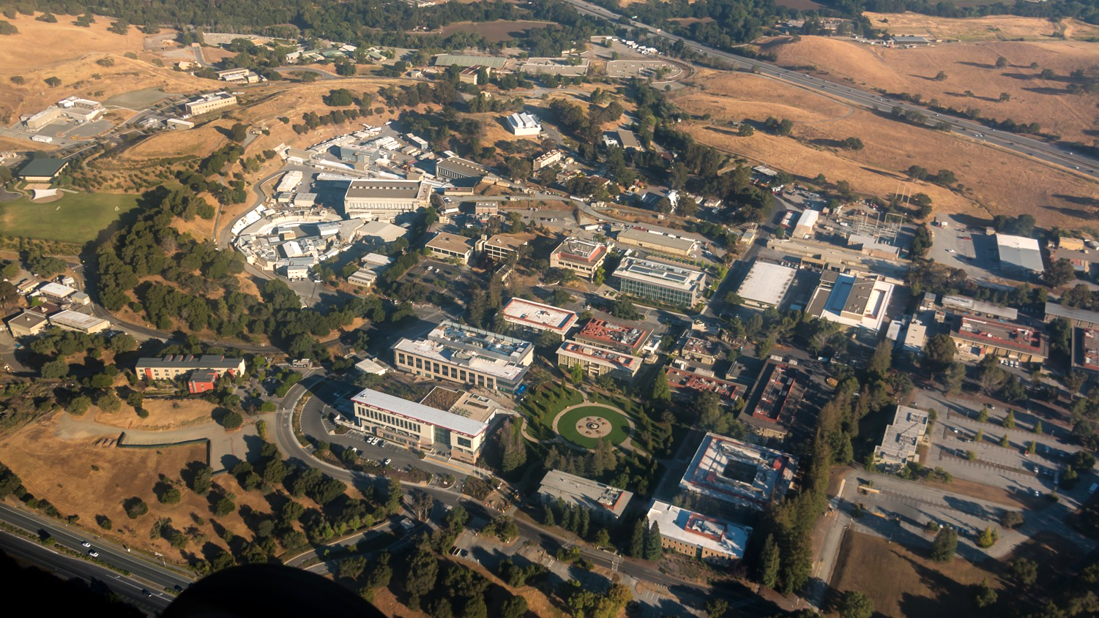
QUESTIONS?

