Slide 1
Analysis Coordinators’ Report
G. Tosti & E. Charles

Slide 2
Outline
Scientific organization and collaboration service
Internal and external data release plans
  Standard photon classes
  LAT Low Energy (LLE)
Recent highlights
  “Pass 7” event analysis
  2 Year catalogs
Conclusions

Slide 3
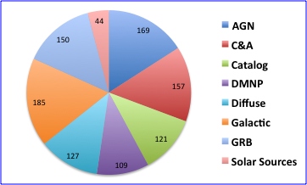
Our Collaboration
Total: 472 members

Slide 4
Collaboration Science Groups Activities
Definition of photon classes
Catalogs, Diffuse Models, Software tools
Science (Peter’s talks)
L1, Data Monitoring, Flares, GRBs Shifts
Data Analysis
Internal documentations, web pages

Slide 5
Internal and external data release plans
IRF Set | Details | Blessed for LAT Use | Public Release Date
P6_V3 | Post-launch, includes overlays | 2008 | August 2009
P6_V11 | Includes in flight corrections | March 2011 Used for several symposium contributions | May 2011
P7 | Pass 7 Event Analysis Includes in flight corrections | April 2011 Used For 2FGL and some related contributions | Expected July 2011
Transition period from Pass 6 to Pass 7 reflects complicated analysis dependencies
(Event Selection -> Diffuse Models + Catalog -> Point Source Analysis)
Many analysis were done with best pass 6 IRFs so as to be ready in time for
symposium
Time between internal release and public release dominated by time to perform and publish first analyses and time in transferring software and documentation to Fermi Science Support Center (FSSC)

Slide 6
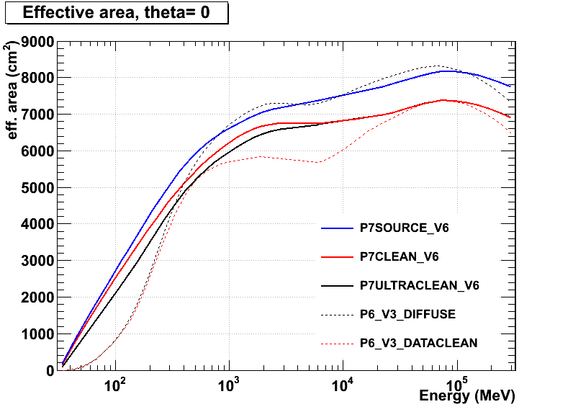
“Pass 7” event analysis
Pass 7 is first
version of event
analysis to use knowledge from flight data
Compensates for pile-up in electronics from cosmic-ray backgrounds
Many times more A_{eff} below 300 MeV
A_{eff} curve is less steep, better for spectral analysis

Slide 7
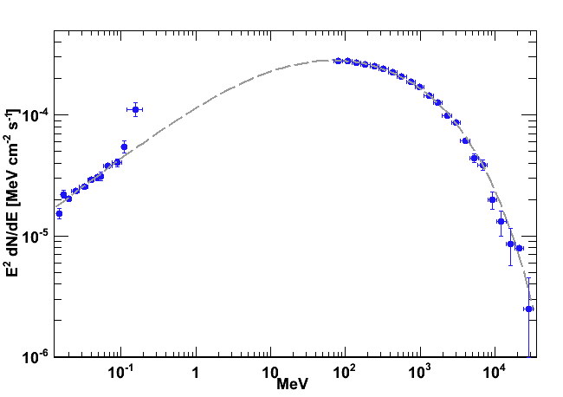
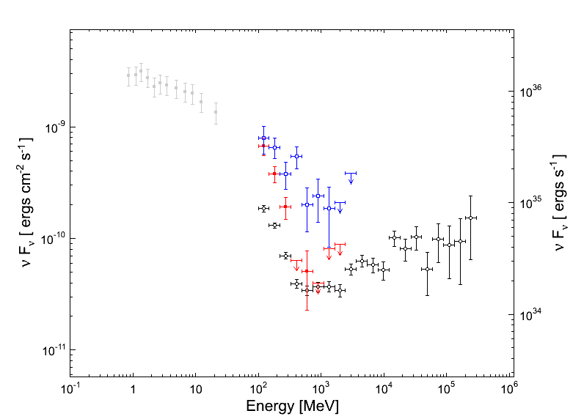
Pass 7 and the E<200 MeV region
AGNs
  Define the Peak of the IC component
Galactic Sources
  Many. ie, Crab
GRBs & Solar flares
  LLE analysis (see Nicola talks) P7 extended classes
Solar
  Lunar emission
DMNP
  DM Dwarfs, Dm Spher.
Diffuse emission
Extragalactic background
  Starbursts vs AGNs
3c454.3 by Marco A.
From the Crab nebula flare paper

Slide 8
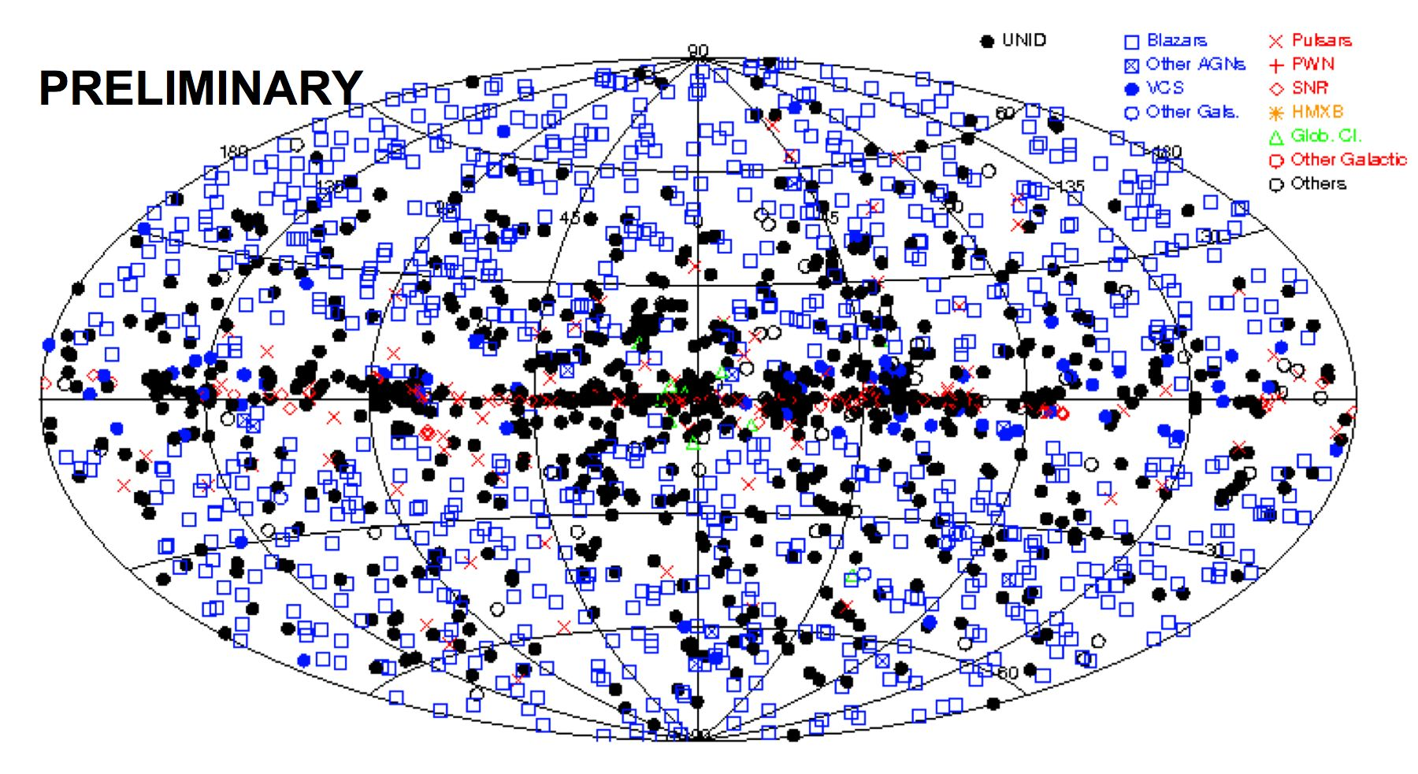
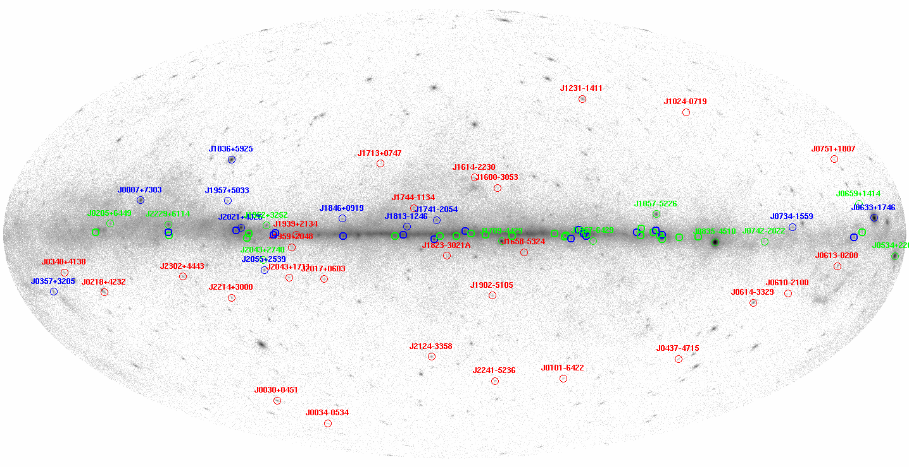
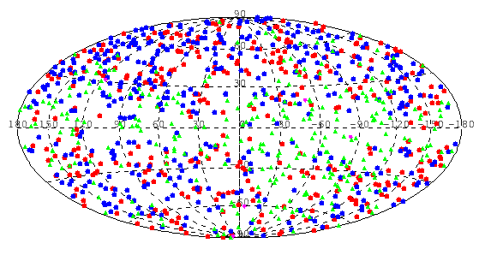
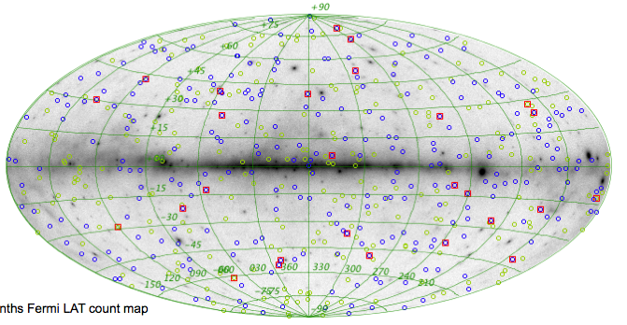
2FGL and Other Catalogs
2FGL Catalog
2nd Pulsar Catalog
2 LAT AGN Catalog
GRB Catalog

Slide 9
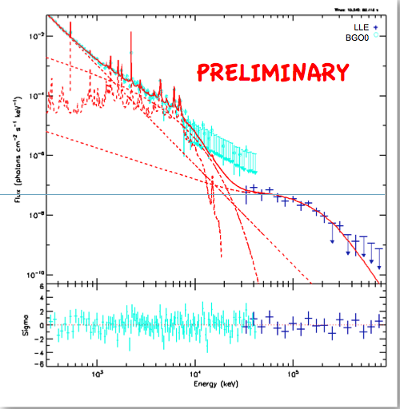
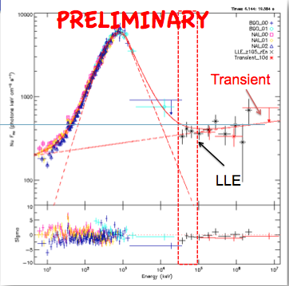
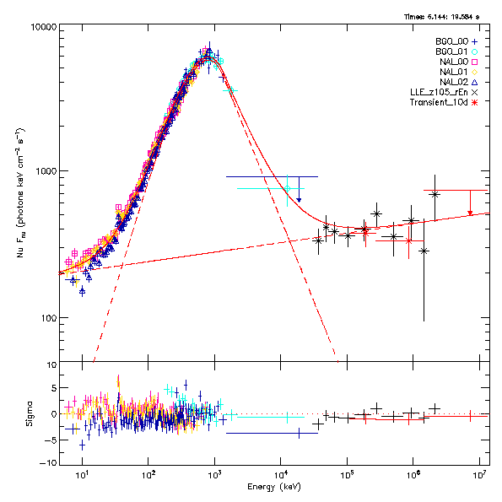
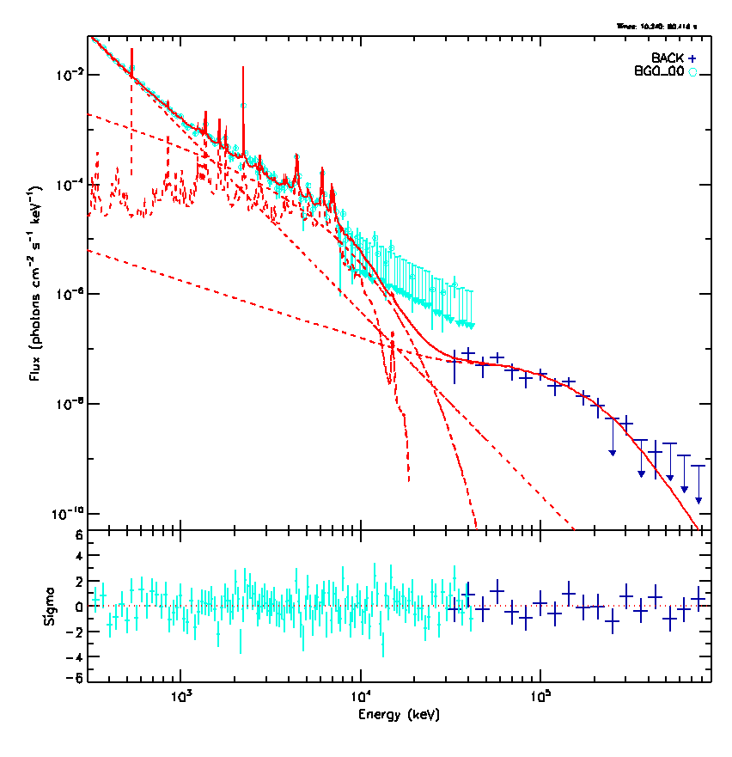
LAT Low Energy (LLE) analysis
SOL2010-06-12T00:57 M2 X-ray Flare
GRB 090902B
Too much data to export it via FSSC
LAT team is developing burst data products
akin to GBM products to export for LLE
Public release later this year
Lots of A_{eff} at energies below
reach of standard event classes
Photon Spectrum of the Solar Flare of June 12th
Photon Spectrum of the Solar Flare of June 12th
Photon Spectrum of the Solar Flare of June 12th
Photon Spectrum of the Solar Flare of June 12th
Photon Spectrum of the Solar Flare of June 12th
Photon Spectrum of the Solar Flare of June 12th
Photon Spectrum of the Solar Flare of June 12th
Photon Spectrum of the Solar Flare of June 12th
Photon Spectrum of the Solar Flare of June 12th
Photon Spectrum of the Solar Flare of June 12th
LLE
BGO0
LLE
BGO0
LLE
BGO0
LLE
BGO0
PRELIMINARY
LLE
BGO0
PRELIMINARY
LLE
BGO0
PRELIMINARY
LLE
BGO0
PRELIMINARY
LLE
BGO0
PRELIMINARY
LLE
BGO0
PRELIMINARY
LLE
BGO0
PRELIMINARY
PRELIMINARY
PRELIMINARY
PRELIMINARY
Thanks to this analysis technique we were able to recover the gamma-ray emission from the Sun during the SOL2010-06-12T00:57 M2 X-ray Flare
Thanks to this analysis technique we were able to recover the gamma-ray emission from the Sun during the SOL2010-06-12T00:57 M2 X-ray Flare
Thanks to this analysis technique we were able to recover the gamma-ray emission from the Sun during the SOL2010-06-12T00:57 M2 X-ray Flare
Thanks to this analysis technique we were able to recover the gamma-ray emission from the Sun during the SOL2010-06-12T00:57 M2 X-ray Flare
Thanks to this analysis technique we were able to recover the gamma-ray emission from the Sun during the SOL2010-06-12T00:57 M2 X-ray Flare
Thanks to this analysis technique we were able to recover the gamma-ray emission from the Sun during the SOL2010-06-12T00:57 M2 X-ray Flare
Thanks to this analysis technique we were able to recover the gamma-ray emission from the Sun during the SOL2010-06-12T00:57 M2 X-ray Flare
Thanks to this analysis technique we were able to recover the gamma-ray emission from the Sun during the SOL2010-06-12T00:57 M2 X-ray Flare
Thanks to this analysis technique we were able to recover the gamma-ray emission from the Sun during the SOL2010-06-12T00:57 M2 X-ray Flare
Thanks to this analysis technique we were able to recover the gamma-ray emission from the Sun during the SOL2010-06-12T00:57 M2 X-ray Flare

Slide 10
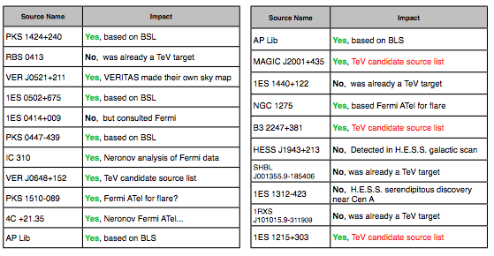
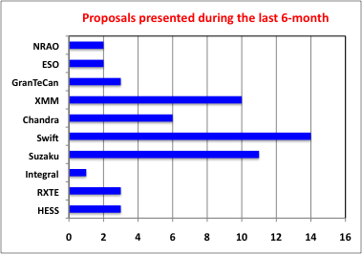
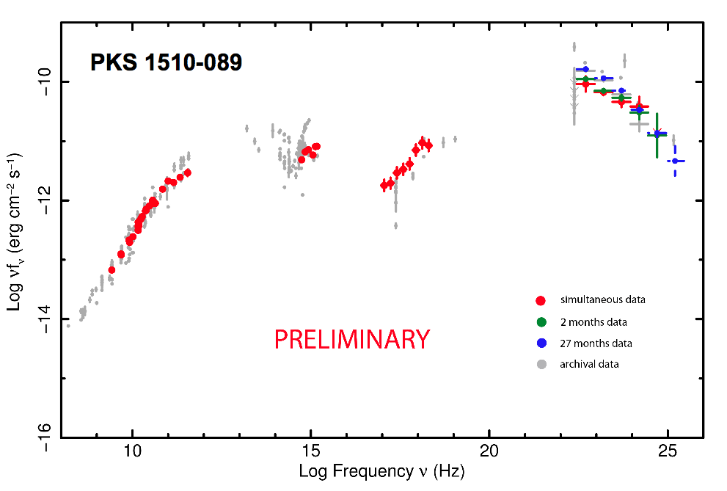
Multi-wavelength activities
Increasing number of common projects with HESS,VERITAS, MAGIC
https://confluence.slac.stanford.edu/display/SCIGRPS/Multiwavelength+Planning+-+Short+Term
Swift
Planck
LAT

Slide 11
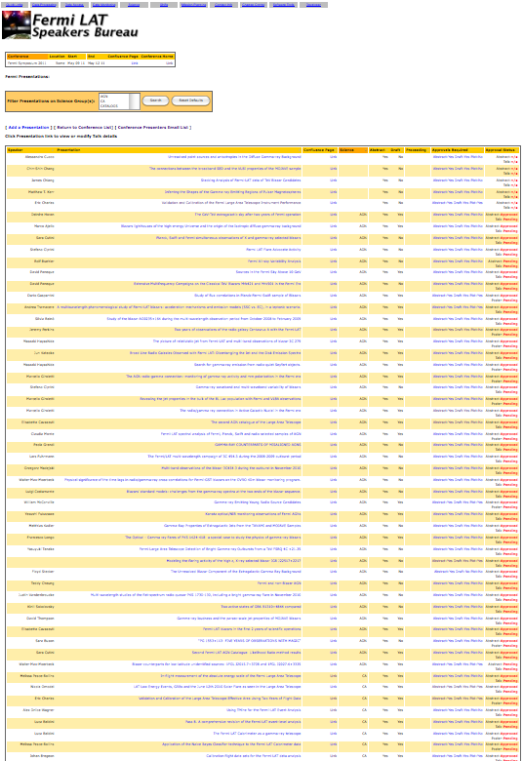
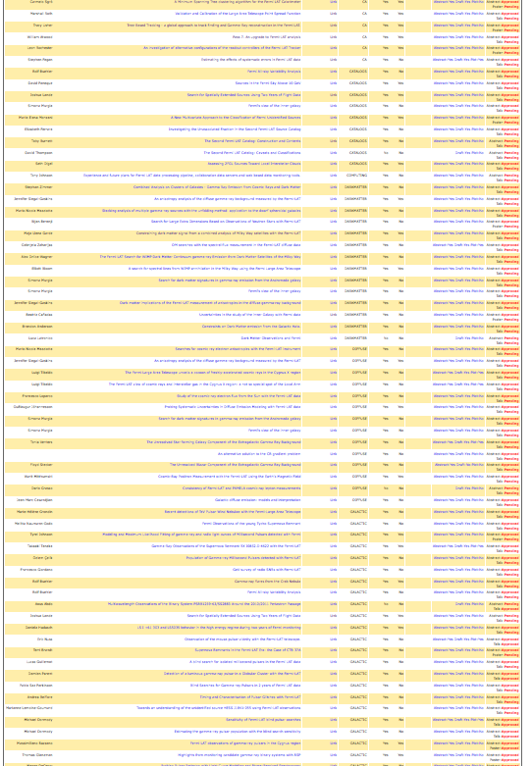
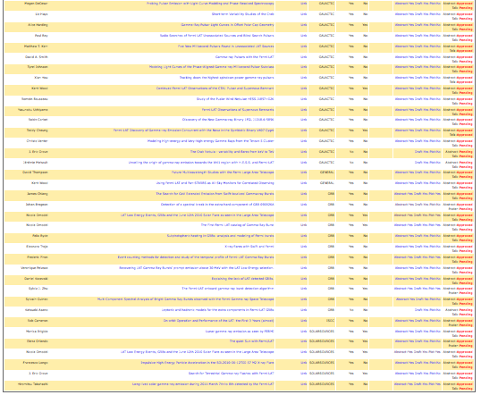
Over 150 LAT Team Contributions
Snapshot of Speakers’
Bureau Web Page for
Fermi Symp. 2011
Writing, reviewing and iterating all of these contributions would have been
impossible without dedicated and tireless work of science groups lead and numerous
collaborators who served as internal reviews

Slide 12
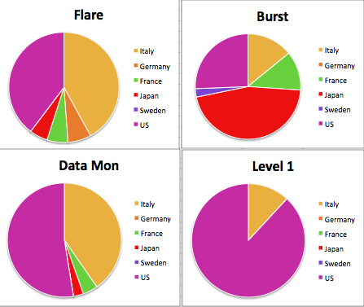
Shift Taking Status
Flare Advocate Shifts
Burst Advocate Shifts
Data Monitoring Shifts
L1 Pipeline Shifts

Slide 13
Internal Documentation and Web pages
Efficient transfer of information a challenges for large collaborations
Ongoing revision of all web site.
  Single login for all sites
    Confluence, glast-ground sites, Pub Board, .....
New Standard analysis documentation page and Workbook update
Evaluating the possibilities to have Web based LAT data analysis
Two days “Hands-on” LAT Analysis and shift training for new young members at the Collaboration Meeting and not only:
  The first “Hands-on” will be held at SLAC the week before the next Collaboration meeting in August .

Slide 14
Conclusions
Organizationally, the 8 collaboration science working groups are inter-connected via common needs, cross-group membership, and collaboration service work
  Their effectiveness in organizing a tremendous number of contributions for this symposium is a proof by example
The collaboration has been effective in publishing papers, including a number of “high-impact” and catalog works
We continue to build on past results

Slide 15
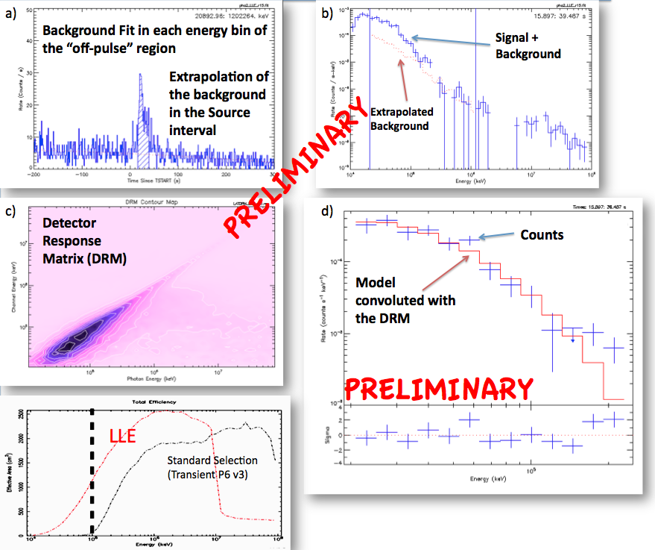
LAT Low Energy (LLE) analysis
The LAT Low Energy (LLE)
analysis use an extremely loose event selection (~70% of all downlinked events) and depends on temporal sidebands to perform background subtraction
For bright transients the
huge increase in A_{eff} more
that compensates for the
increased background
Too much data to export it via FSSC
LAT team is developing burst data products
akin to GBM products to export for LLE
Public release later this year
Lots of A_{eff} at energies below
reach of standard event classes

