Slide 1
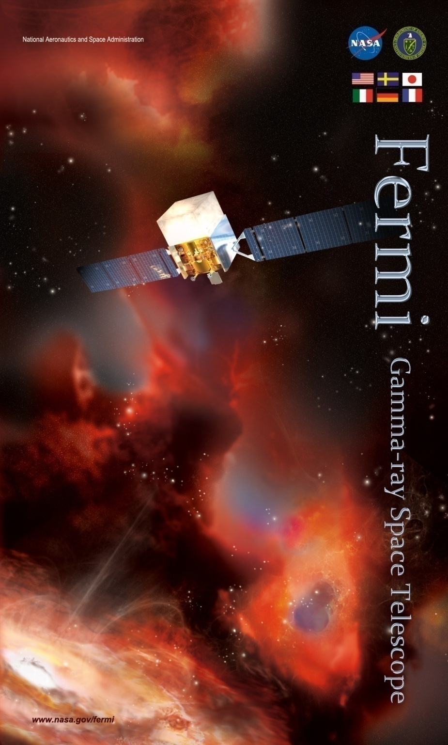
Fermi
Gamma-ray Space Telescope
International Finance Committee Meeting
Mission Status Update
J. McEnery

Slide 2
Status Highlights
Observatory is operating smoothly, FOT continues to look for ways to improve operations.
Reaction wheel life test complete
Teardown/disassembly underway
Updated spacecraft FSW to handle reduced wheel observation modes – code and testing complete
Nadir observations
Fermi sessions at AAS, AAAS, COSPAR, APS
Press and outreach coordination and planning, recent releases:
Dark matter
>10 GeV Sky
Tycho SNR
Cygnus Cocoon
Updates to GI program
In discussion with VERITAS and Arecibo for cycle 6

Slide 3
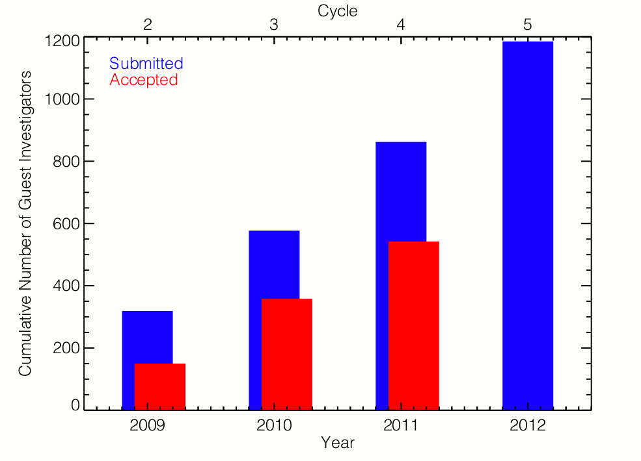
Growing Science Productivity
Total number of people participating in GI program continues to rise
Fermi is a young mission!
Community of Fermi users is growing by >20% per year
Note: These represents U.S. Fermi users only, growth of international community likely follows similar trend
Notes:
Need to make a chart of Fermi Gis (pi+co-I) per year.

Slide 4
Growing Science Productivity
Fermi is a young mission!
Publications and PhD theses continue to rise
Papers search interface: http://fermi.gsfc.nasa.gov/cgi-bin/bibliography_fermi
Notes:
Need to make a chart of Fermi Gis (pi+co-I) per year.

Slide 5
Observations summary (since last meeting)
Almost exclusively in nominal data taking in survey mode
50 deg rocking angle from May 27 2009 onwards
ARRs (1-2 per month)
Nadir survey mode observations
3 orbits at nadir (2.75 hours before observation, modify GBM trigger config to reduce chance of false triggers)
Last nadir observation in 2011 resulted in sunpoint – root cause is due to drift in propagated attitude while the star trackers are blocked
nadir observations are now performed with a manned MOC
Solar observation
2 days rocked south to improve solar coverage during a major outburst in March 8-9
Pole observation for Tkr trunc tests

Slide 6
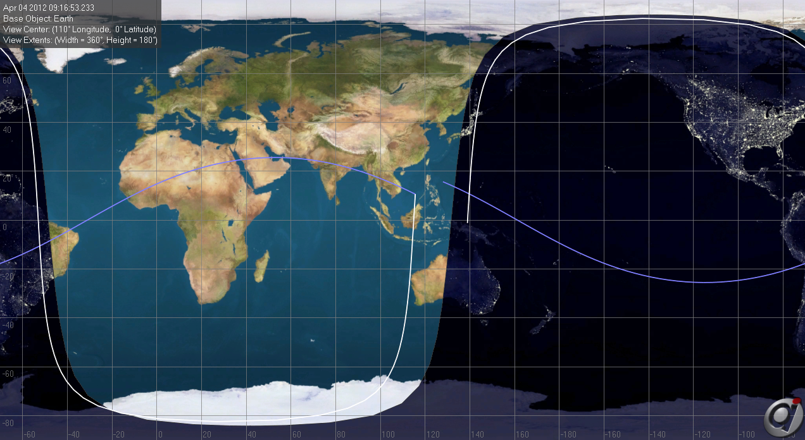
Fermi vs Cosmos 1805
FGST
FGST (33053)
Apogee Height:561 km
Perigee Height:552 km
Inclination:25.6°
Cosmos 1805 (17191)
Apogee Height:599 km
Perigee Height:563 km
Inclination: 82.5°
Conjunction Location:
Latitude:10.6° N
Longitude:115.5° E
Relative Velocity:12.1 km/s
Approach Angle:105.8°
Cosmos 1805
Fermi and Cosmos 1805 predicted to pass within 500 m of one another

Slide 7
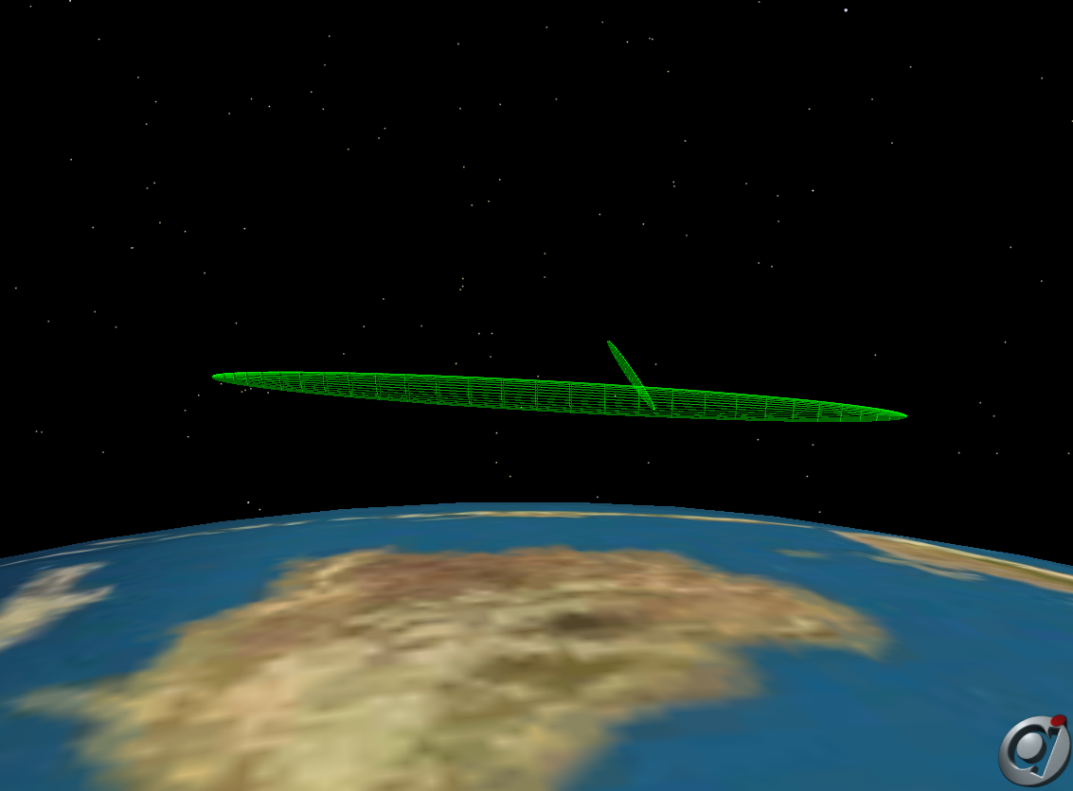
Conjunction visualization
Geometry of the close approach: the two orbits crossed each other – the separation was due to where on each orbits the satellites were -> uncertain
We performed a 1s posigrade burn to move out of the way

Slide 8
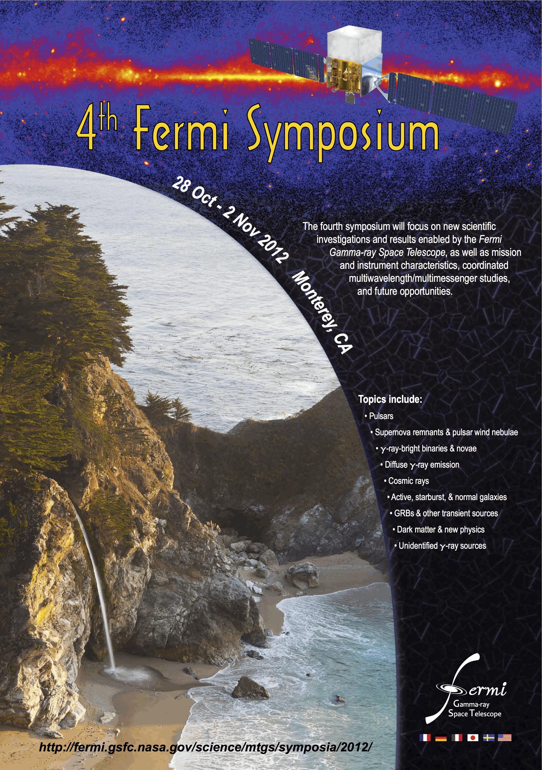
Fermi Symposium
4th Fermi symposium in Monterey, California in Oct 28-Nov 2 2012.

Slide 9
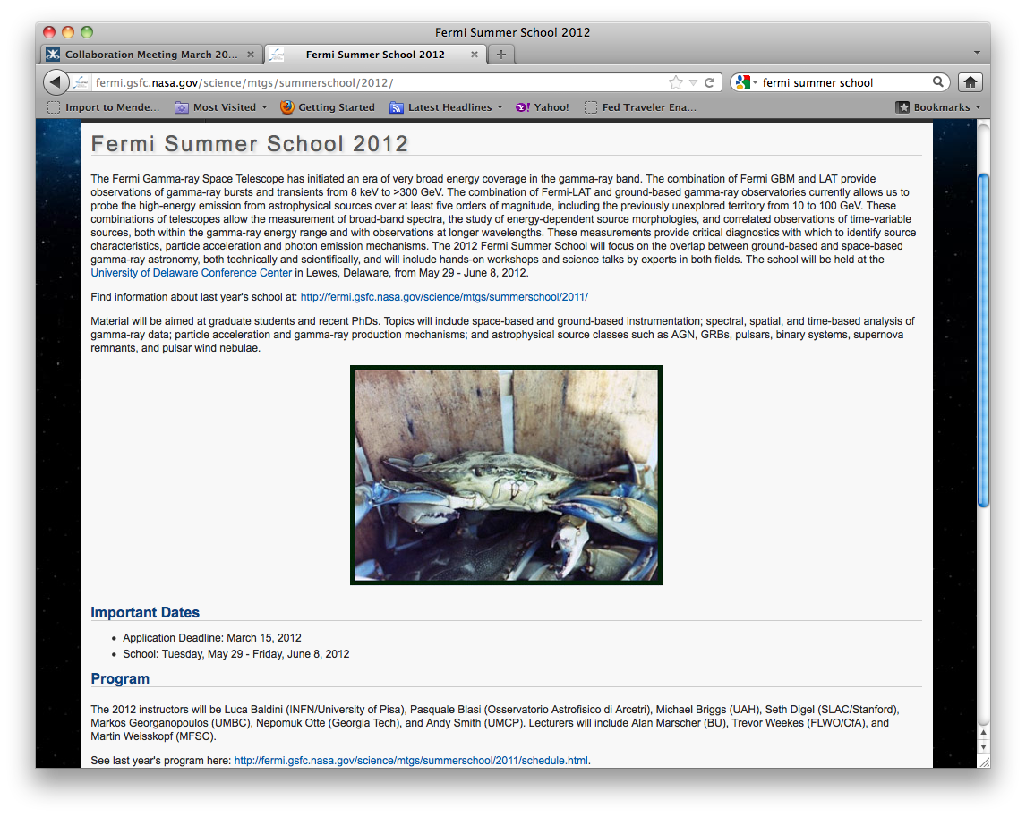
Fermi Summer School – May 29 – June 8

