Slide 1
Analysis Coordinators’ Report April 2012, IFC Telecom
Eric Charles & Luca Latronico

Slide 2
Introduction & Outline
Outline
Recent Science Highlights
Pass 7 Status & Improvements
Pass 8 Overview and Status
Analysis Organization, Working Groups, Shifters
Publications
The IFC requested an updated of the Pass 8 effort
Given the time available we will focus primarily on recent science highlights and the status of Pass 7 and Pass 8
We have included slides covering collaboration analysis efforts and publications at the end of the presentation and can answer questions about them if requested

Slide 3
Recent Science Highlights

Slide 4
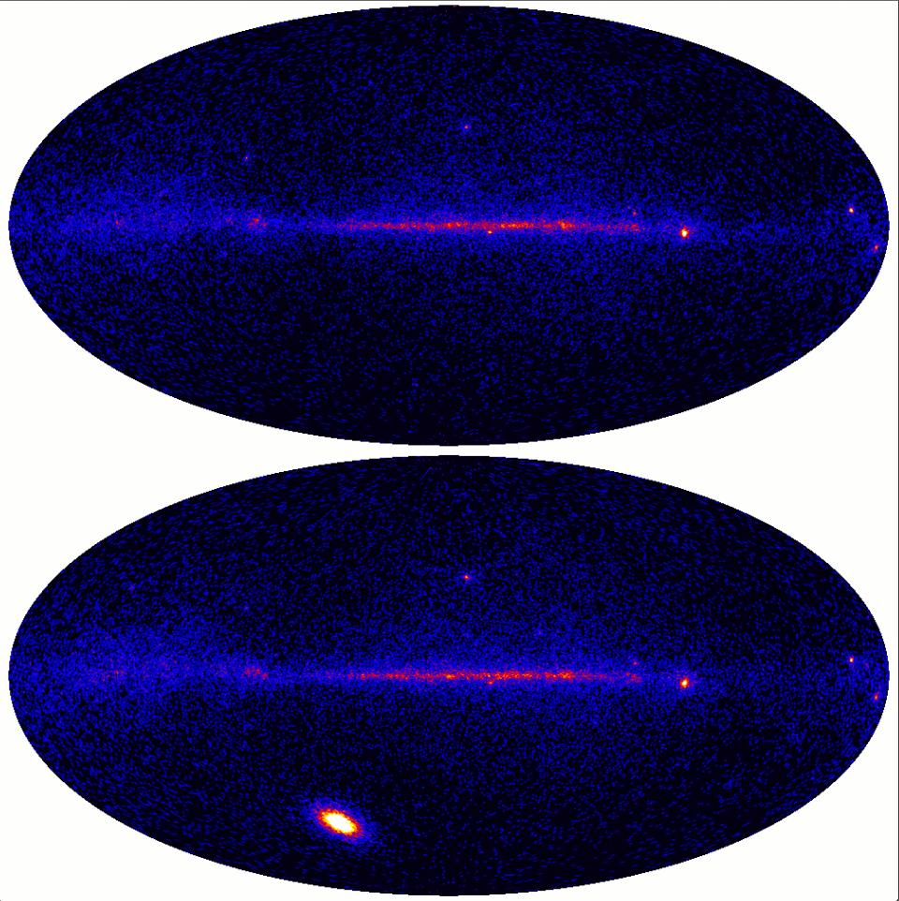
Extreme Solar Flare of March 7, 2012
March 6
X5.4 Class Solar Flare
Solar Flux > 1000x quiet Sun
10⁴ γ ray > 100 MeV
Bright enough to localize
emission region to 2% radius
of solar disk
ACD saturated for early phase
of Flare (mitigated in pass 8)
March 7
This is a “game-changing”
data set for Solar physics in the γ-ray band
N. Omodei & Solar Group
March Collaboration Meeting

Slide 5
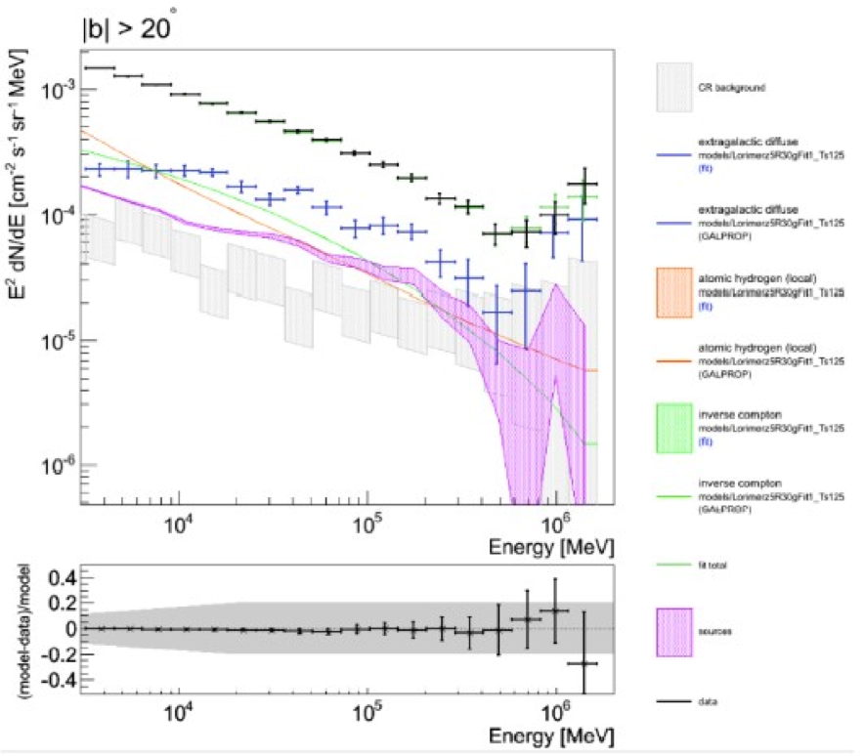
The extragalactic background
Unexpected spectral hardening in EGB
seen above 500 GeV
Preliminary
Not seen in control samples (Earth limb, galactic plane)
Survives source masking and is not correlated with known AGN positions
Current IRFs only go up to 560 GeV (Pass 8 ~ 2TeV)
Also need to study possible CR e⁺e⁻ contamination (improved in Pass 8)
Pass 8 selection will improve statistics above 500 GeV
M. Ackermann & Diffuse Group
March Collaboration Meeting

Slide 6
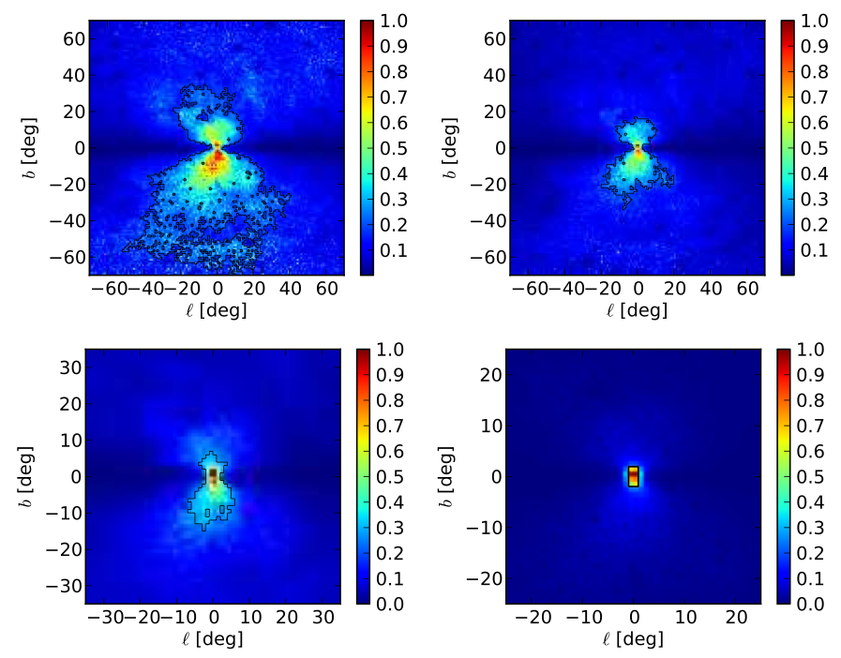
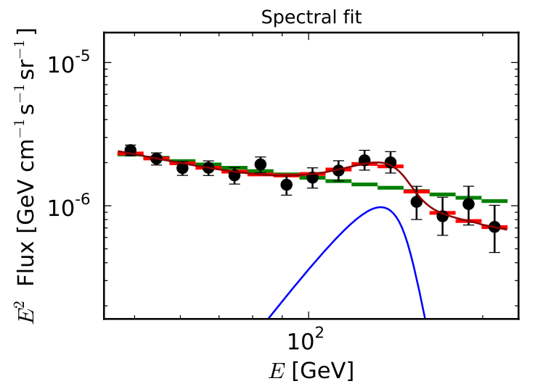
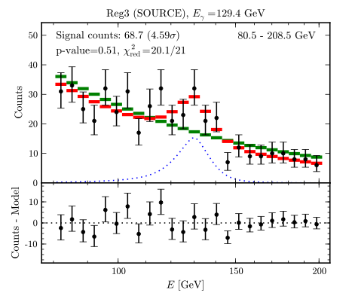
Recent External DM Results
Bringmann et. al.
[arXiv:1203.1312]
Internal Bremsstrahlung
Spectral feature at 130 GeV observed in ROI optimized for S/N under different models
Weniger
[arXiv:1204.2797]
Line Search
Not seen in control samples (Limb & Plane)
Interpretation relies on morphology
Improved high energy PSF in pass 8

Slide 7
Pass 7 Developments

Slide 8
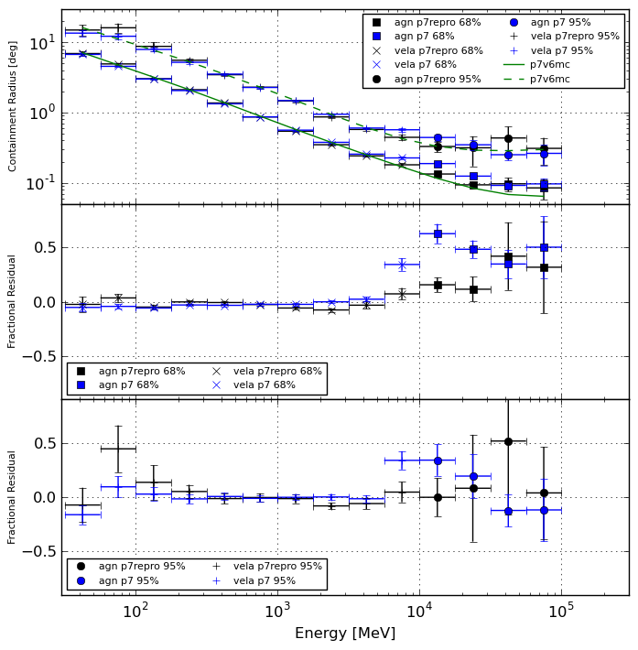
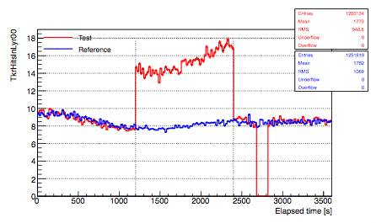
Pass 7 Developments
Preliminary
New TKR readout configuration “trunc64” recovers many hits (recovers all hits in many events)
Simulations show marked reduction of PSF tails above few GeV
PSF with reprocessed data and improved calibrations much closer to MC predictions
Results of engineering runs are indicating that “trunc64” configuration will improve high-energy PSF
C & A Group & ISOC & Pass 8 Group
March Clb. Meeting
M. Wood, M. Roth, April 18th 2012

Slide 9
Pass 8 Status

Slide 10


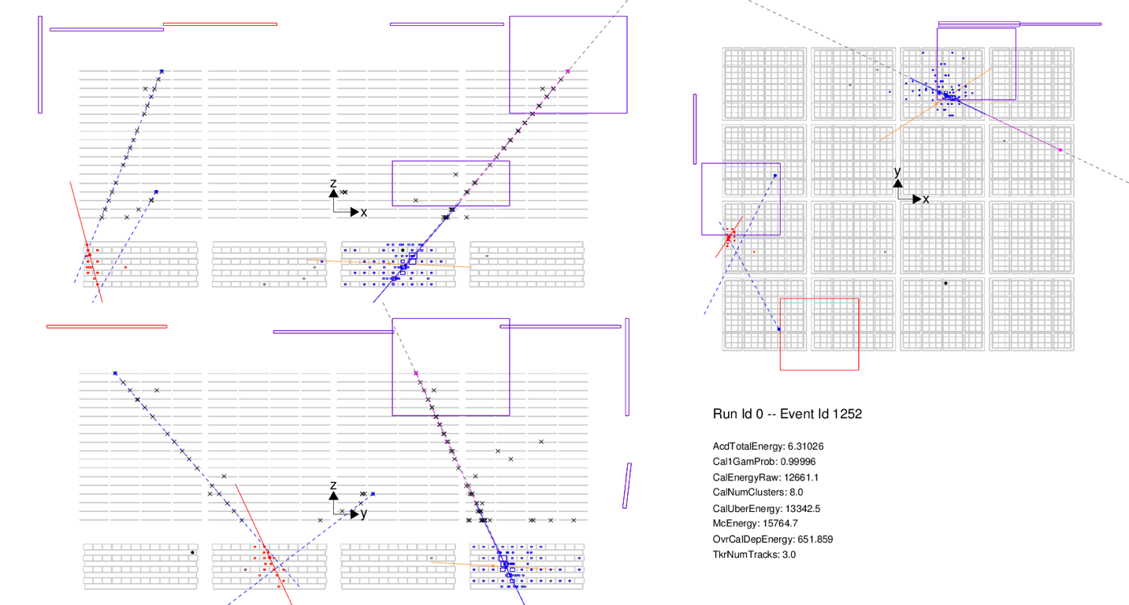
Motivations for Pass 8
A. Drlica-Wagner,
C. Sgro & Pass 8 Group
March Clb. Meeting
The LAT is complex particle detector
LAT event-level analysis was largely developed before launch
We now have improved knowledge of the instrument and backgrounds
E.g., we found that many events are accompanied by GHOST signals...
These ghosts cause a significant losses in effective area
Pass 8 uses this knowledge to improve data for science
Pass 8 R&D started 3 years ago, now nearing completion

Slide 11
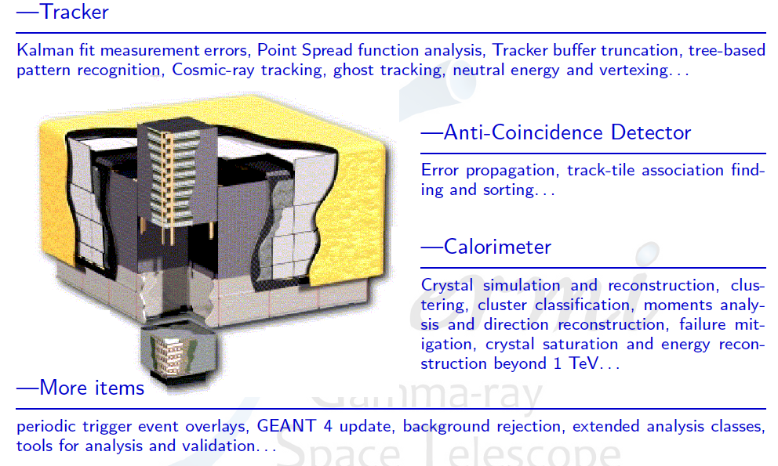
Overview of Pass 8 Development Areas
Pass 8 development group includes researchers from across the collaboration

Slide 12
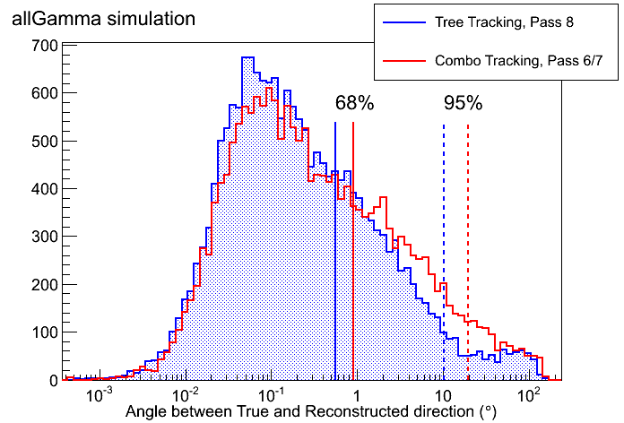
Completed Work: Tree-Based Tracking
Tree-based tracking follows the “flow of energy” in the tracker
Code stable; nearing production
T. Usher & Pass 8 Group
March Clb. Meeting
Better angular resolution, and decreased tails of PSF

Slide 13
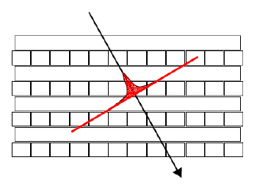
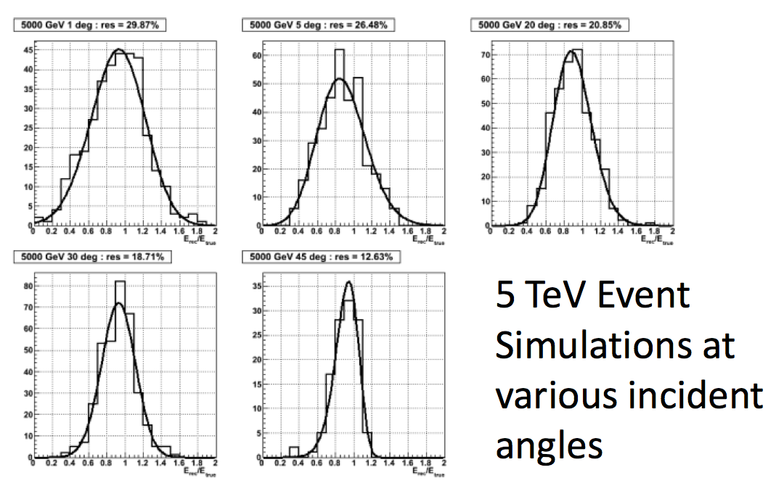
Completed Work: Improved Energy Estimate
New full CAL profile energy analysis
Fit shower profile along shower axis
Better treatment of saturated crystals
Modify χ² for saturated crystals
Opens science window up to > 1 TeV
Recall EGB spectrum on slide 5
χ² useful for background rejection
P. Bruel & Pass 8 Group
March Clb. Meeting
Simulations show ~20% energy resolution up to 5 TeV

Slide 14
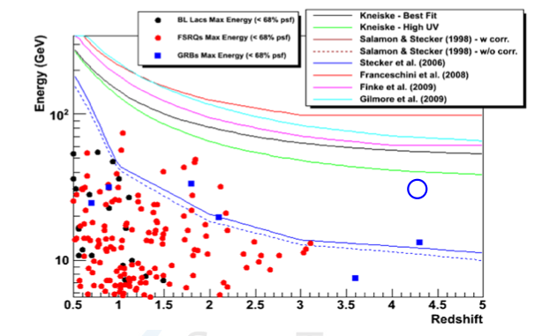
Science Already in the Bag: Updated Selection of γ rays During GRBs
Minimal analysis using new tracking and clustering
3 more γ rays > 5 GeV from GRBs with measured redshift (18 γ rays originally)
Including a 29GeV photon from z = 4.35 GRB
14 more γ rays > 1 GeV from same GRBs
These high-energy, high-redshift γ rays allow us to probe the extra-galactic medium with unprecedented power
L. Baldini & J. Bregeon & Pass 8 Group
Nov. Clb. Mtg.

Slide 15
Current Work: Putting the Event Together
Old CAL Axis
ACD Ghost Hit
- Identify ACD tiles with ghost energy deposits using the fast ACD veto information.
- Can this be accomplished without sacrificing background rejection power?
- Needs more study
TKR Ghost Hits
- Identify ghost energy in the TKR from TOT information and out-of-time hits.
- Remove tagged hits before running track finding.
- Could search for in-time hits on ghost tracks.
CAL Ghost Cluster
- Identify through CAL clustering and cluster classification.
- Work only with gamma cluster (effectively removing ghost) or remove ghost cluster and combine remaining crystals.
Background rejection goes hand-in-hand building the event into a coherent whole, including ghost removal

Slide 16
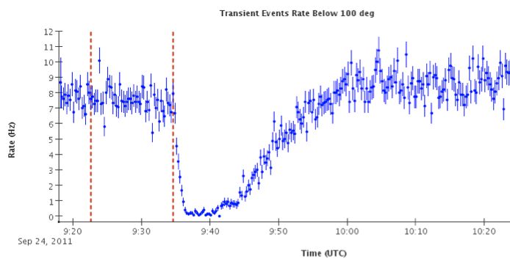
Current Work: ACD Saturation and Solar Flares
Transient Event Rate (from DQM)
10
Rate (Hz)
L. Baldini, EC &
ISOC & Pass 8 Group
March Clb. Mtg.
0
9:30
10:00
Sep 24, 2011
Time (UTC)
High X-ray flux during solar flares saturates ACD
Loss of events in standard events classes
Currently requires use of LLE selection
Recall March 7, 2012 Solar Flare (slide 4)

Slide 17
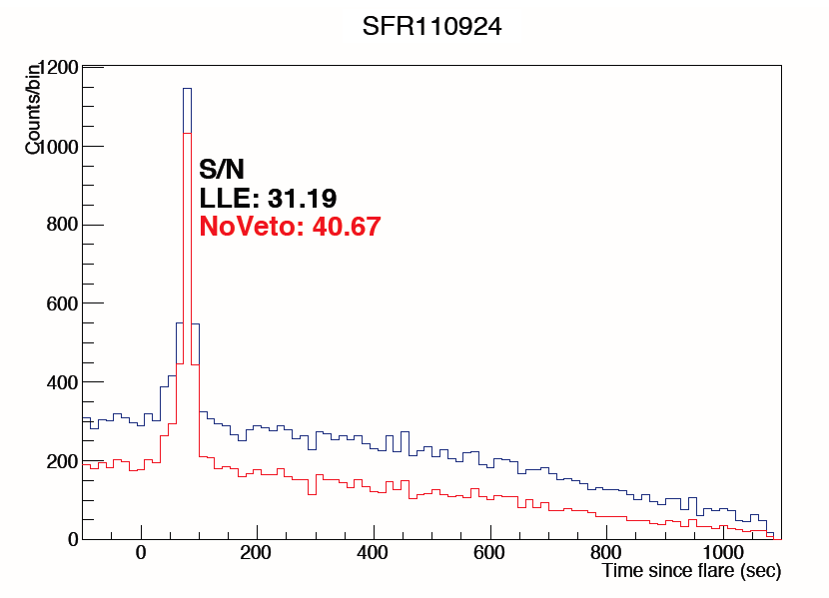
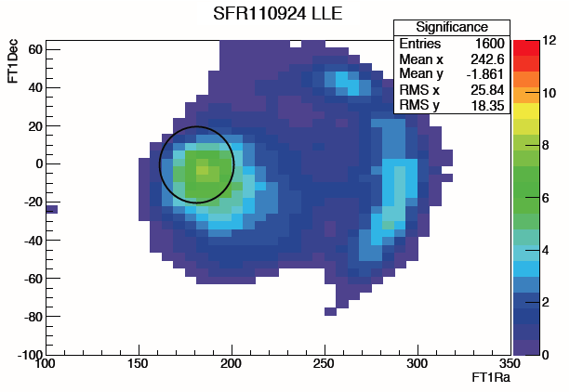
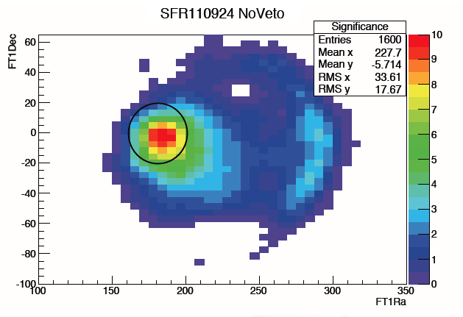
Current Work: Improved ACD Selection for Transients
Solar Flare 110924
Class X2 solar flare
44 deg. from LAT boresight
Overall S/N increase of ~30%
Increase in S/N correlated with Sun position
Also improve S/N over LLE for several GRBs
SFR110924
Use trigger information to remove ghost ACD signals
M. Pesce-Rollins & Pass 8 Group
March Clb. Mtg.
SFR110924 LLE
SFR110924 NoVeto
Include ACD
veto information

Slide 18
Selected Science Highlights and Pass 8
Pass 7 Science Highlight | Pass 8 Developments
Extragalactic Background | Energy Estimation > 1 TeV
Inner Galaxy / DM Searches | Improved PSF & Bkg Rejection TKR Truncations
March 7, 2012 Solar Flare | ACD de-ghosting Extending analysis < 100 MeV
Pass 8 makes improvements in many areas directly related to exciting new science

Slide 19
Pass 8 Timeline
Baseline: have Pass 8 ready for 5 year Catalog (Aug 2013)
Feb 2012
Aug 2012
Feb 2013
Aug 2013
Full Recon Reprocessing
Finalize Recon
Event Building
Test Samples
Final Repro
1st Event Selections
IRFs
Selection Optimization

Slide 20
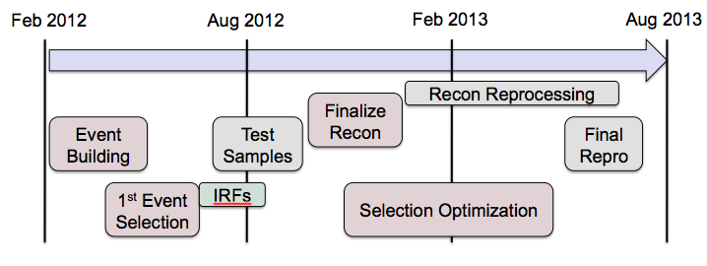
Pass 8 Near Term Timeline
Baseline: IRFs and first test samples for Clb. Mtg. (Aug 2012)
May 2012
June
July
August
TKR Ordering
IRFs
1st Test Samples
Vertexing
TKR/ CAL bkg Rejection
CAL Clustering
Develop Event Classes
ACD Bkg Rejection

Slide 21
Additional Slides

Slide 22
Analysis Organization

Slide 23
Science Group Coordination
Group | Leads (Nov. 2011) | Leads (Apr. 2012)
Calibration & Analysis | Luca Baldini Leon Rochester | Johan Bregeon Leon Rochester
Dark Matter & New Physics | Jennifer Siegal-Gaskins Luca Latronico | Jennifer Siegal-Gaskins Nicola Mazziota
Diffuse | Luigi Tibaldo Gulli Johannessen | Luigi Tibaldo Gulli Johannessen
Catalog | Elizabeth Ferrara Isabelle Grenier | Elizabeth Ferrara Isabelle Grenier
Solar System | Nicola Omodei Nicola Giglietto | Nicola Omodei Nicola Giglietto
AGN | Marco Ajello Justin Finke | Marco Ajello Justin Finke
Galactic Sources | Paul Ray Francesco Giordano | Paul Ray Liz Hays
GRB (LAT members) | Vlasios Vasileiou Judith Racusin | Giacomo Vianello Judith Racusin
Huge amount of organizational work is done by group leaders
We are lucky to have so many skilled people willing to step up

Slide 24
Analysis Procedures & Developments
Several Active WG to address specific analysis issues
All are very productive, seems like a good model for addressing specific, well defined, problems and issues
IRFs (Riccardo Rando)
Binned v. Unbinned (Elizabeth Ferarra)
Low energy systematics (Largely Front/Back) (Steve Fegan)
Solar Template Tool (Elena Orlando)
Earth Emission (Keith Bechtol)
Routine Science Processing (Benoit Lott & Tom Glanzman)
All sky simulations with gtobsim (Max Razzano)
List will need to evolve
e.g., Binned v. Unbinned is effectively completed
Proposals for some new groups…

Slide 25
Looking back: shifter shortage
Continued actively recruiting Data Quality Shifters
Requires about 1 hour /day for 1 week / year
Good response (shifts filled through July 30)
Now people at most institutions who have taken shifts & can help others get involved
Much easier to get started
Documentation is much improved
We will continue to monitor shifter situation to ensure things continue smoothly

Slide 26
Looking Forward: detector/ reconstruction expertise
March pass 8 meeting made it clear LAT team is running low on detector & reconstruction expertise. Many experts moving on to other things
Few people actively working on reconstruction / event classification full time:
TKR (~2-3 FTE)
CAL (~5 FTE)
ACD (~1 FTE)
Even fewer people working on sub-system calibrations:
TKR(<1 FTE)
CAL(<1 FTE)
ACD(<1 FTE)
We are making active efforts to involve students & post-docs in these areas

Slide 27
Looking towards the 5 Year source catalog
Mar. 2012
Mar. 2013
Mar. 2014
4 years
5 years
IRFs:
P7_V6
P7REPRO_V0
P8
Isotropic:
P7 Isotropic (+ rescaled versions)
P8 Isotropic
Galactic:
Diffuse Ring Model? (+GALPROP)
Diffuse Updates (Planck, …)
Catalog:
2FGL
3Y Source List
4Y Source List
Misc:
New Extended Sources

Slide 28
Status of the Publications

Slide 29
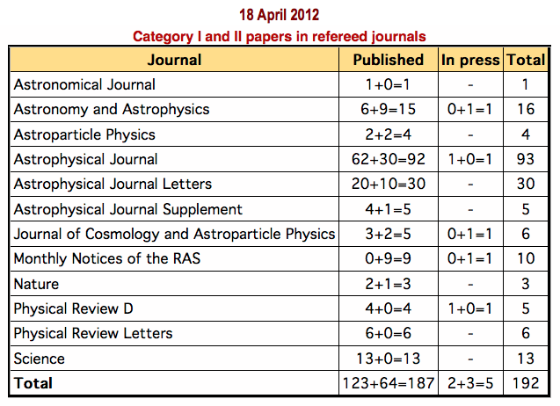
Continued High Level of Paper Production
Number of Cat III papers published = 86
Number of Astronomer’s Telegrams = 191 (~1 / week)
Number of GCN notices = 40
+MW follow ups

Slide 30
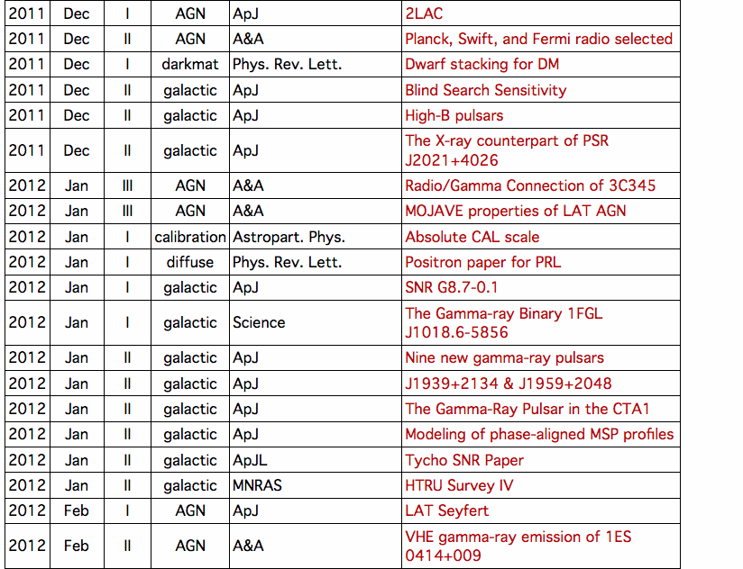
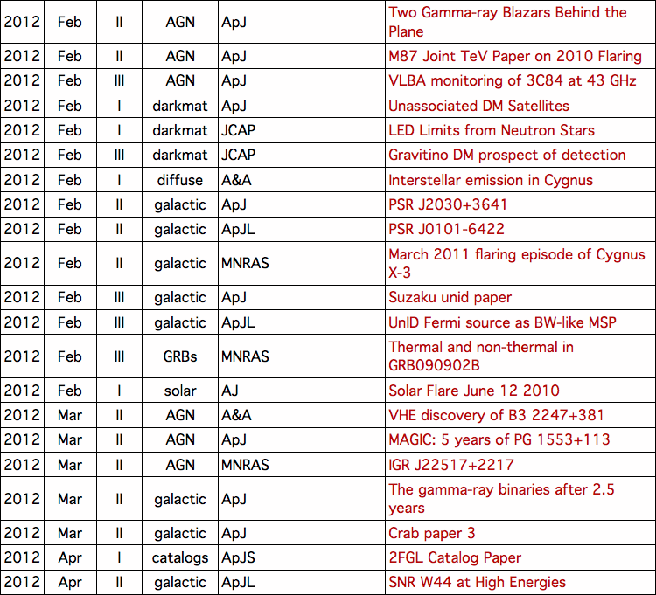
Papers Published Since Nov. 2011

Slide 31
Status of Major Papers for 2011-2012
2nd Fermi LAT AGN Catalog -> Published!
2nd Fermi LAT Source Catalog -> Published!
Galactic Diffuse Model -> Published!
Instrument Performance -> Collaboration Review
2nd Fermi LAT Pulsar Catalog -> Under review in Gal. Group
Fermi GRB Catalog -> Under review in GRB Group
Inner Galaxy Paper -> Analysis finishing, draft in preparation
SNR and PWNe Catalogs -> In preparation in Gal. Group

Slide 32
Summary
Many exciting and high profile results are coming in
Pass 8 is coming together
Work on event level analysis is progress
Seeing first signs of improved science yield
Collaboration is doing well
Extremely productive
Work and responsibilities being shared
Take advantage of gap in scheduled deliverables to put things in order for the future
Develop new analysis techniques
Planning for 5 year source catalog and associated analyses
Working to make analysis cycle routine

